Slide 1

AI Algorithms I (AIDI 1002) Lab #2: Student Grade Prediction
Name: Maviya Shaikh
Student Number: 100766785
Submitted to: Professor Marcos Bittencourt

Slide 2
Problem Statement
The analysis is conducted on two datasets regarding the students performance in two distinct subjects Mathematics and Portuguese language using Regression model to forecast the final grade of students.

Slide 3
Description of Analysis
The following analysis is conducted on datasets to predict the final grade:
Exploratory Data Analysis – Sweet viz report and various graphs like column chart, area chart, boxplot, swarm plot are used to analyse the dataset
Data Preparation: Feature Engineering is done to fix the missing, duplicate values if any and preparing the dataset such that it is input able to the model
Model Building and Testing: Model is built to predict the final grade of the student and after that testing is done to compare actual and predicted values
Insights and Recommendation: It is provided after all the analysis, deployment and testing

Slide 4
Exploratory Data Analysis

Slide 5
Sweet viz report
This report will give the overview of all the features of Mathematics and Portuguese language dataset which is shown in below table:
Properties | Mathematics Dataset | Portuguese language Dataset
Number of rows | 395 | 649
Number of features | 33 | 33
Missing Values | 0 | 0
Duplicate rows | 0 | 0
Zeros in the G3 feature | 38 | 15
After analysing the distribution of target variable final grade G3, the zeros are found in the grade for few students which might be the result of absence or students are not allowed in the exam. Therefore, this needs to be considered while building the model.

Slide 6
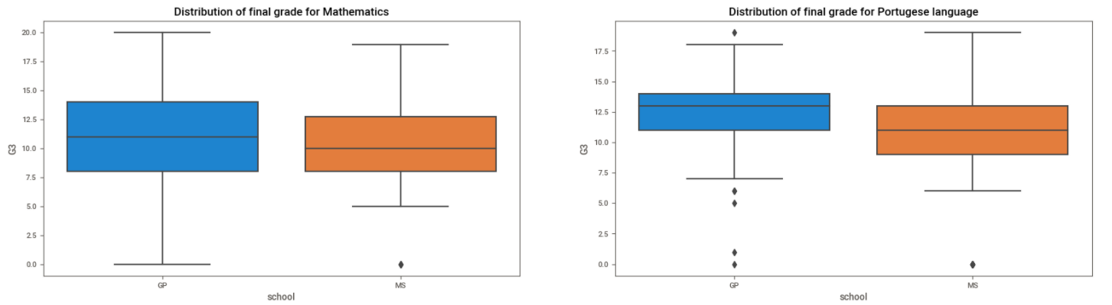
Effect of School on Grades
The box plot is plotted between grades and school to understand whether school matters in getting higher grades.
Gabriel Pereira(GP) school students scores higher compare to Mousinho da Silveira(MS) school for both subjects that can be seen by blue box plot.

Slide 7
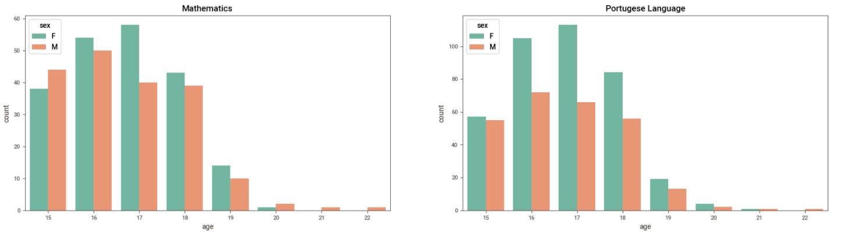
Gender and Age Distribution
The column chart is used to know the distribution of male and female in school and also to know the age of students in the dataset.
There are more female students than male students and most of the students age falls in the range of 15 to 18 years for both the datasets.

Slide 8
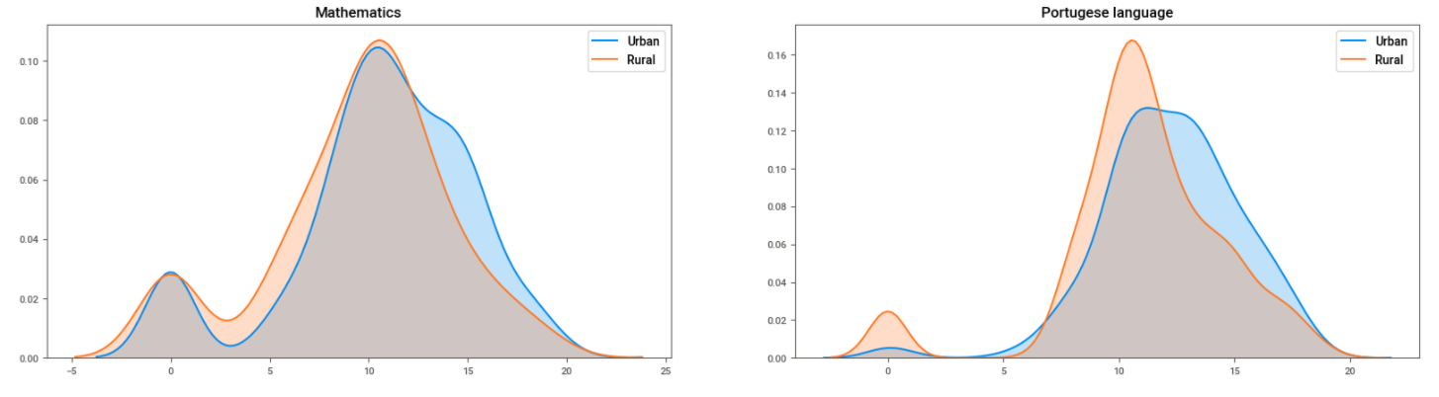
Performance of Student based on their location
The area chart shows two density graphs for urban and rural location to understand the performance of students on the final grade.
For both the dataset, the blue graph is little right skewed that means students living in urban areas got slightly more marks than student living in rural areas.

Slide 9
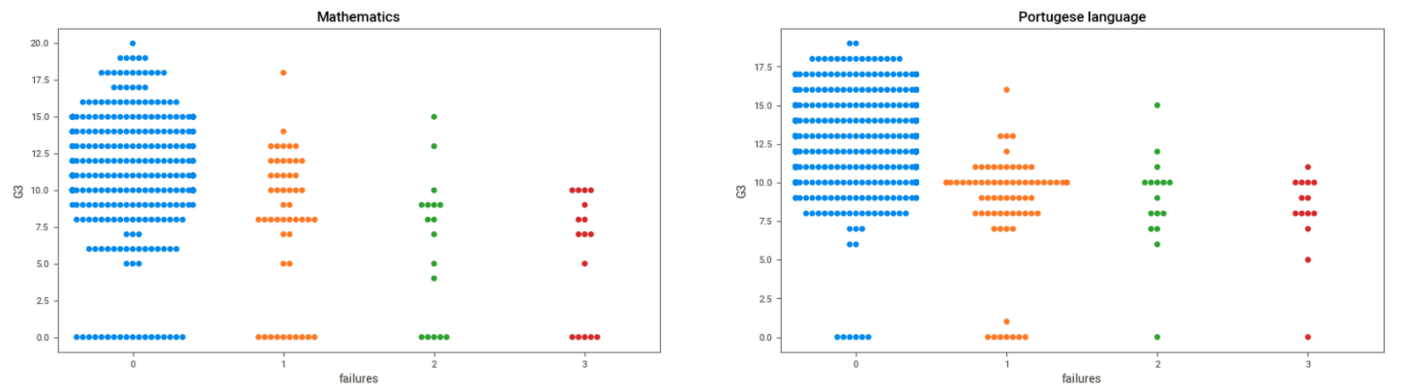
Effect of Failures in previous periods on final grade
The swarm plot is used to see the clear distribution of students grades and the effect of their failure history on final grades.
The students with 0 failures, scores higher grades than the students who are previously failed for both the subjects Mathematics and Portuguese language.

Slide 10
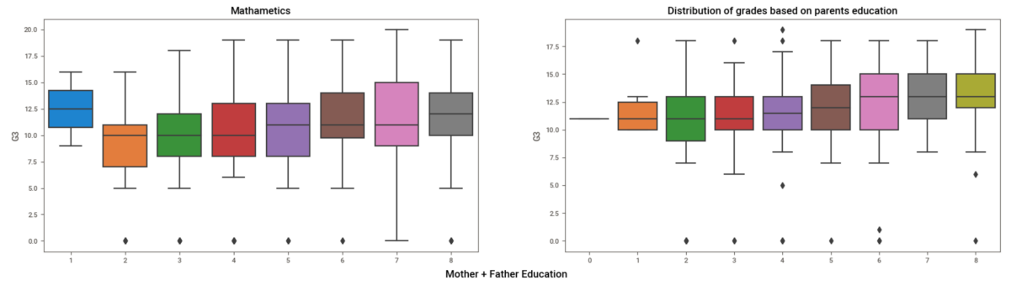
Effect on Grades based on Mother-Father Education
The box plot shows the correlation between students performance on final exam and their mother-father education.
For mathematic subject (1st figure), it seems that final grades slightly increases with the increase in parents education except for the first category with least education. For Portuguese language (2nd figure), final grades elevates as increase in mother and father education.

Slide 11
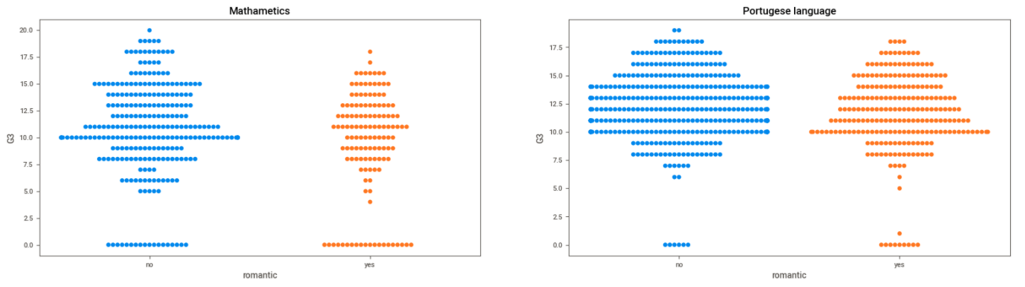
Effect of Romantic Relationship on Grades
The swarm plot shows the distribution of students in two categories i.e. grades of students who are not involved in romantic relationship and grades of student who are involved in romantic relationship.
Students with no romantic relationship score higher than students with romantic relationships mainly for mathematic subject. This is because Portuguese is a language and that does not need much study.

Slide 12
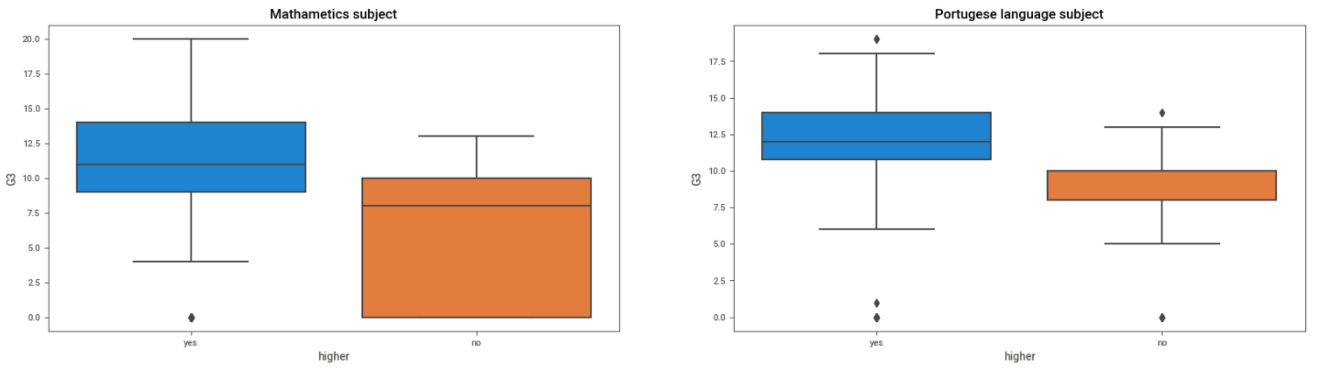
Effect on Grades based on future plans
The box plot show the distribution of final grades based on the student’s plans for studying further.
From both the graphs, it can be said that students who wants to pursue higher studies score more marks than who do not want to pursue higher studies.

Slide 13
Data Preparation

Slide 14
Feature Engineering
The linear regression model cannot take text values. So, we need to convert the features that are in form of text into numerical values.
Label Encoding is use to map the text values
Table shows all the features that needs to be converted and with the help of label encoding all the features are in numeric format as shown in 3rd column
Now all the features are ready to input into the model
Features | Original Values | Label Encoding
School | ['GP' 'MS'] | [0 1]
Sex | ['F' 'M'] | [0 1]
Address | ['U' 'R'] | [1 0]
Famsize | ['GT3' 'LE3'] | [0 1]
Pstatus | ['A' 'T'] | [0 1]
Mjob | ['at_home' 'health' 'other' 'services' 'teacher'] | [0 1 2 3 4]
Fjob | ['teacher' 'other' 'services' 'health' 'at_home'] | [4 2 3 1 0]
reason | ['course' 'other' 'home' 'reputation'] | [0 2 1 3]
guardian | ['mother' 'father' 'other'] | [1 0 2]
schoolsup, famsup, paid, activities, nursery, higher, internet, romantic | ['yes' 'no'] | [1 0]

Slide 15
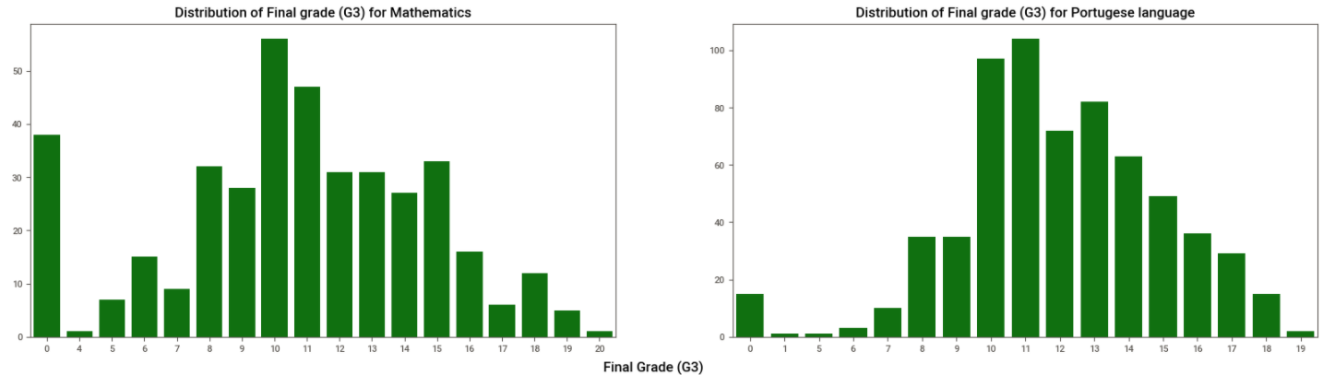
New Dataset
The histogram of target variable is created and it is analysed that 38 observation in mathematics dataset and 15 observation in Portuguese language dataset are zeros. This becomes anomaly in our dataset that needs to be fixed because prediction on 0 score does not make any sense.
The new dataset for both the subjects is created after removing the zero value observation and finally we get the clean dataset without any noise.

Slide 16
Model Building and Testing

Slide 17
Model Building
After preparing the data with feature engineering, the linear regression model is built assuming the linear relationship between independent and dependent variables. This model is used to predict the target variable(G3). For better understanding the results and make decision, the development stage is divided into 4 stages which are explain below.
R2 is a Goodness-of-fit measure for linear regression model that represents the proportion of variance in dependent variable that is explained by independent variable
80% of the data is used for training the data and 20% is used for testing the model and we got the below output
Sr. No. | Development Stages for prediction | Mathematics - R2 | Portuguese language – R2
1 | Original Dataset with all the features | 0.83 | 0.83
2 | New Dataset with all the features | 0.92 | 0.80
3 | Original Dataset with G1 and G2 variable. | 0.75 | 0.86
4 | New Dataset with G1 and G2 variable | 0.93 | 0.80
For new dataset i.e. for development stage 2 and 4, the result of the model prediction with all the variables and with selected variables gives almost similar result.

Slide 18
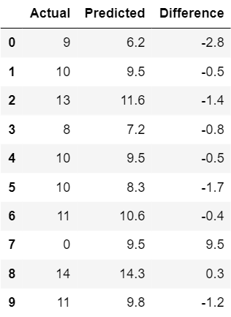
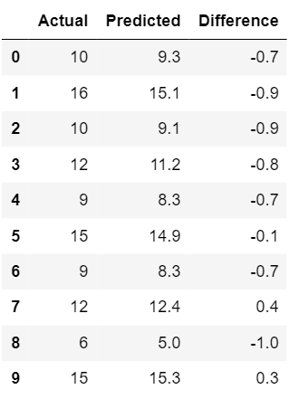
Model Testing
Fig 1: Prediction on Original Dataset
Fig 2: Prediction on New Dataset
If we do prediction on original dataset, we will get wrong prediction and high difference in the values as we can see in the first figure from row 7 but if we do prediction on new dataset then this type of error will not occur.

Slide 19
Insights and Recommendation

Slide 20
Insights
All the features in the dataset are some or the other way useful to predict the final grade because as human all the social and demographical features has impact on our performance
From our exploratory data analysis, it can be said that school, student location, their mother and father education, involvement in romantic relationship and their future plans make difference in their final grades. Also, it is not limited to these features there are other features also but for the sake of simplicity we have conducted analysis for only this features.
If we see the figure 2- prediction on new dataset of model testing, the difference in actual and predicted is very low. So, our model is giving the good result and can be used in real time for the analysis of the student grades

Slide 21
Recommendation
The new dataset should be used for prediction of the model otherwise for some values like 0 , we will get large number which is error in the algorithm
I would recommend to use the model built in development stage 4 for new dataset because using all the features is also giving the same result like G1 and G2 variables. So, I think it is good to reduce the complexity and use the simpler model rather than complex model with lots of features

