Slide 1
Joblift Market and customer data analysis

Slide 2
Recommendations for Marketing Team

Slide 3
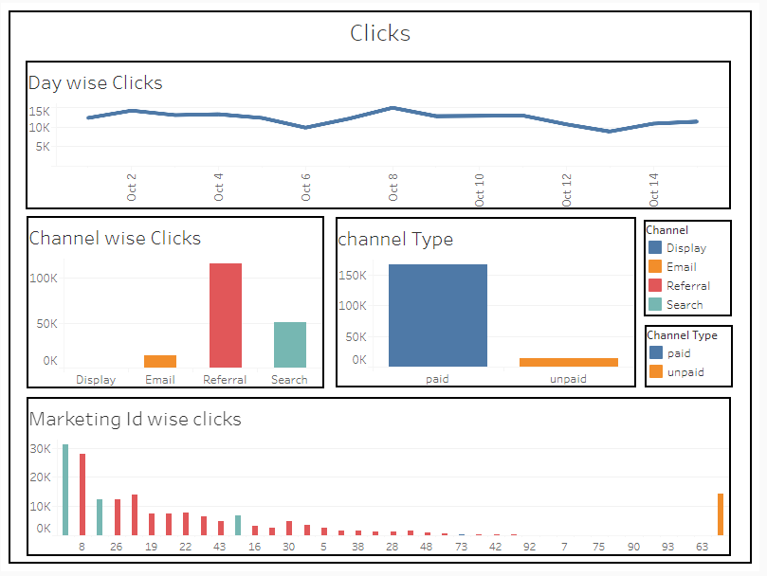
Click Analysis
Numbers of clicks on the landing page are flat over time. Creation of new jobs and boarding new customers will lead to increase in clicks.
Major traffic is coming from referrals followed by search.
Email traffic is quite less, major improvements needed.
Two of the top three marketing channels belong to Search. Create more search channels
SEO optimization is recommendation – Google Advs, etc.
*Color Coding as per variables
Like Referrals are Red, Search is Blue etc.

Slide 4
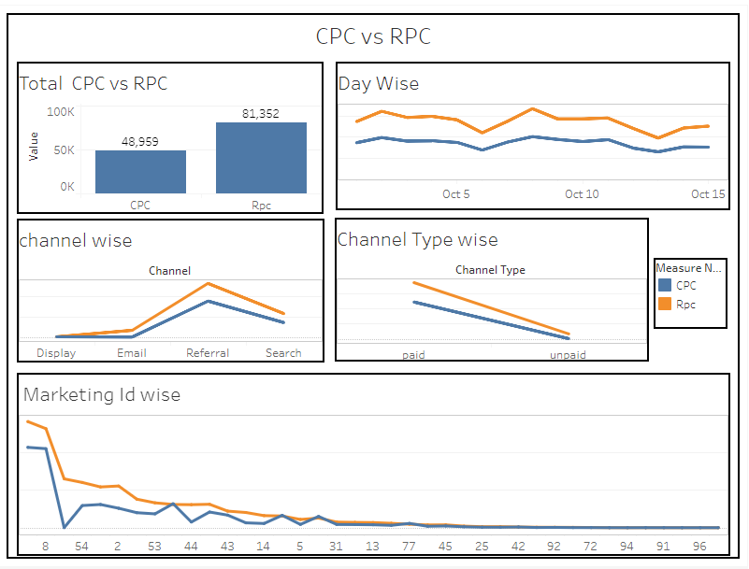
Revenue and Cost Analysis
1) CPC numbers here does not reflect the true story since we do not have total traffic numbers to the landing page
2) Email channel is the revenue generator since it is unpaid. Try to generate more traffic through emails
3) Channels with marketing id 16, 19, 77 & 85 are cost leaders. Their CPC is more than RPC and causing loses
4) Improve Marketing Partners who are low on creating revenue starting from 92,72,94,91,96

Slide 5
Recommendations for Customer Management team

Slide 6
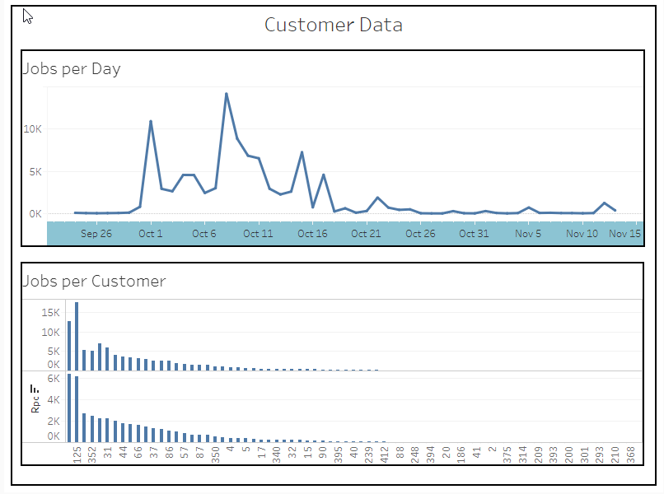
Customer Analysis
Very few jobs are posted in the last 15 days. Efforts should be made to the customers to consistently post new jobs.
2) Only few customers are posting significant numbers of posts. All customers should be encouraged to post new posts.
3) By RPC customer 125,352,31 are doing good. But customer like 368,210,293,301 are low performing with respect of revenue generations and job postings.
4) Another jobs per customer and RPC graphs show which customer post more jobs.

Slide 7
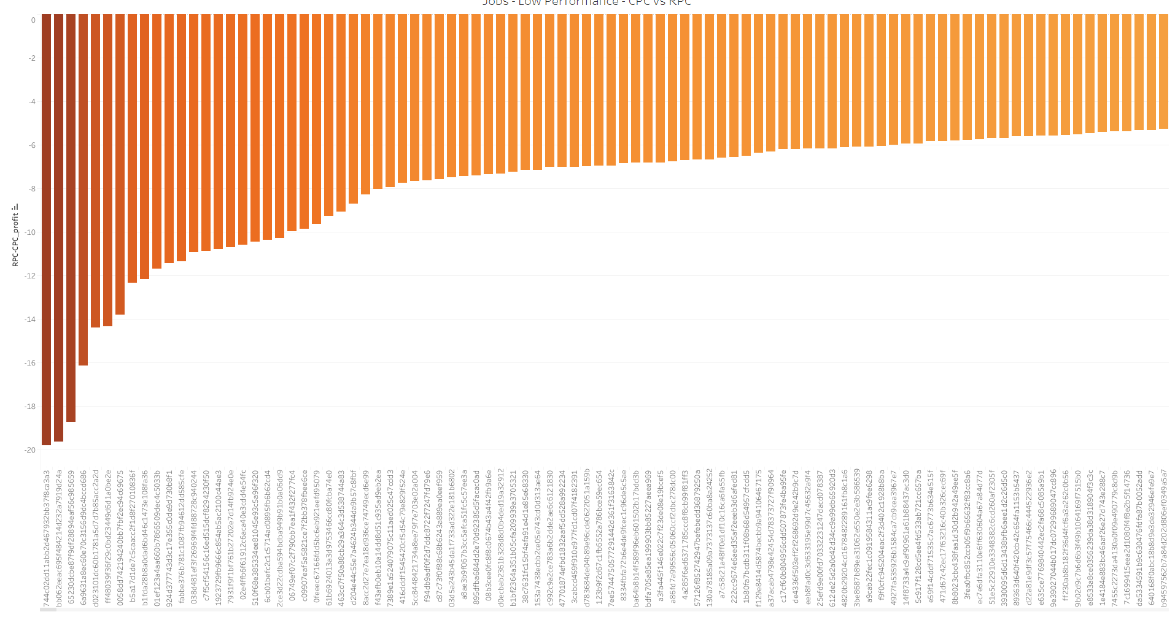
1) Jobs making Negative Profit for the joblift –
2) You will have to manage the customers for posting these kind of jobs.
3) Categorization is important.

Slide 8
Thank you
Process which was followed for analysis.
Imported CSV’s into local SQL server.
Created Cases for Analysis with SQL Queries, Used Joins and Aggregative methods for.
Created Views for different cases
Imported these into Tableau
Visualized the data and different cases, created dashboard for power presentation
These visualizations are interactive in Nature and can be played off to match any requirements
Cases other than these can also be created from the tableau file.

