Slide 1



SUPERSTORE
View in Power BI
Last data refresh:
5/27/2021 12:06:03 PM UTC
Downloaded at:
5/27/2021 12:25:39 PM UTC

Slide 2
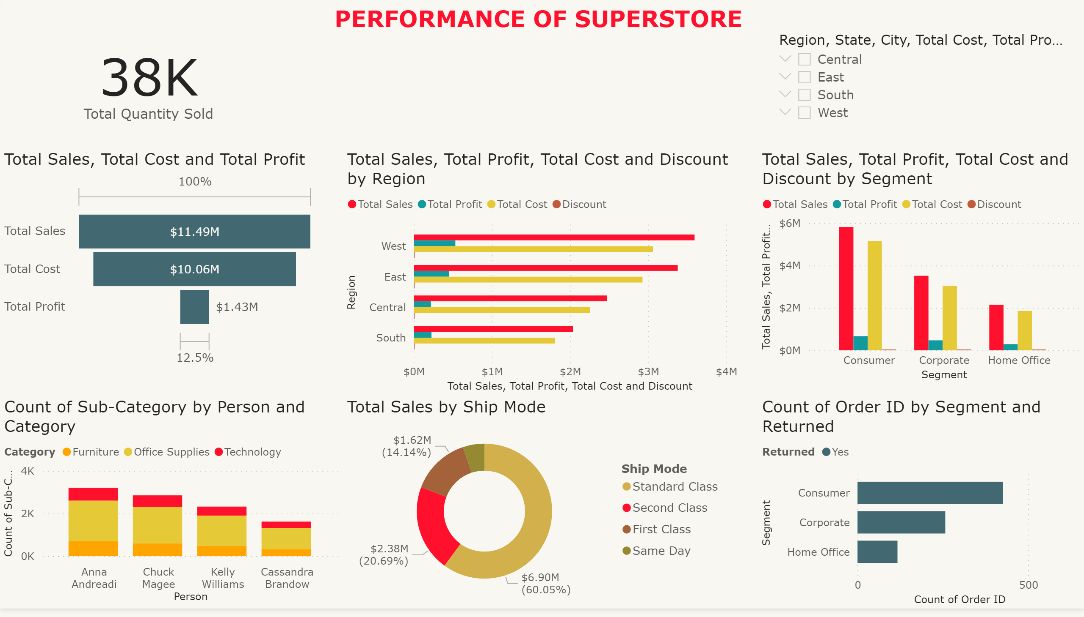
Page 1
Notes:
funnel
No alt text provided.
clusteredBarChart
No alt text provided.
clusteredColumnChart
No alt text provided.
slicer
No alt text provided.
donutChart
No alt text provided.
columnChart
No alt text provided.
textbox
No alt text provided.
clusteredBarChart
No alt text provided.
card
No alt text provided.

Slide 3
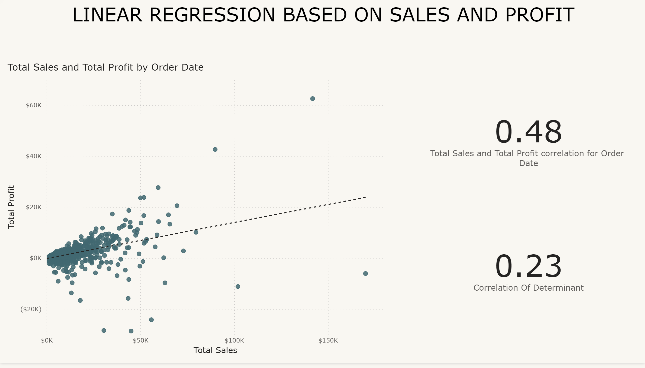
Page 2
Notes:
scatterChart
No alt text provided.
card
No alt text provided.
card
No alt text provided.
textbox
No alt text provided.

Slide 4
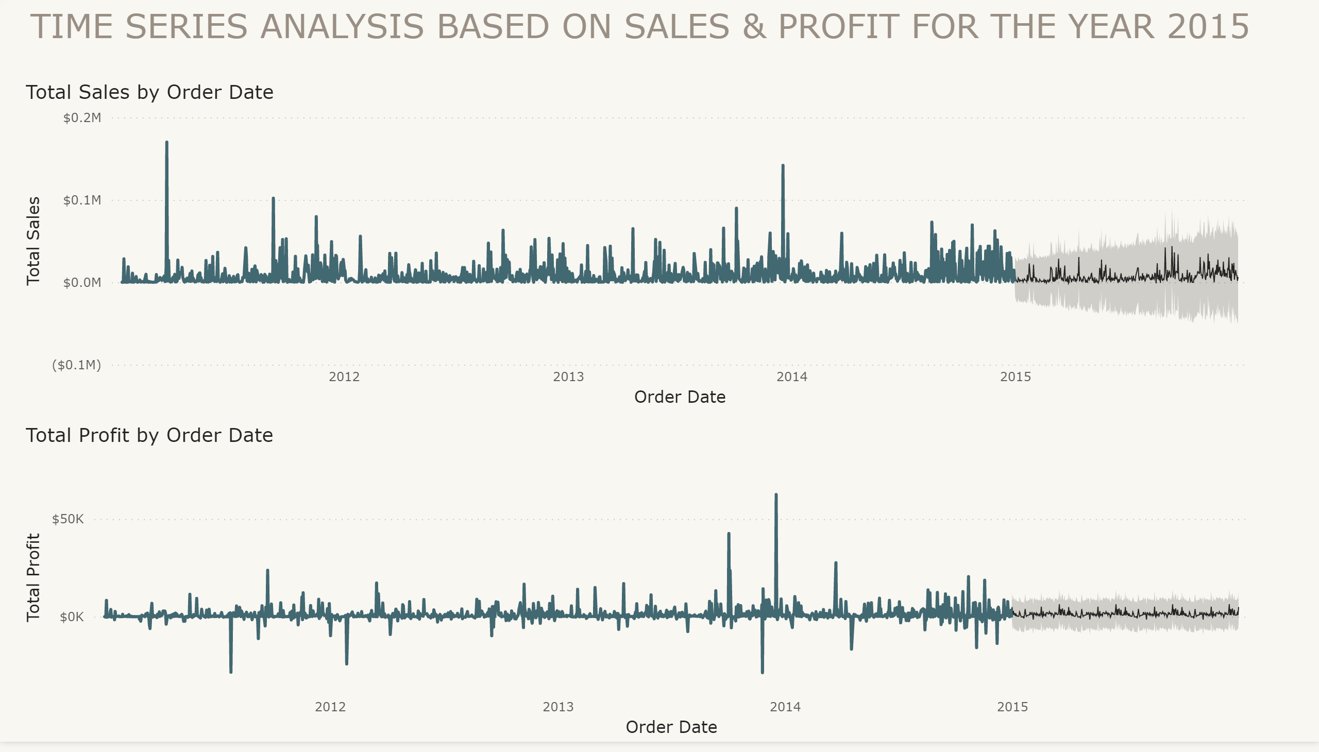
Page 3
Notes:
lineChart
No alt text provided.
lineChart
No alt text provided.
textbox
No alt text provided.

