Slide 1
Group 16 Weekly Update
Group Members: Qiuyu, Maxim, Carmen, Javier, Joshua, Recardo, Sophia

Slide 2
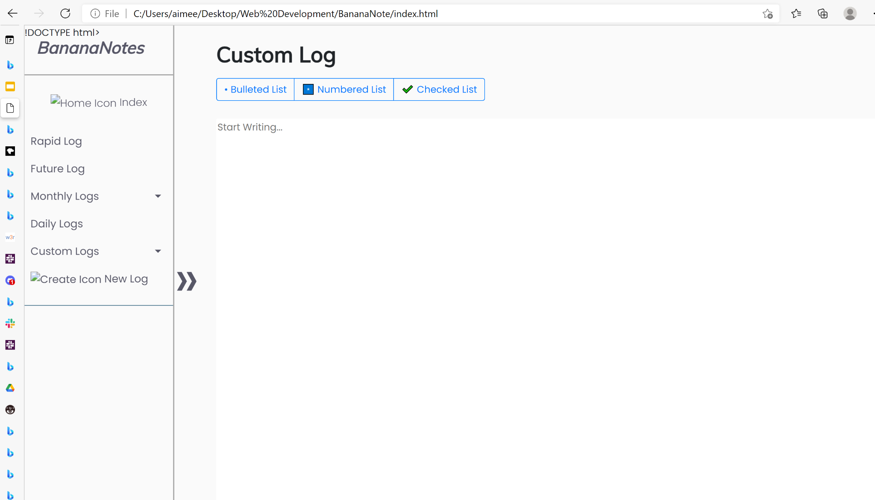
Almost all html files are finished

Slide 3
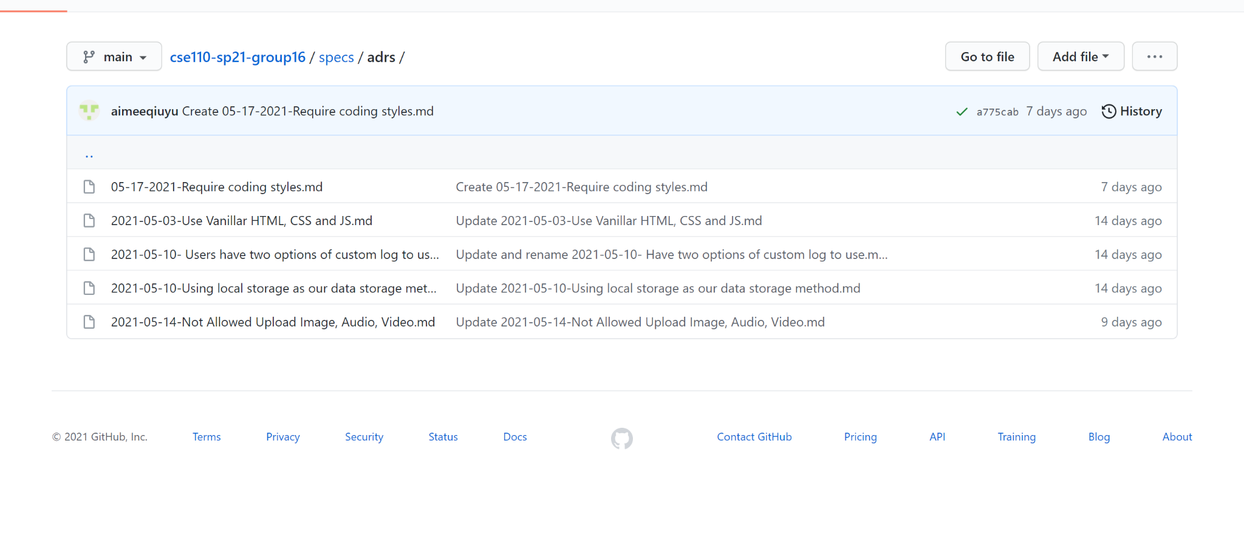
Continuously adding adrs

Slide 4
Writing front-end javascript code
However, we don’t have any code yet to show. We haven’t finished all the code.

Slide 5
Confirm the storage
We have decided to use local storage. One of the members has already practicing using it and learning it.

Slide 6
This is all the updates. Since the team meeting is at 6:30 which is later than this. Probably we will have more updates next week.

