Slide 1
Bootcamp
Machine Learning

Slide 2
Logistic Regression

Slide 3

Logistic Regression
Another generalized linear model
Used for classification, despite name
Output is a probability

Slide 4
Problems with Probability
Only valid between 0 and 1
Linear models extend forever

Slide 5
Odds
Ratio of two probabilities
e.g. P(Win) = 0.2, P(Lose) =0.8
Odds of winning = 0.2/0.8 = 0.25
Odds of losing = 0.8/0.2 = 4

Slide 6
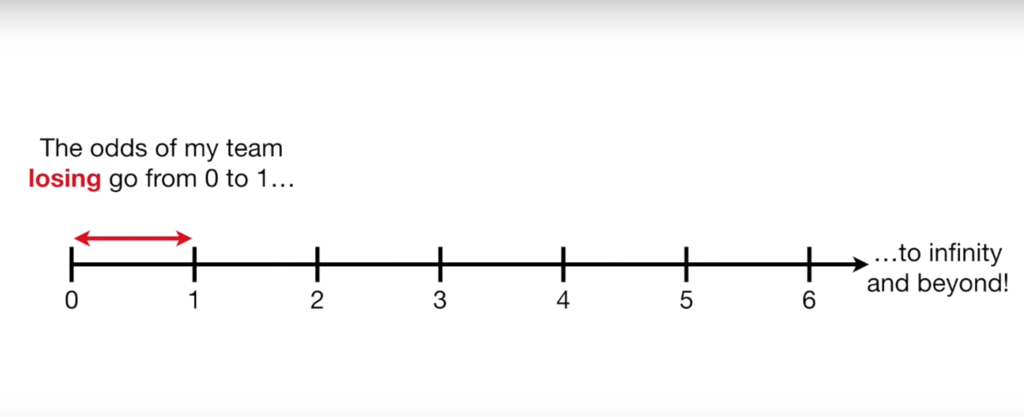
Odds
Only valid between 0 and 1

Slide 7
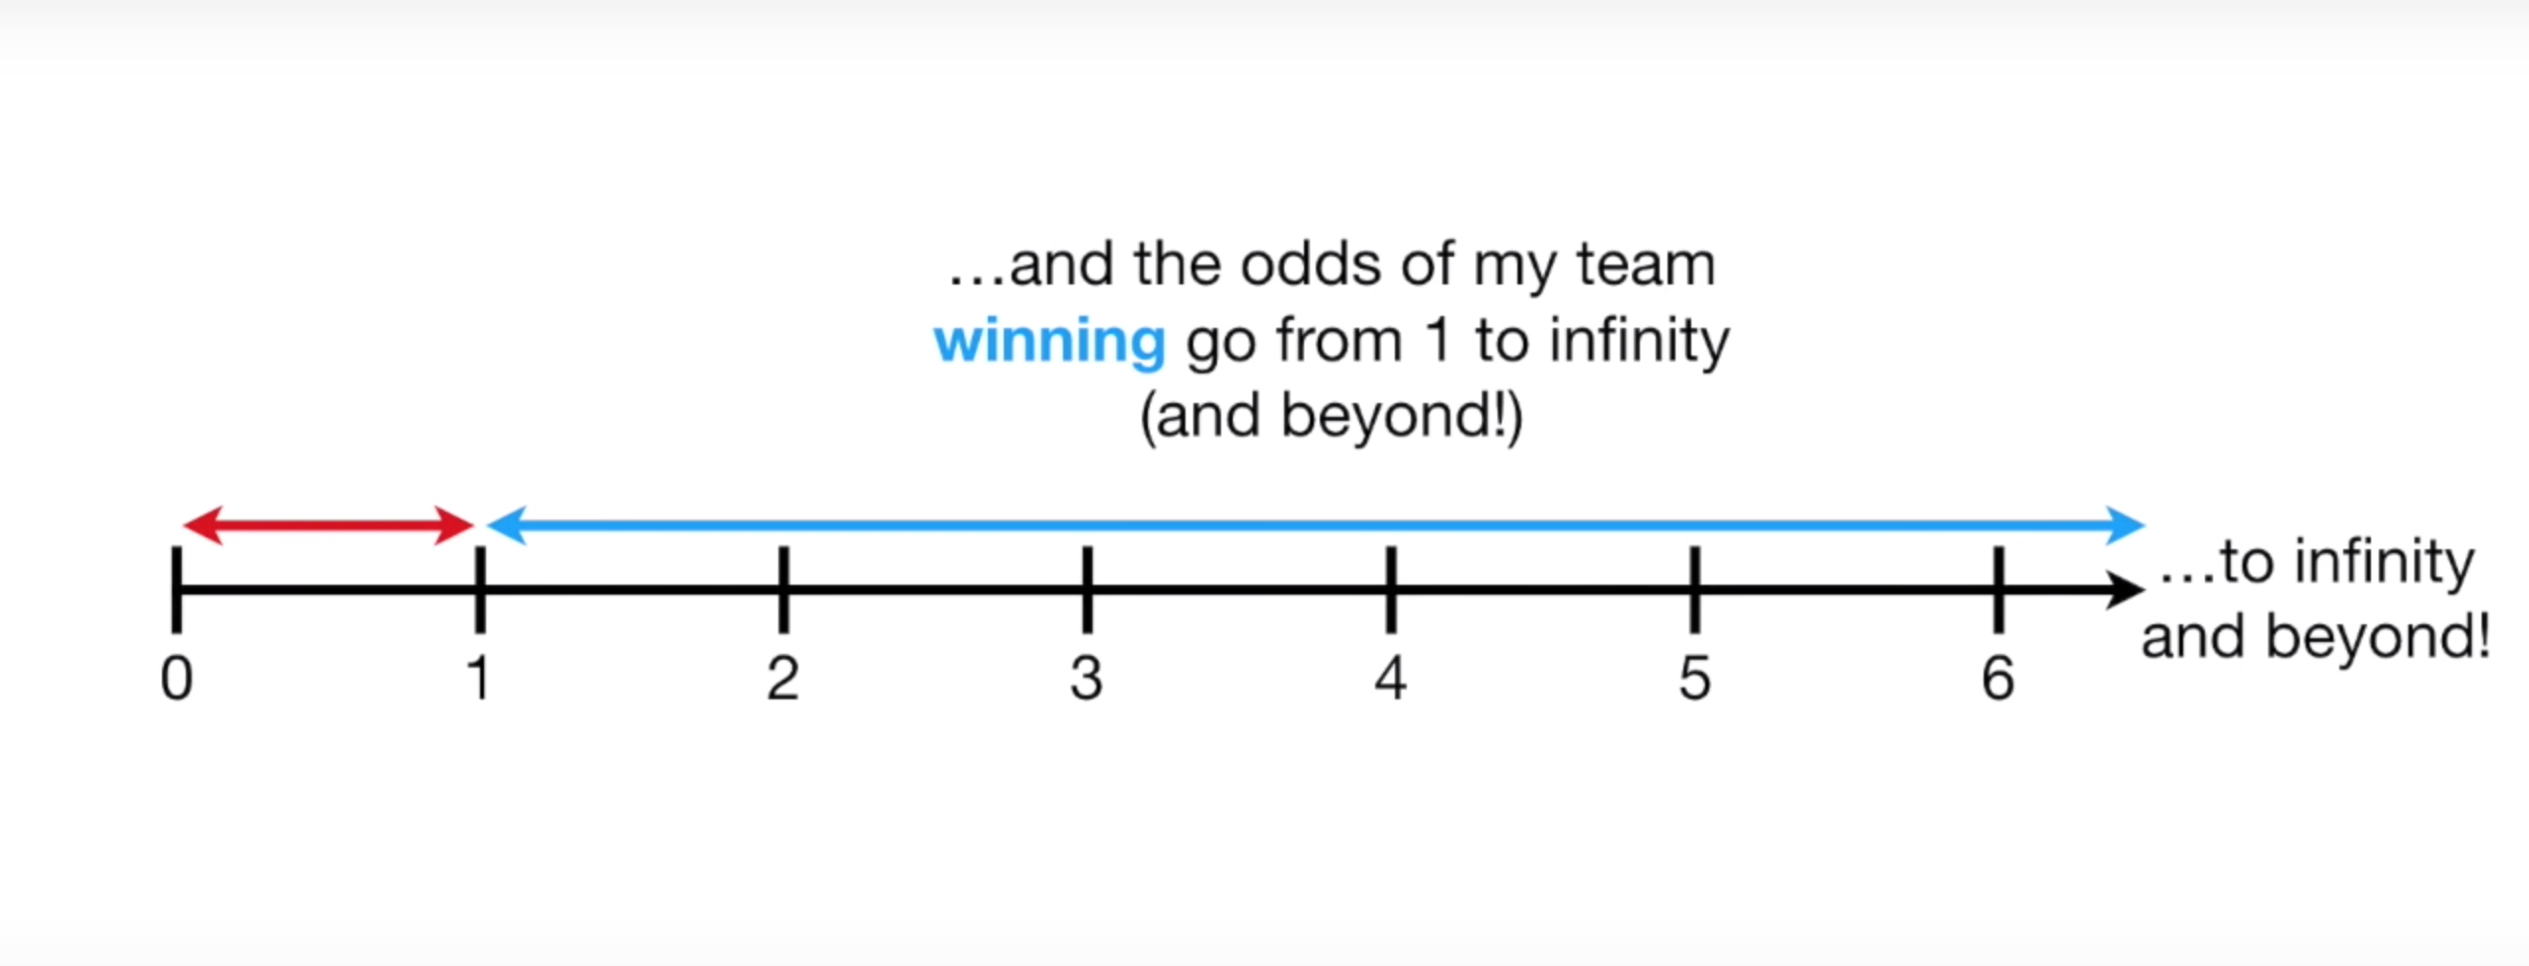
Odds
Only valid between 0 and 1

Slide 8
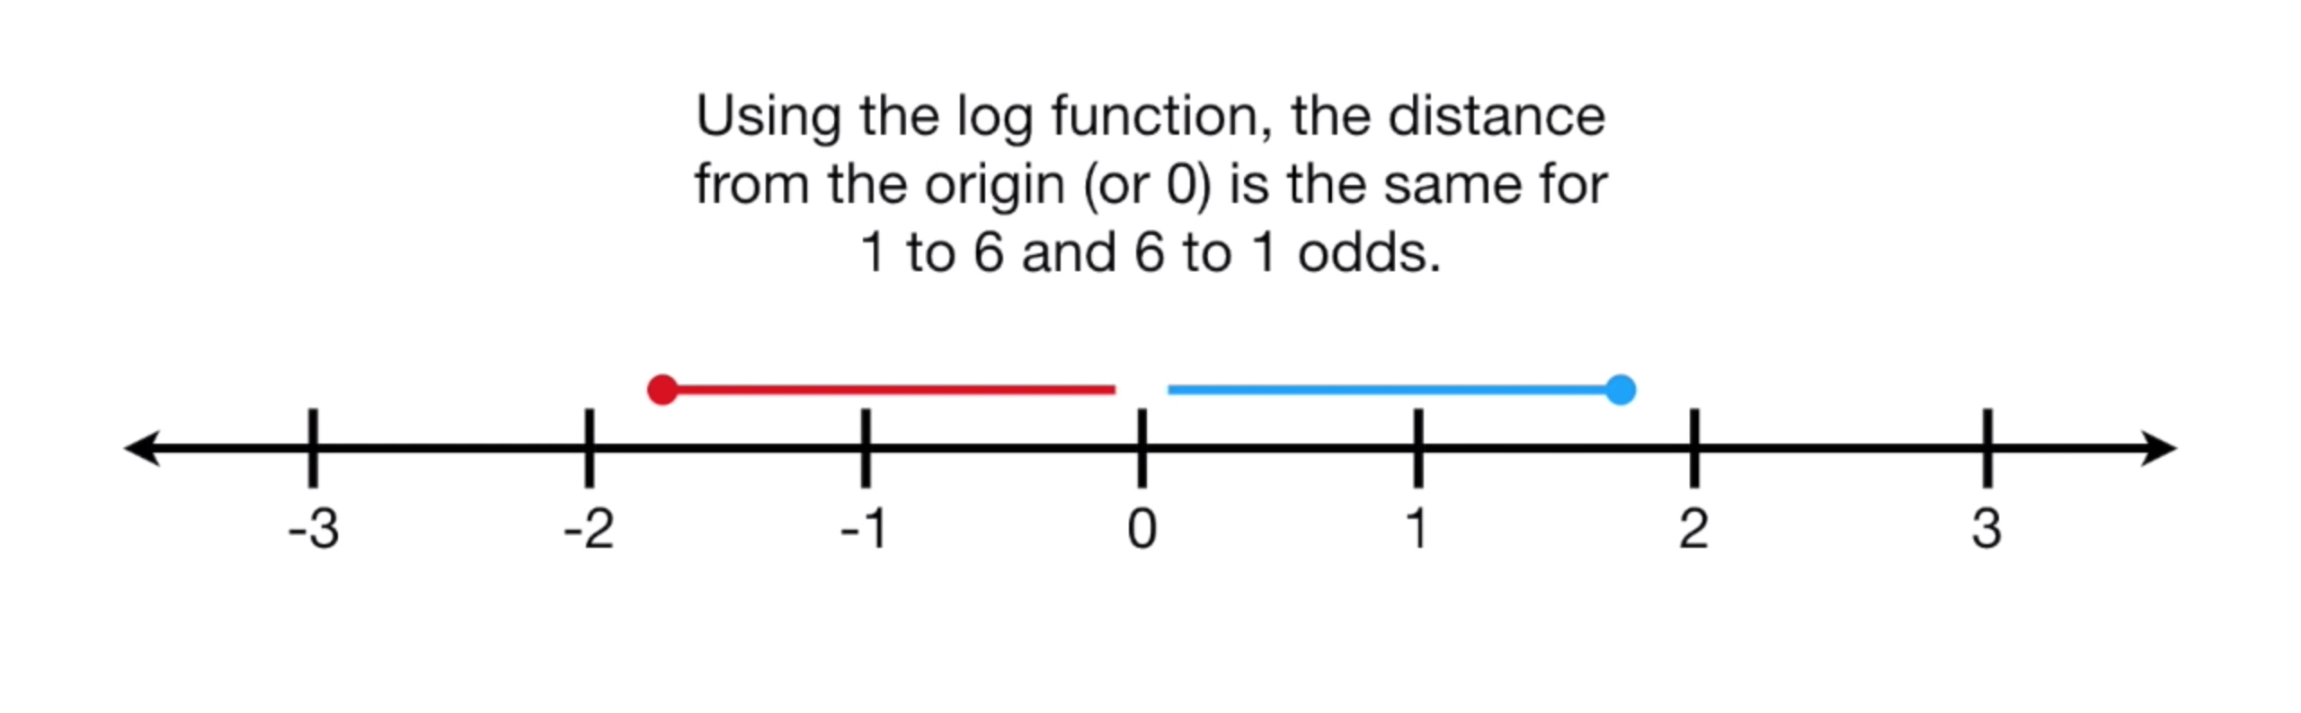
Log-Odds

Slide 9
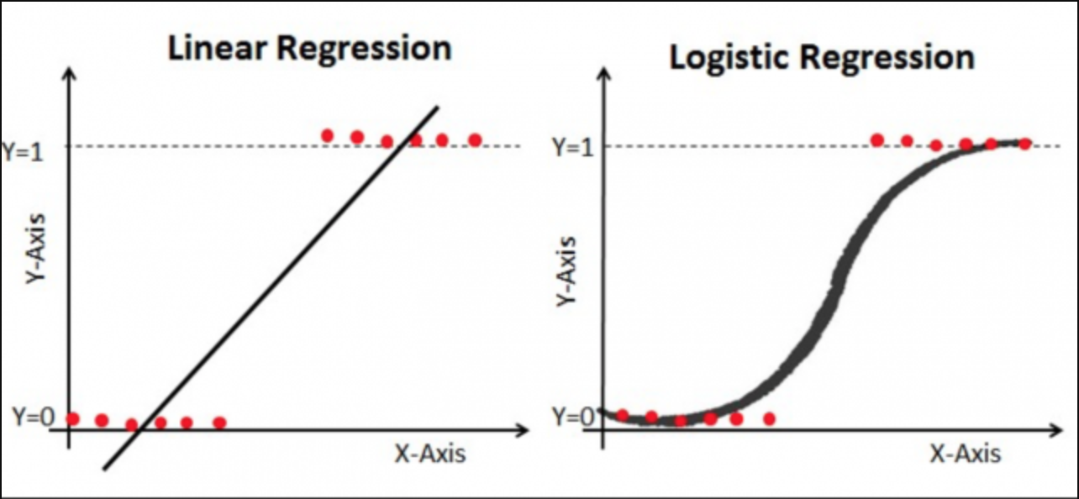

Slide 10
Logistic Regression
Output is probability, but really classifier
Default is 0.5 threshold

Slide 11
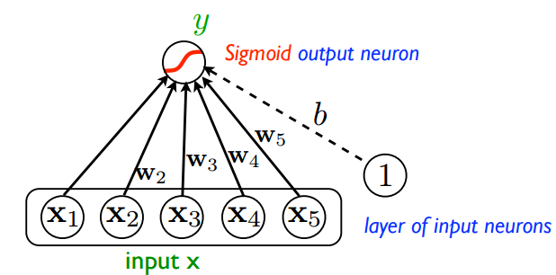

Slide 12
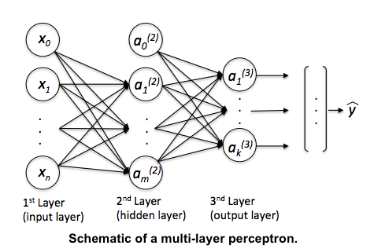

Slide 13
Exercises

Slide 14
Evaluating
Classifiers

Slide 15
Confusion Matrix
Shows where your errors lie
Correction classification on diagonal

Slide 16
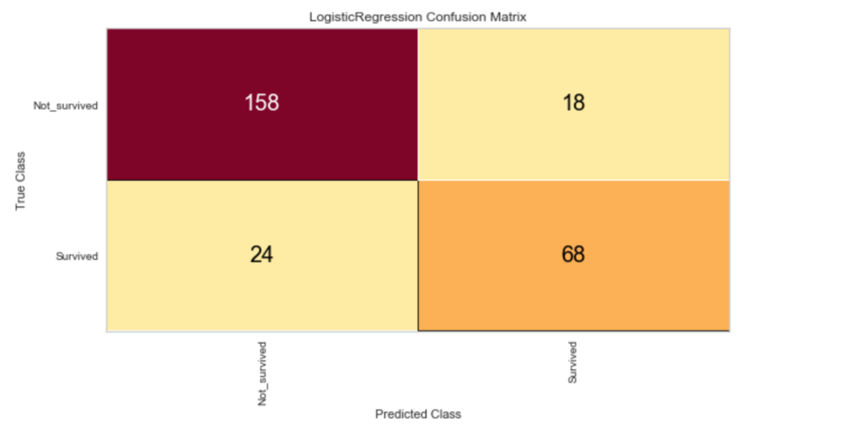

Slide 17
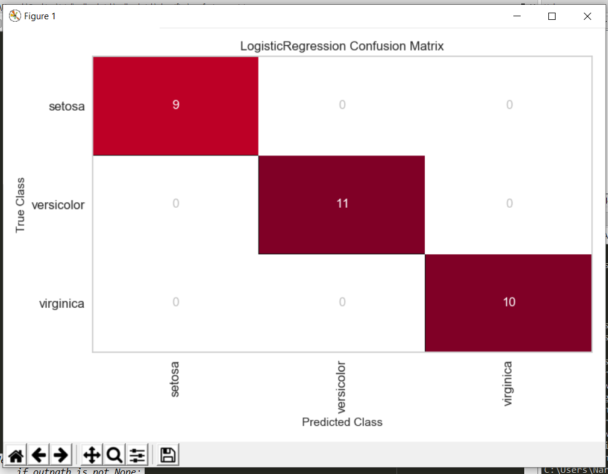
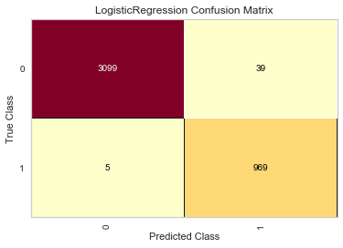
Confusion Matrix

Slide 18
Class prediction Error
Derived from the confusion matrix
Sometimes easier to interpret

Slide 19
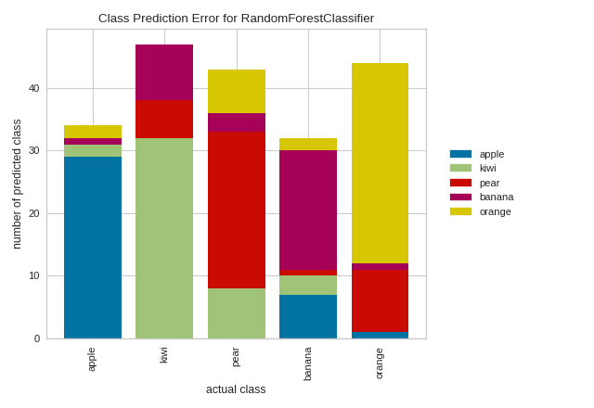

Slide 20
ROC Curve
Short for “Receiver operating characteristic”
Shows effect of changing probability threshold

Slide 21
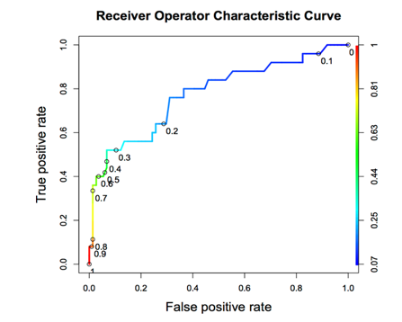

Slide 22
Area Under the curve
Total AUC is a measure of classifier power
1.0 is perfect, 0.5 is as bad as random chance

Slide 23
Choosing a Threshold
Business decision: Which type of errors are more costly?
Equal weight? Closest point on curve to top-left corner

Slide 24
Exercises

Slide 25
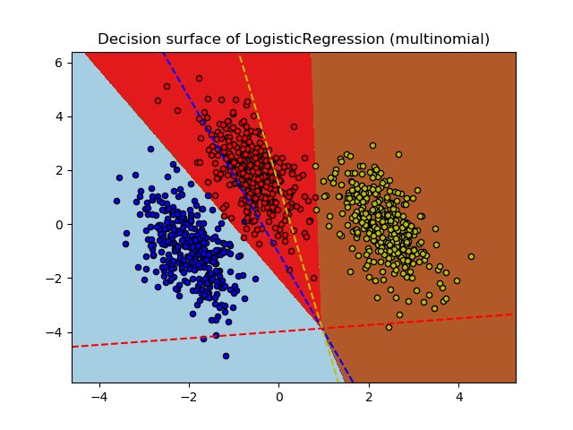

Slide 26
Exercises

Slide 27
Imbalanced classes

Slide 28
The problem
Often have WAY more negative samples than positive
High “accuracy” if you always guess negative!

Slide 29

Transactions
Fraudulent

Slide 30
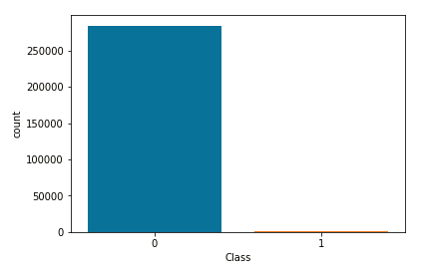

Slide 31
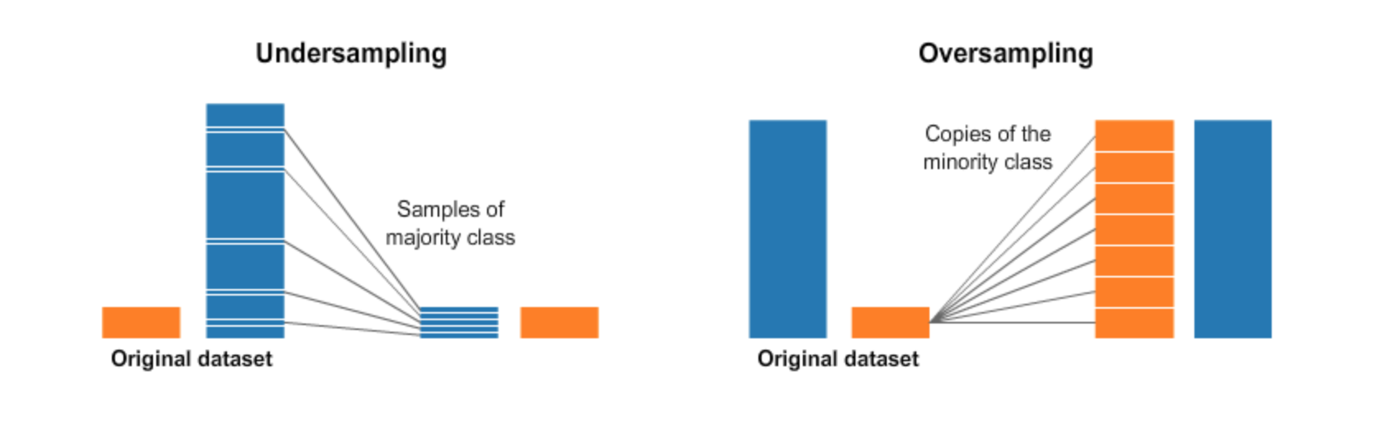

Slide 32
Oversampling
Often have WAY more negative samples than positive
High “accuracy” if you always guess negative!

Slide 34
Undersampling
Avoid — loses data!
Used when size is expensive, eg. Big Data or data that has to be cleaned manually

Slide 35
Imbalance-learn
Fix imbalance in Pipeline
Need to import make_pipeline() from imbalance-learn instead

Slide 36
Random Oversampler
Adds random duplicates
from imblearn.over_sampling import RandomOverSampler

Slide 37
Exercises

