Slide 1
Bootcamp
Machine Learning

Slide 2
Rob Carrington
4 years as a Python developer
Worked in FinTech (@Q2eBanking)

Slide 3



Q2

Slide 4
Projects
Recommendation System
Audience Segmentation
Predicting Overdrafts

Slide 5

Class Goals
Intro to essential ML concepts
Hands-on practice building models from clean data

Slide 6
Class format

Slide 7
Class format

Slide 8
Class format
10 minutes for lesson & demo
15 minutes for exercise
Pause to review & ask questions
Rinse and repeat

Slide 9
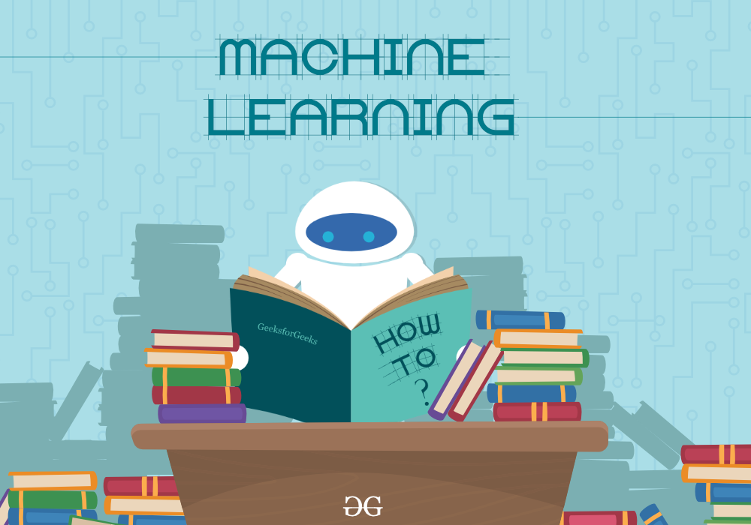

Slide 10
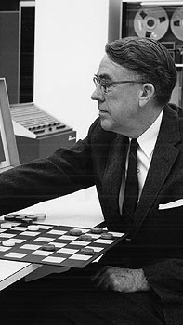
“The field of study that gives computers the ability to learn without being explicitly programmed”
- Arthur Samuel, 1959

Slide 11
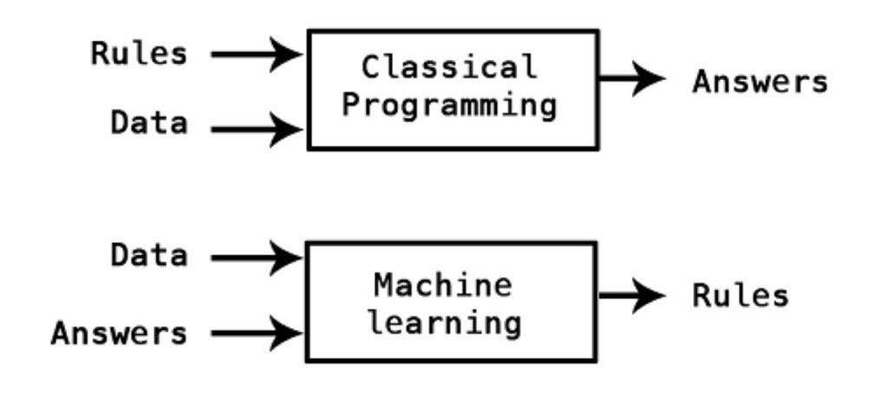

Slide 12
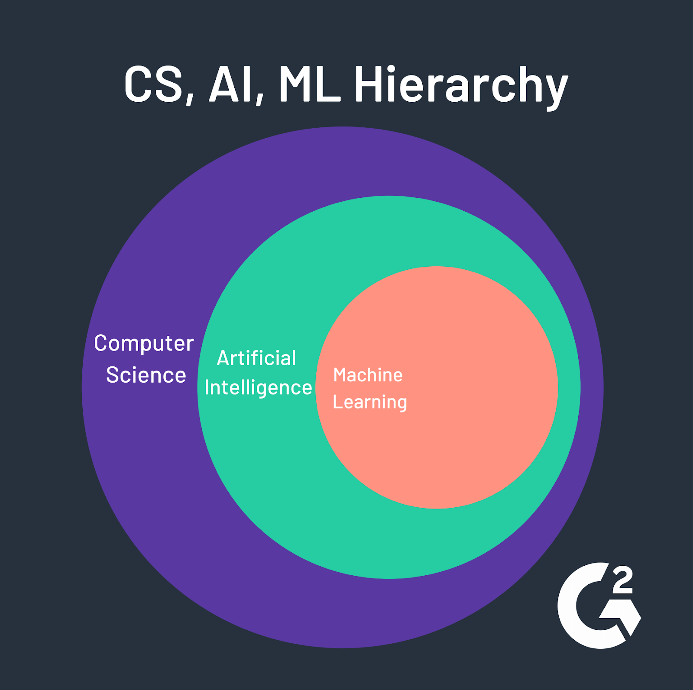

Slide 13
What machine learning isn't

Slide 14
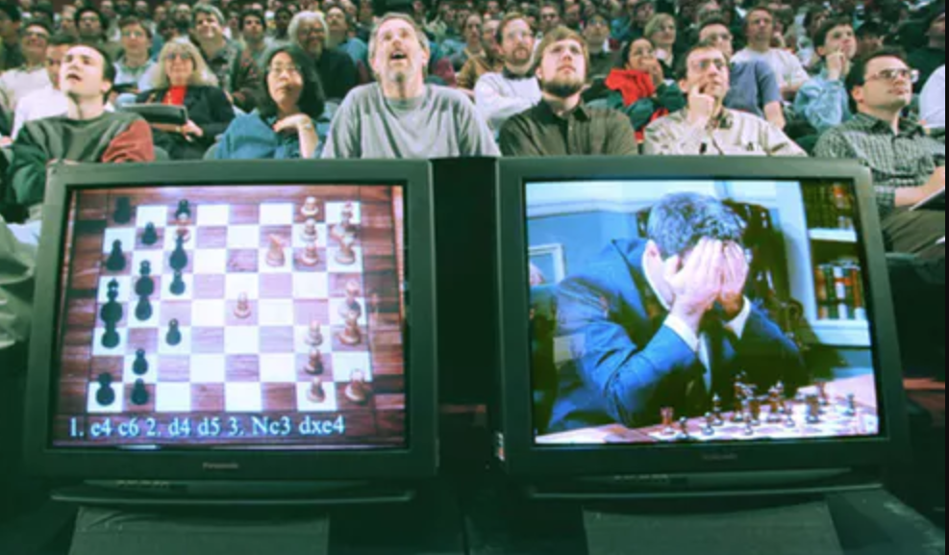
Intelligence = search algorithm (1956 - 1974)

Slide 15
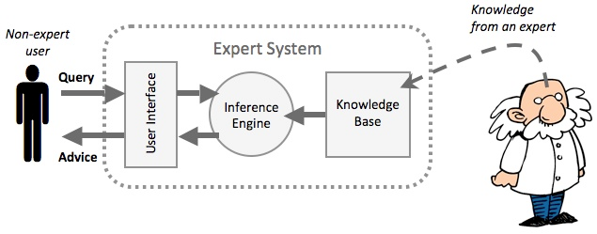
https://www.google.com/url?sa=i&source=images&cd=&ved=2ahUKEwi-kIfs_cHkAhWQxVkKHYNjDYQQjRx6BAgBEAQ&url=https%3A%2F%2Fwww.itgsnews.com%2Fcreating-expert-system-with-clips%2F&psig=AOvVaw2rT1XziARmYSMHLyhFbWN6&ust=1568058074270738
Intelligence = Facts + LOGIC (1980 - 1987)

Slide 16
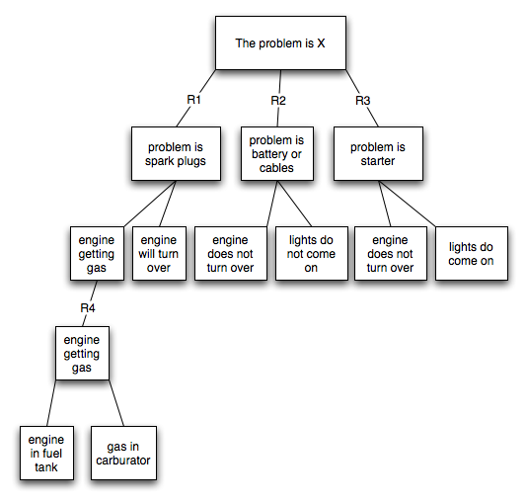

Slide 17
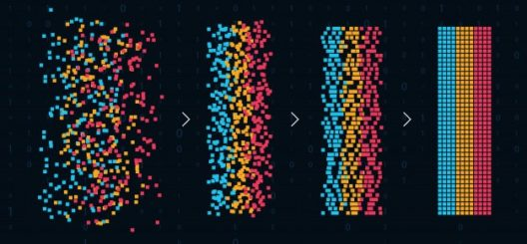
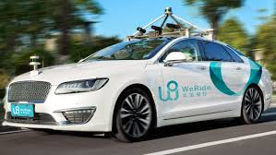
https://www.google.com/url?sa=i&source=images&cd=&ved=2ahUKEwi-kIfs_cHkAhWQxVkKHYNjDYQQjRx6BAgBEAQ&url=https%3A%2F%2Fwww.itgsnews.com%2Fcreating-expert-system-with-clips%2F&psig=AOvVaw2rT1XziARmYSMHLyhFbWN6&ust=1568058074270738
Intelligence = Pattern recognition (1993 - today)

Slide 18
Machine Learning: Why Now?
Ideas are not new! Started in 1950s
Computers have gotten fast and cheap enough for Big Data
A few new concepts (e.g. back-propagation)

Slide 19
What’s it good for?

Slide 20
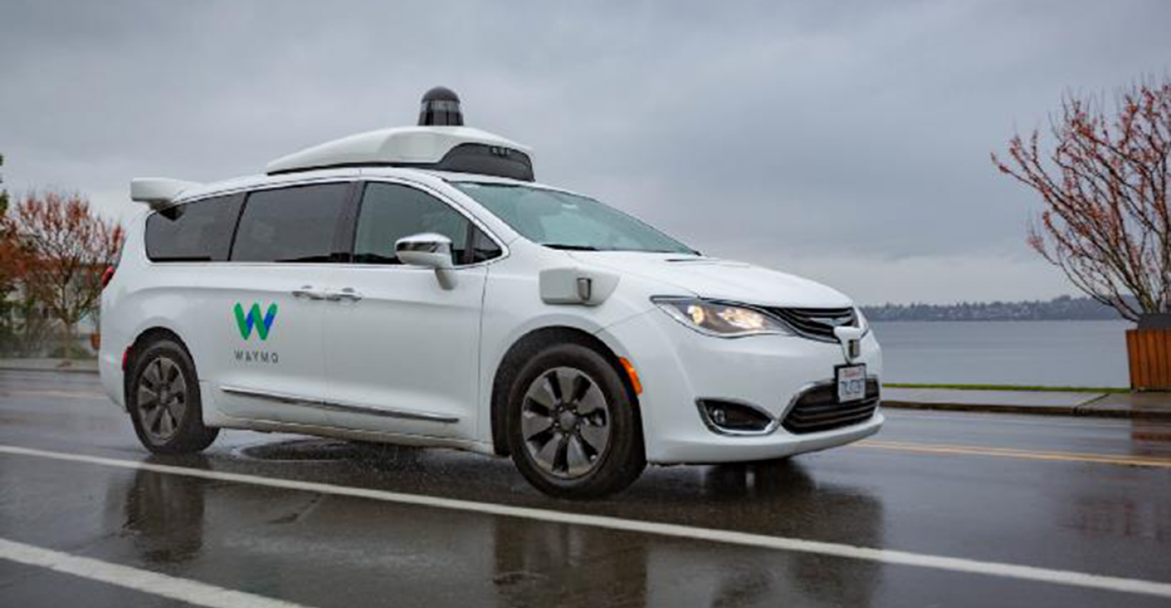
https://www.google.com/url?sa=i&source=images&cd=&ved=2ahUKEwi-kIfs_cHkAhWQxVkKHYNjDYQQjRx6BAgBEAQ&url=https%3A%2F%2Fwww.itgsnews.com%2Fcreating-expert-system-with-clips%2F&psig=AOvVaw2rT1XziARmYSMHLyhFbWN6&ust=1568058074270738
Self-Driving Cars

Slide 21

https://www.google.com/url?sa=i&source=images&cd=&ved=2ahUKEwi-kIfs_cHkAhWQxVkKHYNjDYQQjRx6BAgBEAQ&url=https%3A%2F%2Fwww.itgsnews.com%2Fcreating-expert-system-with-clips%2F&psig=AOvVaw2rT1XziARmYSMHLyhFbWN6&ust=1568058074270738

Slide 22
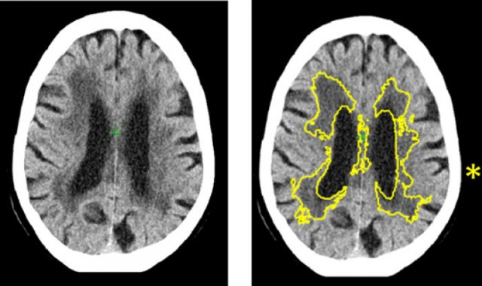
Medical Diagnostics

Slide 23
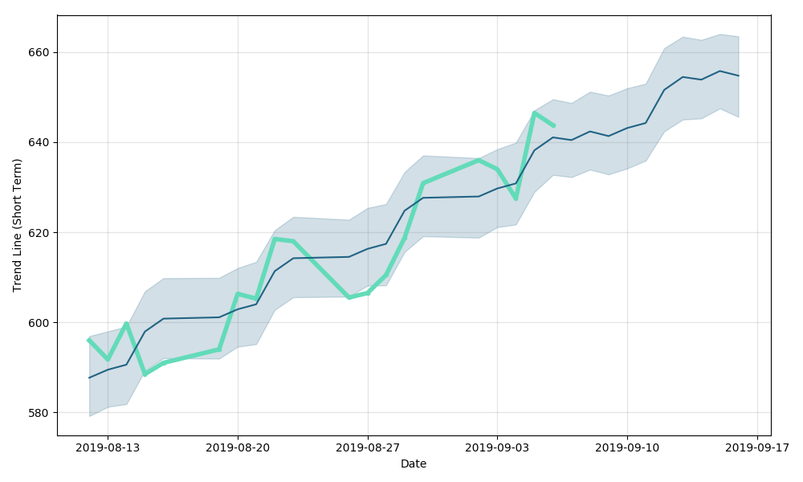
Models for Predictions

Slide 24
Concepts

Slide 25
Supervised vs Unsupervised
Supervised: model trained and evaluated based on previous “right answers”
Unsupervised: Finds patterns, with no right/wrong answers

Slide 26
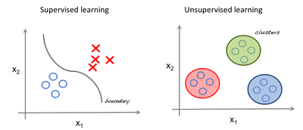

Slide 27
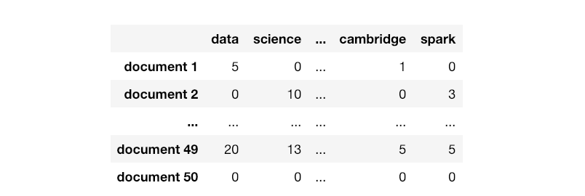

Slide 28
samples

Slide 29
features
samples

Slide 30
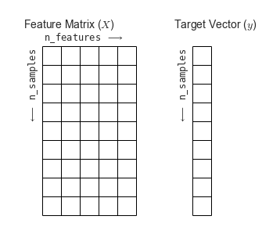

Slide 32

Wait! How do we test?

Slide 33
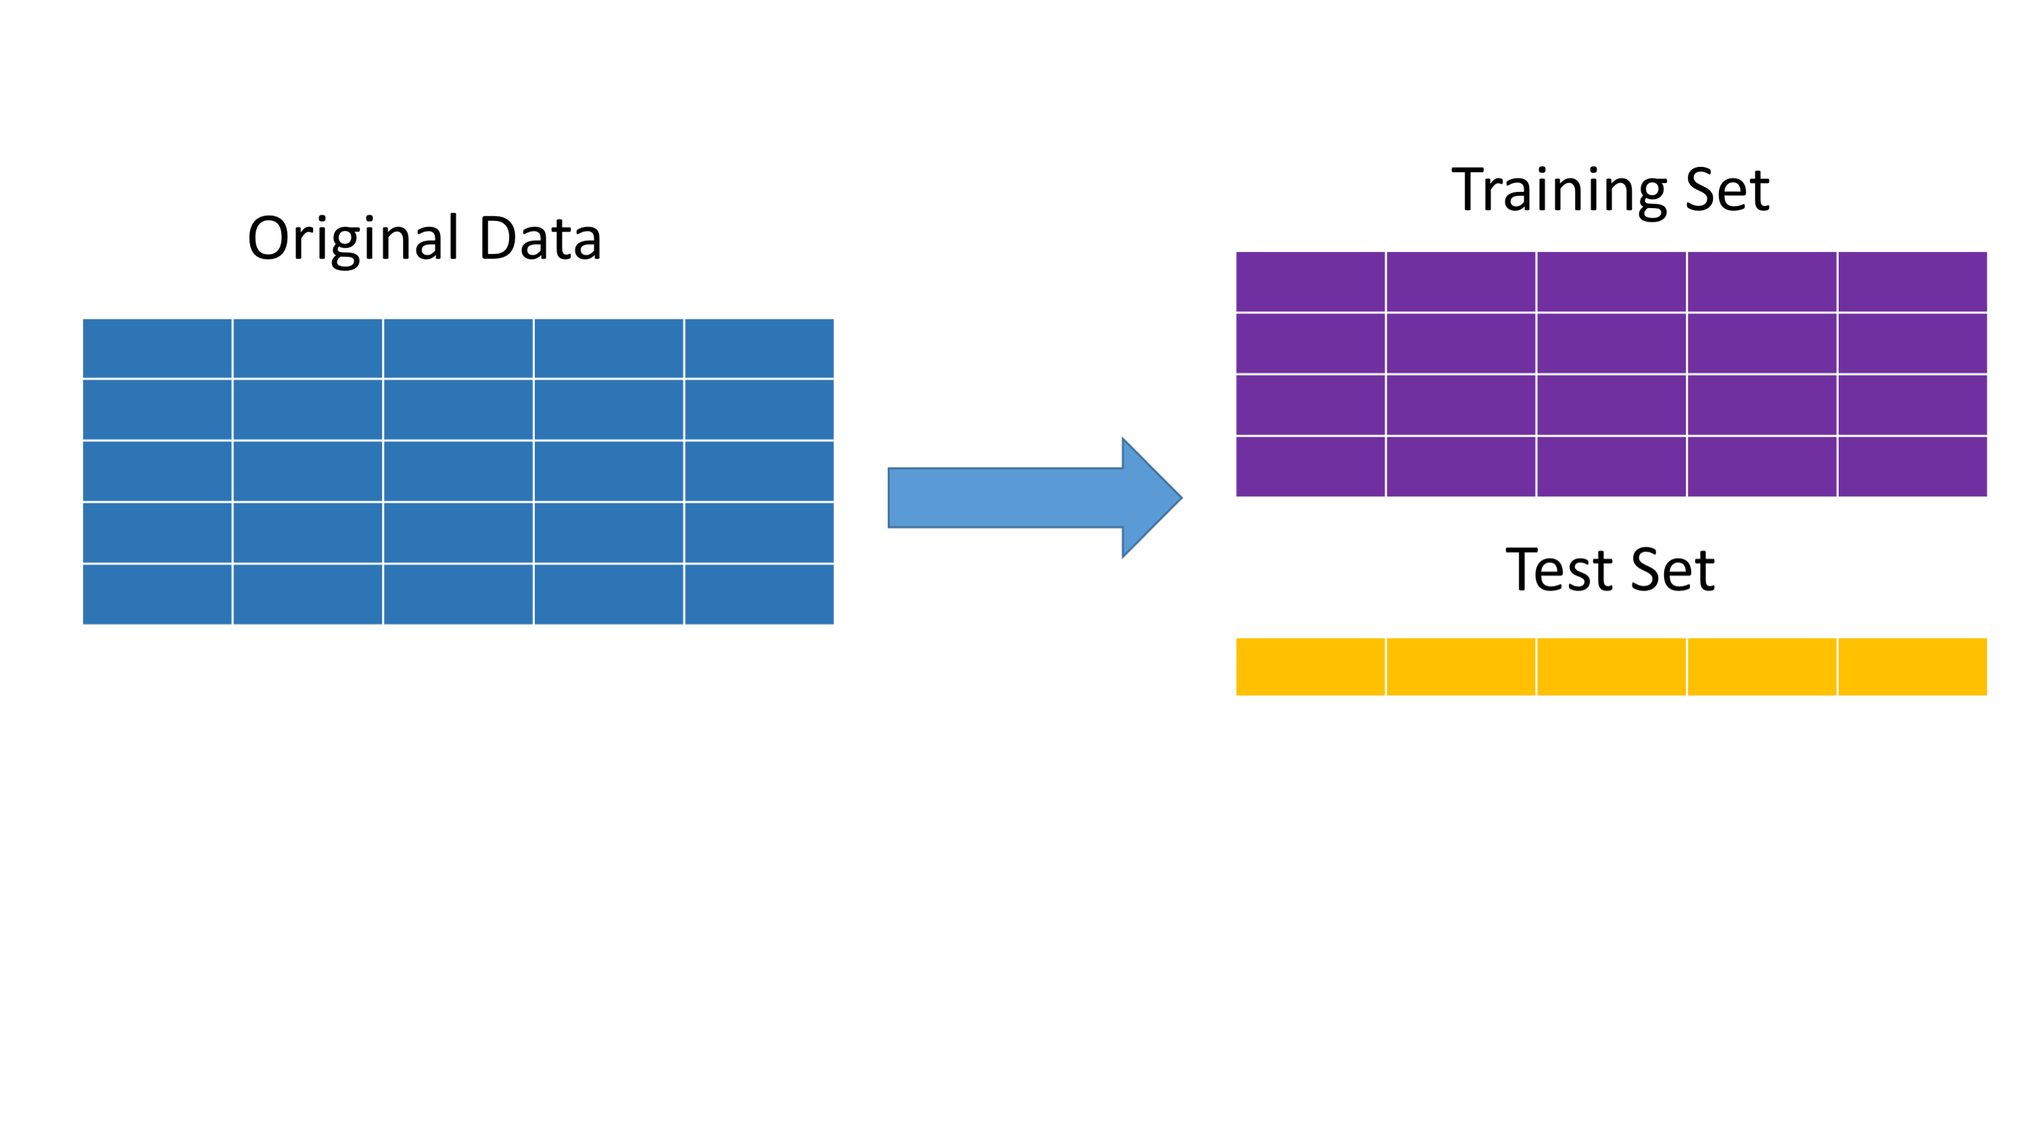
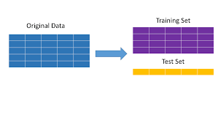

Slide 34
Quiz

Slide 35
Hands on
with Python

Slide 36
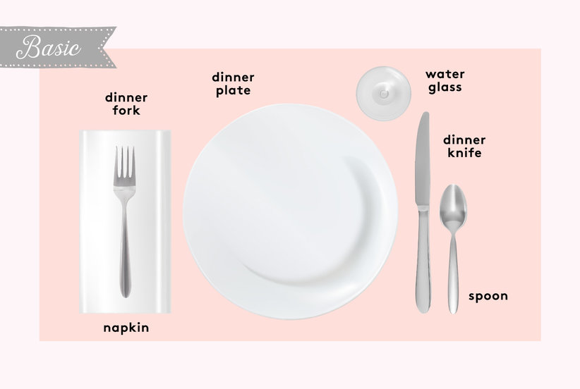
Setting the table

Slide 37
Pandas
Short for “panel data”
DataFrame concept from R

Slide 38
Dataframe
Similar to a spreadsheet
Columns are Numpy arrays with special index

Slide 39
importing Pandas
import pandas as pd

Slide 40
creating a Dataframe
df = pd.read_csv(“file_name”)

Slide 41
Grabbing a Column
df[‘profit’]

Slide 42
Dataframe from columns
columns = [‘revenue’, ‘profit’]
df[columns]

Slide 43
Dropping Nulls
df.dropna()

Slide 46
Exercises

Slide 47
Sci-Kit Learn
All-in-one machine learning package
Built on Numpy and matplotlib

Slide 48
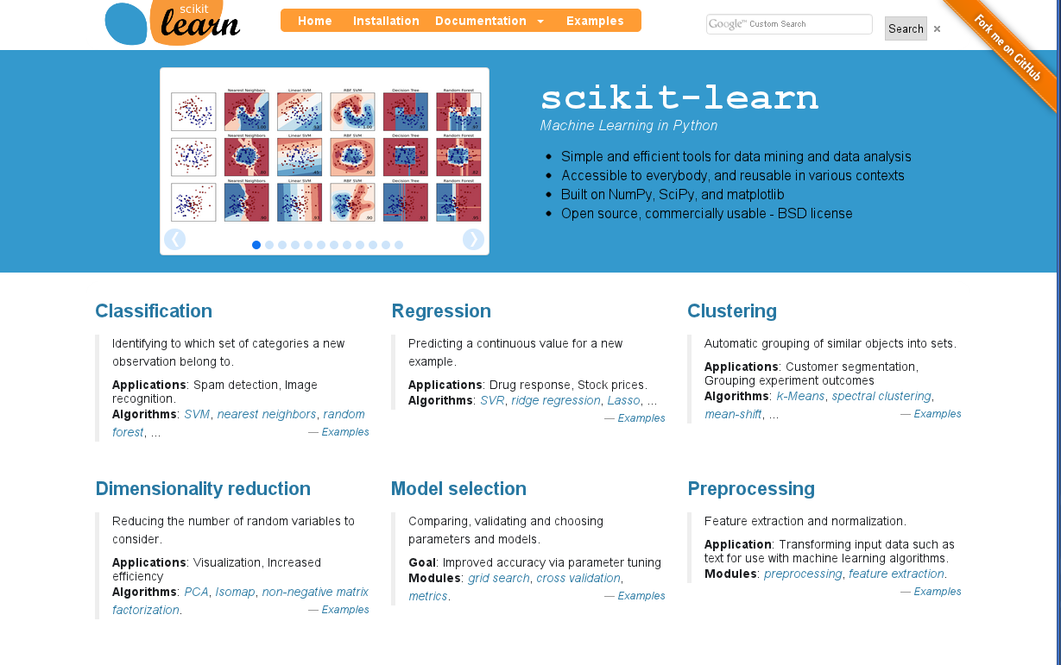
Text

Slide 49
Imported as sklearn
import sklearn

Slide 50
Imported as sklearn
from sklearn.linear_model \
import LinearRegression

Slide 51
Linear Regression
y = 2x0 + 3x1 + … + 1

Slide 52
Training a Model
model = LinearRegression()
model.fit(X_train,y_train)

Slide 53
Using a Model
y_predicted = model.predict(X_test)

Slide 54
Evaluating a Model
model.score(X_test, y_test)

Slide 55
Mean absolute error
from sklearn.metrics \
import mean_absolute_error
mean_absolute_error(y_predicted, y_test)

Slide 56
Exercises

Slide 57
One-Hot Encoding

Slide 58
The Problem
Linear models use multiplication (with coefficient)
We can’t multiply categorical data :(

Slide 59
Simple Encoding Doesn’t work
What if we re-label each category as 0,1, 2, .. etc?
Model thinks we’re adding more and more of same thing!

Slide 60
One-hot encoding
Creates a 1-or-0 column for each unique value in categorical
Per row, only one of the new columns will have a 1, hence 1-hot

Slide 61
How the math works:
y = … + 3xn + ..

Slide 62
How the math works:
y = … + 3(1) + ..

Slide 63
How the math works:
y = … + 3(0) + ..

Slide 64
How the math works:
y = … + 3(0) + ..
Adds a fixed amount, or doesn’t!

Slide 65
Exercises

