Slide 1
Bootcamp
Machine Learning

Slide 2
Review

Slide 3
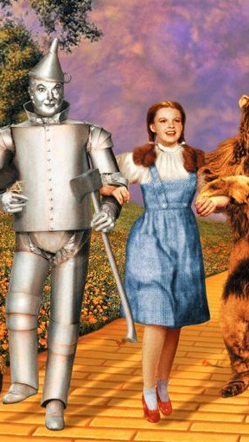
Yellowbrick
Introducing

Slide 4

Yellowbrick
Auto-generates visualizations!
Built to integrate with scikit-learn

Slide 5
Example from data
from yellowbrick.features import rank2d
visualizer = rank2D(X)
visualizer.poof()

Slide 6
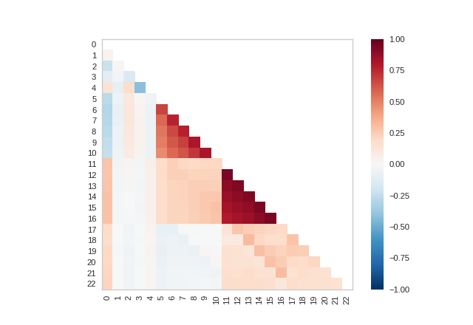

Slide 7
Example from Model
from yellowbrick.regressor import ResidualsPlot
model = ResidualsPlot(model)
...

Slide 8
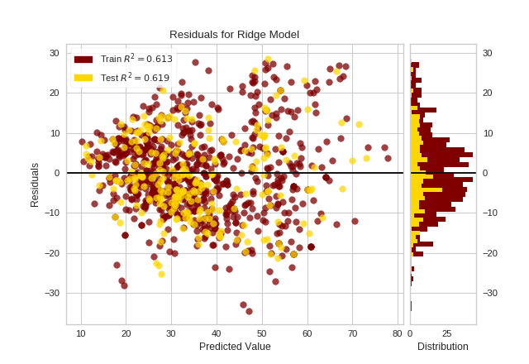

Slide 9
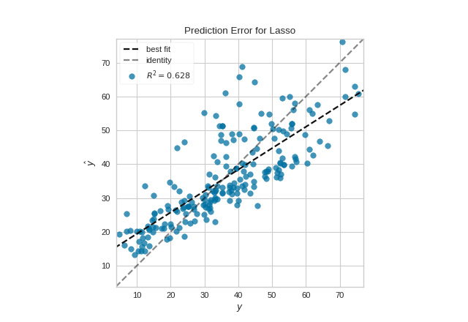

Slide 10
Learning curve
Scores model as size of data increases
Convergence means more data won’t help

Slide 11
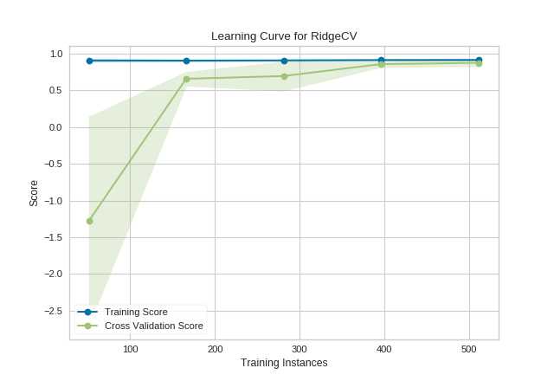

Slide 12
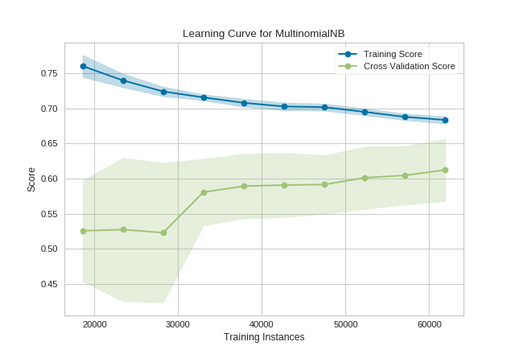

Slide 13
Exercises

Slide 14
Polynomial regression

Slide 15
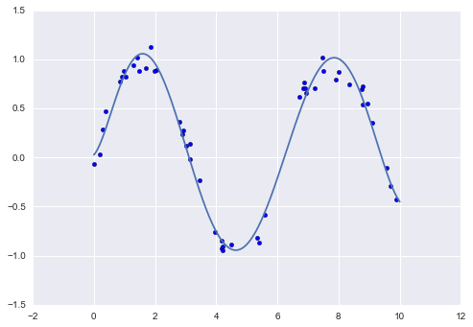

Slide 16
Use fewer degrees
Features matrix grows FAST!
Complex models overfit data

Slide 17
Bias-Variance Tradeoff

Slide 18
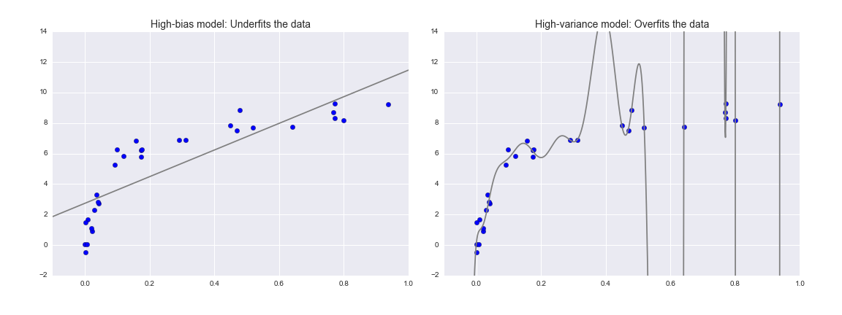

Slide 20
Overfitting
Model fits training set
Complex models overfit data

Slide 21
Validation curve
See if more complex model helps
Look for sweet spot in middle

Slide 22
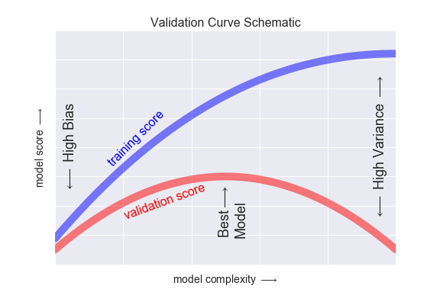

Slide 23
Exercises

Slide 24
Regularization

Slide 25
regularization
Fix what “best-fit” means
Add penalty for complex models

Slide 26
Ridge Regression (L2)
sum(model.coef_**2)
Low-signal features will have smaller and smaller coefficients

Slide 27
Lasso Regression (L1)
sum(abs(model.coef_))
Low-signal features will end up with coefficients of 0

Slide 28
Alpha parameter
Changes how heavily we weight regularization
Can test different values with validation curve!

Slide 29
Exercises

