Slide 1
Bootcamp
Machine Learning

Slide 2
Non-Parametric Models

Slide 3

Non-parametric Model
Has parameters, despite name
Complexity of model grows with number of rows of data

Slide 4
Contrast: Linear Regression
y = 2x0 + 3x1 + … + 1

Slide 5
Benefits
No assumptions about probability distribution or functional form
Can fit very irregular patterns

Slide 6
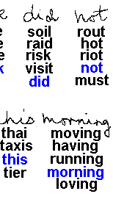
Recognition
Handwriting

Slide 7
Drawbacks
Low bias means it’s easy to overfit
Requires much more data to be accurate
“Model” keeps the entire dataset!

Slide 8
K-nearest Neighbors

Slide 9
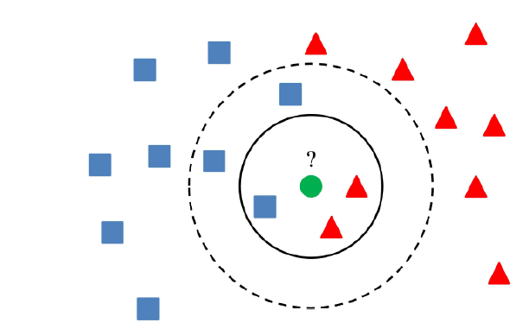

Slide 10
Pros of KNN
Simple to understand, no training step
Can do regression or classification
Easy to do multi-class classification
Easy to add new data

Slide 11
Cons of KNN
Numerical inputs only
Major problems with imbalanced data
Model slows down with more data
Curse of dimensionality

Slide 12

Dimensionality
the curse of

Slide 13
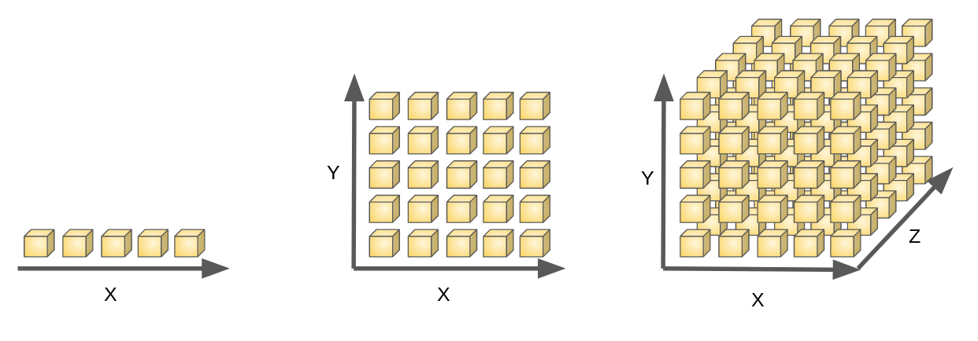

Slide 14
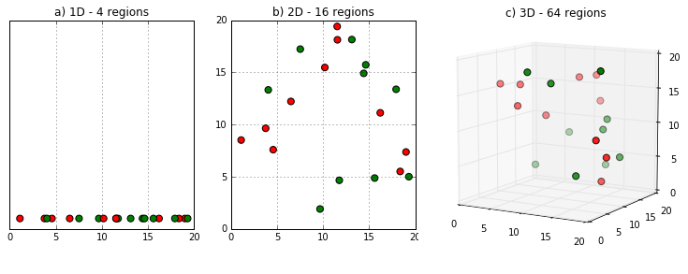

Slide 15
Exercises

Slide 16
Decision Trees

Slide 17

Interpreting
Decision tree

Slide 18
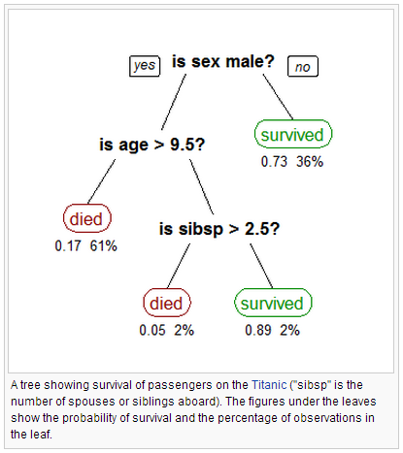

Slide 19
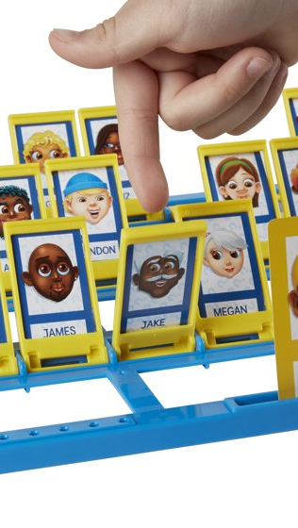
Building
Decision tree

Slide 20
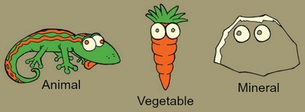

Slide 21
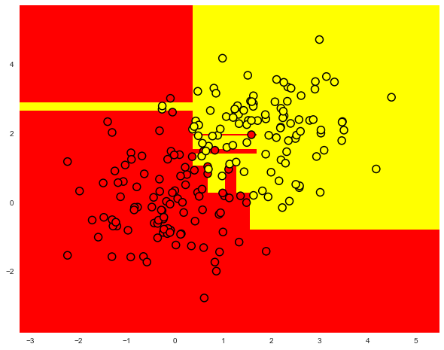

Slide 22
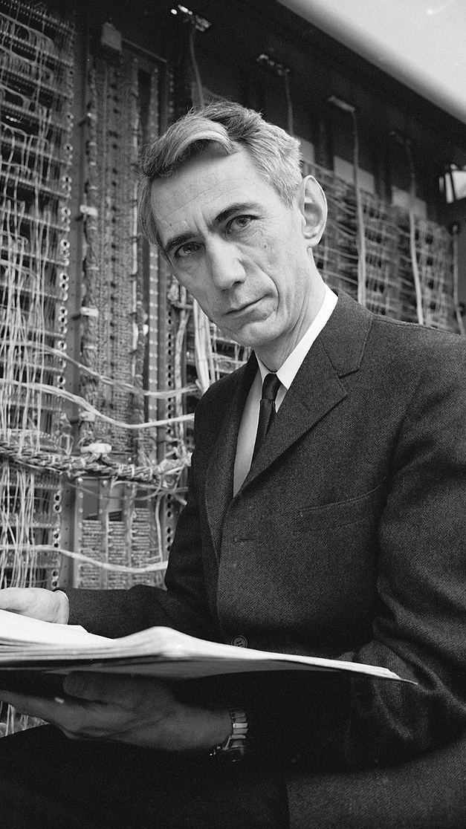
Claude Shannon

Slide 23
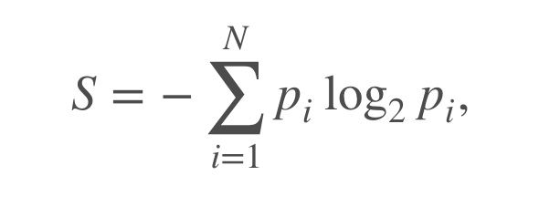
Shannon Entropy
Measure of how many possible states a a system can be in
Features that reduce entropy are good to split on in decision trees

Slide 24
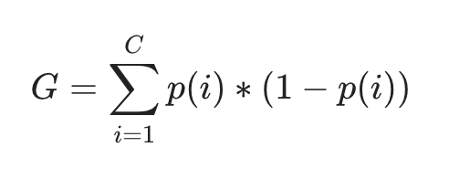
Gini Index/Impurity
Intuitively: fraction that belongs to that class X chance of misclassifying
IFeatures that reduce entropy are good to split on in decision trees

Slide 25
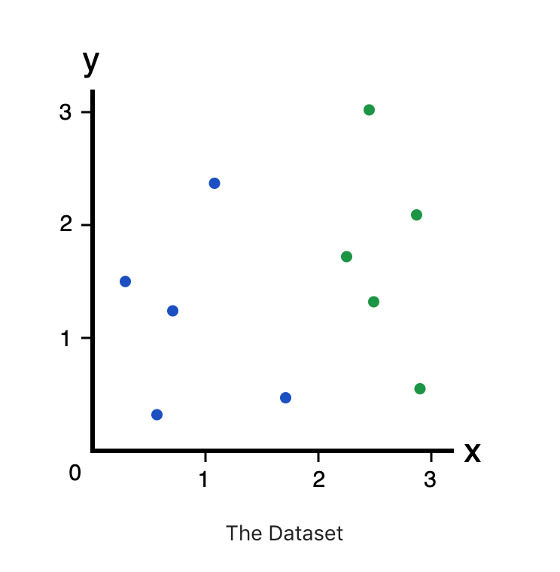

Slide 26
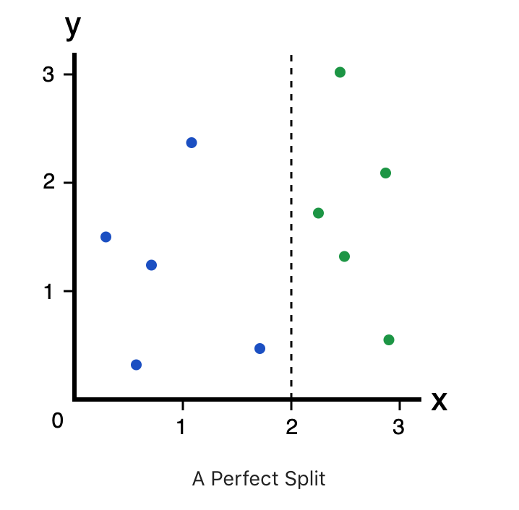

Slide 27
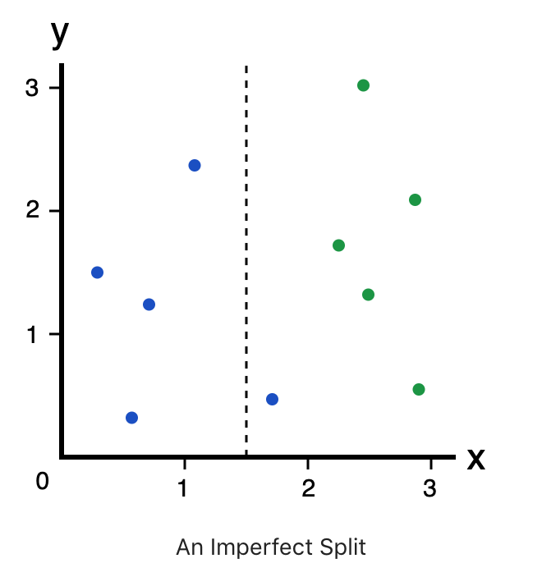

Slide 28
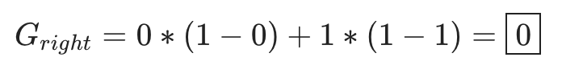

Slide 30
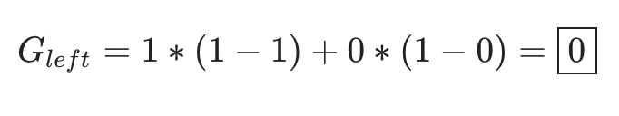

Slide 32
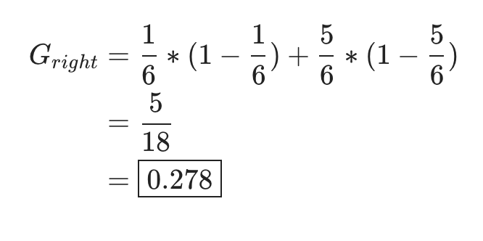

Slide 35
Pros of Decision Trees
Transparent, interpretable by humans
Inputs can be categorical or numeric
Can do regression or classification

Slide 36
Pros of Decision Trees
Transparent, interpretable by humans
Inputs can be categorical or numeric
Can do regression or classification

Slide 37
Cons of Decision Trees
High variance. Unstable even with small changes in training set.
Each order is called a “statement”

Slide 38
Ensemble Methods

Slide 39
Ensemble methods
Combining multiple models
Akin to “Wisdom of the Crowds”
Models can focus on different parts of the data

Slide 40
Bagging
Short for bootstrap aggregating
Models are trained on random subsets of the data

Slide 41
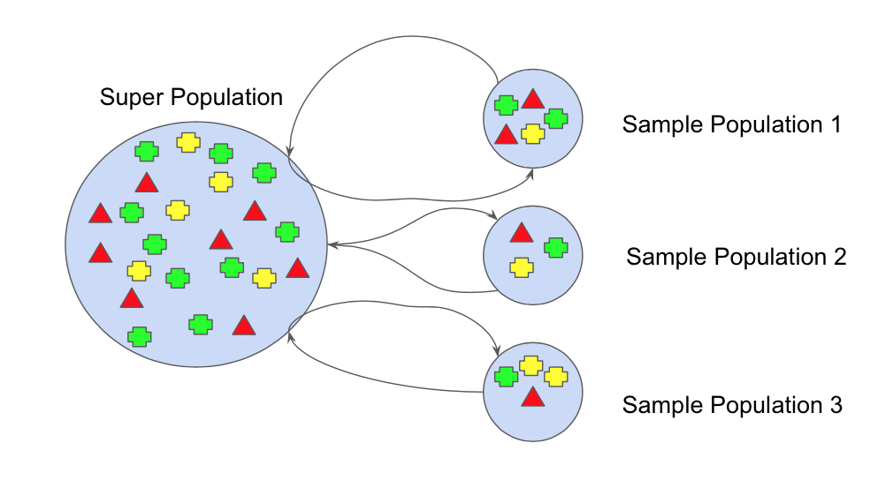

Slide 42
Bagging: Final Step
Classification: Majority vote
Regression: Average the outputs

Slide 43
Random Forest
Train a multitude of decision trees
Each tree uses a random subset of samples, features

Slide 44

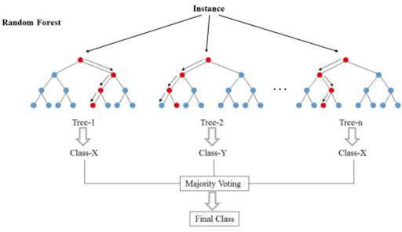

Slide 45
Random features
Some features will be predictive
Predictive features will end up being used by many models, and affecting final output

Slide 46
Exercises

