Slide 1
Bootcamp
Machine Learning

Slide 2
Review

Slide 3

Setting the Table
Feature Matrix, Target Vector
Training Set, Test Set

Slide 4
Feature Matrix, Target Vector
X = df.drop(['price'], 1)
y = df['price']

Slide 5
Training Set, Test Set
X_train, X_test, y_train, y_test = = train_test_split(X, y)

Slide 6
One-hot encoding
Creates a 1-or-0 column for each unique value in categorical
Per row, only one of the new columns will be positive, hence “one-hot”

Slide 7
Columns based on unique values
transformer.fit(X)

Slide 8
Map rows into new encoding
transformer.transform(X)

Slide 9
Review

Slide 10

Yellowbrick
Introducing

Slide 11
Yellowbrick
Diagnostic visualizations! Automatic!
Built to integrate with scikit-learn

Slide 12
Example from data
from yellowbrick.features import rank2d
visualizer = rank2D(X)
visualizer.poof()

Slide 13
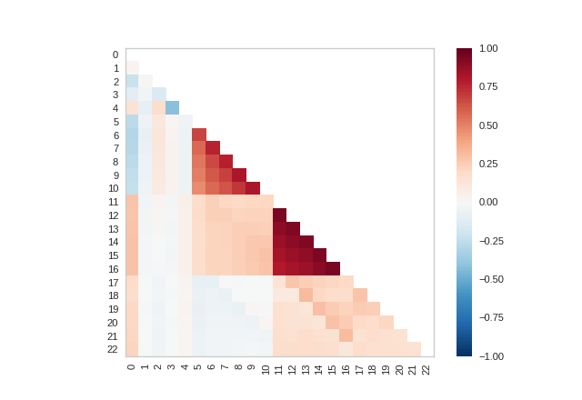

Slide 14
Example
ResidualsPlot(LinearRegression())

Slide 15
ResidualS Plot
See where your model does well or poorly
Target vector is X axis, amount of error is Y axis

Slide 16
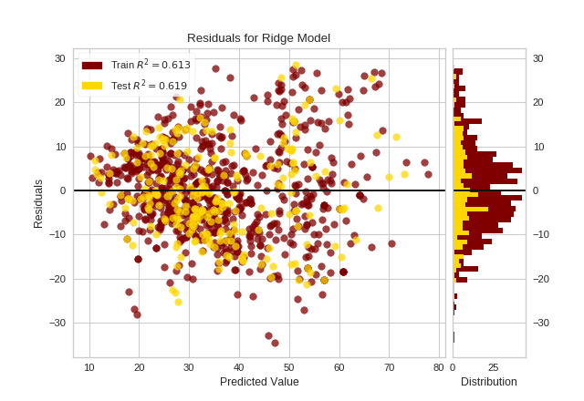
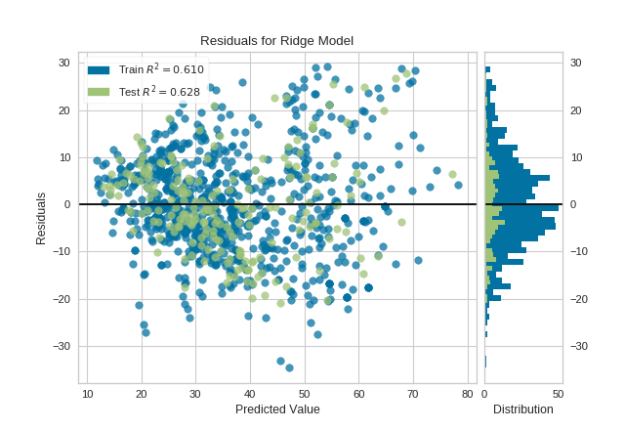

Slide 17
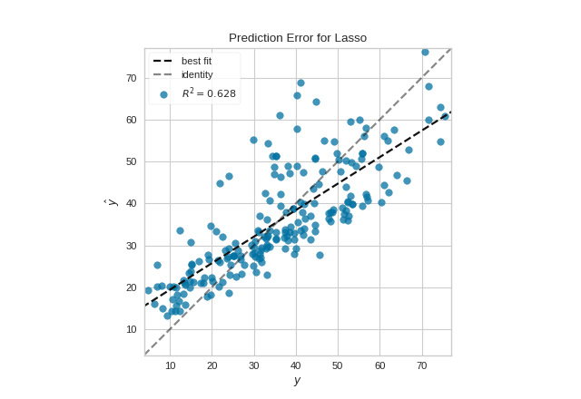

Slide 18
Learning curve
Scores model as size of data increases
Convergence means more data won’t help

Slide 19
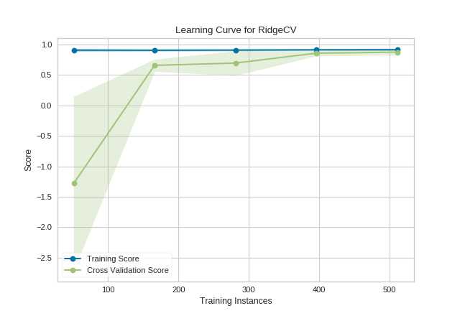

Slide 20
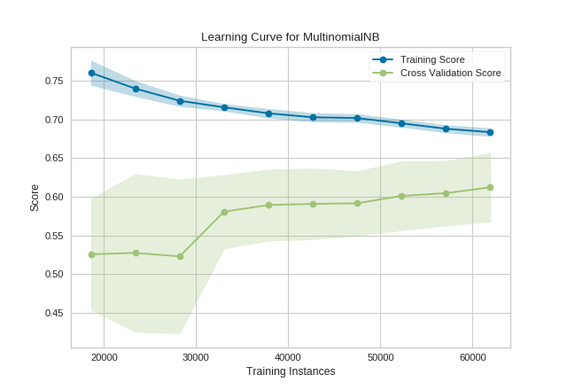

Slide 21
Exercises

Slide 22
Polynomial Regression
Feature engineering: data is modified, not the model
New column is the square of the original column (or cube, etc)

Slide 23
Linear Regression
y = 2x0 + 3x1 + … + 1

Slide 24
Polynomial Regression
y = 2x0 + 3x1 + … + 1
+ 1x0² + 2x1² + …

Slide 25
Polynomial Regression
y = 2x0 + 3x1 + … + 1
+ 1x0² + 2x1² + …
+ 3x0³ + 1x1³ + …

Slide 26
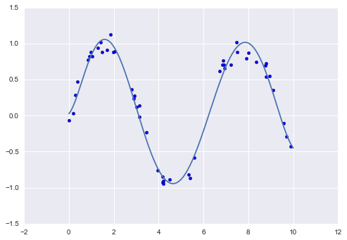

Slide 27
Downsides
Features matrix grows FAST!
Complex models overfit data

Slide 28
Bias-Variance Tradeoff

Slide 29
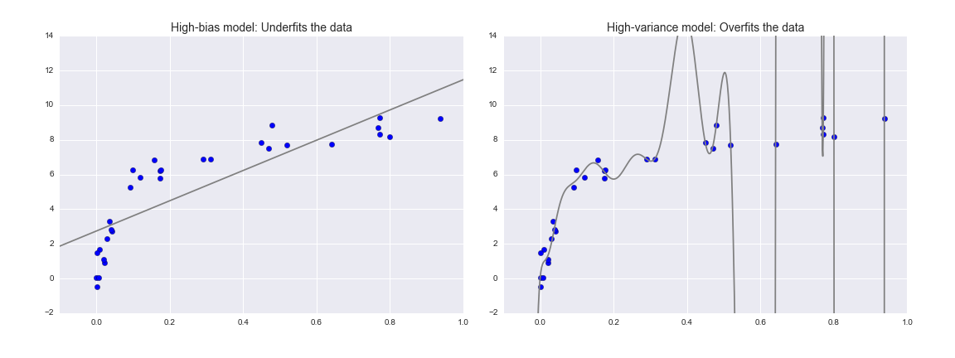

Slide 31
Overfitting
Model fits training set
Complex models overfit data

Slide 32
Validation curve
See if more complex model helps
Look for sweet spot in middle

Slide 33
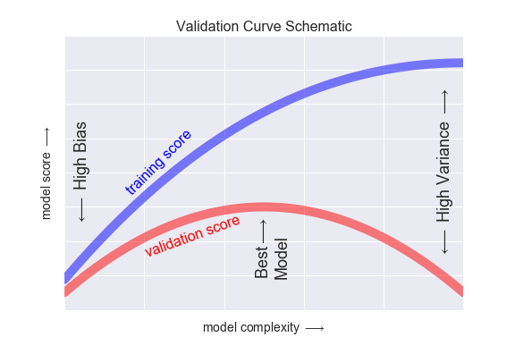

Slide 34
Exercises

Slide 35
Regularization

Slide 36
regularization
Fix what “best-fit” means
Add penalty for complex models

Slide 37
Ridge Regression (L2)
sum(model.coef_**2)
Low-signal features will have smaller and smaller coefficients

Slide 38
Lasso Regression (L1)
sum(abs(model.coef_))
Low-signal features will end up with coefficients of 0

Slide 39
Alpha parameter
Changes how heavily we weight regularization
Can test different values with validation curve!

Slide 40
Exercises

