Slide 1
Bootcamp
Machine Learning

Slide 2
Review

Slide 3

One-hot encoding
Feature engineering: transforming our input
Creates a 1-or-0 column for each unique value in original categorical column

Slide 4
Polynomial Regression
Feature engineering: transforming our input
New column is the square of the original column (or cube, etc)

Slide 5
regularization
Changes what “best-fit” means
Adds penalty for using too many features

Slide 6
Logistic Regression

Slide 7
Logistic Regression
Modify output of linear model to be a probability
Used for classification, despite name

Slide 8
Problems with Probability
Positive values only
Must fit between 0 and 1

Slide 9
Solution: Output something easier
Output something more line-friendly
Translate back to probability later

Slide 10
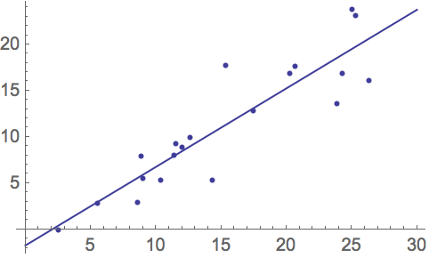

Slide 11
Fix #1: Odds
Ratio of two probabilities
e.g. P(Win) = 0.8, P(Lose) =0.2
Odds of winning = 0.8/0.2 = 4
Odds of losing = 0.2/0.8 = 0.25

Slide 12
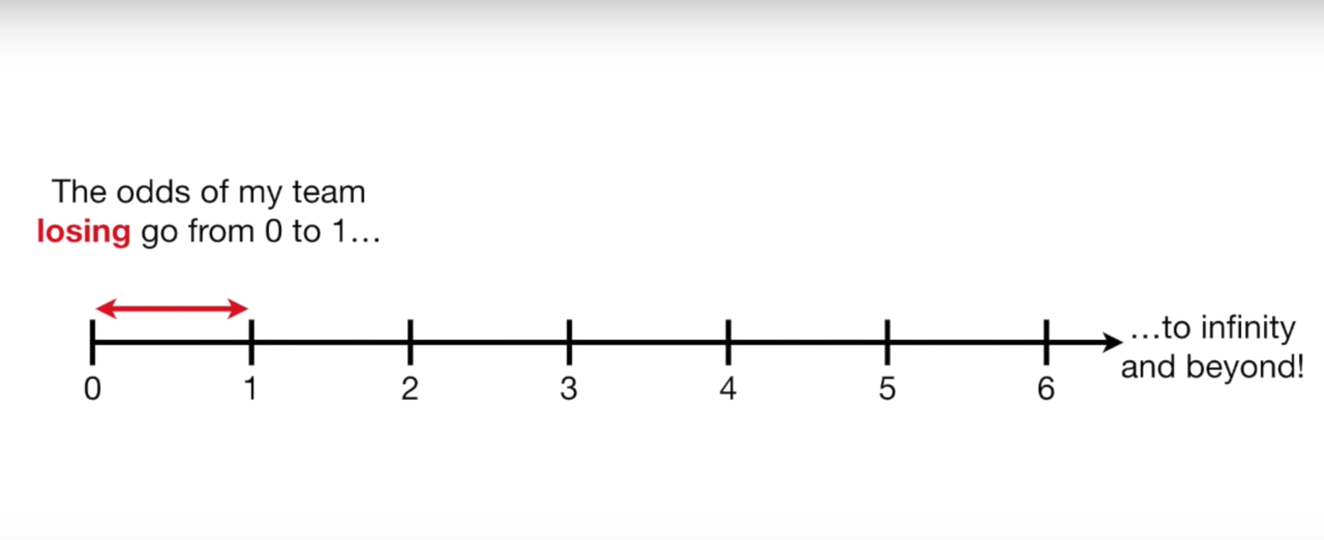
Odds
Only valid between 0 and 1

Slide 13
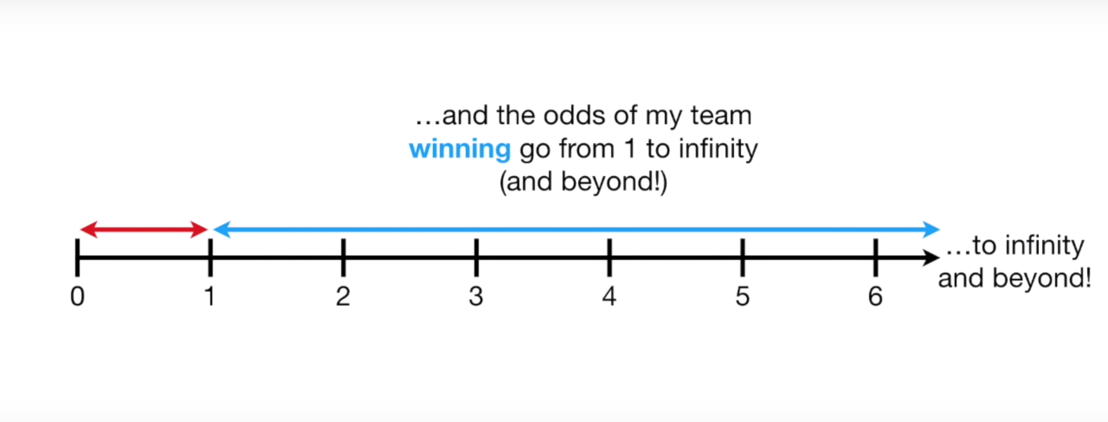
Odds
Only valid between 0 and 1

Slide 14
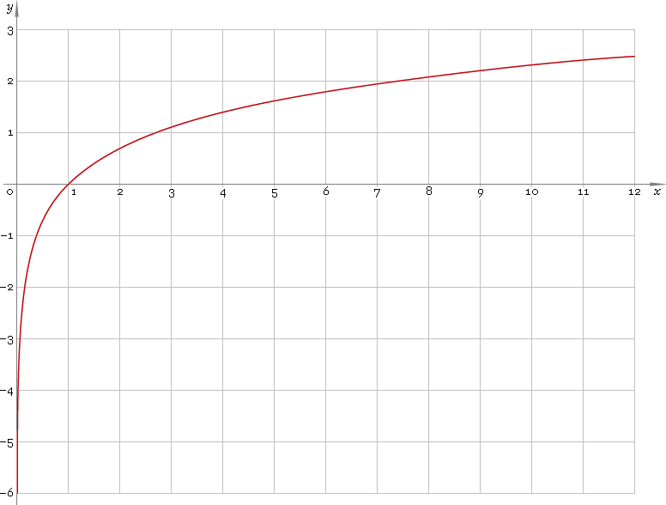
Fix #2: Log()
Evens out scale between 0-1 and rest

Slide 15
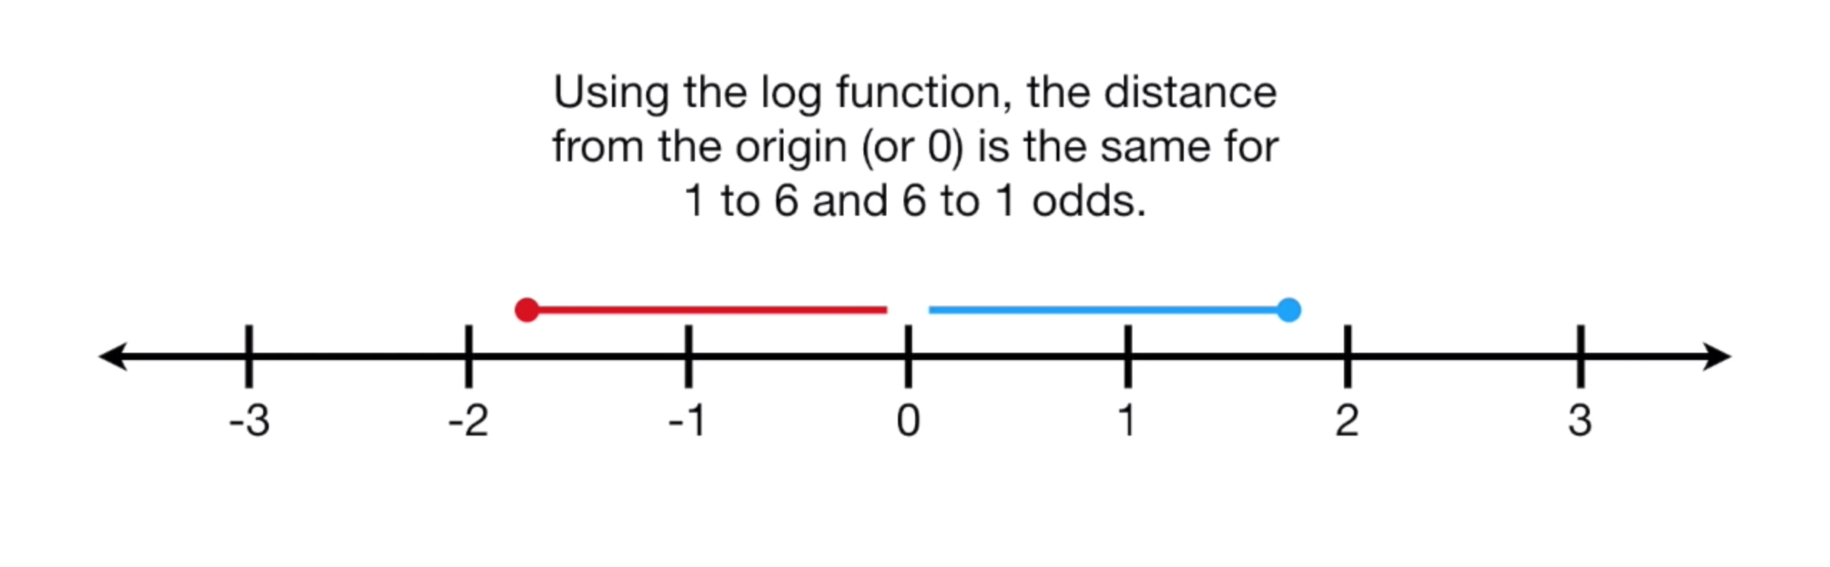
Log-Odds

Slide 16
Fix #2: Log()
Win = log(4) = 1.39
Lose = log(0.25) = -1.39

Slide 17
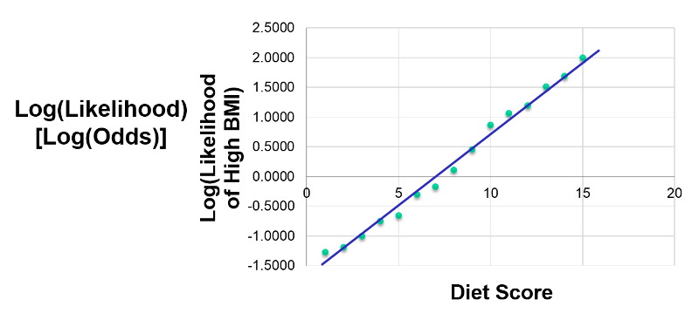

Slide 18
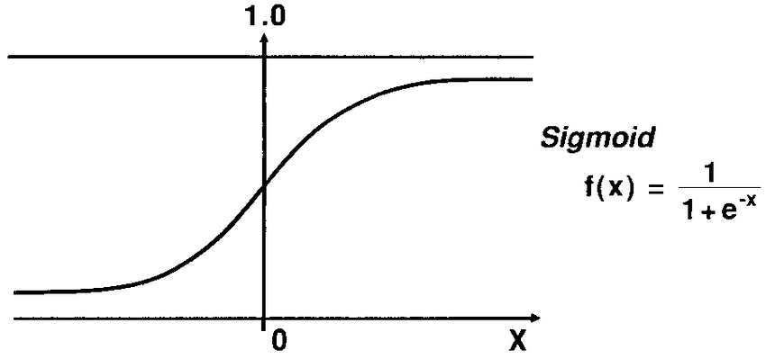
Sigmoid function
Translates log-odds back to probability

Slide 19
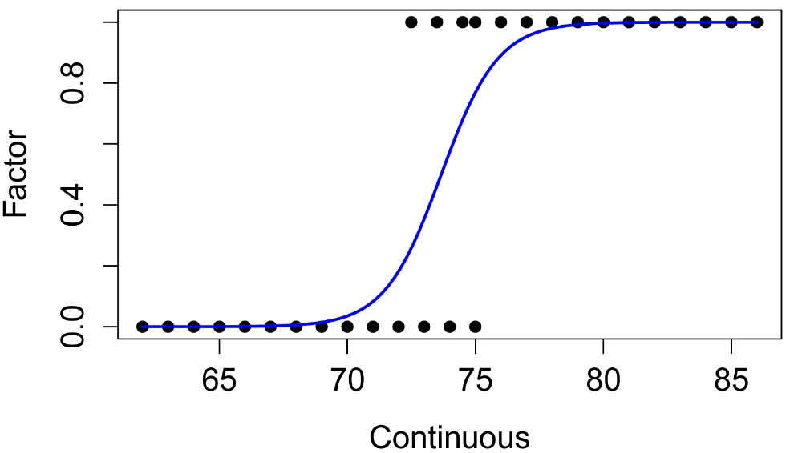

Slide 20
Logistic Regression
Output is probability
Probability -> classification using a discrimination threshold
Default threshold: 0.5

Slide 22
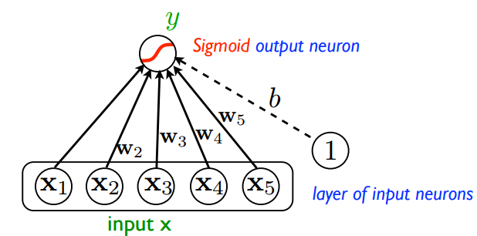

Slide 23
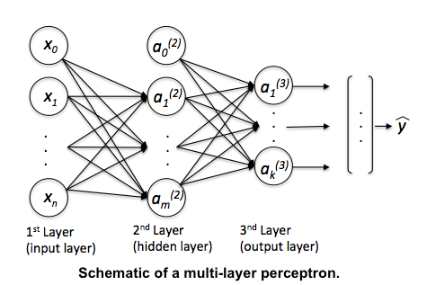

Slide 24
Exercises

Slide 25
Evaluating
Classifiers

Slide 26
Cannot use Regression metrics
Outputs are classes, not numbers
“Amount of error” is a bad fit

Slide 27
Accuracy
% of samples correctly classified
Does not tell you WHERE error is

Slide 28
Confusion Matrix
Grid comparing predicted VS actual
Shows where your errors lie
Correction classification on diagonal

Slide 29
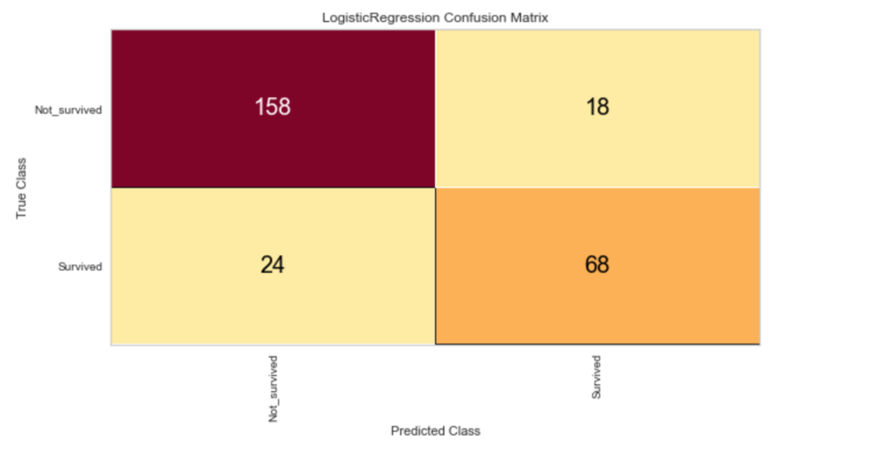

Slide 30
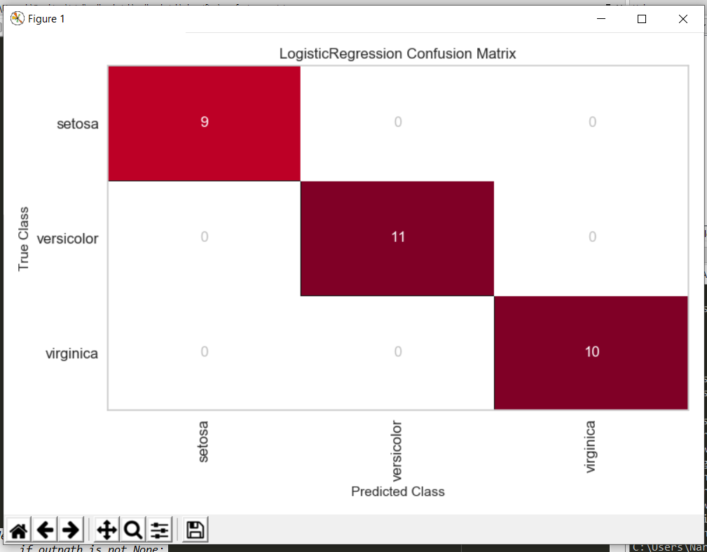
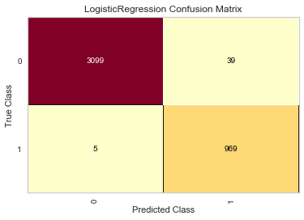
Confusion Matrix

Slide 31
Class prediction Error
Derived from the confusion matrix
Sometimes easier to interpret

Slide 32
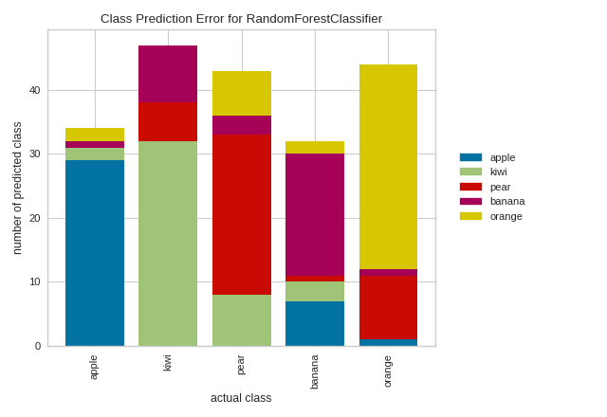

Slide 33
Choosing a Threshold
Business decision: Which type of errors are more costly?
Equal weight? Closest point on curve to top-left corner

Slide 34
ROC Curve
Short for “Receiver operating characteristic”
Shows effect of changing probability threshold

Slide 35
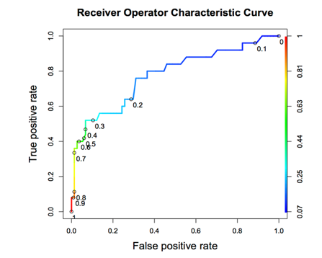

Slide 36
Area Under the curve
Total AUC is a measure of classifier power
1.0 is perfect, 0.5 is as bad as random chance

Slide 37
Exercises

Slide 38
Imbalanced classes

Slide 39
The problem
Often have WAY more negative samples than positive
High “accuracy” if you always guess negative!

Slide 40

Transactions
Fraudulent

Slide 41
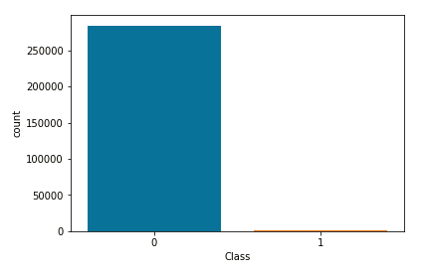

Slide 42
Sensitivity
TP / TP + FN
Focuses only on performance on TRUE samples

Slide 43
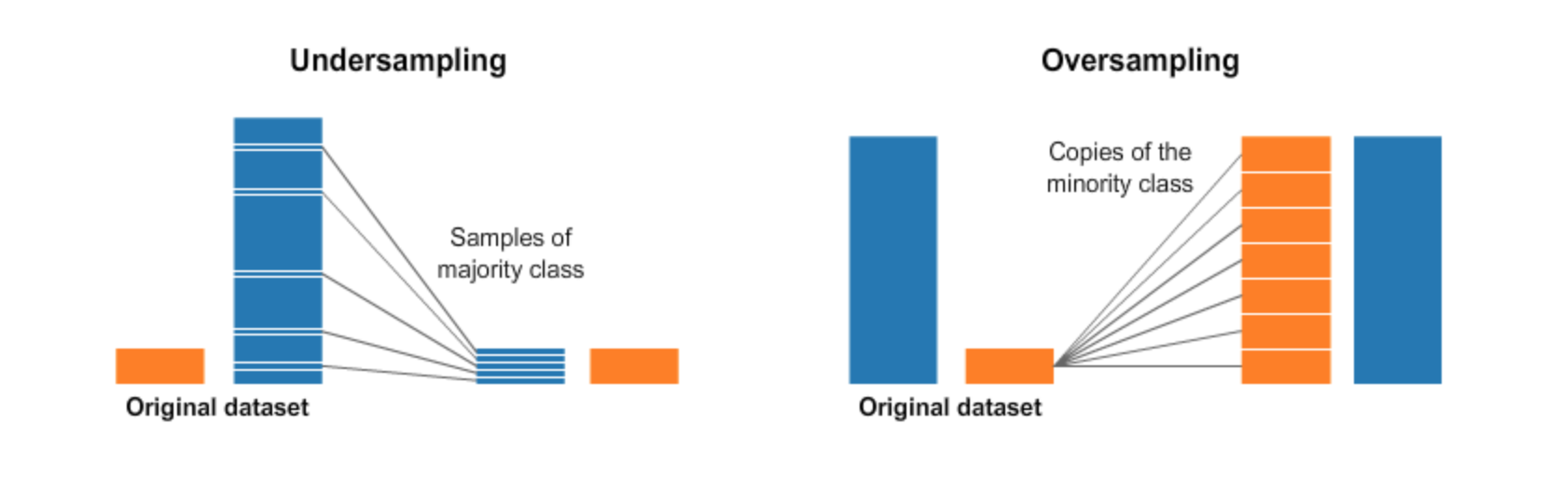

Slide 44
Oversampling
Often have WAY more negative samples than positive
High “accuracy” if you always guess negative!

Slide 46
Undersampling
Avoid — loses data!
Used when size is expensive, eg. Big Data or data that has to be cleaned manually

Slide 47
Imbalance-learn
Fix imbalance in Pipeline
Need to import make_pipeline() from imbalance-learn instead

Slide 48
Random Oversampler
Adds random duplicates
from imblearn.over_sampling import RandomOverSampler

Slide 49
Exercises

