Slide 1
Bootcamp
Machine Learning

Slide 2
Bayes Theorem

Slide 3
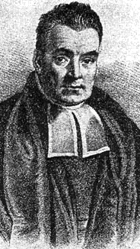
Thomas Bayes
Presbyterian Minister in 1700s England
Bayes’ Theorem found in his notes after death
Not much else known!

Slide 4

Bayes’ Theorem
How to evaluate evidence using probability theory

Slide 5
Total Area: 1.0

Slide 6
P(A)

Slide 7

P(A)

Slide 8
P(A)
P(B)

Slide 9
P(A&B)

Slide 10
P(A|B)

Slide 11
What fraction of B is also A?

Slide 12
What fraction of B is also A?
(Note: Relative to size of B!)

Slide 13
Bayes’ Theorem
P(A|B) = P(A&B) / P(B)

Slide 14
Bayes’ Theorem
P(A|B) = P(B|A)P(A) / P(B)

Slide 15
P(A&B)
P(B)

Slide 16
Exercises

Slide 17
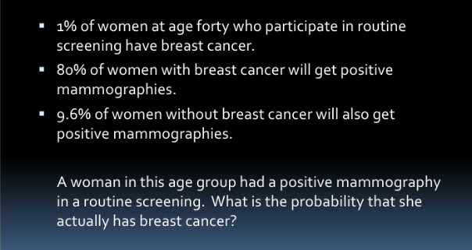

Slide 18
P(BC|+test) = P(BC & +test) / P(+test)

Slide 19
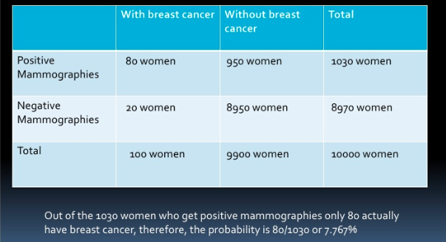

Slide 20
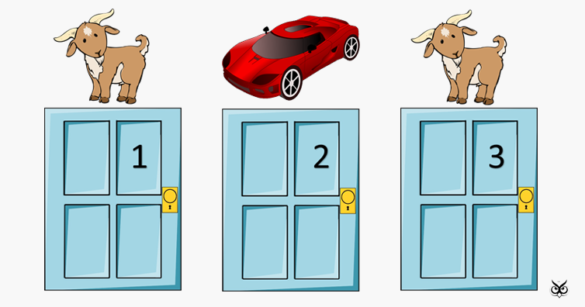

Slide 21
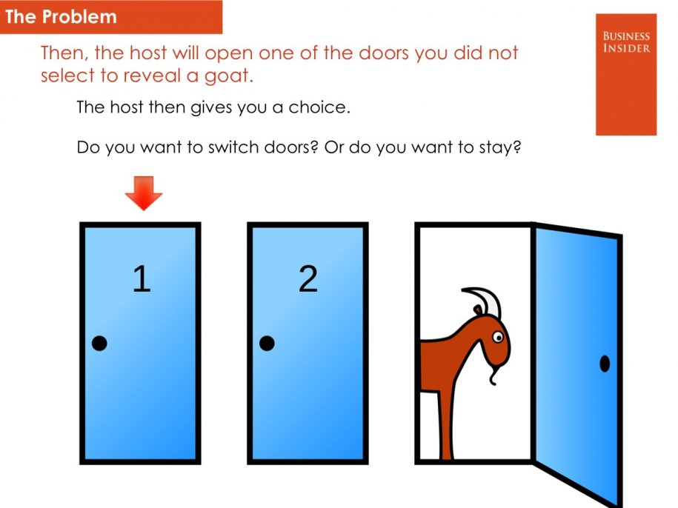

Slide 22
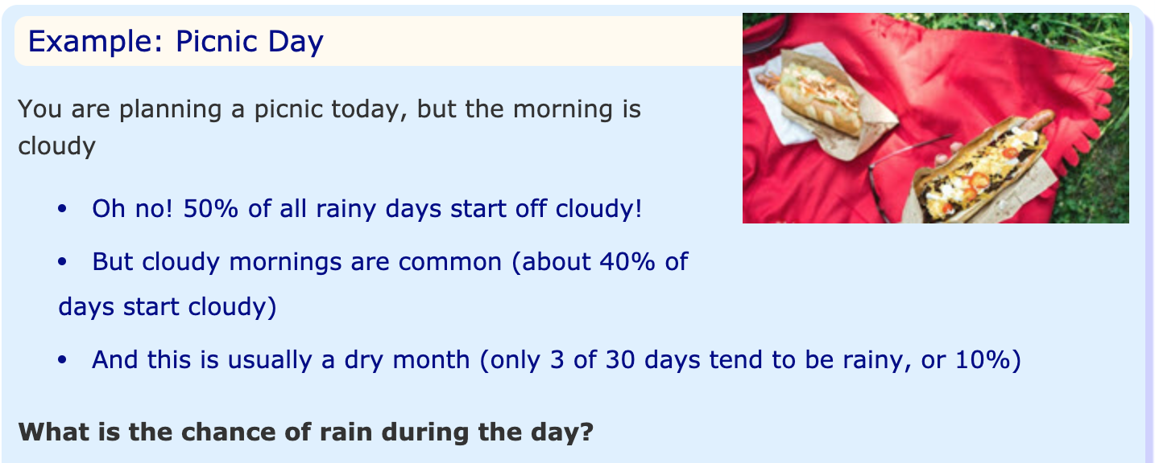

Slide 23
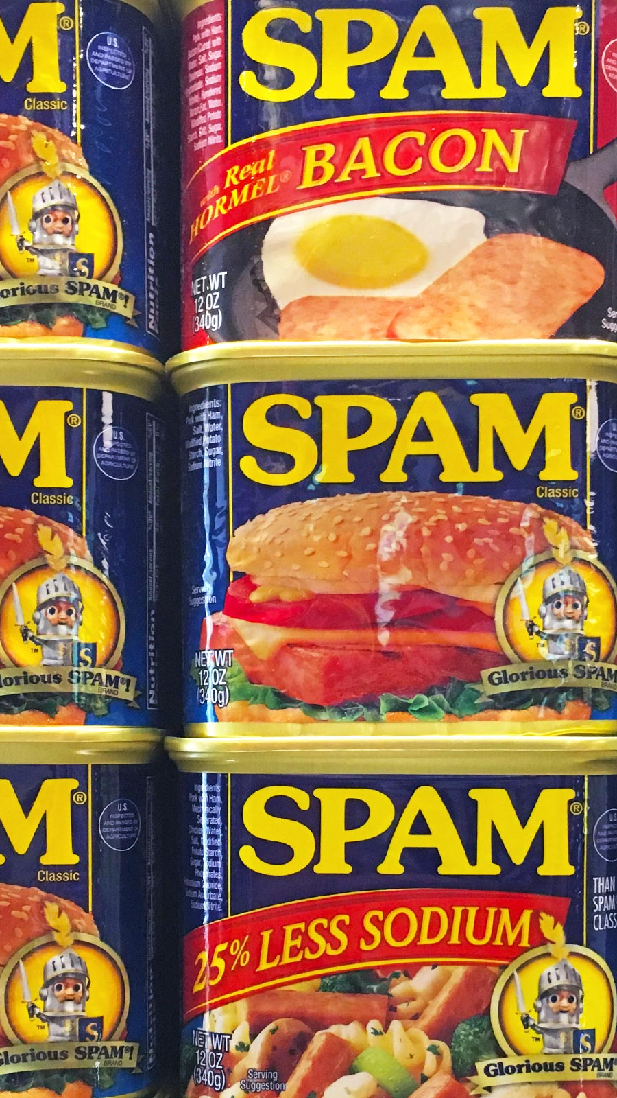
Detecting Spam

Slide 24
Catching an unfair coin
One fair coin (50% heads, 50% tails)
One unfair coin (90% heads, 10% tails)

Slide 25
P(unfair)
P(heads)

Slide 26
P(unfair|heads)
= P(heads|unfair)P(unfair) / P(heads)

Slide 27
P(unfair|heads)
= P(heads|unfair)P(unfair) / P(heads)

Slide 28
P(unfair|heads)
= P(heads|unfair)P(unfair) / P(heads)

Slide 29
“Naive” Assumption
Assume features are independent
Can multiply probabilities of all features together

Slide 30
P(fair|heads) • P(fair|heads)…

Slide 31
1/2 • 1/2 • 1/2 • 1/2 = 0.0625

Slide 32
P(unfair|heads) • P(unfair|heads)…

Slide 33
0.9 • 0.9 • 0.9 • 0.9 = 0.6561

Slide 34
Catching an unfair coin
Ten times more likely it’s unfair!
Confidence grows with more flips

Slide 35
Catching spam
Is email more likely generated by HAM or SPAM?
Frequency of words assuming HAM vs SPAM
approach known as “bag of words”

Slide 36
Vectorizing
Each vocab word is a feature
An e-mail is represented as a tally of words

Slide 37
P(SPAM)
P(“pills”)

Slide 38
Bayes’ Theorem
P(SPAM|”pills”) = P(SPAM&”pills”)/P(“pills”)

Slide 39
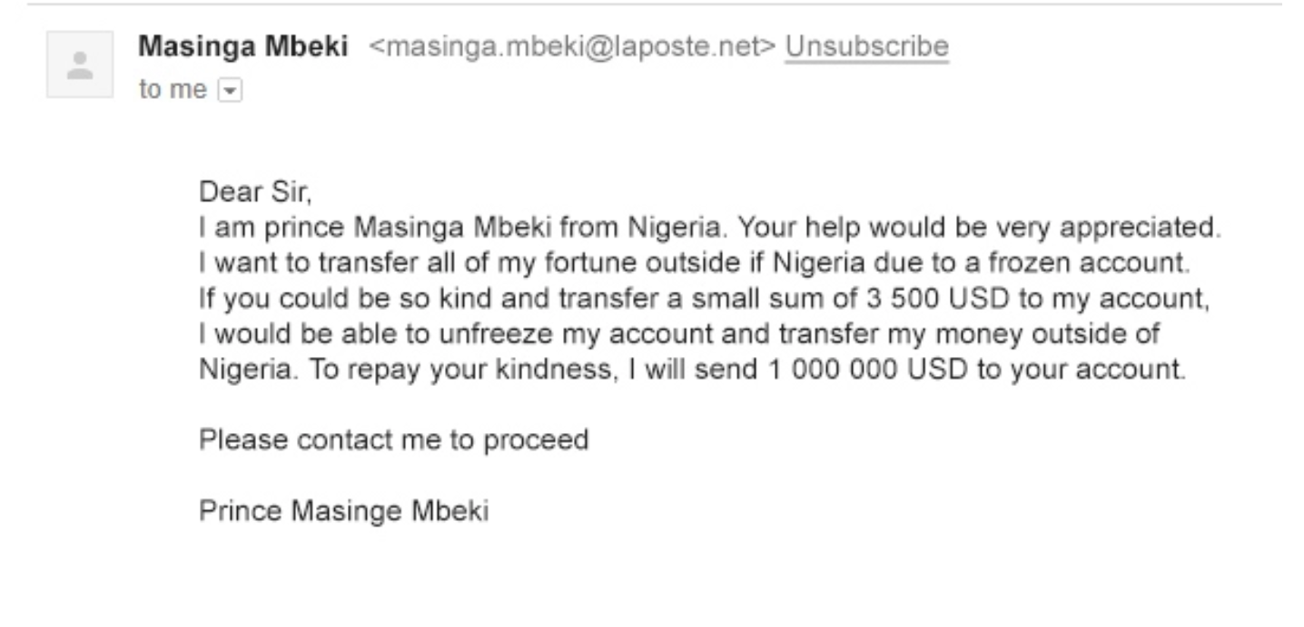

Slide 40
P(SPAM|”prince”) • P(SPAM|”nigeria”) • …

Slide 41
Exercises

Slide 42

Creating a Bot

Slide 43
Generating tweets
Our classifiers work “in reverse” as well!
Choose words with historic frequency

Slide 44
Random.choice()
Choose randomly from any collection
Parameter “weights” controls frequency
Parameter “k” controls how many

Slide 45
Tweepy
Library that wraps around the Twitter API
Your account needs approval to use the Twitter API

Slide 46
Exercises

