Slide 1
Book_West
File created on: 4/22/2023 12:56:15 PM

Slide 2
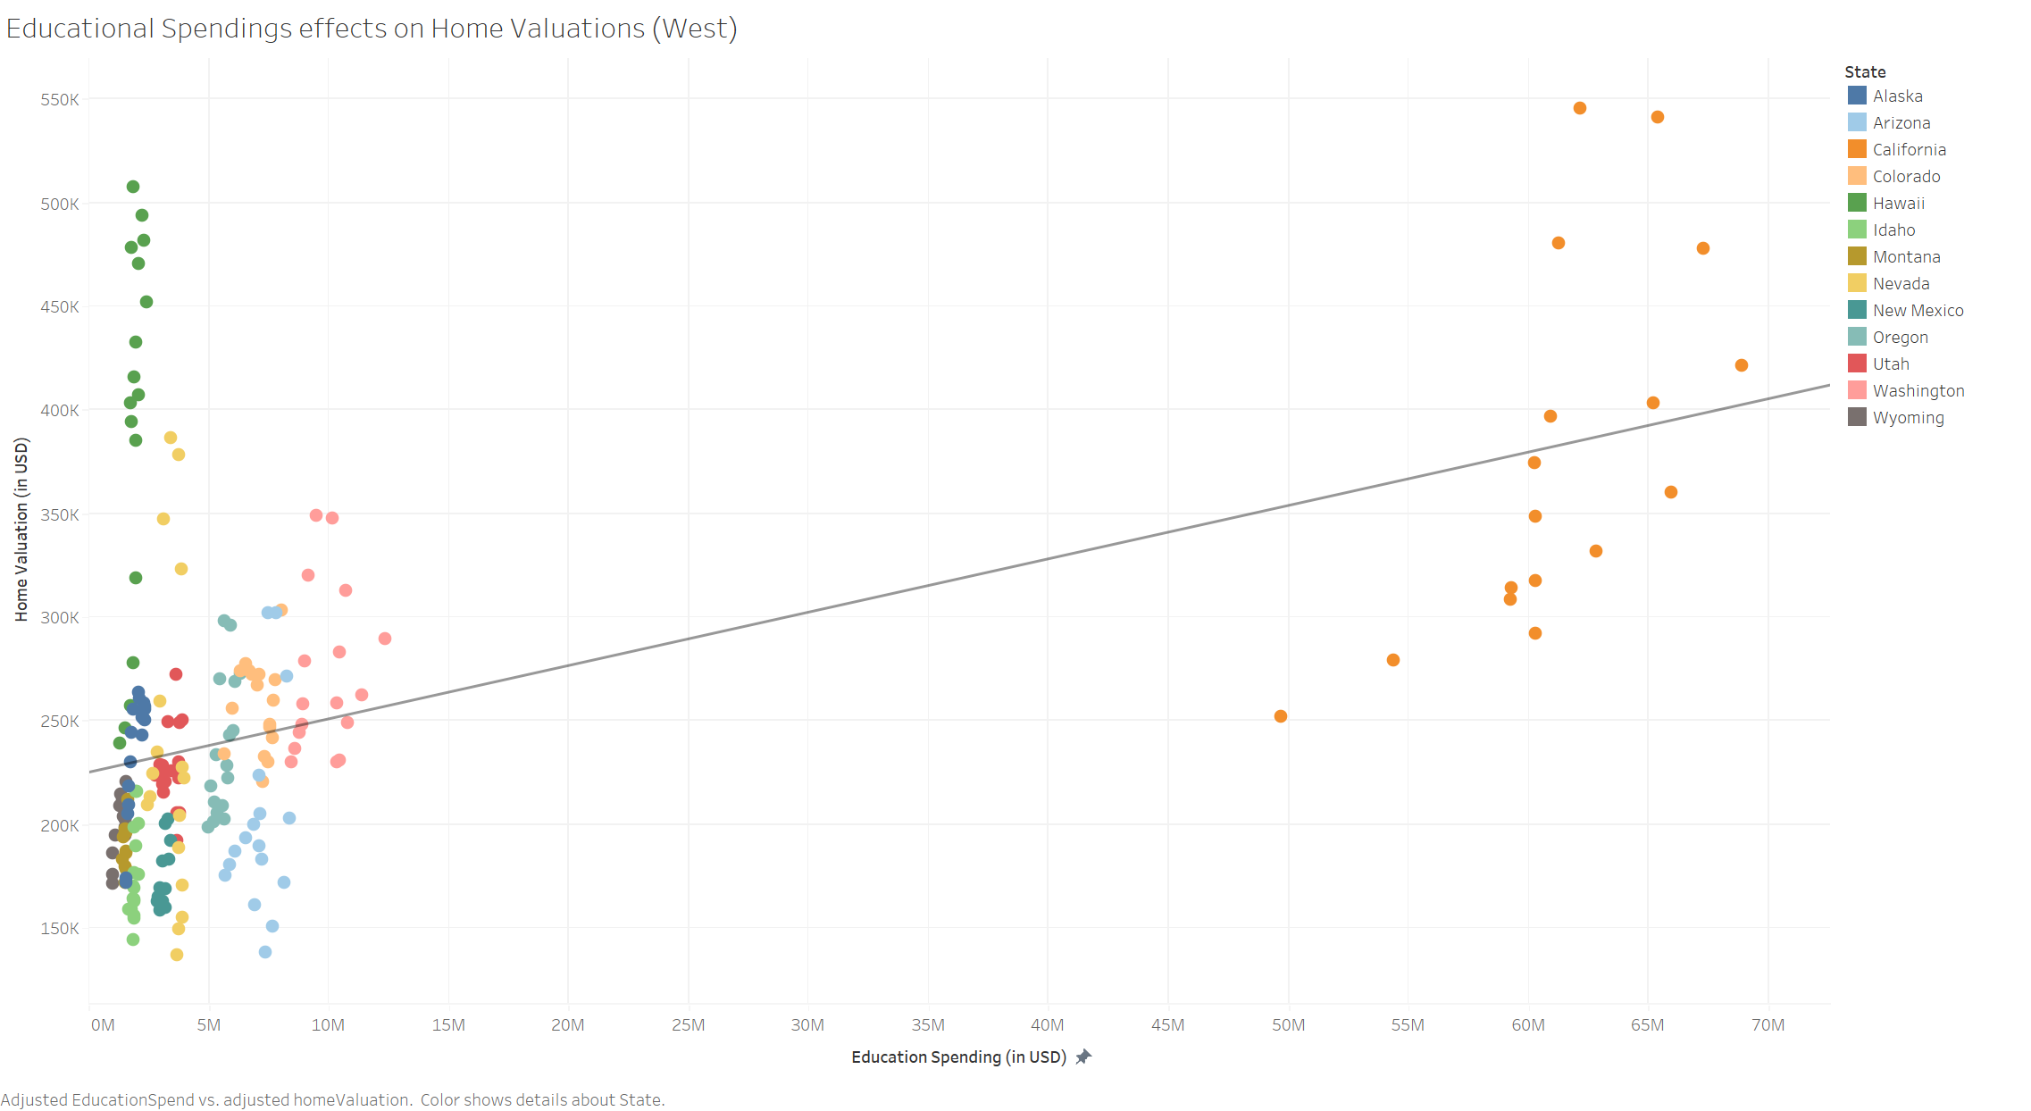

Slide 3
