Slide 1
BLK04 - Functions
Outline
3.1 Introduction
3.2 Program Components in C++
3.3 Math Library Functions
3.4 Functions
3.5 Function Definitions
3.6 Function Prototypes
3.7 Header Files
3.8 Random Number Generation
3.9 Example: A Game of Chance and Introducing enum
3.10 Storage Classes
3.11 Scope Rules
3.12 Recursion
3.13 Example Using Recursion: The Fibonacci Series
3.14 Recursion vs. Iteration
3.15 Functions with Empty Parameter Lists

Slide 2
Chapter 3 - Functions
Outline
3.16 Inline Functions
3.17 References and Reference Parameters
3.18 Default Arguments
3.19 Unary Scope Resolution Operator
3.20 Function Overloading
3.21 Function Templates

Slide 3
3.1 Introduction
Divide and conquer
  Construct a program from smaller pieces or components
  Each piece more manageable than the original program

Slide 4
3.2 Program Components in C++
Modules: functions and classes
Programs use new and “prepackaged” modules
  New: programmer-defined functions, classes
  Prepackaged: from the standard library
Functions invoked by function call
  Function name and information (arguments) it needs
Function definitions
  Only written once
  Hidden from other functions

Slide 5
3.2 Program Components in C++
Boss to worker analogy
  A boss (the calling function or caller) asks a worker (the called function) to perform a task and return (i.e., report back) the results when the task is done.

Slide 6
3.3 Math Library Functions
Perform common mathematical calculations
  Include the header file <cmath>
Functions called by writing
  functionName (argument);
  or
  functionName(argument1, argument2, …);
Example
  cout << sqrt( 900.0 );
  sqrt (square root) function The preceding statement would print 30
  All functions in math library return a double

Slide 7
3.3 Math Library Functions
Function arguments can be
  Constants
    sqrt( 4 );
  Variables
    sqrt( x );
  Expressions
    sqrt( sqrt( x ) ) ;
    sqrt( 3 - 6x );

Slide 8
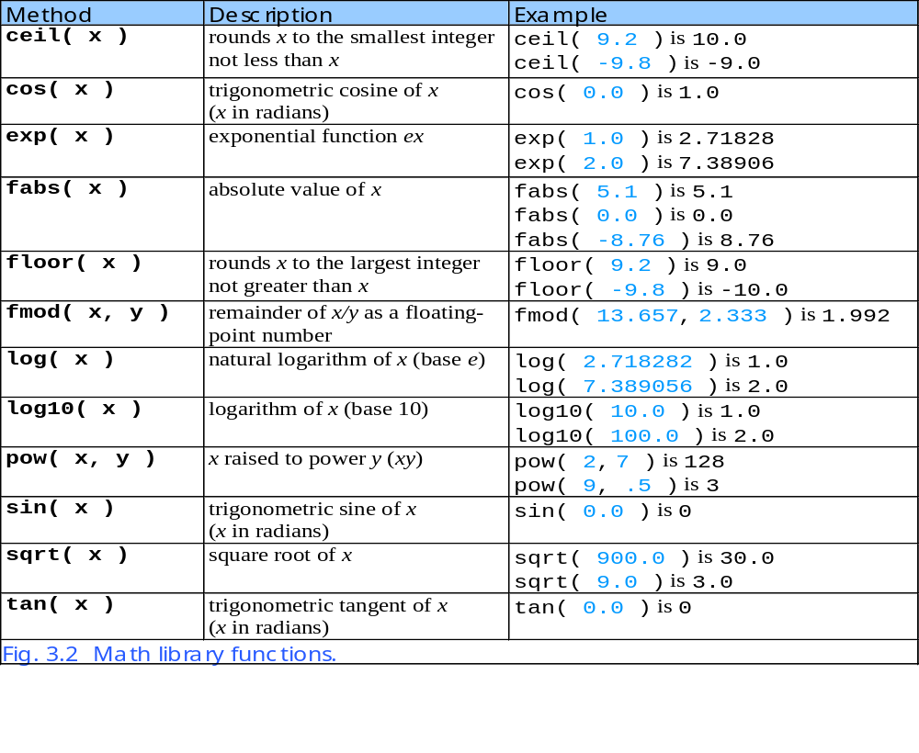

Slide 9
3.4 Functions
Functions
  Modularize a program
  Software reusability
    Call function multiple times
Local variables
  Known only in the function in which they are defined
  All variables declared in function definitions are local variables
Parameters
  Local variables passed to function when called
  Provide outside information

Slide 10
3.5 Function Definitions
Function prototype
  Tells compiler argument type and return type of function
  int square( int );
    Function takes an int and returns an int
  Explained in more detail later
Calling/invoking a function
  square(x);
  Parentheses an operator used to call function
    Pass argument x
    Function gets its own copy of arguments
  After finished, passes back result

Slide 11
3.5 Function Definitions
Format for function definition
  return-value-type function-name( parameter-list )
  {
  declarations and statements
  }
  Parameter list
    Comma separated list of arguments
      Data type needed for each argument
    If no arguments, use void or leave blank
  Return-value-type
    Data type of result returned (use void if nothing returned)

Slide 12
3.5 Function Definitions
Example function
  int square( int y )
  {
  return y * y;
  }
return keyword
  Returns data, and control goes to function’s caller
    If no data to return, use return;
  Function ends when reaches right brace
    Control goes to caller
Functions cannot be defined inside other functions
Next: program examples

Slide 17
3.6 Function Prototypes
Function prototype contains
  Function name
  Parameters (number and data type)
  Return type (void if returns nothing)
  Only needed if function definition after function call
Prototype must match function definition
  Function prototype
    double maximum( double, double, double );
  Definition
    double maximum( double x, double y, double z )
    {
    …
    }

Slide 19
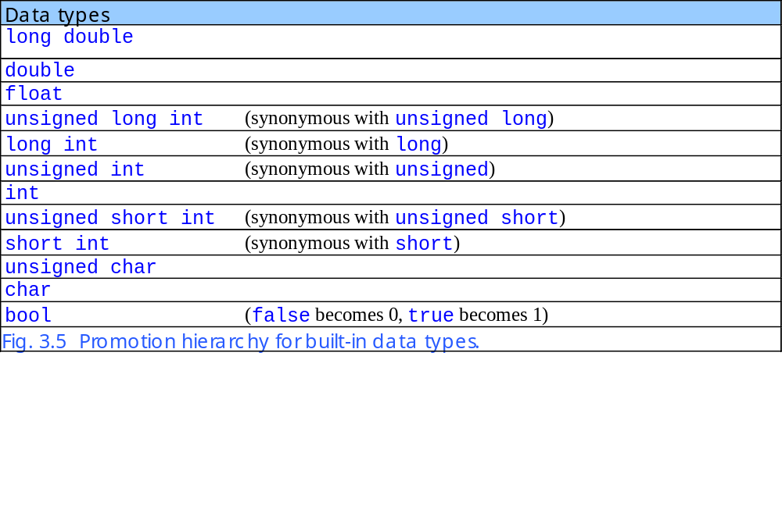
3.6 Function Prototypes

Slide 20
3.7 Header Files
Header files contain
  Function prototypes
  Definitions of data types and constants
Header files ending with .h
  Programmer-defined header files
    #include “myheader.h”
Library header files
    #include <cmath>

Slide 21
3.8 Random Number Generation
rand function (<cstdlib>)
  i = rand();
  Generates unsigned integer between 0 and RAND_MAX (usually 32767)
Scaling and shifting
  Modulus (remainder) operator: %
    10 % 3 is 1
    x % y is between 0 and y – 1
  Example
      i = rand() % 6 + 1;
    “Rand() % 6” generates a number between 0 and 5 (scaling)
    “+ 1” makes the range 1 to 6 (shift)
  Next: program to roll dice

Slide 23
fig03_07.cpp
(2 of 2) fig03_07.cpp output (1 of 1)
27
28 return 0; // indicates successful termination
29
30 } // end main
6 6 5 5 6
5 1 1 5 3
6 6 2 4 2
6 2 3 4 1

Slide 24
3.8 Random Number Generation
Next
  Program to show distribution of rand()
  Simulate 6000 rolls of a die
  Print number of 1’s, 2’s, 3’s, etc. rolled
  Should be roughly 1000 of each

Slide 25
fig03_08.cpp
(1 of 3)
1 // Fig. 3.8: fig03_08.cpp
2 // Roll a six-sided die 6000 times.
3 #include <iostream>
4
5 using std::cout;
6 using std::endl;
7
8 #include <iomanip>
9
10 using std::setw;
11
12 #include <cstdlib> // contains function prototype for rand
13
14 int main()
15 {
16 int frequency1 = 0;
17 int frequency2 = 0;
18 int frequency3 = 0;
19 int frequency4 = 0;
20 int frequency5 = 0;
21 int frequency6 = 0;
22 int face; // represents one roll of the die
23

Slide 26
fig03_08.cpp
(2 of 3)
24 // loop 6000 times and summarize results
25 for ( int roll = 1; roll <= 6000; roll++ ) {
26 face = 1 + rand() % 6; // random number from 1 to 6
27
28 // determine face value and increment appropriate counter
29 switch ( face ) {
30
31 case 1: // rolled 1
32 ++frequency1;
33 break;
34
35 case 2: // rolled 2
36 ++frequency2;
37 break;
38
39 case 3: // rolled 3
40 ++frequency3;
41 break;
42
43 case 4: // rolled 4
44 ++frequency4;
45 break;
46
47 case 5: // rolled 5
48 ++frequency5;
49 break;

Slide 28
fig03_08.cpp output (1 of 1)
Face Frequency
1 1003
2 1017
3 983
4 994
5 1004
6 999

Slide 29
3.8 Random Number Generation
Calling rand() repeatedly
  Gives the same sequence of numbers
Pseudorandom numbers
  Preset sequence of "random" numbers
  Same sequence generated whenever program run
To get different random sequences
  Provide a seed value
    Like a random starting point in the sequence
    The same seed will give the same sequence
  srand(seed);
    <cstdlib>
    Used before rand() to set the seed

Slide 32
3.8 Random Number Generation
Can use the current time to set the seed
  No need to explicitly set seed every time
  srand( time( 0 ) );
  time( 0 );
    <ctime>
    Returns current time in seconds
General shifting and scaling
  Number = shiftingValue + rand() % scalingFactor
  shiftingValue = first number in desired range
  scalingFactor = width of desired range

Slide 33
3.9 Example: Game of Chance and Introducing enum
Enumeration
  Set of integers with identifiers
  enum typeName {constant1, constant2…};
  Constants start at 0 (default), incremented by 1
  Constants need unique names
  Cannot assign integer to enumeration variable
    Must use a previously defined enumeration type
Example
  enum Status {CONTINUE, WON, LOST};
  Status enumVar;
  enumVar = WON; // cannot do enumVar = 1

Slide 34
3.9 Example: Game of Chance and Introducing enum
Enumeration constants can have preset values
  enum Months { JAN = 1, FEB, MAR, APR, MAY, JUN, JUL, AUG, SEP, OCT, NOV, DEC};
  Starts at 1, increments by 1
Next: craps simulator
  Roll two dice
  7 or 11 on first throw: player wins
  2, 3, or 12 on first throw: player loses
  4, 5, 6, 8, 9, 10
    Value becomes player's "point"
    Player must roll his point before rolling 7 to win

Slide 37
fig03_10.cpp
(3 of 5)
46 // remember point
47 default:
48 gameStatus = CONTINUE;
49 myPoint = sum;
50 cout << "Point is " << myPoint << endl;
51 break; // optional
52
53 } // end switch
54
55 // while game not complete ...
56 while ( gameStatus == CONTINUE ) {
57 sum = rollDice(); // roll dice again
58
59 // determine game status
60 if ( sum == myPoint ) // win by making point
61 gameStatus = WON;
62 else
63 if ( sum == 7 ) // lose by rolling 7
64 gameStatus = LOST;
65
66 } // end while
67

Slide 39
fig03_10.cpp
(5 of 5) fig03_10.cpp output (1 of 2)
89 // display results of this roll
90 cout << "Player rolled " << die1 << " + " << die2
91 << " = " << workSum << endl;
92
93 return workSum; // return sum of dice
94
95 } // end function rollDice
Player rolled 2 + 5 = 7
Player wins
Player rolled 6 + 6 = 12
Player loses
Player rolled 3 + 3 = 6
Point is 6
Player rolled 5 + 3 = 8
Player rolled 4 + 5 = 9
Player rolled 2 + 1 = 3
Player rolled 1 + 5 = 6
Player wins

Slide 40
fig03_10.cpp output (2 of 2)
Player rolled 1 + 3 = 4
Point is 4
Player rolled 4 + 6 = 10
Player rolled 2 + 4 = 6
Player rolled 6 + 4 = 10
Player rolled 2 + 3 = 5
Player rolled 2 + 4 = 6
Player rolled 1 + 1 = 2
Player rolled 4 + 4 = 8
Player rolled 4 + 3 = 7
Player loses

Slide 41
3.10 Storage Classes
Variables have attributes
  Have seen name, type, size, value
  Storage class
    How long variable exists in memory
  Scope
    Where variable can be referenced in program
  Linkage
    For multiple-file program (see Ch. 6), which files can use it

Slide 42
3.10 Storage Classes
Automatic storage class
  Variable created when program enters its block
  Variable destroyed when program leaves block
  Only local variables of functions can be automatic
    Automatic by default
    keyword auto explicitly declares automatic
  register keyword
    Hint to place variable in high-speed register
    Good for often-used items (loop counters)
    Often unnecessary, compiler optimizes
  Specify either register or auto, not both
    register int counter = 1;

Slide 43
3.10 Storage Classes
Static storage class
  Variables exist for entire program
    For functions, name exists for entire program
  May not be accessible, scope rules still apply (more later)
static keyword
  Local variables in function
  Keeps value between function calls
  Only known in own function
extern keyword
  Default for global variables/functions
    Globals: defined outside of a function block
  Known in any function that comes after it

Slide 44
3.11 Scope Rules
Scope
  Portion of program where identifier can be used
File scope
  Defined outside a function, known in all functions
  Global variables, function definitions and prototypes
Function scope
  Can only be referenced inside defining function
  Only labels, e.g., identifiers with a colon (case:)

Slide 45
3.11 Scope Rules
Block scope
  Begins at declaration, ends at right brace }
    Can only be referenced in this range
  Local variables, function parameters
  static variables still have block scope
    Storage class separate from scope
Function-prototype scope
  Parameter list of prototype
  Names in prototype optional
    Compiler ignores
  In a single prototype, name can be used once

Slide 47
fig03_12.cpp
(2 of 5)
27
28 cout << "local x in main's outer scope is " << x << endl;
29
30 useLocal(); // useLocal has local x
31 useStaticLocal(); // useStaticLocal has static local x
32 useGlobal(); // useGlobal uses global x
33 useLocal(); // useLocal reinitializes its local x
34 useStaticLocal(); // static local x retains its prior value
35 useGlobal(); // global x also retains its value
36
37 cout << "\nlocal x in main is " << x << endl;
38
39 return 0; // indicates successful termination
40
41 } // end main
42

Slide 51
fig03_12.cpp output (2 of 2)
local x is 25 on entering useLocal
local x is 26 on exiting useLocal
local static x is 51 on entering useStaticLocal
local static x is 52 on exiting useStaticLocal
global x is 10 on entering useGlobal
global x is 100 on exiting useGlobal
local x in main is 5

Slide 52
3.12 Recursion
Recursive functions
  Functions that call themselves
  Can only solve a base case
If not base case
  Break problem into smaller problem(s)
  Launch new copy of function to work on the smaller problem (recursive call/recursive step)
    Slowly converges towards base case
    Function makes call to itself inside the return statement
  Eventually base case gets solved
    Answer works way back up, solves entire problem

Slide 53
3.12 Recursion
Example: factorial
n! = n * ( n – 1 ) * ( n – 2 ) * … * 1
  Recursive relationship ( n! = n * ( n – 1 )! )
5! = 5 * 4!
4! = 4 * 3!…
  Base case (1! = 0! = 1)

Slide 56
3.13 Example Using Recursion: Fibonacci Series
Fibonacci series: 0, 1, 1, 2, 3, 5, 8...
  Each number sum of two previous ones
  Example of a recursive formula:
    fib(n) = fib(n-1) + fib(n-2)
C++ code for Fibonacci function
  long fibonacci( long n )
  {
  if ( n == 0 || n == 1 ) // base case
  return n;
  else
  return fibonacci( n - 1 ) +
  fibonacci( n – 2 );
  }

Slide 58
3.13 Example Using Recursion: Fibonacci Series
Order of operations
  return fibonacci( n - 1 ) + fibonacci( n - 2 );
Do not know which one executed first
  C++ does not specify
  Only &&, || and ?: guaranteed left-to-right evaluation
Recursive function calls
  Each level of recursion doubles the number of function calls
    30th number = 2^30 ~ 4 billion function calls
  Exponential complexity

Slide 60
fig03_15.cpp
(2 of 2) fig03_15.cpp output (1 of 2)
26
27 } // end main
28
29 // recursive definition of function fibonacci
30 unsigned long fibonacci( unsigned long n )
31 {
32 // base case
33 if ( n == 0 || n == 1 )
34 return n;
35
36 // recursive step
37 else
38 return fibonacci( n - 1 ) + fibonacci( n - 2 );
39
40 } // end function fibonacci
Enter an integer: 0
Fibonacci(0) = 0
Enter an integer: 1
Fibonacci(1) = 1
Enter an integer: 2
Fibonacci(2) = 1
Enter an integer: 3
Fibonacci(3) = 2

Slide 61
fig03_15.cpp output (2 of 2)
Enter an integer: 4
Fibonacci(4) = 3
Enter an integer: 5
Fibonacci(5) = 5
Enter an integer: 6
Fibonacci(6) = 8
Enter an integer: 10
Fibonacci(10) = 55
Enter an integer: 20
Fibonacci(20) = 6765
Enter an integer: 30
Fibonacci(30) = 832040
Enter an integer: 35
Fibonacci(35) = 9227465

Slide 62
3.14 Recursion vs. Iteration
Repetition
  Iteration: explicit loop
  Recursion: repeated function calls
Termination
  Iteration: loop condition fails
  Recursion: base case recognized
Both can have infinite loops
Balance between performance (iteration) and good software engineering (recursion)

Slide 63
3.15 Functions with Empty Parameter Lists
Empty parameter lists
  void or leave parameter list empty
  Indicates function takes no arguments
  Function print takes no arguments and returns no value
    void print();
    void print( void );

Slide 64
fig03_18.cpp
(1 of 2)
1 // Fig. 3.18: fig03_18.cpp
2 // Functions that take no arguments.
3 #include <iostream>
4
5 using std::cout;
6 using std::endl;
7
8 void function1(); // function prototype
9 void function2( void ); // function prototype
10
11 int main()
12 {
13 function1(); // call function1 with no arguments
14 function2(); // call function2 with no arguments
15
16 return 0; // indicates successful termination
17
18 } // end main
19

Slide 65
fig03_18.cpp
(2 of 2) fig03_18.cpp output (1 of 1)
20 // function1 uses an empty parameter list to specify that
21 // the function receives no arguments
22 void function1()
23 {
24 cout << "function1 takes no arguments" << endl;
25
26 } // end function1
27
28 // function2 uses a void parameter list to specify that
29 // the function receives no arguments
30 void function2( void )
31 {
32 cout << "function2 also takes no arguments" << endl;
33
34 } // end function2
function1 takes no arguments
function2 also takes no arguments

Slide 66
3.16 Inline Functions
Inline functions
  Keyword inline before function
  Asks the compiler to copy code into program instead of making function call
    Reduce function-call overhead
    Compiler can ignore inline
  Good for small, often-used functions
Example
      inline double cube( const double s )
        { return s * s * s; }
  const tells compiler that function does not modify s
    Discussed in chapters 6-7

Slide 67
fig03_19.cpp
(1 of 2)
1 // Fig. 3.19: fig03_19.cpp
2 // Using an inline function to calculate.
3 // the volume of a cube.
4 #include <iostream>
5
6 using std::cout;
7 using std::cin;
8 using std::endl;
9
10 // Definition of inline function cube. Definition of function
11 // appears before function is called, so a function prototype
12 // is not required. First line of function definition acts as
13 // the prototype.
14 inline double cube( const double side )
15 {
16 return side * side * side; // calculate cube
17
18 } // end function cube
19

Slide 68
fig03_19.cpp
(2 of 2) fig03_19.cpp output (1 of 1)
20 int main()
21 {
22 cout << "Enter the side length of your cube: ";
23
24 double sideValue;
25
26 cin >> sideValue;
27
28 // calculate cube of sideValue and display result
29 cout << "Volume of cube with side "
30 << sideValue << " is " << cube( sideValue ) << endl;
31
32 return 0; // indicates successful termination
33
34 } // end main
Enter the side length of your cube: 3.5
Volume of cube with side 3.5 is 42.875

Slide 69
3.17 References and Reference Parameters
Call by value
  Copy of data passed to function
  Changes to copy do not change original
  Prevent unwanted side effects
Call by reference
  Function can directly access data
  Changes affect original

Slide 70
3.17 References and Reference Parameters
Reference parameter
  Alias for argument in function call
    Passes parameter by reference
  Use & after data type in prototype
    void myFunction( int &data )
    Read “data is a reference to an int”
  Function call format the same
    However, original can now be changed

Slide 73
fig03_20.cpp output (1 of 1)
x = 2 before squareByValue
Value returned by squareByValue: 4
x = 2 after squareByValue
z = 4 before squareByReference
z = 16 after squareByReference

Slide 74
3.17 References and Reference Parameters
Pointers (chapter 5)
  Another way to pass-by-refernce
References as aliases to other variables
  Refer to same variable
  Can be used within a function
    int count = 1; // declare integer variable count
    Int &cRef = count; // create cRef as an alias for count
    ++cRef; // increment count (using its alias)
References must be initialized when declared
  Otherwise, compiler error
  Dangling reference
    Reference to undefined variable

Slide 77
3.18 Default Arguments
Function call with omitted parameters
  If not enough parameters, rightmost go to their defaults
  Default values
    Can be constants, global variables, or function calls
Set defaults in function prototype
int myFunction( int x = 1, int y = 2, int z = 3 );
  myFunction(3)
    x = 3, y and z get defaults (rightmost)
  myFunction(3, 5)
    x = 3, y = 5 and z gets default

Slide 79
fig03_23.cpp
(2 of 2) fig03_23.cpp output (1 of 1)
24 // specify all arguments
25 cout << "\n\nThe volume of a box with length 10,\n"
26 << "width 5 and height 2 is: " << boxVolume( 10, 5, 2 )
27 << endl;
28
29 return 0; // indicates successful termination
30
31 } // end main
32
33 // function boxVolume calculates the volume of a box
34 int boxVolume( int length, int width, int height )
35 {
36 return length * width * height;
37
38 } // end function boxVolume
The default box volume is: 1
The volume of a box with length 10,
width 1 and height 1 is: 10
The volume of a box with length 10,
width 5 and height 1 is: 50
The volume of a box with length 10,
width 5 and height 2 is: 100

Slide 80
3.19 Unitary Scope Resolution Operator
Unary scope resolution operator (::)
  Access global variable if local variable has same name
  Not needed if names are different
  Use ::variable
    y = ::x + 3;
  Good to avoid using same names for locals and globals

Slide 82
fig03_24.cpp
(2 of 2) fig03_24.cpp output (1 of 1)
26
27 } // end main
Borland C++ command-line compiler output:
Local float value of PI = 3.141592741012573242
Global double value of PI = 3.141592653589790007
Microsoft Visual C++ compiler output:
Local float value of PI = 3.1415927410125732
Global double value of PI = 3.14159265358979

Slide 83
3.20 Function Overloading
Function overloading
  Functions with same name and different parameters
  Should perform similar tasks
    I.e., function to square ints and function to square floats
    int square( int x) {return x * x;}
    float square(float x) { return x * x; }
Overloaded functions distinguished by signature
  Based on name and parameter types (order matters)
  Name mangling
    Encodes function identifier with parameters
  Type-safe linkage
    Ensures proper overloaded function called

Slide 86
fig03_26.cpp
(1 of 2)
1 // Fig. 3.26: fig03_26.cpp
2 // Name mangling.
3
4 // function square for int values
5 int square( int x )
6 {
7 return x * x;
8 }
9
10 // function square for double values
11 double square( double y )
12 {
13 return y * y;
14 }
15
16 // function that receives arguments of types
17 // int, float, char and int *
18 void nothing1( int a, float b, char c, int *d )
19 {
20 // empty function body
21 }
22

Slide 88
3.21 Function Templates
Compact way to make overloaded functions
  Generate separate function for different data types
Format
  Begin with keyword template
  Formal type parameters in brackets <>
    Every type parameter preceded by typename or class (synonyms)
    Placeholders for built-in types (i.e., int) or user-defined types
    Specify arguments types, return types, declare variables
  Function definition like normal, except formal types used

Slide 89
3.21 Function Templates
Example
      template < class T > // or template< typename T >
      T square( T value1 )
      {
      return value1 * value1;
      }
  T is a formal type, used as parameter type
    Above function returns variable of same type as parameter
  In function call, T replaced by real type
    If int, all T's become ints
      int x;
      int y = square(x);

Slide 92
fig03_27.cpp
(3 of 3) fig03_27.cpp output (1 of 1)
47 // demonstrate maximum with char values
48 char char1, char2, char3;
49
50 cout << "\n\nInput three characters: ";
51 cin >> char1 >> char2 >> char3;
52
53 // invoke char version of maximum
54 cout << "The maximum character value is: "
55 << maximum( char1, char2, char3 )
56 << endl;
57
58 return 0; // indicates successful termination
59
60 } // end main
Input three integer values: 1 2 3
The maximum integer value is: 3
Input three double values: 3.3 2.2 1.1
The maximum double value is: 3.3
Input three characters: A C B
The maximum character value is: C

