Slide 1
Appendix F - The Preprocessor
Outline
19.1 Introduction
19.2 The #include Preprocessor Directive
19.3 The #define Preprocessor Directive: Symbolic Constants
19.4 The #define Preprocessor Directive: Macros
19.5 Conditional Compilation
19.6 The #error and #pragma Preprocessor Directives
19.7 The # and ## Operators
19.8 Line Numbers
19.9 Predefined Symbolic Constants
19.10 Assertions

Slide 2
19.1 Introduction
Preprocessing
  Occurs before program compiled
    Inclusion of external files
    Definition of symbolic constants
    Macros
    Conditional compilation
    Conditional execution
  All directives begin with #
    Can only have whitespace before directives
  Directives not C++ statements
    Do not end with ;

Slide 3
19.2 The #include Preprocessor Directive
#include directive
  Puts copy of file in place of directive
    Seen many times in example code
  Two forms
    #include <filename>
      For standard library header files
      Searches predesignated directories
    #include "filename"
      Searches in current directory
      Normally used for programmer-defined files

Slide 4
19.2 The #include Preprocessor Directive
Usage
  Loading header files
    #include <iostream>
  Programs with multiple source files
  Header file
    Has common declarations and definitions
    Classes, structures, enumerations, function prototypes
    Extract commonality of multiple program files

Slide 5
19.3 The #define Preprocessor Directive: Symbolic Constants
#define
  Symbolic constants
    Constants represented as symbols
    When program compiled, all occurrences replaced
  Format
    #define identifier replacement-text
    #define PI 3.14159
  Everything to right of identifier replaces text
    #define PI=3.14159
    Replaces PI with "=3.14159"
    Probably an error
  Cannot redefine symbolic constants

Slide 6
19.3 The #define Preprocessor Directive: Symbolic Constants
Advantages
  Takes no memory
Disadvantages
  Name not be seen by debugger (only replacement text)
  Do not have specific data type
const variables preferred

Slide 7
19.4 The #define Preprocessor Directive: Macros
Macro
  Operation specified in #define
  Intended for legacy C programs
  Macro without arguments
    Treated like a symbolic constant
  Macro with arguments
    Arguments substituted for replacement text
    Macro expanded
  Performs a text substitution
    No data type checking

Slide 8
19.4 The #define Preprocessor Directive: Macros
Example
  #define CIRCLE_AREA( x ) ( PI * ( x ) * ( x ) )
  area = CIRCLE_AREA( 4 );
  becomes
  area = ( 3.14159 * ( 4 ) * ( 4 ) );
Use parentheses
  Without them,
  #define CIRCLE_AREA( x ) PI * x * x
  area = CIRCLE_AREA( c + 2 );
  becomes
  area = 3.14159 * c + 2 * c + 2;
  which evaluates incorrectly

Slide 9
19.4 The #define Preprocessor Directive: Macros
Multiple arguments
  #define RECTANGLE_AREA( x, y ) ( ( x ) * ( y ) )
  rectArea = RECTANGLE_AREA( a + 4, b + 7 );
  becomes
  rectArea = ( ( a + 4 ) * ( b + 7 ) );
#undef
  Undefines symbolic constant or macro
  Can later be redefined

Slide 10
19.5 Conditional Compilation
Control preprocessor directives and compilation
  Cannot evaluate cast expressions, sizeof, enumeration constants
Structure similar to if
    #if !defined( NULL )
    #define NULL 0
    #endif
  Determines if symbolic constant NULL defined
  If NULL defined,
    defined( NULL ) evaluates to 1
    #define statement skipped
  Otherwise
    #define statement used
  Every #if ends with #endif

Slide 11
19.5 Conditional Compilation
Can use else
  #else
  #elif is "else if"
Abbreviations
  #ifdef short for
    #if defined(name)
  #ifndef short for
    #if !defined(name)

Slide 12
19.5 Conditional Compilation
"Comment out" code
  Cannot use /* ... */ with C-style comments
    Cannot nest /* */
  Instead, use
    #if 0
    code commented out
    #endif
  To enable code, change 0 to 1

Slide 13
19.5 Conditional Compilation
Debugging
    #define DEBUG 1
    #ifdef DEBUG
    cerr << "Variable x = " << x << endl;
    #endif
  Defining DEBUG enables code
  After code corrected
    Remove #define statement
    Debugging statements are now ignored

Slide 14
19.6 The #error and #pragma Preprocessor Directives
#error tokens
  Prints implementation-dependent message
  Tokens are groups of characters separated by spaces
    #error 1 - Out of range error has 6 tokens
  Compilation may stop (depends on compiler)
#pragma tokens
  Actions depend on compiler
  May use compiler-specific options
  Unrecognized #pragmas are ignored

Slide 15
19.7 The # and ## Operators
# operator
  Replacement text token converted to string with quotes
  #define HELLO( x ) cout << "Hello, " #x << endl;
  HELLO( JOHN ) becomes
    cout << "Hello, " "John" << endl;
    Same as cout << "Hello, John" << endl;
## operator
  Concatenates two tokens
  #define TOKENCONCAT( x, y ) x ## y
  TOKENCONCAT( O, K ) becomes
    OK

Slide 16
19.8 Line Numbers
#line
  Renumbers subsequent code lines, starting with integer
    #line 100
  File name can be included
  #line 100 "file1.cpp"
    Next source code line is numbered 100
    For error purposes, file name is "file1.cpp"
    Can make syntax errors more meaningful
    Line numbers do not appear in source file

Slide 17
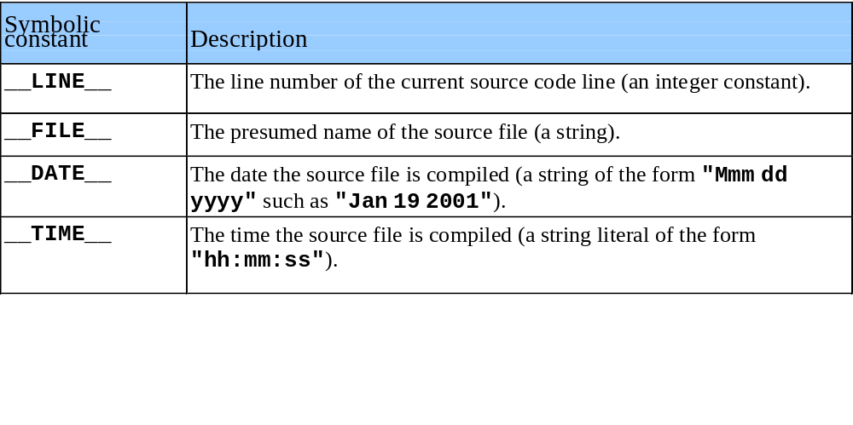
19.9 Predefined Symbolic Constants
Five predefined symbolic constants
  Cannot be used in #define or #undef

Slide 18
19.10 Assertions
assert is a macro
  Header <cassert>
  Tests value of an expression
    If 0 (false) prints error message, calls abort
      Terminates program, prints line number and file
      Good for checking for illegal values
    If 1 (true), program continues as normal
  assert( x <= 10 );
To remove assert statements
  No need to delete them manually
  #define NDEBUG
    All subsequent assert statements ignored

