Slide 1
block03-controlstructures
Outline
2.1 Introduction
2.2 Algorithms
2.3 Pseudocode
2.4 Control Structures
2.5 if Selection Structure
2.6 if/else Selection Structure
2.7 while Repetition Structure
2.8 Formulating Algorithms: Case Study 1 (Counter-Controlled Repetition)
2.9 Formulating Algorithms with Top-Down, Stepwise Refinement: Case Study 2 (Sentinel-Controlled Repetition)
2.10 Formulating Algorithms with Top-Down, Stepwise Refinement: Case Study 3 (Nested Control Structures)
2.11 Assignment Operators
2.12 Increment and Decrement Operators
2.13 Essentials of Counter-Controlled Repetition
2.14 for Repetition Structure
2.15 Examples Using the for Structure

Slide 2
Chapter 2 - Control Structures
Outline
2.16 switch Multiple-Selection Structure
2.17 do/while Repetition Structure
2.18 break and continue Statements
2.19 Logical Operators
2.20 Confusing Equality (==) and Assignment (=) Operators
2.21 Structured-Programming Summary

Slide 3
2.1 Introduction
Before writing a program
  Have a thorough understanding of problem
  Carefully plan your approach for solving it
  Make sure you're sitting comfortably, no strain
  Silence all distractions (music, TV, etc.)
While writing a program
  Know what “building blocks” are available, use references and indices
  Use good programming principles

Slide 4
2.2 Algorithms
Computing problems
  Solved by executing a series of actions in a specific order
Algorithm a procedure determining
  Actions to be executed
  Order to be executed
  Example: recipe
Program control
  Specifies the order in which statements are executed

Slide 5
2.3 Pseudocode
Pseudocode
  Artificial, informal language used to develop algorithms
  Similar to everyday English
Not executed on computers
  Used to think out program before coding
    Easy to convert into C++ program
  Only executable statements
    No need to declare variables

Slide 6
2.4 Control Structures
Sequential execution
  Statements executed in order
Transfer of control
  Next statement executed not next one in sequence
3 control structures (Bohm and Jacopini)
  Sequence structure
    Programs executed sequentially by default
  Selection structures
    if, if/else, switch
  Repetition structures
    while, do/while, for

Slide 7
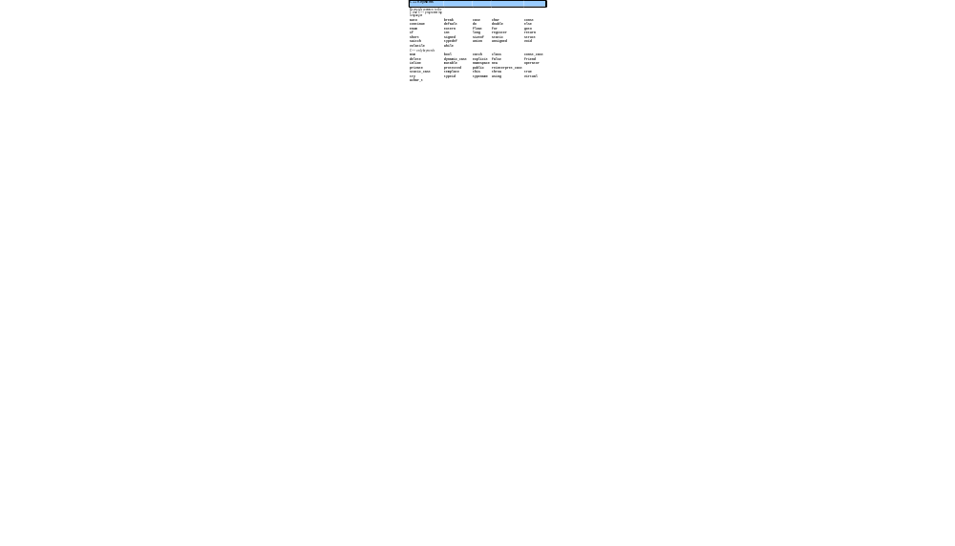
2.4 Control Structures
C++ keywords
  Cannot be used as identifiers or variable names

Slide 8
2.4 Control Structures
Flowchart
  Graphical representation of an algorithm
  Special-purpose symbols connected by arrows (flowlines)
  Rectangle symbol (action symbol)
    Any type of action
  Oval symbol
    Beginning or end of a program, or a section of code (circles)
Single-entry/single-exit control structures
  Connect exit point of one to entry point of the next
  Control structure stacking

Slide 9
2.5 if Selection Structure
Selection structure
  Choose among alternative courses of action
  Pseudocode example:
      If student’s grade is greater than or equal to 60
      Print “Passed”
  If the condition is true
    Print statement executed, program continues to next statement
  If the condition is false
    Print statement ignored, program continues
  Indenting makes programs easier to read
    C++ ignores whitespace characters (tabs, spaces, etc.)

Slide 10
2.5 if Selection Structure
Translation into C++
      If student’s grade is greater than or equal to 60
      Print “Passed”
      if ( grade >= 60 )
      cout << "Passed";
Diamond symbol (decision symbol)
  Indicates decision is to be made
  Contains an expression that can be true or false
    Test condition, follow path
if structure
  Single-entry/single-exit

Slide 12
2.6 if/else Selection Structure
if
  Performs action if condition true
if/else
  Different actions if conditions true or false
Pseudocode
    if student’s grade is greater than or equal to 60
    print “Passed”
    else
    print “Failed”
C++ code
    if ( grade >= 60 )
    cout << "Passed";
    else
    cout << "Failed";

Slide 14
2.6 if/else Selection Structure
Nested if/else structures
  One inside another, test for multiple cases
  Once condition met, other statements skipped
  if student’s grade is greater than or equal to 90
  Print “A”
  else
  if student’s grade is greater than or equal to 80
  Print “B”
  else
  if student’s grade is greater than or equal to 70
  Print “C”
  else
  if student’s grade is greater than or equal to 60
  Print “D”
  else
    Print “F”

Slide 15
2.6 if/else Selection Structure
Example
if ( grade >= 90 ) // 90 and above
cout << "A";
else if ( grade >= 80 ) // 80-89
cout << "B";
else if ( grade >= 70 ) // 70-79
cout << "C";
else if ( grade >= 60 ) // 60-69
cout << "D";
else // less than 60
cout << "F";

Slide 16
2.6 if/else Selection Structure
Compound statement
  Set of statements within a pair of braces
  if ( grade >= 60 )
  cout << "Passed.\n";
  else {
  cout << "Failed.\n";
  cout << "You must take this course again.\n";
  }
  Without braces,
  cout << "You must take this course again.\n";
  always executed
Block
  Set of statements within braces

Slide 17
2.7 while Repetition Structure
Repetition structure
  Action repeated while some condition remains true
  Psuedocode
    while there are more items on my shopping list
    Purchase next item and cross it off my list
  while loop repeated until condition becomes false
Example
      int product = 2;
      while ( product <= 1000 )
      product = 2 * product;

Slide 19
2.8 Formulating Algorithms (Counter-Controlled Repetition)
Counter-controlled repetition
  Loop repeated until counter reaches certain value
Definite repetition
  Number of repetitions known
Example
  A class of ten students took a quiz. The grades (integers in the range 0 to 100) for this quiz are available to you. Determine the class average on the quiz.

Slide 20
2.8 Formulating Algorithms (Counter-Controlled Repetition)
Pseudocode for example:
    Set total to zero
    Set grade counter to one
    While grade counter is less than or equal to ten
    Input the next grade
    Add the grade into the total
    Add one to the grade counter
    Set the class average to the total divided by ten
    Print the class average
Next: C++ code for this example

Slide 21
2.9 Formulating Algorithms (Sentinel-Controlled Repetition)
Many programs have three phases
  Initialization
    Initializes the program variables
  Processing
    Input data, adjusts program variables
  Termination
    Calculate and print the final results
  Helps break up programs for top-down refinement

Slide 23
2.12 Increment and Decrement Operators
Increment operator (++) - can be used instead of c += 1
Decrement operator (--) - can be used instead of c -= 1
  Preincrement
    When the operator is used before the variable (++c or –c)
    Variable is changed, then the expression it is in is evaluated.
  Posincrement
    When the operator is used after the variable (c++ or c--)
    Expression the variable is in executes, then the variable is changed.

Slide 24
2.12 Increment and Decrement Operators
Increment operator (++)
  Increment variable by one
  c++
    Same as c += 1
Decrement operator (--) similar
  Decrement variable by one
  c--

Slide 25
2.12 Increment and Decrement Operators
Preincrement
  Variable changed before used in expression
    Operator before variable (++c or --c)
Postincrement
  Incremented changed after expression
    Operator after variable (c++, c--)

Slide 26
2.12 Increment and Decrement Operators
If c = 5, then
  cout << ++c;
    c is changed to 6, then printed out
  cout << c++;
    Prints out 5 (cout is executed before the increment.
    c then becomes 6

Slide 27
2.12 Increment and Decrement Operators
When variable not in expression
  Preincrementing and postincrementing have same effect
    ++c;
    cout << c;
  and
    c++;
    cout << c;
  are the same

Slide 28
fig02_14.cpp
(1 of 2)
1 // Fig. 2.14: fig02_14.cpp
2 // Preincrementing and postincrementing.
3 #include <iostream>
4
5 using std::cout;
6 using std::endl;
7
8 // function main begins program execution
9 int main()
10 {
11 int c; // declare variable
12
13 // demonstrate postincrement
14 c = 5; // assign 5 to c
15 cout << c << endl; // print 5
16 cout << c++ << endl; // print 5 then postincrement
17 cout << c << endl << endl; // print 6
18
19 // demonstrate preincrement
20 c = 5; // assign 5 to c
21 cout << c << endl; // print 5
22 cout << ++c << endl; // preincrement then print 6
23 cout << c << endl; // print 6

Slide 29
2.13 Essentials of Counter-Controlled Repetition
Counter-controlled repetition requires
  Name of control variable/loop counter
  Initial value of control variable
  Condition to test for final value
  Increment/decrement to modify control variable when looping

Slide 30
fig02_16.cpp
(1 of 1)
1 // Fig. 2.16: fig02_16.cpp
2 // Counter-controlled repetition.
3 #include <iostream>
4
5 using std::cout;
6 using std::endl;
7
8 // function main begins program execution
9 int main()
10 {
11 int counter = 1; // initialization
12
13 while ( counter <= 10 ) { // repetition condition
14 cout << counter << endl; // display counter
15 ++counter; // increment
16
17 } // end while
18
19 return 0; // indicate successful termination
20
21 } // end function main

Slide 31
fig02_16.cpp output (1 of 1)
1
2
3
4
5
6
7
8
9
10

Slide 32
2.13 Essentials of Counter-Controlled Repetition
The declaration
      int counter = 1;
  Names counter
  Declares counter to be an integer
  Reserves space for counter in memory
  Sets counter to an initial value of 1

Slide 34
fig02_17.cpp
(1 of 1)
1 // Fig. 2.17: fig02_17.cpp
2 // Counter-controlled repetition with the for structure.
3 #include <iostream>
4
5 using std::cout;
6 using std::endl;
7
8 // function main begins program execution
9 int main()
10 {
11 // Initialization, repetition condition and incrementing
12 // are all included in the for structure header.
13
14 for ( int counter = 1; counter <= 10; counter++ )
15 cout << counter << endl;
16
17 return 0; // indicate successful termination
18
19 } // end function main

Slide 35
fig02_17.cpp output (1 of 1)
1
2
3
4
5
6
7
8
9
10

Slide 36
2.14 for Repetition Structure
for loops can usually be rewritten as while loops
    initialization;
    while ( loopContinuationTest){
    statement
    increment;
    }
Initialization and increment
  For multiple variables, use comma-separated lists
    for (int i = 0, j = 0; j + i <= 10; j++, i++)
    cout << j + i << endl;

Slide 37
fig02_20.cpp
(1 of 1) fig02_20.cpp output (1 of 1)
1 // Fig. 2.20: fig02_20.cpp
2 // Summation with for.
3 #include <iostream>
4
5 using std::cout;
6 using std::endl;
7
8 // function main begins program execution
9 int main()
10 {
11 int sum = 0; // initialize sum
12
13 // sum even integers from 2 through 100
14 for ( int number = 2; number <= 100; number += 2 )
15 sum += number; // add number to sum
16
17 cout << "Sum is " << sum << endl; // output sum
18 return 0; // successful termination
19
20 } // end function main
Sum is 2550

Slide 38
2.16 switch Multiple-Selection Structure
switch
  Test variable for multiple values
  Series of case labels and optional default case
switch ( variable ) {
case value1: // taken if variable == value1
statements
break; // necessary to exit switch
case value2:
case value3: // taken if variable == value2 or == value3
statements
break;
default: // taken if variable matches no other cases
statements
break;
}

Slide 40
2.16 switch Multiple-Selection Structure
Example upcoming
  Program to read grades (A-F)
  Display number of each grade entered
Details about characters
  Single characters typically stored in a char data type
    char a 1-byte integer, so chars can be stored as ints
  Can treat character as int or char
    97 is the numerical representation of lowercase ‘a’ (ASCII)
    Use single quotes to get numerical representation of character
    cout << "The character (" << 'a' << ") has the value "
    << static_cast< int > ( 'a' ) << endl;
    Prints
    The character (a) has the value 97

Slide 42
2.18 break and continue Statements
break statement
  Immediate exit from while, for, do/while, switch
  Program continues with first statement after structure
Common uses
  Escape early from a loop
  Skip the remainder of switch

Slide 44
fig02_26.cpp
(2 of 2) fig02_26.cpp output (1 of 1)
26
27 return 0; // indicate successful termination
28
29 } // end function main
1 2 3 4
Broke out of loop when x became 5

Slide 45
2.18 break and continue Statements
continue statement
  Used in while, for, do/while
  Skips remainder of loop body
  Proceeds with next iteration of loop
while and do/while structure
  Loop-continuation test evaluated immediately after the continue statement
for structure
  Increment expression executed
  Next, loop-continuation test evaluated

Slide 47
fig02_27.cpp
(2 of 2) fig02_27.cpp output (1 of 1)
26
27 } // end function main
1 2 3 4 6 7 8 9 10
Used continue to skip printing the value 5

Slide 48
2.19 Logical Operators
Used as conditions in loops, if statements
&& (logical AND)
  true if both conditions are true
  if ( gender == 1 && age >= 65 )
  ++seniorFemales;
|| (logical OR)
  true if either of condition is true
  if ( semesterAverage >= 90 || finalExam >= 90 )
  cout << "Student grade is A" << endl;

Slide 49
2.19 Logical Operators
! (logical NOT, logical negation)
  Returns true when its condition is false, & vice versa
  if ( !( grade == sentinelValue ) )
  cout << "The next grade is " << grade << endl;
  Alternative:
  if ( grade != sentinelValue )
  cout << "The next grade is " << grade << endl;

Slide 50
2.20 Confusing Equality (==) and Assignment (=) Operators
Common error
  Does not typically cause syntax errors
Aspects of problem
  Expressions that have a value can be used for decision
    Zero = false, nonzero = true
  Assignment statements produce a value (the value to be assigned)

Slide 51
2.20 Confusing Equality (==) and Assignment (=) Operators
Example
    if ( payCode == 4 )
    cout << "You get a bonus!" << endl;
  If paycode is 4, bonus given
If == was replaced with =
    if ( payCode = 4 )
    cout << "You get a bonus!" << endl;
  Paycode set to 4 (no matter what it was before)
  Statement is true (since 4 is non-zero)
  Bonus given in every case

Slide 52
2.20 Confusing Equality (==) and Assignment (=) Operators
Lvalues
  Expressions that can appear on left side of equation
  Can be changed (I.e., variables)
    x = 4;
Rvalues
  Only appear on right side of equation
  Constants, such as numbers (i.e. cannot write 4 = x;)
Lvalues can be used as rvalues, but not vice versa

Slide 53
2.21 Structured-Programming Summary
Structured programming
  Programs easier to understand, test, debug and modify
Rules for structured programming
  Only use single-entry/single-exit control structures
  Rules
    1) Begin with the “simplest flowchart”
    2) Any rectangle (action) can be replaced by two rectangles (actions) in sequence
    3) Any rectangle (action) can be replaced by any control structure (sequence, if, if/else, switch, while, do/while or for)
    4) Rules 2 and 3 can be applied in any order and multiple times

Slide 55
2.21 Structured-Programming Summary
All programs broken down into
  Sequence
  Selection
    if, if/else, or switch
    Any selection can be rewritten as an if statement
  Repetition
    while, do/while or for
    Any repetition structure can be rewritten as a while statement

