Slide 1
Multi-Agent DSL Framework (Inspired by SGLang)
An Innovative Framework for Multi-Agent Systems
Performance Evaluation: Cache vs. No Cache

Slide 2
Multi-Agent DSL Framework Overview
This framework provides a Domain-Specific Language (DSL) for defining and executing multi-agent tasks, inspired by SGLang. It integrates a RadixTrie-based cache system to enhance throughput and reduce latency in multi-agent cooperation scenarios. Key features include:
- Task decomposition
- Cache-aware scheduling
- Asynchronous event handling
- Lightweight contract validation

Slide 3
Experiment Setup
Experiments were conducted to compare performance with and without cache in two key multi-agent systems:
- Autonomous Driving (AD)
- Smart City Management
The experiments focus on:
- Throughput
- Latency Distribution
- Cache Hit Rate

Slide 4
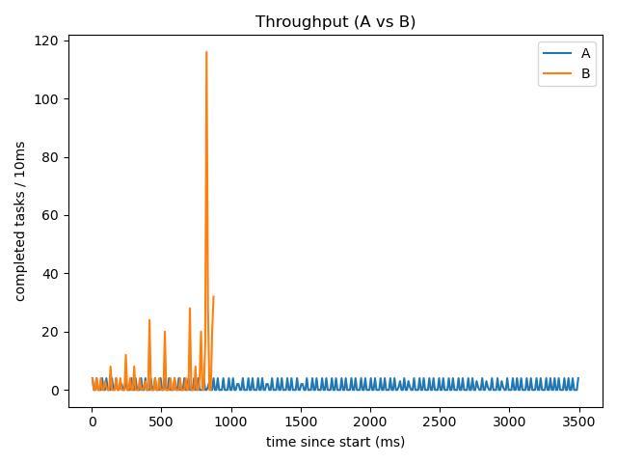
Performance Comparison: Autonomous Driving

Slide 5
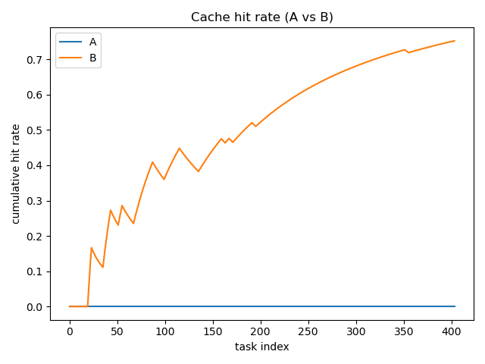
Performance Comparison: Cache Hit Rate

Slide 6
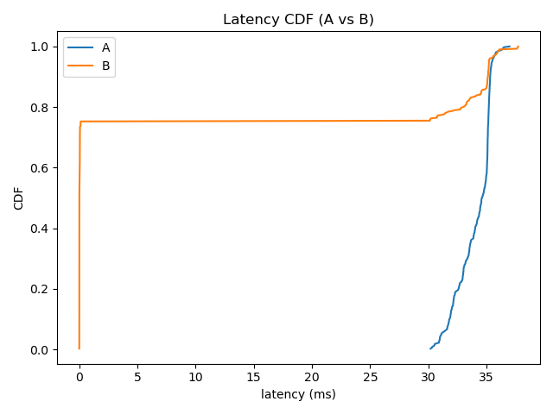
Latency Distribution: Autonomous Driving

Slide 7
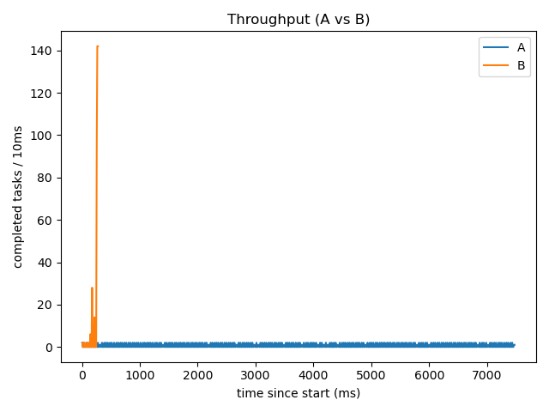
Performance Comparison: Smart City

Slide 8
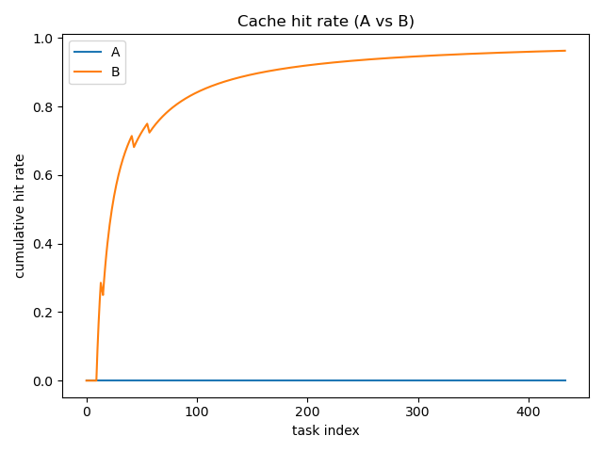
Performance Comparison: Cache Hit Rate (Smart City)

Slide 9
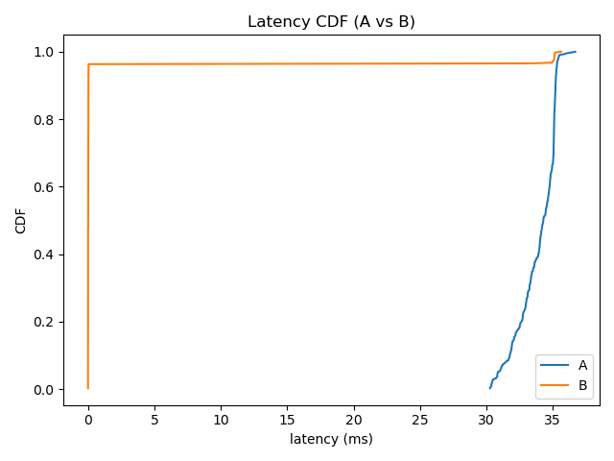
Latency Distribution: Smart City

Slide 10
Conclusion
The Multi-Agent DSL framework demonstrates significant performance improvements with cache-enabled scheduling.
Key findings include:
- Higher cache hit rate significantly improves throughput
- Latency is drastically reduced in repeated tasks
- Cache-free scenarios remain fast for low-concurrency environments but suffer with high task volume
Next steps:
- Extended benchmarks with different task complexities
- Integration with real-world LLMs for improved reliability

