Slide 1
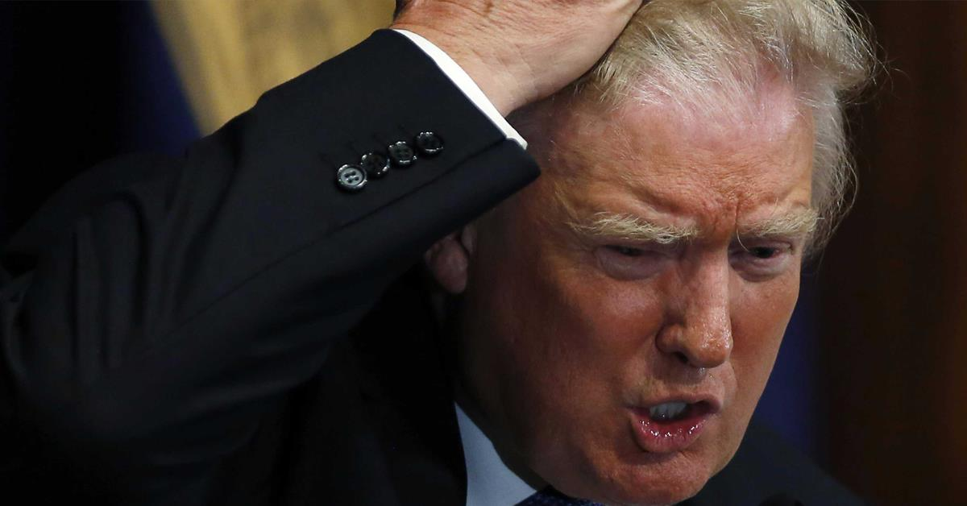

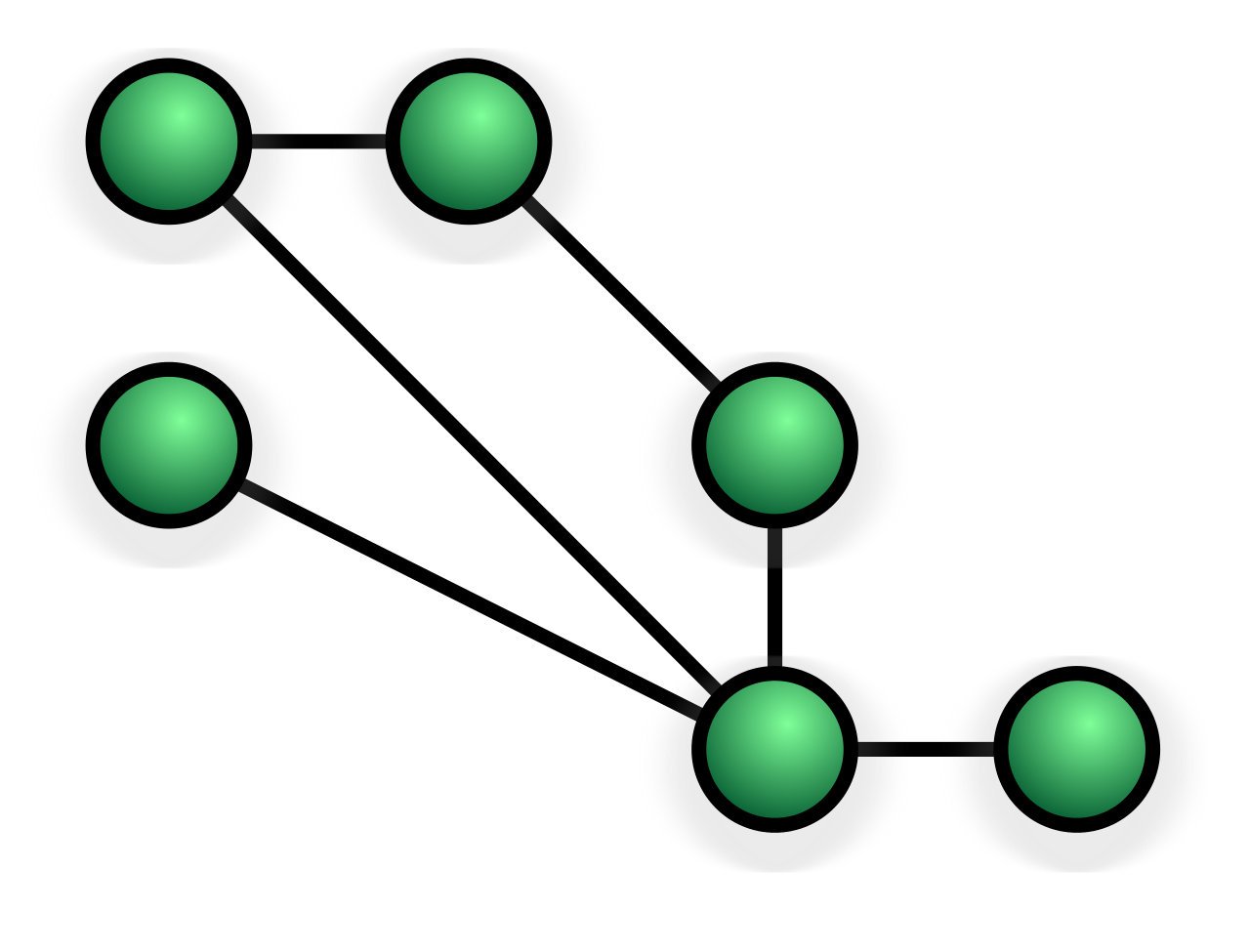

Loudspeaker/GroupThink/etc.
Idea: An app that uses mobile mesh network technology to allow users to broadcast audio/text with minimal access to the Internet

