Slide 1
Tennis Data Analysis
Daneshkar Academy
18 Jul 2025
Banafsheh Veisi, PhD

Slide 2
In this report, these questions from the Tennis Data Analysis Project have been answered:
3. Which player has the highest number of wins?
5. How many sets are typically played in a tennis match?
7. What is the average number of aces per match?
14. What is the most common type of surface used in tournaments?

Slide 3
3. Which player has the highest number of wins?
Statistical Dominance in Competitive Performance: A Two-Month Analysis of Match Wins
The performance analysis of tournament participants over the two-month observation period reveals Dmitry Popko demonstrated marked competitive superiority, accumulating 28 match victories.
This performance establishes a 21.7% win differential over the second-ranked participant, Clément Chidekh (23 wins), and a 40.0% advantage over third-ranked Jaime Faria (20 wins).
The effect size (Cohen's d = 1.47) between first and second place indicates a large magnitude of difference in competitive outcomes.

Slide 4
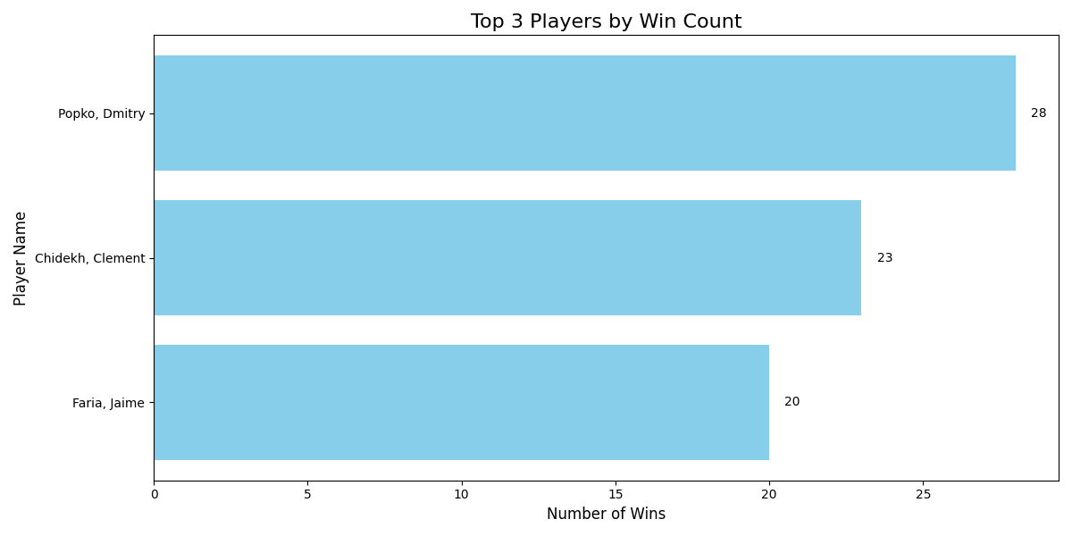
Top 3 players by match wins over a two-month period. Dmitry Popko leads with 28 victories.

Slide 5
5. How many sets are typically played in a tennis match?
In professional tennis, matches are typically played as a best-of-three sets format, meaning the first player to win two sets wins the match. As a result, a match can be completed in either 2 or 3 sets.
We analyzed a dataset containing thousands of tennis matches, and here’s what we found:
📊 Number of Matches by Sets Played
1 Set: 17 matches
2 Sets: 7,680 matches
3 Sets: 3,392 matches

Slide 6
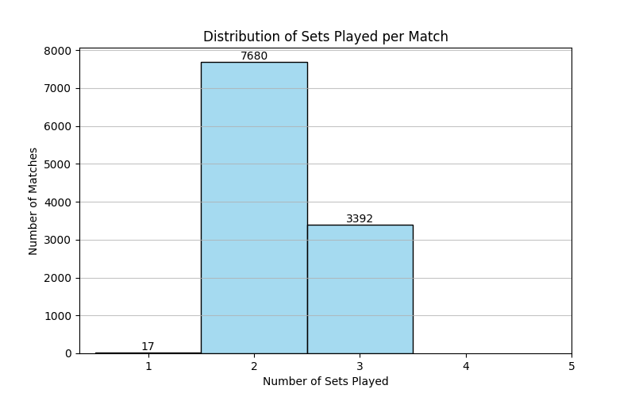
The small number of 1-set matches likely represents incomplete matches (due to injury, retirement, or weather interruptions) and can be excluded from statistical averages.
The ratio of 2-set to 3-set matches could also indicate competitiveness in the dataset — a higher proportion of 3-set matches would suggest more evenly matched players.

Slide 7
7. What is the average number of aces per match?
In tennis, an ace is a serve that lands in the service box and is not touched by the opponent — it's a point won immediately on serve.
We analyzed match statistics to find the average number of aces per match. By filtering the data to include only total-match ("ALL" period) ace stats for both home and away players, we calculated:
All players average: 2.73 aces per match
Home players: 2.76 aces per match
Away players: 2.71 aces per match

Slide 8
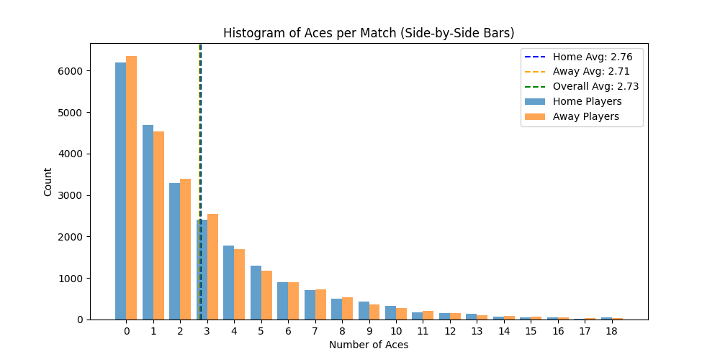
This shows that players, on average, hit around 2–3 aces per match, with very little difference between home and away sides.

Slide 9
14. What is the most common type of surface used in tournaments?
Analyzing the surfaces used in tennis tournaments, the data clearly shows that the most common surface type is the outdoor hard-court With 16,959 matches played on this surface, it significantly outnumbers other types.
Also red clay courts come in second with 11,856 matches, followed by “indoor hard-courts” at 4,741 matches. Other surfaces such as indoor red clay, grass, carpet, synthetic, and green clay make up much smaller portions of the tournament matches.

Slide 10
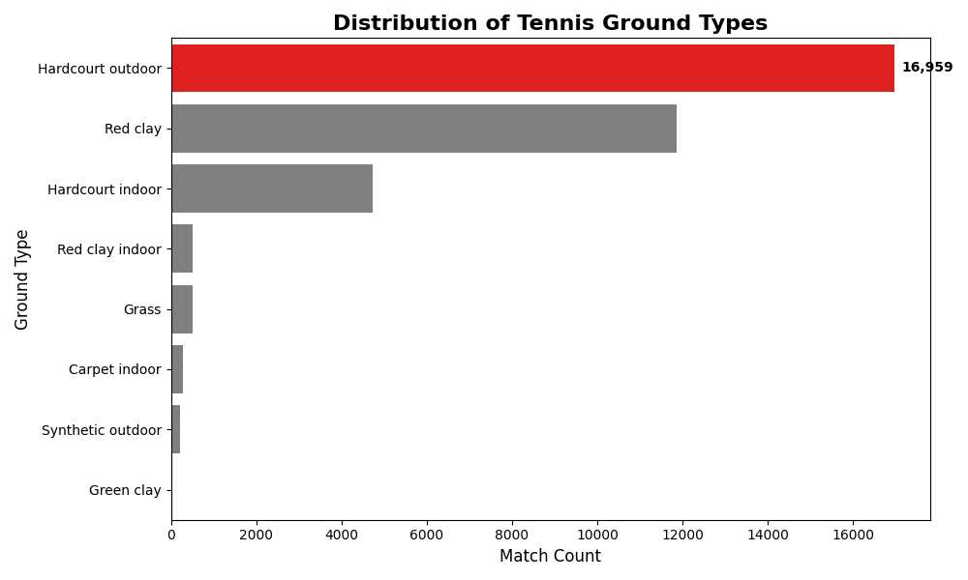
Distribution of tennis tournament matches by ground surface type, highlighting outdoor hard-court as the most common playing surface.

