Slide 1
Tennis Data Analysis
Daneshkar Academy
18 Jul 2025
Fatemeh Mohamadi

Slide 2
In this report, these questions from the Tennis Data Analysis Project have been answered:
1. How many tennis players are included in the dataset?
13. What is the distribution of left-handed versus right-handed players?
15. How many distinct countries are represented in the dataset?

Slide 3
1. How many tennis players are included in the dataset?
This analysis reveals a comprehensive view of professional tennis participation, identifying 2,644 unique players with complete tracking - no missing data obscures the picture.
The data highlights one extraordinary outlier: Player 250934, who appears in 55 matches – dwarfing their peers.
The most striking is their lopsided 50 home vs. 5 away appearances, a 10:1 ratio that suggests either tournament seeding advantages or potential regional bias.

Slide 4
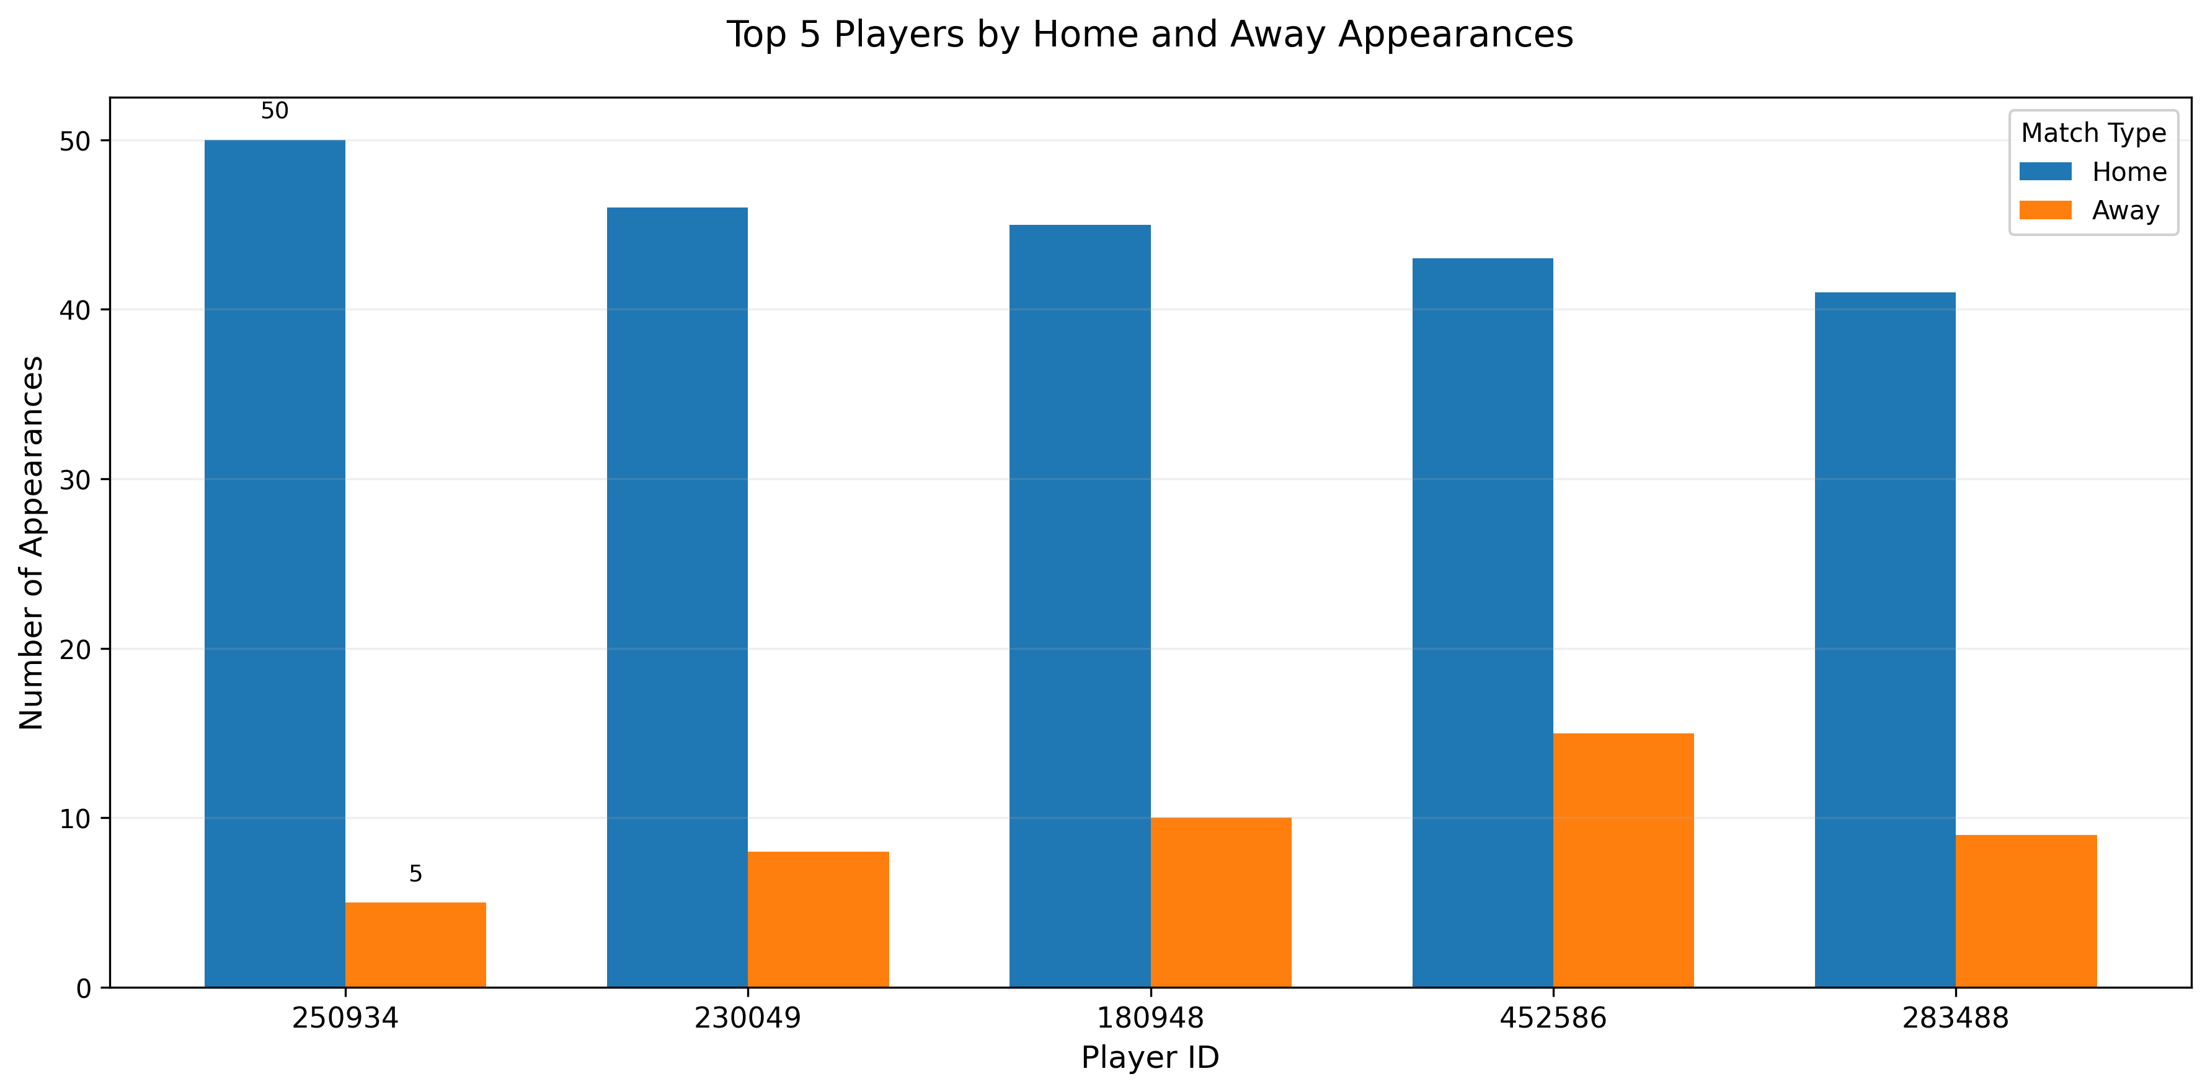
This dataset tracks 2,644 unique tennis players during a home-heavy tournament period, as seen in the top performer's lopsided 50 home versus just 5 away matches. The visualization highlights how playing frequency and location varied significantly across competitors.

Slide 5
13. What is the distribution of left-handed versus right-handed players?
The distribution of right-handed versus left-handed players in professional tennis using a dataset of over 2,600 players records.
Right-handed players dominate:
* 43.4% of players are right-handed
* Only 5.7% of players are left-handed
* 50.9% of records lack handedness information
✅ If we exclude missing data, the adjusted distribution would be:
* Right-handed: 88.4% ~ (21,600 players out of 24,443)
* Left-handed: 11.6%

Slide 6
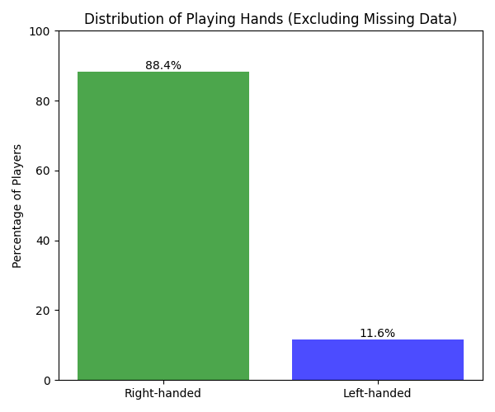
When excluding missing data, 88.4% of pro tennis players are right-handed, while left-handers make up 11.6%.
Right-handed players are ~7.6x more common than left-handed ones.

Slide 7
15. How many distinct countries are represented in the dataset?
Our analysis reveals that professional tennis players come from 101 distinct countries, demonstrating the sport’s global reach. A small portion of players (14 entries) lack country data, but the vast majority are properly classified.
The dataset includes 225 players from the USA, making it the most represented nation, followed by Italy with 205 players and France with 202 players.
While the top five nations account for 33.7% of all players. Despite this concentration, the player distribution remains relatively even, with a Gini coefficient of just 0.037.

Slide 8
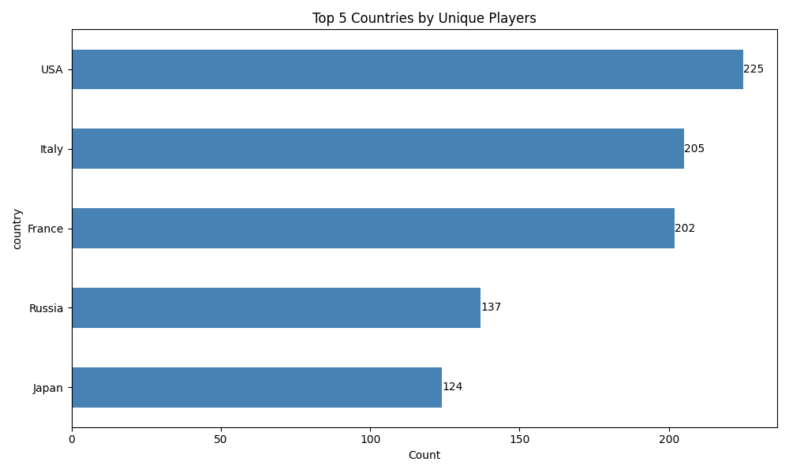
Out of 101 distinct countries, the US with 225 players has the highest number of players.
Top 5 countries contain 33.7% of all players.

