Slide 1
Tennis Data Analysis
Daneshkar Academy
18 Jul 2025
Masoud Shiri

Slide 2
In this report, these questions from the Tennis Data Analysis Project have been answered:
2. What is the average height of the players?
4. What is the longest match recorded in terms of duration?
6. Which country has produced the most successful tennis players?
9. Which player has won the most tournaments in a single month?
10. Is there a correlation between a player's height and their ranking?

Slide 3
2. What is the average height of the players?
This analysis focuses on understanding the height distribution of professional tennis players, with a particular emphasis on gender differences.
✅ The average height of all players in the dataset is approximately 1.82 meters
Male players have an average height of 1.84 meters
Female players have an average height of 1.73 meters
This shows that, on average, male players are taller than female players by only 11 centimeters

Slide 4
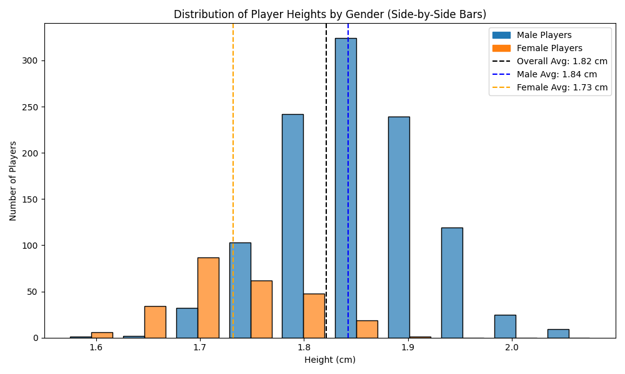

Slide 5
4. What is the longest match recorded in terms of duration?
The dataset comprises 22,561 tennis matches with an average duration of around 63 minutes, though match lengths vary widely—from just under 10 minutes to nearly 3 hours.
Interestingly, the longest matches show no recorded duration for the fourth and fifth periods, suggesting that most matches conclude within the first three periods, consistent with tournaments being played in best-of-three sets.
✅ The longest recorded match in the dataset (Match ID 12130100) lasted an impressive “2 hours, 52 minutes, and 1 second”.

Slide 6
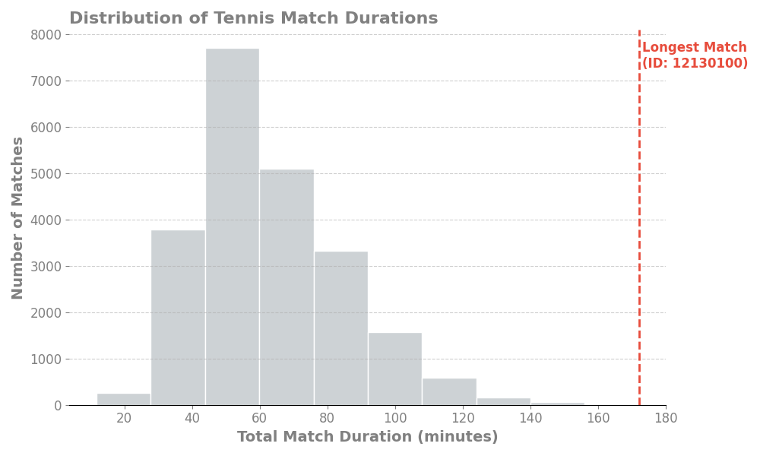
Histogram showing the distribution of tennis match durations, highlighting the longest match at 2 hours, 52 minutes, and 1 second

Slide 7
6. Which country has produced the most successful tennis players?
Our analysis shows that France 🇫🇷 leads with the highest number of tennis match wins over the two-month period, totaling 847 wins.
Looking closely at the top five countries, we see a competitive but clear hierarchy:
France holds a solid lead with 847 wins, approximately 10% more wins than the USA, which stands second with 771 wins.
The USA and Italy are relatively close, with Italy recording 667 wins—about 13% fewer wins than the USA—indicating a competitive gap but still strong performance.
Moving further down, Russia (492 wins) and Germany (424 wins) show a larger difference from the top three, with Russia having roughly 27% fewer wins than Italy, and Germany about 14% fewer wins than Russia.

Slide 8
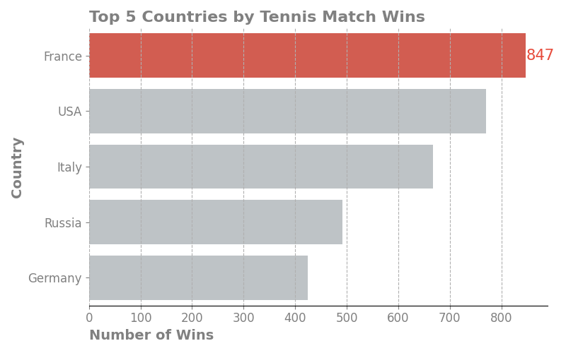
The top 5 countries by tennis match wins over the two-month period highlight “France” 🇫🇷 as the leader with 847 wins. The USA 🇺🇸 and Italy 🇮🇹 closely follow with 771 and 667 wins respectively, while Russia 🇷🇺 and Germany 🇩🇪 hold notable but smaller shares at 492 and 424 wins. This distribution reflects a competitive yet tiered landscape of international tennis success.

Slide 9
9. Which player has won the most tournaments in a single month?
📅 Our analysis shows that Dmitry Popko achieved the highest number of tournament wins in a single month, scoring 15 wins in February 2024.
During that month, a total of 4,530 matches were played, meaning Popko won approximately 0.33% of all tournaments held. He narrowly outperformed Marek Gengel and Katarína Kužmová, who both secured 14 wins.
📅 In March 2024, a total of 4,794 matches were played. Jaime Faria and Adria Soriano Barrera each secured 14 tournament wins, accounting for approximately 0.29% of all matches played that month. Julieta Estable closely followed with 13 wins, representing about 0.27%.

Slide 10
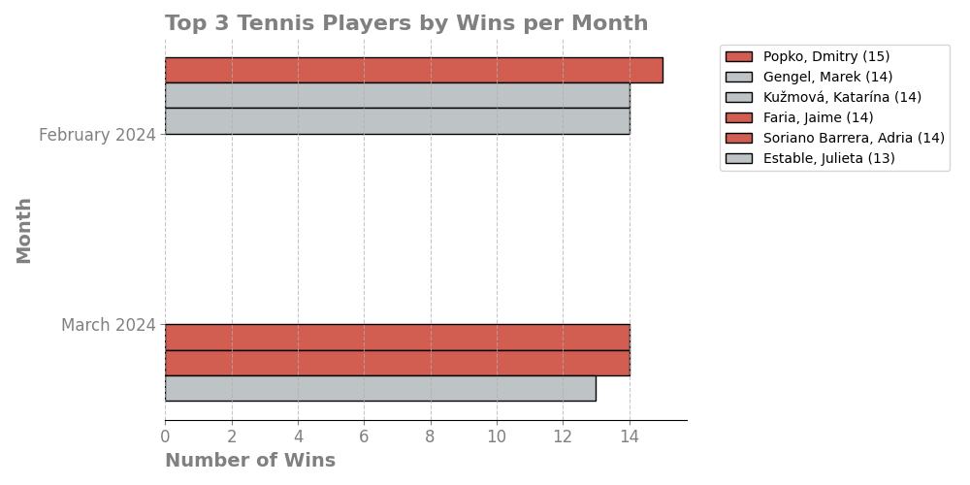
Top 3 tennis players with the highest number of tournament wins each month. Players who led their month in wins are highlighted in red

Slide 11
10. Is there a correlation between a player's height and their ranking?
📉 In analysis of Player Height vs. Ranking ,There are 1345 unique players analyzed, with both height and ranking data, Correlation result:
* Pearson correlation coefficient = 0.106
* p-value = 9.72 × 10⁻⁵ (highly significant)
The correlation coefficient of 0.106 indicates a very weak correlation between player height and ranking.
Since ranking is reversed numerically (1 is best), here it means that taller players tend to have slightly higher (worse) ranking numbers.
However, the correlation is weak enough to suggest that height is not a predictor of ranking.
The low p-value confirms the correlation is statistically significant, but the effect size is small — height alone explains very little about player ranking.

Slide 12
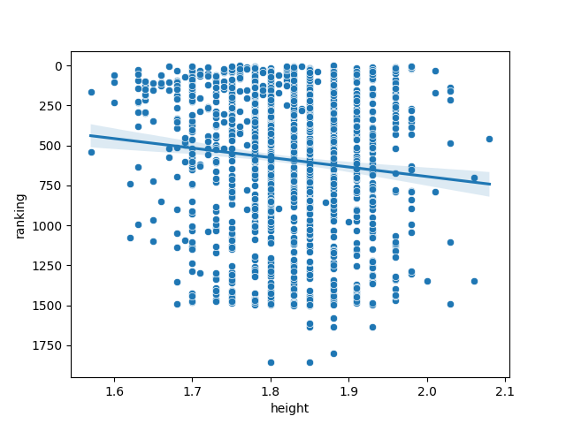
The analysis reveals a very weak correlation (r = 0.11) between player height and ranking, indicating that height is not a significant factor in determining a player’s ranking.

