Slide 1
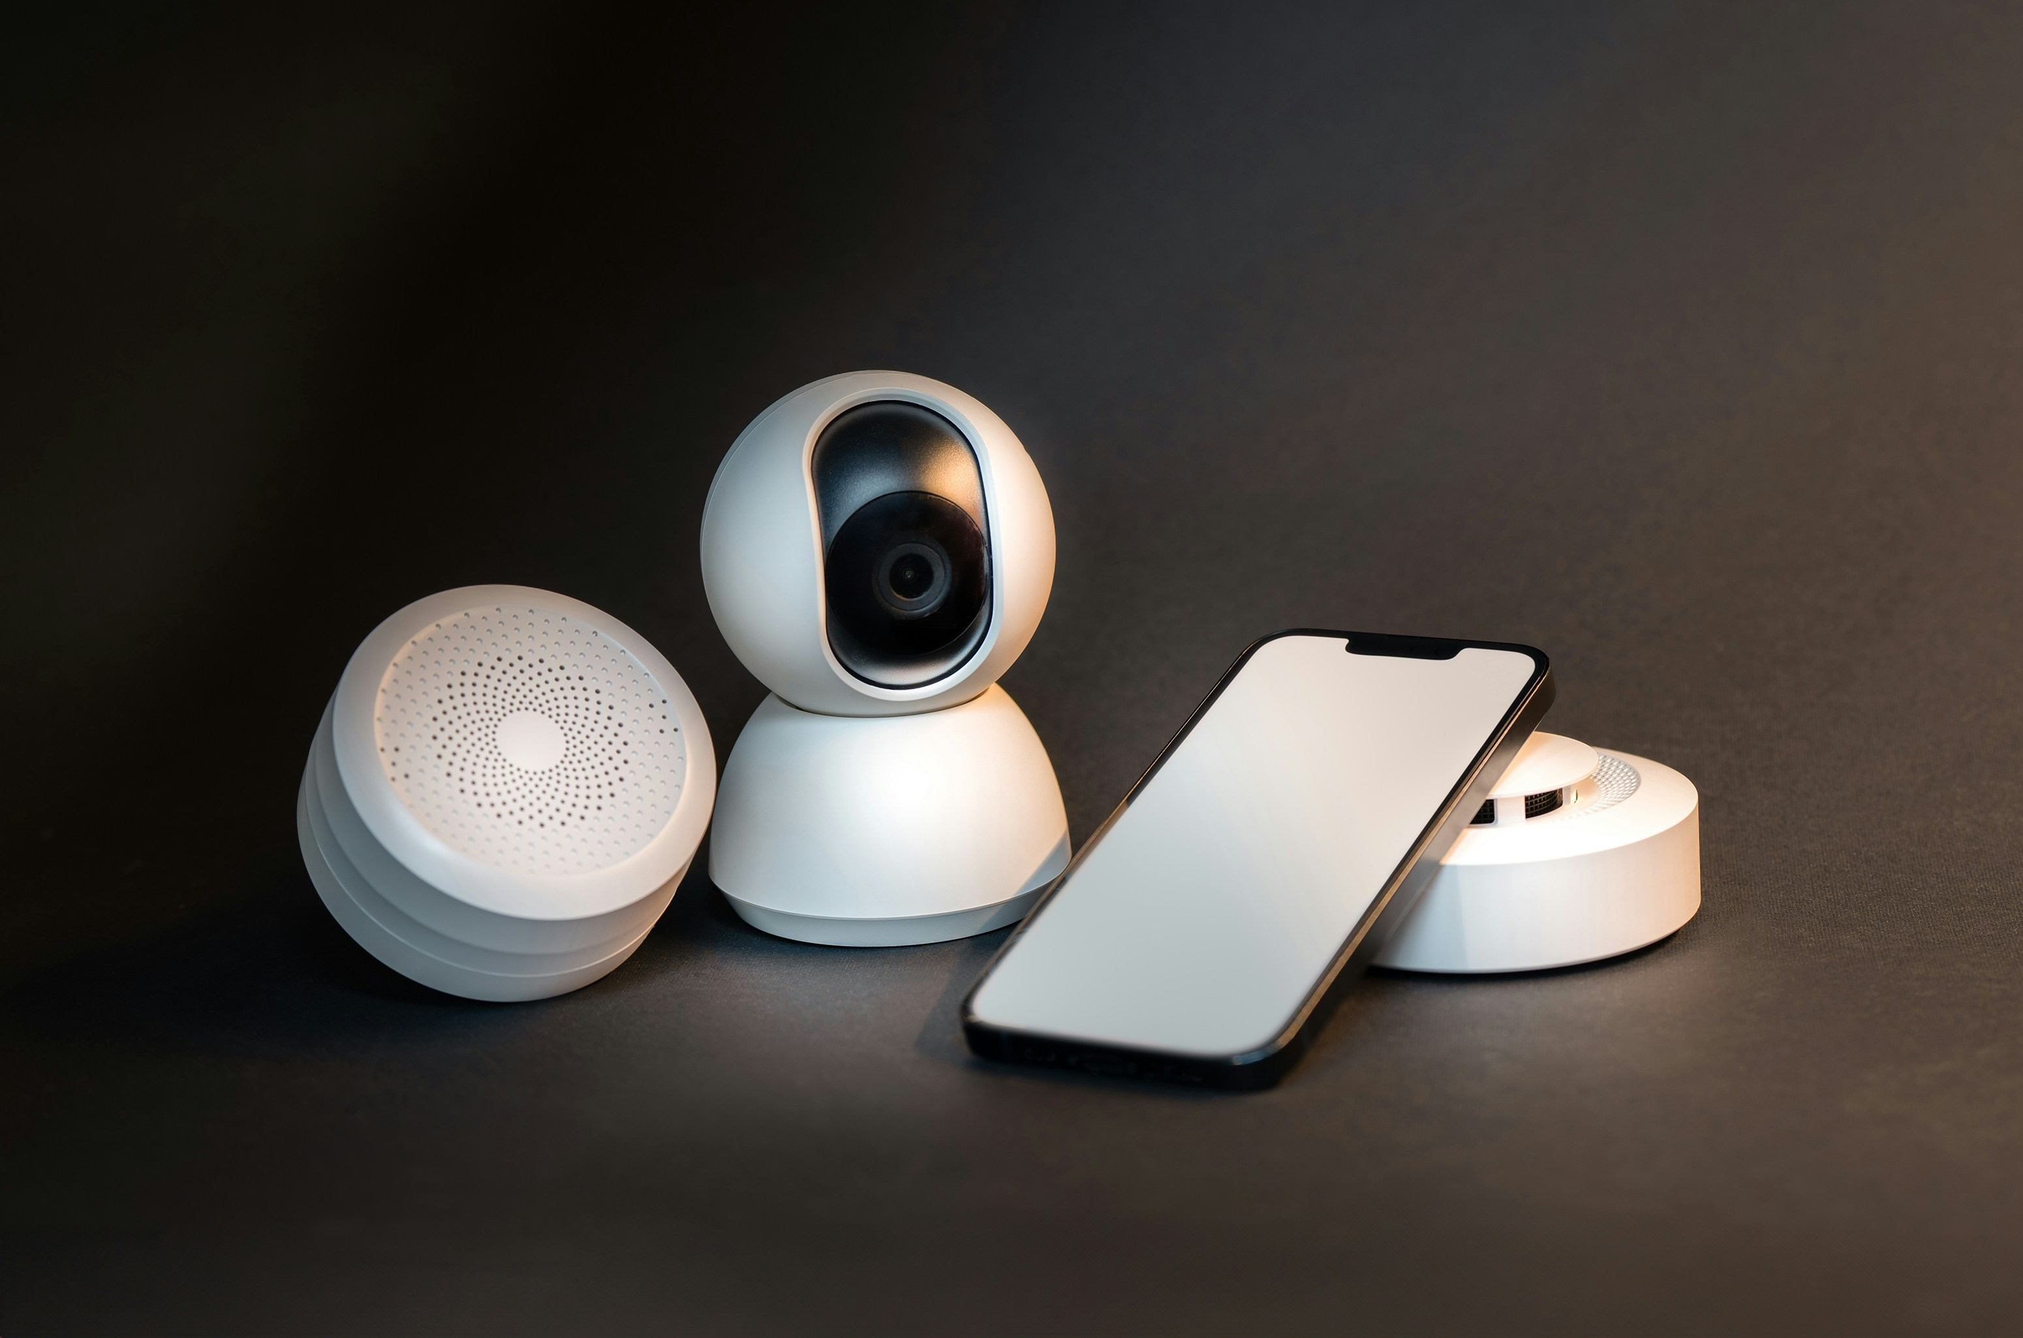
INTERNET OF THINGS
AN INNOVATION IN MY FIELD

Slide 2
What is IOT
The Internet of Things (IoT) is one of the most significant and transformative innovations in the Information Technology (IT) field.
It represents the culmination of decades of technological advancements and is fundamentally changing the way we interact with the world around us.
IoT refers to the concept of connecting everyday objects—ranging from household appliances to industrial machines—over the internet, allowing them to collect, exchange, and act on data.
This seemingly simple idea has far-reaching implications, from creating smarter homes and cities to revolutionizing industries and healthcare systems.

Slide 3
The beginnings of IOT
The Internet of Things (IoT) emerged from early computing and networking concepts but gained momentum in the 21st century as wireless communication, data processing, and sensor technology advanced.
Today, IoT is at the forefront of digital transformation, driving innovation across numerous sectors and reshaping the global economy.
Its impact is felt in industries ranging from manufacturing to healthcare, as it enables smarter operations, enhances efficiency, and opens up new opportunities for growth and development.

Slide 4
What’s New in IOT?
IoT has rapidly evolved, with key developments propelling the technology to new levels.
These advancements are making IoT devices smarter, more efficient, and increasingly adopted across various sectors.
Notable recent innovations include enhanced AI integration, improved security protocols, the rise of edge computing, and the expansion of 5G networks, all of which are driving IoT's growth and impact.
All these will be discussed in depth as we learn about this great innovation in the Information Technology field.

Slide 5
1.Edge Computing
Enhancing Real-Time Processing and Decision-Making
Edge computing is a pivotal advancement in the IoT ecosystem, bringing data processing closer to the source rather than relying on centralized cloud servers.
This approach reduces latency and enables real-time decision-making, which is crucial for applications like industrial automation where immediate responses are necessary.
By processing data locally, edge computing enhances efficiency, improves reliability, and minimizes the risk of data loss, making IoT devices more effective in handling time-sensitive tasks.

Slide 6
2.5G Connectivity
Unlocking New Possibilities for IoT
The rollout of 5G networks is a transformative milestone for IoT, offering faster data speeds, lower latency, and the capacity to connect a vast number of devices simultaneously.
These enhancements are vital for real-time IoT applications such as autonomous vehicles, remote surgery, and smart cities.
With 5G, IoT devices can transmit large amounts of data instantaneously, enabling smarter resource management and significantly improving the quality of life in urban environments.

Slide 7
3.AI Integration
Making IoT Devices Smarter
The integration of Artificial Intelligence (AI) with IoT is propelling the next wave of technological innovation.
AI allows IoT devices to autonomously analyze data, recognize patterns, and make decisions without human intervention.
This capability is particularly valuable in sectors like healthcare, where AI-powered IoT devices can continuously monitor patients and alert healthcare providers in case of emergencies.
In industrial settings, AI enhances predictive maintenance, reducing downtime and boosting productivity.

Slide 8
Uses of IOT
The applications of IoT are vast and varied, spanning multiple sectors and industries. Below are some of the most prominent uses of IoT:
Healthcare: IoT is transforming healthcare by enabling real-time monitoring and personalized care through wearable devices and smart medical systems.
Agriculture: IoT enables precision farming, optimizing the use of resources like water, fertilizers, and pesticides through real-time data from sensors. This technology improves crop yields, reduces waste, and enhances the sustainability of farming practices.
Home automation: offers remote control and automation of home systems, such as lighting, heating, and security. These smart home devices provide convenience, energy savings, and enhanced security, making everyday life more efficient and comfortable.

Slide 9
More uses…
Transportation: IOT enables real-time tracking, optimizing routes, and paving the way for autonomous vehicles. Smart traffic management and connected vehicle systems reduce congestion, improve safety, and enhance the overall transportation experience.
Retail: IoT enhances shopping experiences by using smart shelves and personalized promotions. These technologies streamline inventory management, improve supply chain efficiency, and create a more tailored shopping experience for consumers.

Slide 10
Advantages of IOT
Increased Efficiency and Automation-IoT automates processes, reducing the need for human intervention and boosting operational efficiency.
Data-Driven Decision-Making-IoT generates vast data, enabling informed decision-making across industries e.g. In healthcare, IoT data allows for early disease detection, improving outcomes.
Cost Savings and Resource Optimization- IOT reduces costs by optimizing resource use and minimizing waste. It enhances energy management, cuts utility bills, and improves production efficiency.
Enhanced Convenience and User Experience IoT offers convenience through remote control and automation e.g. Smart home devices provide control over home environments via smartphones

Slide 11
Disadvantages of IOT
Security and Privacy-IoT devices are vulnerable to cyberattacks due to their constant internet connectivity, which can lead to data theft and system breaches and the extensive data collected by these devices, including personal information, raises significant privacy concerns.
Interoperability and Compatibility-Integrating IoT devices from various manufacturers can be challenging due to differing communication protocols and standards.
Complexity -Managing IoT systems is complex, requiring specialized skills and infrastructure. As networks grow, tasks like device provisioning and network monitoring become increasingly difficult.
Power Consumption and Battery Life IoT devices often rely on batteries, and increasing power demands can shorten battery life, especially in remote locations.

Slide 12
What should we improve…
Standardization and Interoperability-The IoT industry needs standardized protocols and frameworks to ensure seamless communication between devices from different manufacturers.
Security Enhancements-Improved security measures, including encryption and secure communication, are essential as the number of connected devices grows.
Power Efficiency and Sustainability-Advanced power management and energy harvesting technologies are necessary to improve battery life and reduce power consumption
Scalability and Network Management-To manage the growing complexity of IoT networks, advanced tools and platforms are needed for device provisioning, firmware updates, and real-time monitoring
Scalable data processing and analytics solutions, such as edge computing and AI-driven analytics, are essential for handling vast amounts of data.

Slide 13
Conclusion
The Internet of Things (IoT) is set to revolutionize various sectors—healthcare, agriculture, transportation, and retail—by enabling new technologies and business models.
It offers transformative benefits like increased efficiency, data-driven decision-making, cost savings, and enhanced convenience.
However, to fully realize IoT's potential, challenges such as standardization, security, power efficiency, and scalability must be addressed.
Future success depends on ongoing innovation and collaboration among stakeholders to ensure IoT's development benefits all.

Slide 14
Thank You

