Slide 1
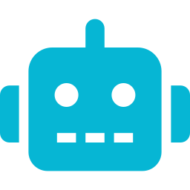
AI AGENTS FOR BEGINNERS
Your New Role as an
Automation Manager
Lesson 1: From AI Worker to AI Architect

Slide 2


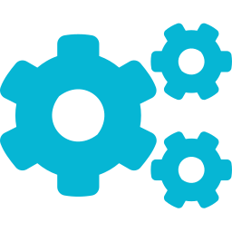
THE HOOK
Stop Being a Digital Courier
Manual copy-pasting into chat boxes
is just faster grunt work.
What You're Doing
What AI Should Be Doing
Extract data from one system
Format it manually
Paste into another chat/app
Repeat every hour
Triggered by events (email, webhook)
Processes data automatically
Delivers results to the right place
Runs on its own, 24/7

Slide 3

THE SHIFT
From AI Worker to
AI Architect
AI Worker
AI Architect
AI Orchestrator
Executes individual prompts. One task at a time. You're still in the loop.
Designs automated workflows. Builds systems that run independently. Sets the rules.
Coordinates multiple agents. Manages handoffs. Monitors and adapts in real time.
More impact →

Slide 4
CORE PRINCIPLE
The Three-Question Blueprint
Every automated system answers
exactly three questions:
01
02
03
What triggers
the work?
What logic processes
the data?
Where does the final
action go?
Email arrives. Form submits. Timer fires. Webhook hits.
AI decides. Rules filter. Code transforms. API enriches.
Slack message. Email reply. Sheet update. API call.

Slide 5


THE THREE-QUESTION BLUEPRINT
Visual Flow Diagram
Trigger
Logic
Action
New email in inbox
Form submission
Scheduled time
>
AI reads & classifies
Rules filter by content
Data is transformed
>
Send Slack notification
Update Google Sheet
Create calendar event
💡 Every automation you build will answer these three questions. Write them down before you write a single line of code.

Slide 6
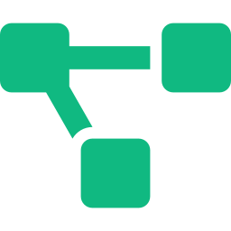
ACTIONABLE SKILL
Diagram Before You Build
Visually diagram a manual workplace
bottleneck on the n8n canvas
n8n Canvas
before connecting any software.
Trigger: New Email
Logic: AI Classify
1. Identify one repetitive task you do daily
2. Map it as Trigger → Logic → Action
Action: Slack Message
3. Draw it on the n8n canvas with empty nodes

Slide 7


YOUR FIRST STEP
Start Thinking Like
an Architect
Before you automate, ask the three questions
Diagram the workflow before writing any code
Your value is in designing systems, not running errands
Your task this week: identify ONE bottleneck and draw it on n8n. Just the blueprint — no connectors yet.

