Slide 1

Microtraining
Data Analytics with Rapidminer

Slide 2
Agenda Microtraining
Microtraining: Data Analytics
1
Theoretical Background
2
Use Case
3
Hands-On with Rapidminer
4
Exemplary solution and outlook

Slide 3
Introduction to Data Analytics
Microtraining: Data Analytics
Learning objectives
Gaining an introduction into the field of data analytics in production
Application of analytics and visualization techniques to optimize our production scenario
Use of RapidMiner® for data analytics

Slide 4
Introduction to Data Analytics
Microtraining: Data Analytics
Data analytics
Use of computer-aided techniques to analyze data
Goal: extract knowledge from data. Identification of patterns that are
yet unknown
potentially useful
easily interpretable
Data analytics in production and manufacturing: helps to automate and optimize production processes
Notes:
Finally: gain competitive advantage

Slide 5
Introduction to Data Analytics
Microtraining: Data Analytics
Data analytics process
Preprocessing
Data selection
Data collection
Cleansing
Filtering
Transformation
Analysis
Correlation
Prediction
Classification
Regression
Segmentation
Association
Evaluation
Interpretation
Assessment
Visualization
Reporting
Notes:
All three phases are equally important
Preprocessing: data has to be
Carefully selected
Prepared for the use of algorithms (e.g. transformation)
Analysis: the use of statistical techniques and algorithms for analyzing the data
Correlation: statistical technique for identifying relationships and dependencies in the data
Prediction: if you analyze the past, you can conclude to the future. Classification and regression techniques are used for it. Regression is for numerical predictions and classification is for categorical prediction (later more)
Segmentation: finding groups of similar patterns in the data (e.g. market segmentation, customer segmentation)
Association: finding frequent patterns in the data (e.g. market-basket anaylisis, recommender systems of online shops (amazon, ebay, taobao)
Evaluation: Analysis results have to be
Evaluated: looking how good they are
Interprated: looking for found patterns
Reporting: visualized and presented
POST:
Later we implement in the practical unit, not so much pre-processing because we have done it with opc-ua in the scenario, but more analysis and evaluation.
We will use classification, so now we will learn more about classification

Slide 6
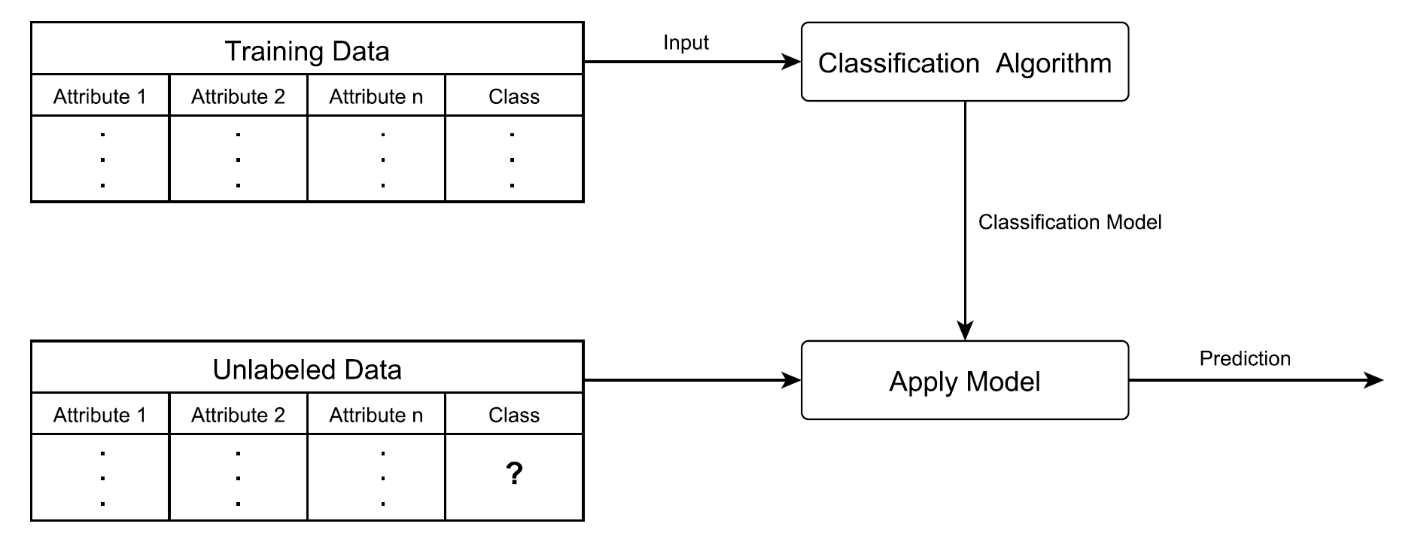
Introduction to Data Analytics
Microtraining: Data Analytics
Classification
Data records have different classes (categorical/nominal)
Building a model that predicts the unknown class of new data
Data consists of: records, attributes, one class attribute

Slide 7
Classification
Microtraining: Data Analytics
Decision tree
Nr. | a | b | Klasse
1 | -1 | 1 | $$C_{1}$$
2 | 5 | 2 | $$C_{4}$$
3 | -1 | 4 | $$C_{3}$$
4 | -8 | 2 | $$C_{2}$$
5 | 3 | 4 | $$C_{5}$$
6 | -2 | 4 | $$C_{3}$$
7 | 1 | 2 | $$C_{4}$$
Tree-based structure
Inner node: attribute test
Edge: result of the test
Leave node: class membership
Advantage: interpretable by the user
Classifying new records in top-down manner
$$a<0$$
$$0<a$$
$$b=1$$
$$b=4$$
$$b=2$$
$$b=4$$
$$b=2$$
$$C_{1}$$
$$C_{2}$$
$$C_{3}$$
$$C_{4}$$
$$C_{5}$$
Notes:
PRE: There exist many many algorithms and techniques for classification

Slide 8
Classification
Microtraining: Data Analytics
Example of decision tree
Example task: classification of „animal“ type
Data basis: 8 records with attributes: height and number of legs
ID | h [m] | l [number] | Class
1 | 0,1 | 0 | F
2 | 0,2 | 2 | B
3 | 1,8 | 2 | M
4 | 0,2 | 4 | C
5 | 2,1 | 4 | H
6 | 1,7 | 2 | M
7 | 0,1 | 4 | C
8 | 1,6 | 2 | M
F: fish, C: cat, M: man, H: horse, B: bird

Slide 9
Classification
Microtraining: Data Analytics
Decision tree - pseudocode
Input Sample $S$ (with attributes$a_{1},…,a_{n}$, attribute values$k_{1},…,k_{n}$, and classes $C_{1},…,C_{p}$)
Output Decision tree for sample $S$
Generate a node for $S$
Select best attribute $atr_{j}, j∈\left\{1,…,n\right\}$
Split sample, case attribute-type
Nominal: split sample $S$ according to $k=k_{j}$ different values of this attribute into sub-samples$S_{1},…,S_{k}$
Numeric/continuous: binary split (median or mean)
Generate edge from $S$ to successors $S_{1},…,S_{k}$
For each sub-sample $S_{1},…,S_{k}$:
if sub-sample is homogenous: assign the class $C_{i}$
If not: recursively generate tree for the sub-sample
Notes:
Most important steps:
Best Attribute Selection: so that
Sub-Sample is homogeneous, best separation of the classes

Slide 10
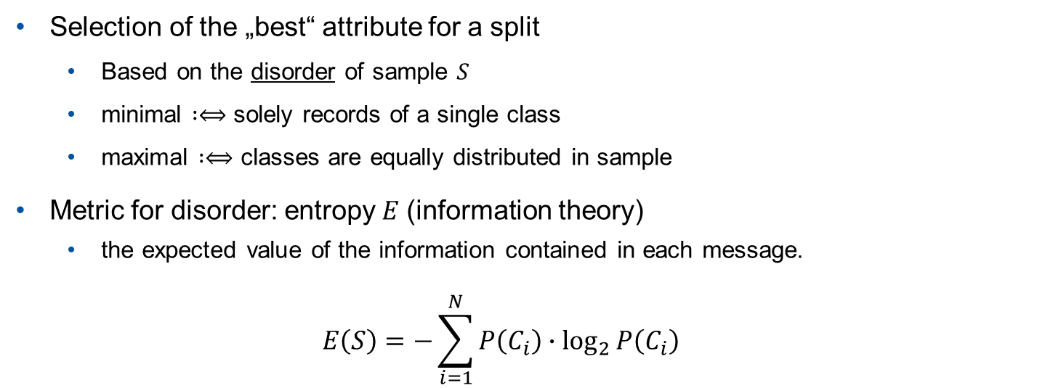
Classification
Microtraining: Data Analytics
Decision tree – attribute selection
Selection of the „best“ attribute for a split
Based on the disorder of sample $S$
minimal $:⟺$ solely records of a single class
maximal $:⟺$ classes are equally distributed in sample
Metric for disorder: entropy$E$ (information theory)
the expected value of the information contained in each message.
$$E\left(S\right)=−\sum_{i=1}^{N}{P\left(C_{i}\right)∙\log_{2}{P\left(C_{i}\right)}}$$
Notes:
POST: Entropy also exists in other domains, like thermodynamics, but different meaning

Slide 11
Classification
Microtraining: Data Analytics
Example classification with decision tree
Which attribute is the best one?
Case 1: First split with attribute h (binary split at value 1)
$$S_{1}$$
ID | h [m] | l [count] | Class
1 | 0,1 | 0 | F
2 | 0,2 | 2 | B
4 | 0,2 | 4 | C
7 | 0,1 | 4 | C
ID | h [m] | l [count] | Class
1 | 0,1 | 0 | F
2 | 0,2 | 2 | B
3 | 1,8 | 2 | M
4 | 0,2 | 4 | C
5 | 2,1 | 4 | H
6 | 1,7 | 2 | M
7 | 0,1 | 4 | C
8 | 1,6 | 2 | M
$$S_{2}$$
ID | h [m] | l [count] | Class
3 | 1,8 | 2 | M
5 | 2,1 | 4 | H
6 | 1,7 | 2 | M
8 | 1,6 | 2 | M
Notes:
PRE:
now discuss the attribute selection with two example decision trees on the same dataset

Slide 12
Classification
Microtraining: Data Analytics
Example classification with decision tree
$$S_{1}$$
ID | h [m] | l [count] | Class
1 | 0,1 | 0 | F
2 | 0,2 | 2 | B
4 | 0,2 | 4 | C
7 | 0,1 | 4 | C
h<1
l=0
l=2
l=4
F
B
C
$$S_{2}$$
ID | h [m] | l [count] | Class
3 | 1,8 | 2 | M
5 | 2,1 | 4 | H
6 | 1,7 | 2 | M
8 | 1,6 | 2 | M
1≤h
l=2
l=4
M
H

Slide 13
Classification
Microtraining: Data Analytics
Example classification with decision tree
Case 1: final decision tree
ID | h [m] | l [count] | Class
1 | 0,1 | 0 | F
2 | 0,2 | 2 | B
3 | 1,8 | 2 | M
4 | 0,2 | 4 | C
5 | 2,1 | 4 | H
6 | 1,7 | 2 | M
7 | 0,1 | 4 | C
8 | 1,6 | 2 | M
h<1
1≤h
l=0
l=2
l=4
l=2
l=4
F
B
C
M
H

Slide 14
Classification
Microtraining: Data Analytics
Example classification with decision tree
Case 2: First split with attribute l (categorical split)
$$S_{1}$$
ID | h [m] | l [count] | Class
1 | 0,1 | 0 | F
$$S_{2}$$
ID | h [m] | l [count] | Class
2 | 0,2 | 2 | B
3 | 1,8 | 2 | M
6 | 1,7 | 2 | M
8 | 1,6 | 2 | M
ID | h [m] | l [count] | Class
1 | 0,1 | 0 | F
2 | 0,2 | 2 | B
3 | 1,8 | 2 | M
4 | 0,2 | 4 | C
5 | 2,1 | 4 | H
6 | 1,7 | 2 | M
7 | 0,1 | 4 | C
8 | 1,6 | 2 | M
$$S_{3}$$
ID | h [m] | l [count] | Class
4 | 0,2 | 4 | C
5 | 2,1 | 4 | H
7 | 0,1 | 4 | C
Notes:
Legs-count 0 → fish, so allways fish when 0, this is true in this world/domain

Slide 15
Classification
Microtraining: Data Analytics
Example classification with decision tree
l=0
$$S_{1}$$
ID | h [m] | l [count] | Class
1 | 0,1 | 0 | F
F
$$S_{2}$$
ID | h [m] | l [count] | Class
2 | 0,2 | 2 | B
3 | 1,8 | 2 | M
6 | 1,7 | 2 | M
8 | 1,6 | 2 | M
l=2
h<1
1≤h
B
M
l=4
$$S_{3}$$
ID | h [m] | l [count] | Class
4 | 0,2 | 4 | C
5 | 2,1 | 4 | H
7 | 0,1 | 4 | C
h<1
1≤h
C
H

Slide 16
Classification
Microtraining: Data Analytics
Example classification with decision tree
Leads to a leave node in the first level → lower entropy as in the first decision tree
Case 2: final decision tree
ID | h [m] | l [count] | Class
1 | 0,1 | 0 | F
2 | 0,2 | 2 | B
3 | 1,8 | 2 | M
4 | 0,2 | 4 | C
5 | 2,1 | 4 | H
6 | 1,7 | 2 | M
7 | 0,1 | 4 | C
8 | 1,6 | 2 | M
l=0
l=2
l=4
F
h<1
1≤h
h<1
1 ≤ h
B
M
C
H

Slide 17
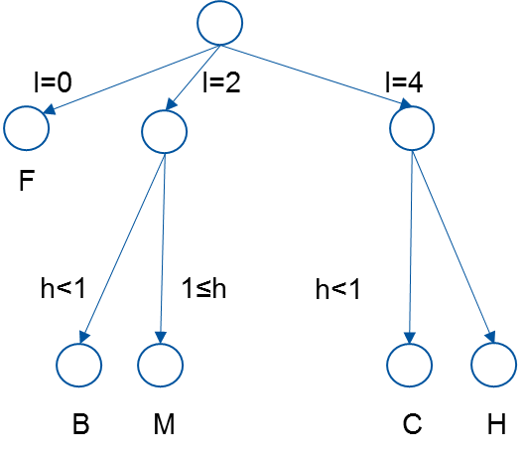
Classification
Microtraining: Data Analytics
Rule-based classification
Rule set
Similar to decision tree
If-Then rules
Condition: attribute test
Conclusion: class value
Construction
Create rule that covers at most records of a single class
Add further rules, until
stopping criterion is fulfilled
all records are covered
Attribute selection is based on entropy
IF l=0 THEN F
IF l=2 AND h<1 THEN B
IF l=2 AND h≥1 THEN M
IF l=4 AND h<1 THEN C
IF l=4 AND h≥1 THEN H
Else default

Slide 18
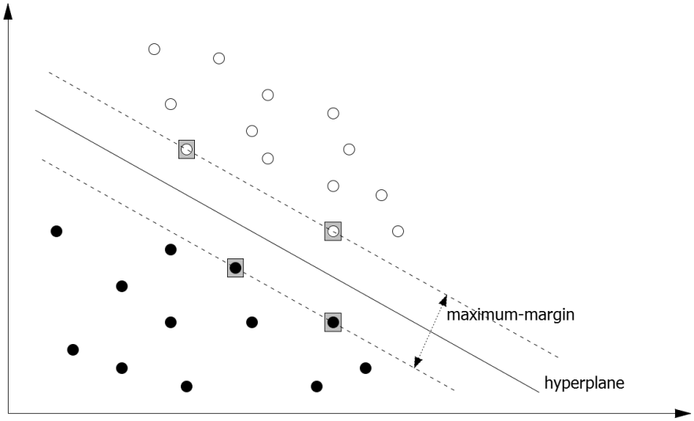
Classification
Microtraining: Data Analytics
Support Vector Machine
Case 1: linearly separable data
Find a hyperplane that separates between the classes
Maximal margin of hyperplane
Case 2: non-linear separation
Use of the kernel-trick
Transform data into higher-dimensional space
Linear separation in high-dimensional space
Non-linear separation in original attribute-space

Slide 19
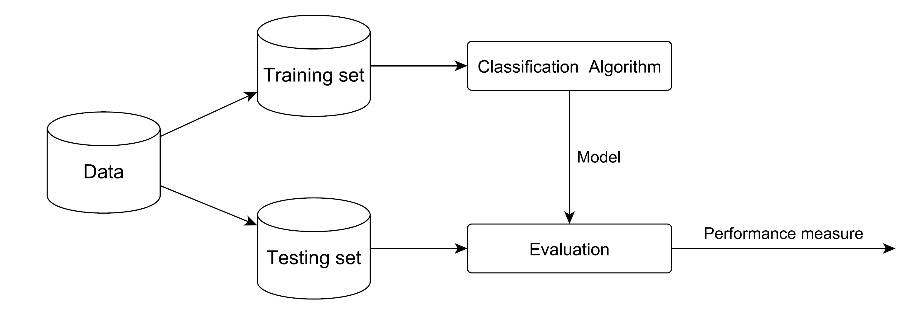
Classification
Microtraining: Data Analytics
Evaluation
How well does the classification model predict?
Learned model is tested on a separate test set
Model predicts the class of each test record
Compare predictions with the real classes
Output of a performance measure

Slide 20
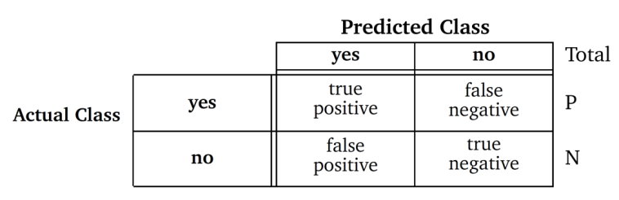
Classification
Microtraining: Data Analytics
Evaluation metrics
In a 2-class problem: 4 different cases possible
True-positive, false-positive, true-negative, false-negative
Selection of an appropriate metric
Popular metric: accuracy = $\frac{\# correctly_classified_records}{\# all_records}$
Notes:
PRE:
Prediction models make mistakes, that inevitable
The question: which mistakes can occur and which are the costs for them
Example: model is diagnosing cancer of patients
If patient is well, and models predicts that he is ill, that‘s not so bad
But: if patient has cancer and the model says he is well, that is really bad, the patient would die because of no treatment
So: both are mistakes with different costs → selection of appropriate metric
Accuracy might not be good: example cancer
If model analyses data from patients, where 5% have cancer and 95% have not
Model predicts: everybody is fine → 95% accuracy
But it‘s not fine!

Slide 21
Classification
Microtraining: Data Analytics
Evaluation – When accuracy is not enough
Different metrics can be calculated from the matrix, e.g.
True Positive Rate (TPR)
Proportion of positives that are correctly identified as positive
TPR = TP/P
False Positive Rate (FPR)
Proportion of negatives that are incorrectly classified as positive
FPR = FP/N
Out of these two metrics, a new metric can be calculated
Receiver Operator Characteristics (ROC)
Notes:
PRE:
Prediction models make mistakes, that inevitable
The question: which mistakes can occur and which are the costs for them
Example: model is diagnosing cancer of patients
If patient is well, and models predicts that he is ill, that‘s not so bad
But: if patient has cancer and the model says he is well, that is really bad, the patient would die because of no treatment
So: both are mistakes with different costs → selection of appropriate metric
Accuracy might not be good: example cancer
If model analyses data from patients, where 5% have cancer and 95% have not
Model predicts: everybody is fine → 95% accuracy
But it‘s not fine!

Slide 22
Classification
Microtraining: Data Analytics
Receiver Operator Characteristics (ROC)
Graphical plot that illustrates the predictive performance of a binary classifier
Created by plotting the TPR against the FPR a different threshold settings
The diagonal line represents a random guess
Ideal behavior
ROC-curve rises to the upper left corner (best possible prediction)
TPR
„good“ classifier
„not so good“ classifiert
FPR
Notes:
PRE:
Prediction models make mistakes, that inevitable
The question: which mistakes can occur and which are the costs for them
Example: model is diagnosing cancer of patients
If patient is well, and models predicts that he is ill, that‘s not so bad
But: if patient has cancer and the model says he is well, that is really bad, the patient would die because of no treatment
So: both are mistakes with different costs → selection of appropriate metric
Accuracy might not be good: example cancer
If model analyses data from patients, where 5% have cancer and 95% have not
Model predicts: everybody is fine → 95% accuracy
But it‘s not fine!

Slide 23
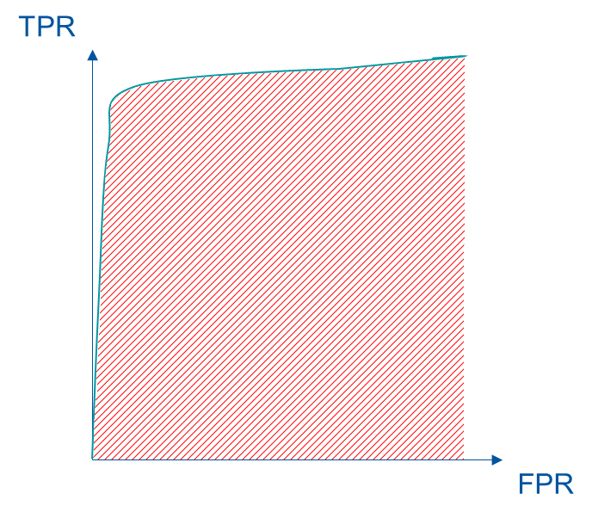
Classification
Microtraining: Data Analytics
From ROC to AUC
Area under the Curve
Reduction of the ROC-performance to a single metric
Value range: 0 to 1
The higher the AUC, the better the classifier
Random guess: 0.5
Notes:
PRE:
Prediction models make mistakes, that inevitable
The question: which mistakes can occur and which are the costs for them
Example: model is diagnosing cancer of patients
If patient is well, and models predicts that he is ill, that‘s not so bad
But: if patient has cancer and the model says he is well, that is really bad, the patient would die because of no treatment
So: both are mistakes with different costs → selection of appropriate metric
Accuracy might not be good: example cancer
If model analyses data from patients, where 5% have cancer and 95% have not
Model predicts: everybody is fine → 95% accuracy
But it‘s not fine!

Slide 24
Agenda – Day 4
09:00 – 09:15 Welcome and Introduction to Day 4
09:15 – 09:45 Industry 4.0 and the Internet of Things
09:45 – 10:15 Hands-On: Internet of Things using MQTT
10:15 – 10:30 Coffee Break
10:30 – 10:45 Incorporation of Legacy Systems using OPC
10:45 – 11:00 Hands-On: Production Process
11:00 – 11:30 From OPC to OPC UA
11:30 – 12:00 Practical Session: Adding Meta-Data and Modeling using OPC UA
12:00 – 13:00 Lunch Break
14:00 – 14:30 Modern Data Analytics in Production
14:30 – 15:00 Data Analysis and Data Mining
15:00 – 15:30 Practical Unit: Hands-On RapidMiner
15:30 – 15:45 Coffee Break
15:45 – 16:45 Practical Use-Case with RapidMiner and Discussion
16:45 – 17:00 Discussion and End of the Day

Slide 25
Agenda Microtraining
Microtraining: Data Analytics
1
Theoretical Background
2
Use Case
3
Hands-On with Rapidminer
4
Exemplary solution and outlook

Slide 26
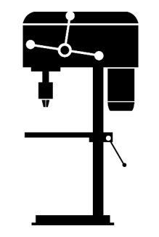
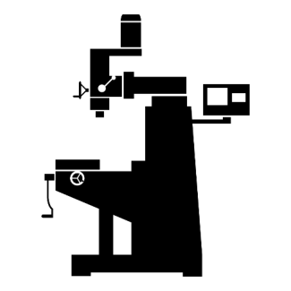






Use-Case – Analyzing the gear shaft process
Microtraining: Data Analytics
Autonomous organization of the production
diameter of drilling hole
drill hole surface quality
drilling speed
drilling contact pressure
type of gear: spur gear, bevel gear, crown gear
gearing tooth system: ivolute toothing, cycloidal teeth
hardening process of gear: case-hardening, nitrifying, induction hardening
depth of gear
root circle diameter
Sensor variables
Sensor variables
Drilling
Milling
Raw Material
Data Analytics Evaluate product failures
Assembly
Shaft Raw Material
Turning
Sensor variables
turning rotation speed
shaft diameter
cutting speed
cutting depth

Slide 27
Use-Case – Analyzing the gear shaft process
Microtraining: Data Analytics
Reject prediction
Use of existing data to predict failed products
Reject prediction is based on sensor and process data
Benefit:
Early identification of quality-related problems
Identification of influencing factors in the process
Optimization of the process on the basis of gained knowledge
Efficiency increase of the production
Notes:
Rejection Analysis is a process of identification of quality and productivity related problems which the key factors in manufacturing process

Slide 28
Use-Case – Analyzing the gear shaft process
Microtraining: Data Analytics
Data basis for the classification problem
Data collected and merged through OPC UA
Generation of a single data set
10,000 records
Characteristics of the data
10 numeric attributes (e.g. milling gear diameter, drill pressure)
Process output
2 nominal classes (OK and Failure)
Notes:
We have simulated the process
Each records represents a whole production process: the production of a gear shaft

Slide 29
Agenda – Day 4
09:00 – 09:15 Welcome and Introduction to Day 4
09:15 – 09:45 Industry 4.0 and the Internet of Things
09:45 – 10:15 Hands-On: Internet of Things using MQTT
10:15 – 10:30 Coffee Break
10:30 – 10:45 Incorporation of Legacy Systems using OPC
10:45 – 11:00 Hands-On: Production Process
11:00 – 11:30 From OPC to OPC UA
11:30 – 12:00 Practical Session: Adding Meta-Data and Modeling using OPC UA
12:00 – 13:00 Lunch Break
14:00 – 14:30 Modern Data Analytics in Production
14:30 – 15:00 Data Analysis and Data Mining
15:00 – 15:30 Practical Unit: Hands-On RapidMiner
15:30 – 15:45 Coffee Break
15:45 – 16:45 Practical Use-Case with RapidMiner and Discussion
16:45 – 17:00 Discussion and End of the Day

Slide 30

Coffee Break

Slide 31
Agenda – Day 4
09:00 – 09:15 Welcome and Introduction to Day 4
09:15 – 09:45 Industry 4.0 and the Internet of Things
09:45 – 10:15 Hands-On: Internet of Things using MQTT
10:15 – 10:30 Coffee Break
10:30 – 10:45 Incorporation of Legacy Systems using OPC
10:45 – 11:00 Hands-On: Production Process
11:00 – 11:30 From OPC to OPC UA
11:30 – 12:00 Practical Session: Adding Meta-Data and Modeling using OPC UA
12:00 – 13:00 Lunch Break
14:00 – 14:30 Modern Data Analytics in Production
14:30 – 15:00 Data Analysis and Data Mining
15:00 – 15:30 Practical Unit: Hands-On RapidMiner
15:30 – 15:45 Coffee Break
15:45 – 16:45 Practical Use-Case with RapidMiner and Discussion
16:45 – 17:00 Discussion and End of the Day

Slide 32
Agenda Microtraining
Microtraining: Data Analytics
1
Theoretical Background
2
Use Case
3
Hands-On with Rapidminer
4
Exemplary solution and outlook

Slide 33

Hands-On with

Slide 34
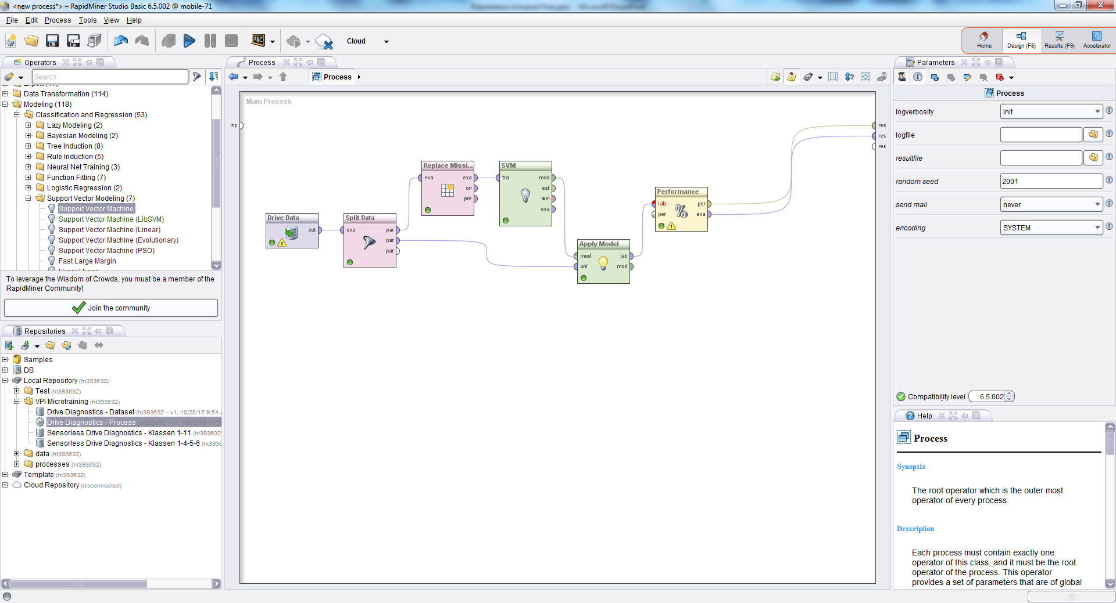
Hands-On with Rapidminer
Microtraining: Data Analytics
Main window of Rapidminer

Slide 35
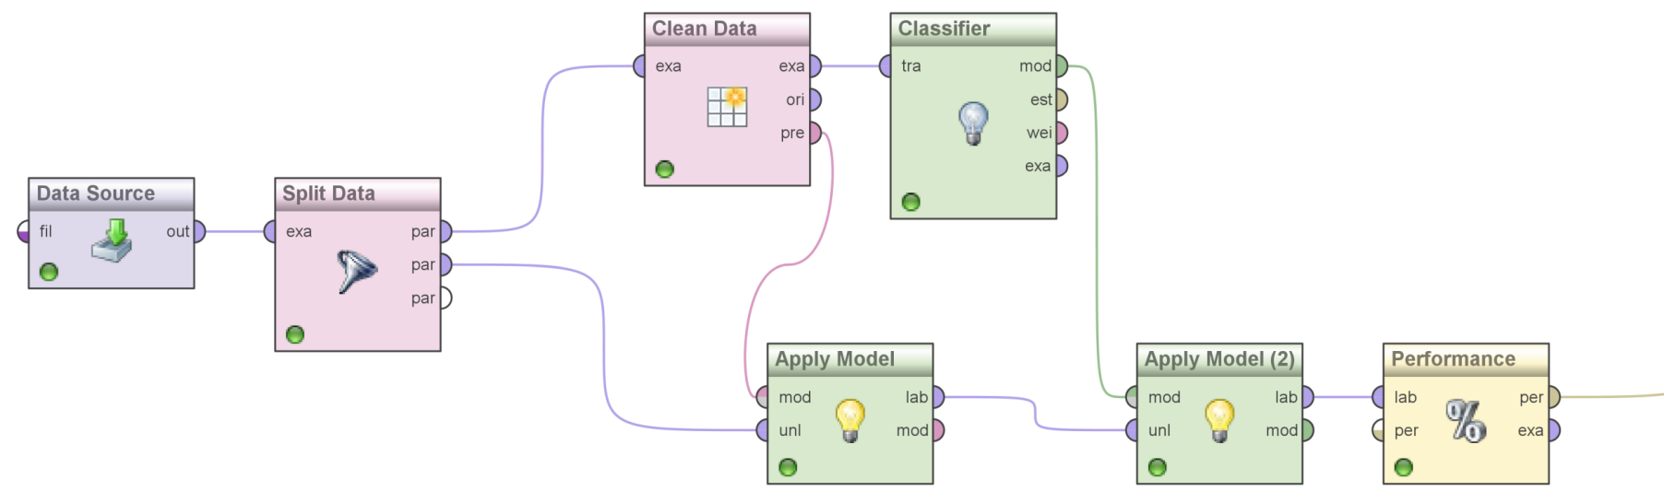
Hands-On with Rapidminer
Microtraining: Data Analytics
Implementation of a knowledge flow
Rapidminer provides operators for data processing, model building, and evaluation
Connection of operators leads to a knowledge and data flow
Notes:
Zeige Rapidminer,
Prozessdesigner, Repository, Operatoren, Parameter
Process-View und Result-View
Beispiel-Prozess bilden: datensatz nehmen, play, filtern, play, multiply, play
Prozess bilden, an Process-Output verbinden, und Play drücken. Wenn man nicht verbindet passiert gar nix.
Zeige Daten an, zeige Statistiken an, zeige Visualisierungen an
Einen kleinen Beispiel-Prozess gemeinsam implementieren:
Nehme Golf Datensatz und lasse in Ausgaben
Erkläre Datensatz (Klasse Play) und Attribute
Zeige Statistiken, Missing Values, Ausprägungen,
Zeige eine Beispiel Streudiagramm mit Attributen Outlook und Tempereature, Outlook = bewölkt sehr gut
Correlation Matrix nehmen und Daten analysieren. Matrix und Daten ausgeben.
Filter Examples nach der Korrelation und Parameter mit Play=yes und diese und unmatched ausgeben
Multiply und Decision Tree auf Daten anwenden (originalen Daten mit Multiply)
Decision Tree zeigen
Hinweis auf Outlook = Overcast → yes

Slide 36
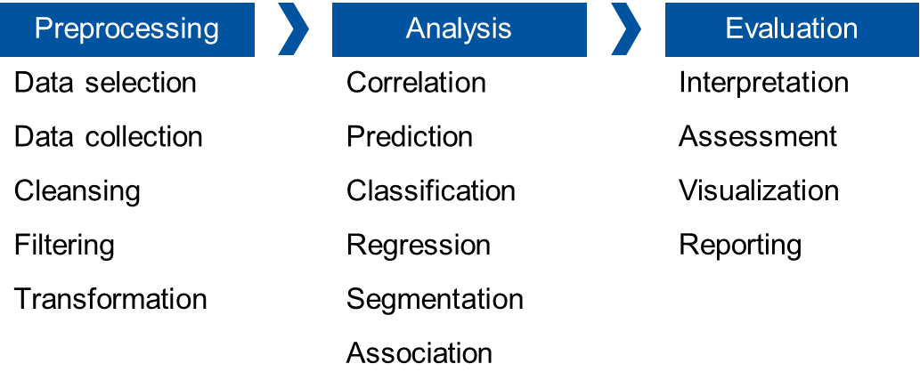
Hands-On with Rapidminer
Microtraining: Data Analytics
Task
Provided:
CSV-file with ~10.000 data records
Rapidminer Studio
Tasks:
Implementation of a data analytics process on the basis of the data
Use of 3 classification models for predicting „OK“ and „Failure“
Evaluation of the models with regard to accuracy and interpretability
Notes:
Mit Rapidminer setzen wir an dem Punkt Pre-processing an, obwohl schon sehr vieles im Voraus gemacht wurde.

Slide 37
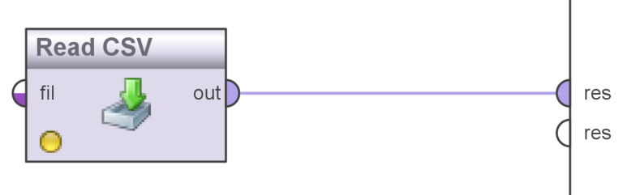
Hands-On with Rapidminer
Microtraining: Data Analytics
Step 1: Loading the data into Rapidminer
Together: Load csv-file into Rapidminer
Set role of attribute „Class“ to label
On your own: analyze the data by looking at statistics and charts (e.g. scatter plot)
Goal: understanding the data and the problem
Notes:
Class als Label setzten beim Laden der CSV-Date!!!
UND Class auf Binomial setzen!!

Slide 38
Hands-On with Rapidminer
Microtraining: Data Analytics
Classification process

Slide 39
Hands-On with Rapidminer
Microtraining: Data Analytics
Split data
Split the data into a training set (70%) and a test set (30%) (operator: Split Data, set parameters to 0.7 and 0.3)
Preprocessing of the training set
Replace all missing numerical attribute values in the training set with the average (Operator: Replace Missing Values)
Building models
Build classification model on the training set
Try the following models: Decision Tree, Rule-learner (Rule Induction) and Support Vector Machine
Evaluation
Apply the trained model on the test set (Operator: Apply Model)
Determine the quality of the prediction (Operator: Performance(Binomial Classification))
Use evaluation metric accuracy and AUC (i.e. set parameter)
Asses the models concerning their accuracy and interpretability
Notes:
In Step 3: connect models to the output so you can see them
5min
5min
15min
10min

Slide 40
Agenda Microtraining
Microtraining: Data Analytics
1
Theoretical Background
2
Use Case
3
Hands-On with Rapidminer
4
Exemplary solution and outlook

Slide 41
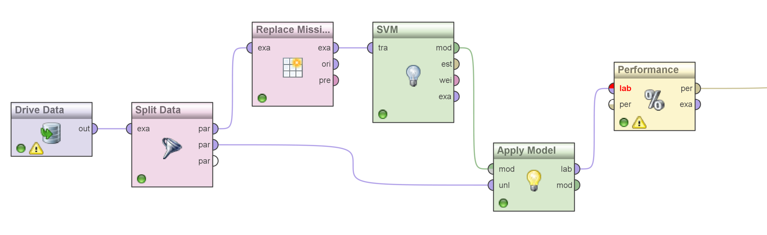
Exemplary solution and outlook
Microtraining: Data Analytics
Exemplary Solution
Notes:
Zeige den Beispiel Process (ob parallel oder einzeln ist egal)
Führe den Process in Rapidminer aus mit Decision Tree aus
Zeig den Decision Tree so wie er ist (groß und unübersichtlich aber gute Performance). Weise auf den ersten beiden Splits (Drilling Speed and Drilling Diameter)
Zeige Parameter vom Tree (Split-Kritierum für bestes Attribut)
Ändere die Parameter vom Tree (auf Tiefe 5 setzen) und zeige den neuen Baum (aber schlechtere Performance)
Zeige die Confidence-Zuweisungen für die Instanzen

Slide 42
Exemplary solution and outlook
Microtraining: Data Analytics
Comparison of 3 classification models
SVM
Complex model
High accuracy
Decision Tree & Rule-learner
High accuracies
Easily interpretable
Metric | Rule-learner | Decision Tree | SVM
Accuracy | 91.3% | 97.57% | 95.0%
AUC | 0.915 | 0.976 | 0.970
Size | 5 rules | 43 nodes, 41 leaves | 7400 SV

Slide 43
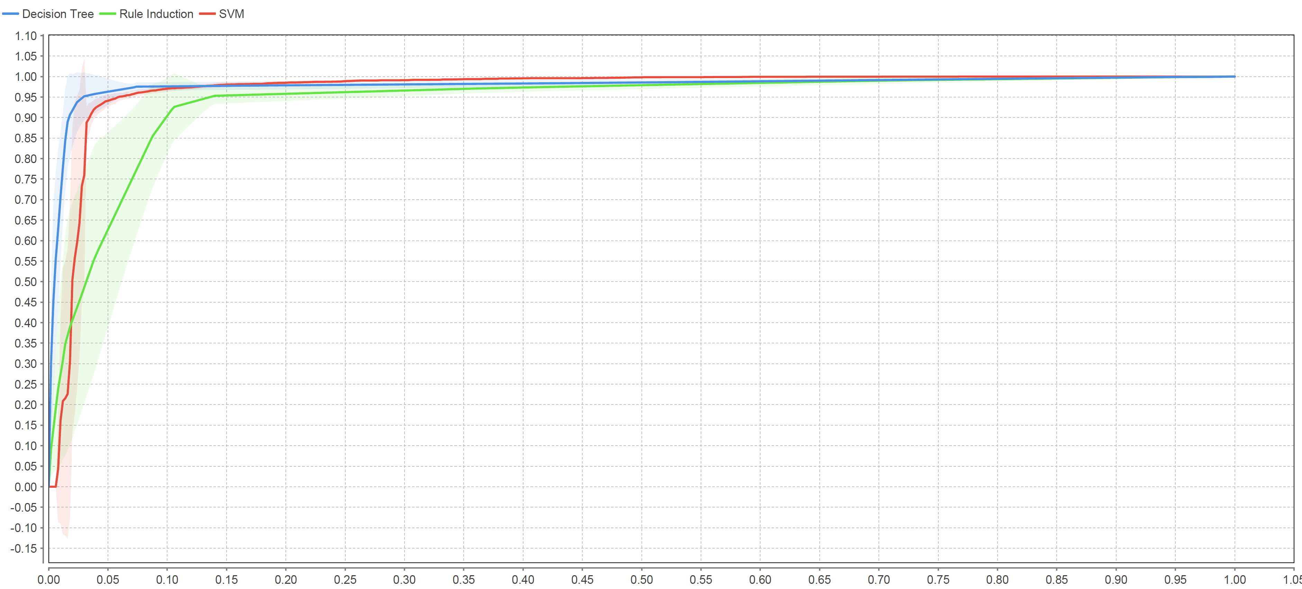
Exemplary solution and outlook
Microtraining: Data Analytics
Comparison of 3 classification models

Slide 44
Exemplary solution and outlook
Microtraining: Data Analytics
SVM: how about non-linear classification
Default SVM implementation in Rapidminer is based on the so-called “dot-product” (see parameter “kernel”)
For non-linear problems, other kernels might be more appropriate
How about a radial kernel (kernel type = radial)?
Metric | Dot | Radial
Accuracy | 95.20% | 99.37%
AUC | 0.970 | 0.982

Slide 45
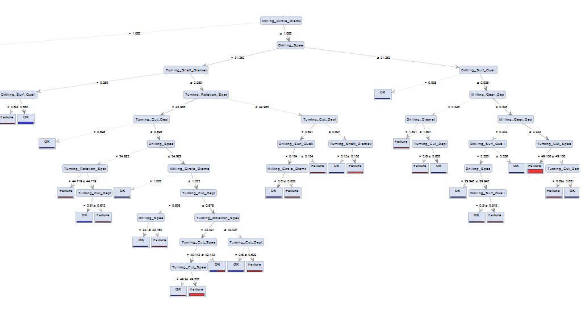
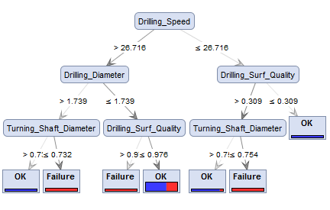
Exemplary solution and outlook
Microtraining: Data Analytics
Decision Trees with different sizes
Notes:
Kleinen Baum in Rapidminer analysieren: zeigen bei 2 Attributtests ist man beim Blatt. Wenn man zwei oder 3 Parameter ändert hat man schon einen Failure

Slide 46
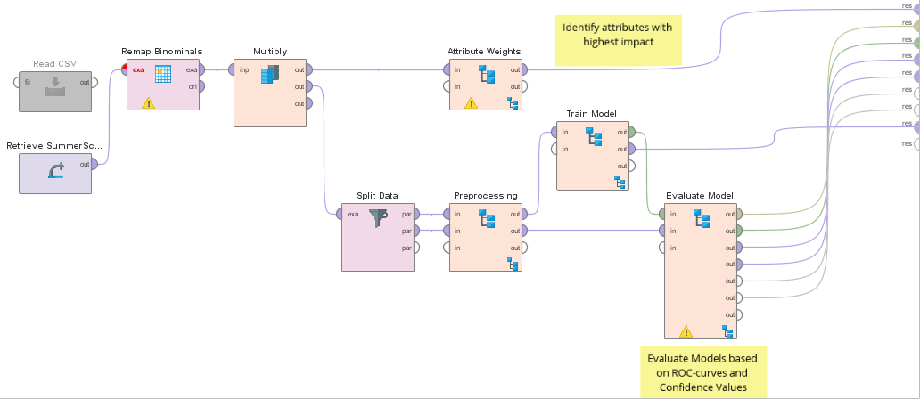
Exemplary solution and outlook
Microtraining: Data Analytics
Exemplary solution – Investigation of causes
Notes:
Sub-Processe, um die Übersichtlichkeit zu verbessern
2 weitere Sachen hinzugefügt
Eine weitere Evaluierungsmöglichkeit
Eine Möglichkeit zur Identifizierung der größten Einflussfaktoren innerhalb der Attribute

Slide 47
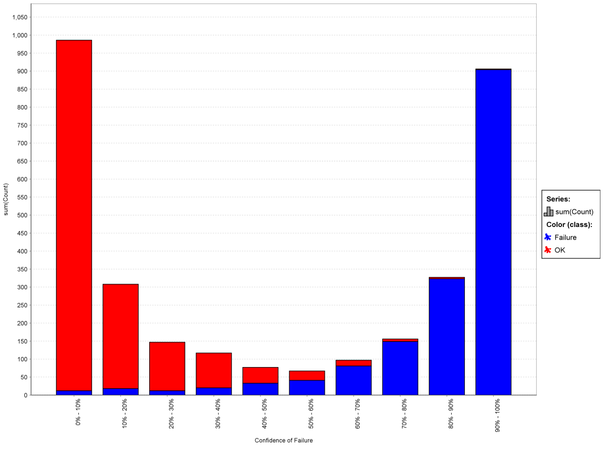
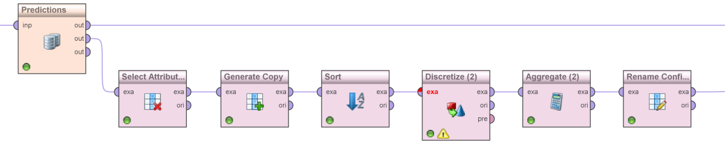
Exemplary solution and outlook
Microtraining: Data Analytics
Assessment of probability prediction (SVM)
Division of test set according to probability predictions of the model
Distribution of the real classes over the probabilities:
SVM separates very well between both classes (OK and Failure)
Notes:
Man kann sich ein Diagramm „zusammenbauen“, das ein bisschen als Alternative zur ROC-Curve dient.
Wir haben die Wahrscheinlichkeitszuweisungen des Klassifizierers gesehen
Nun können wir schauen, wie gut diese Zuweisungen für z.B. einen Fehler funktionieren. Wenn man die Werte sortiert und in Dezile einteilt, kann man zählen wie viele tatsächliche Fehler in den Dezilen sind.
Was man sieht: hohe Wahrscheinlichkeit für Fehler (rechte Seite), da gibt es kaum Fehler, die meisten dieser Instanzen sind auch tatsächlich Fehler gewesen und umgekehrt
Also: sehr gute Trennung zwischen Fehler und nicht Fehler.

Slide 48
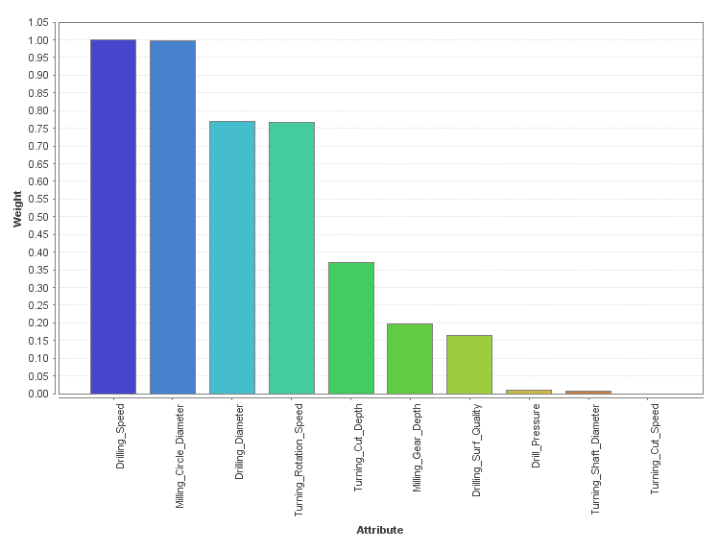
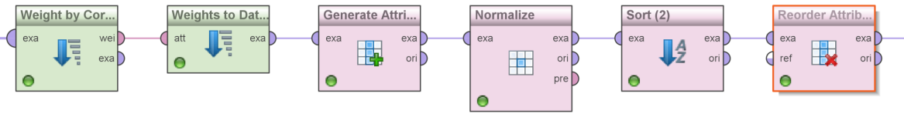
Exemplary solution and outlook
Microtraining: Data Analytics
Correlation analysis to identify most influential attributes
Drilling-speed and milling-circle-diameter correlate the most with the process output
Further procedure possible: removing irrelevant attributes
Improves the performance
Notes:
Diesen Teil in Rapidminer machen
Nun kann man sehr viel mehr machen als nur Prognosemodelle anschauen
Wir haben im Entscheidungsbaum gesehen er Attribut Drilling-speed als erstes genommen hat, aber warum?
Man kann sich z.B. anschauen, wie stark die Eingangsattribute mit der Klasse korrelieren → Identifikation der stärksten Einflussgrößen
Wobei zu beachten ist: Korrelation ist mit Vorsicht zu genießen, es muss nicht immer gültig sein. Dennoch, man sieht, dass attribute drilling speed, milling-circle-diameter, drilling diameter am meisten korrelierend sind
Weitergedacht: es gibt einige irrelevante Attribute. In einem weiteren Vorgehen würde man nun versuchen, diese Attribute zu entfernen. Das ist vor allem dann wichtig, wenn man zu viele Attribute hat, es gibt Szenarien da hat man mehrere Hundert Attribute, da ist eine Reduktion unbedingt nötig.

Slide 49
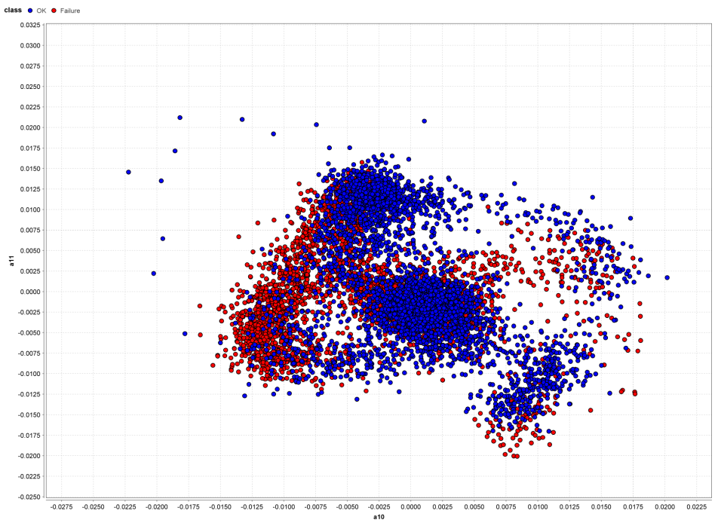
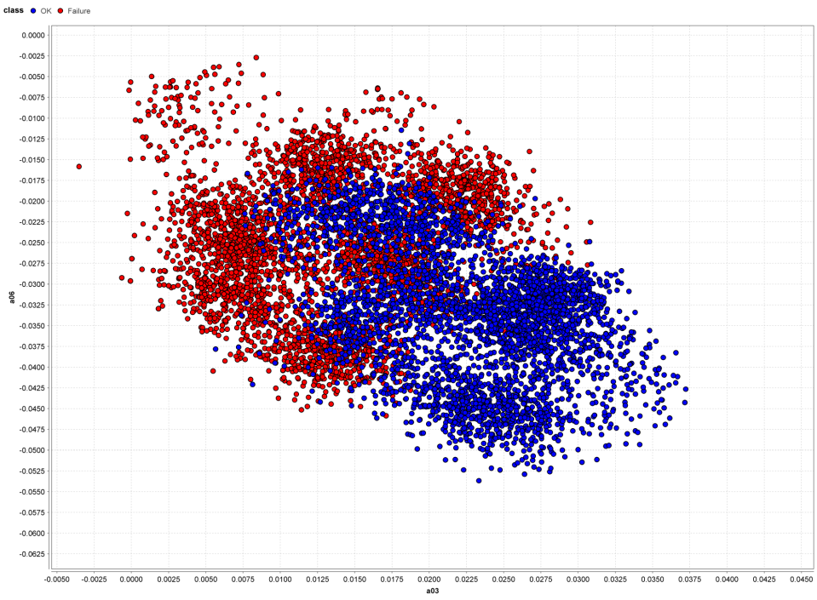
Exemplary solution and outlook
Microtraining: Data Analytics
Separation of classes in 2-dimensional space
Milling gear depth and turning cutting depth
Bad separation!
Drilling diameter and drilling speed
Better separation!
Notes:
- Diesen Teil auch in Rapidminer zeigen
Warum die einen so großen Einfluss haben, kann man an den Streudiagrammen erklären (alle Instanzen im 2-Dim Raum)
Drilling-diameter und drilling-speed machen gute separierung. Auch der Baum hat das Erkannt!
Milling-gear depth und turning cutting depth machen bad separation

Slide 50
Exemplary solution and outlook
Microtraining: Data Analytics
Lessons Learned
Successful application of data analytics in production
Important notes
Appropriate selection of input data (domain knowledge needed)
Several steps of data preprocessing
Selection of appropriate analysis and evaluation methods
Benefit of data analytics for the gear shaft process
Building precise models for predicting the process output („OK“ und „Failure“)
Identification of relationships within the data
Visual analysis of the findings
Notes:
Beachte, dies war nur ein Use Case, nämlich die Prediction für das End-produkt auf Basis des gesamten Prozesses.
Außerdem waren das nachgelagerte Analysen jetzt, als Entscheidungsunterstützung für den Menschen, es kann aber auch automatisierte Sachen gemacht werden.
Es gibt noch viele andere Use-Cases, die man für diesen Gear Shaft Process machen könnte.

