Slide 1
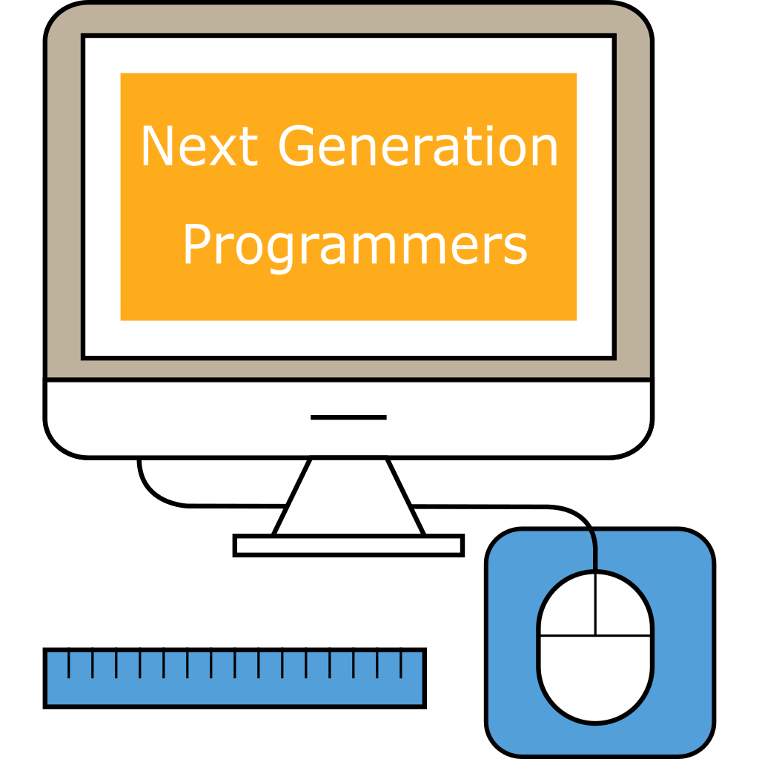
Introduction to Android Studio

Slide 2
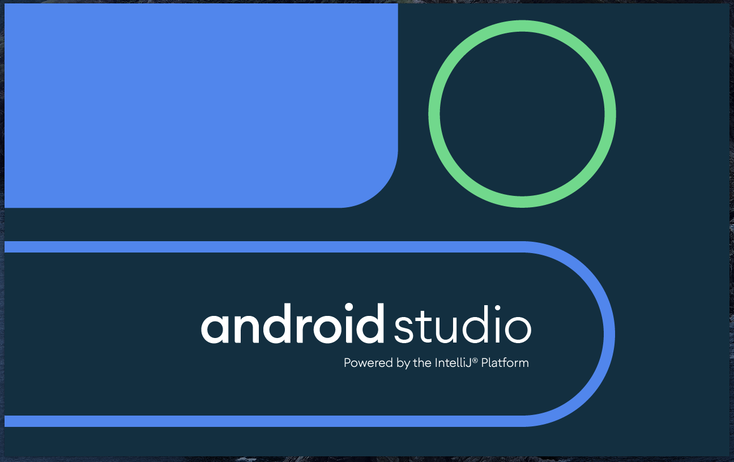
Android Studio is an IDE (= integrated development environment) for writing code for Android OS (=Operating System)
IDE is like a “Word” processor but for code
It simplifies writing, structuring, debugging code (=find errors/mistakes)
We will learn how to create Android apps in Java language
80% of mobile apps for Android are written in Java

Slide 3
Task 1: Let’s open & run a ready-made app

Slide 4
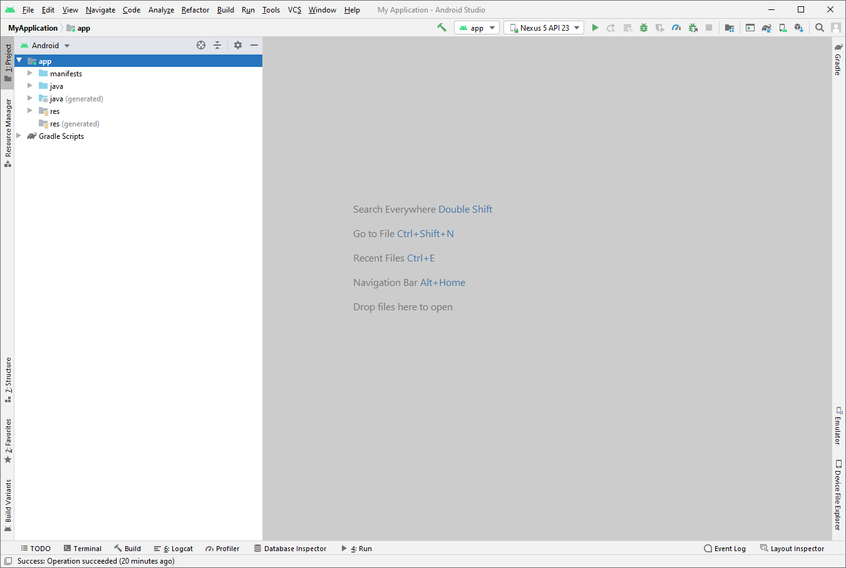

Slide 5
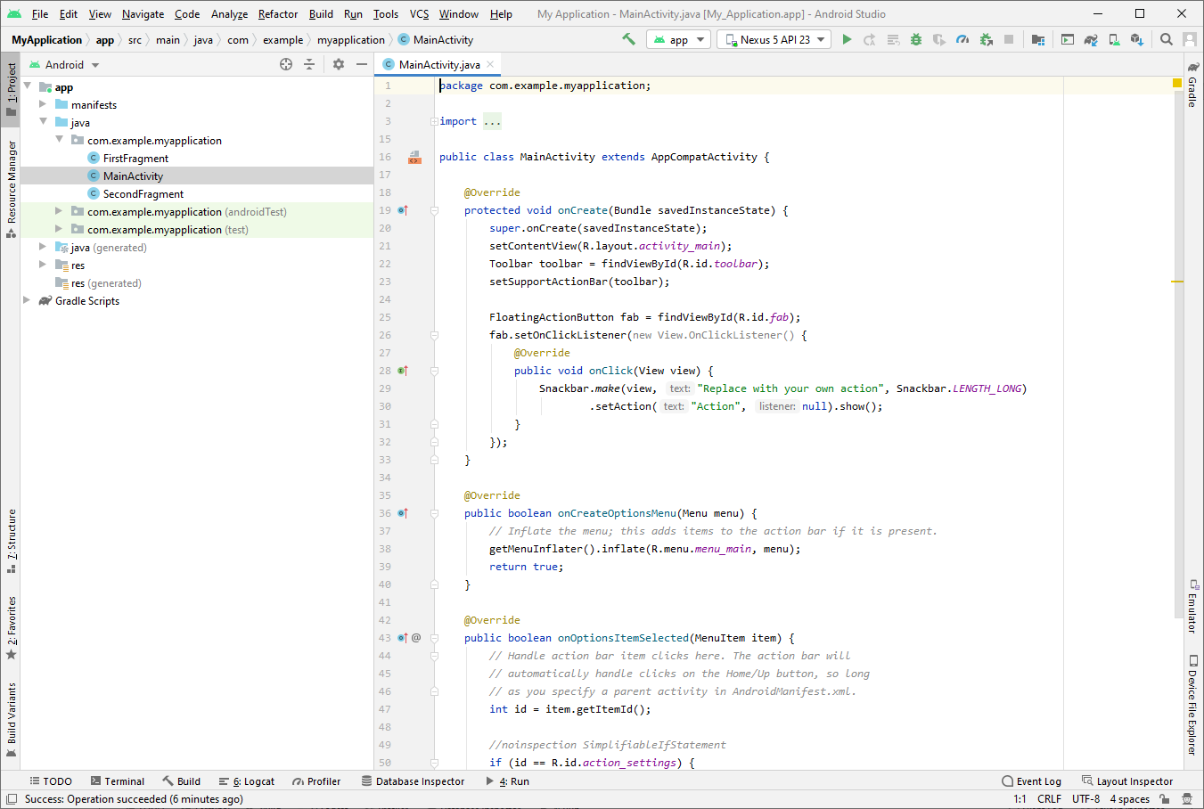

Slide 6
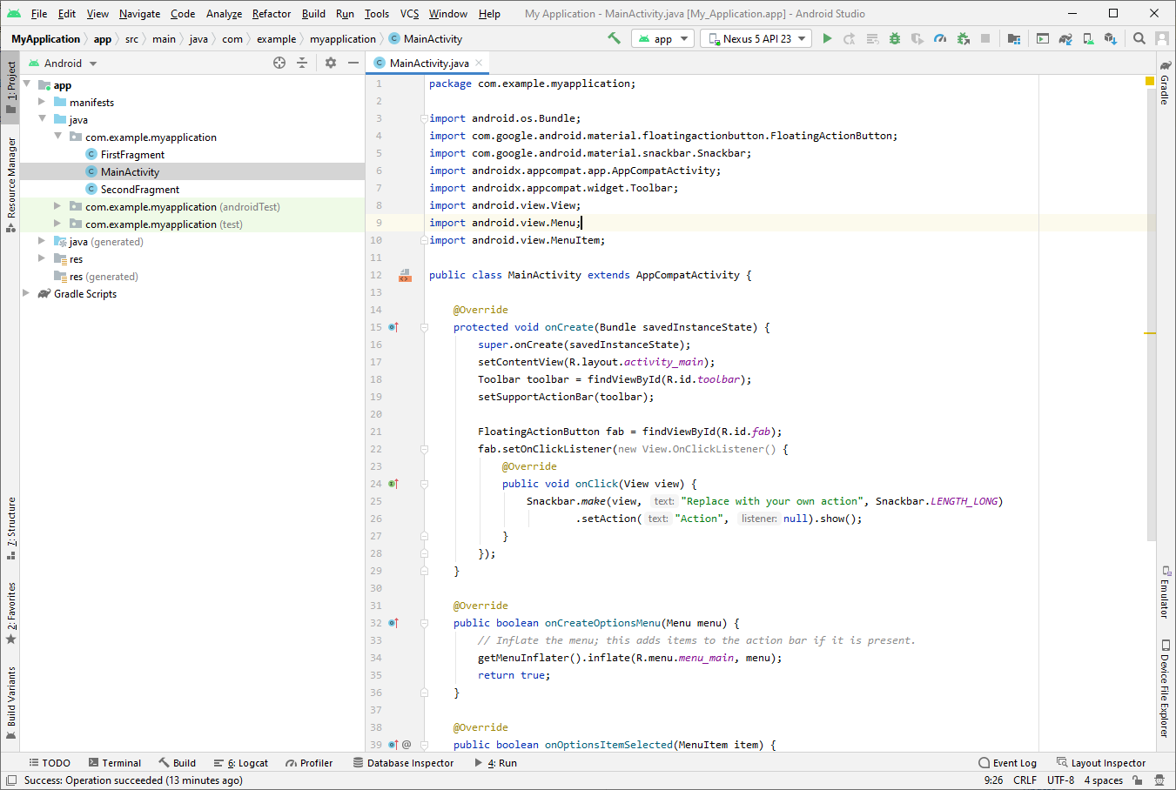
Function

Slide 7
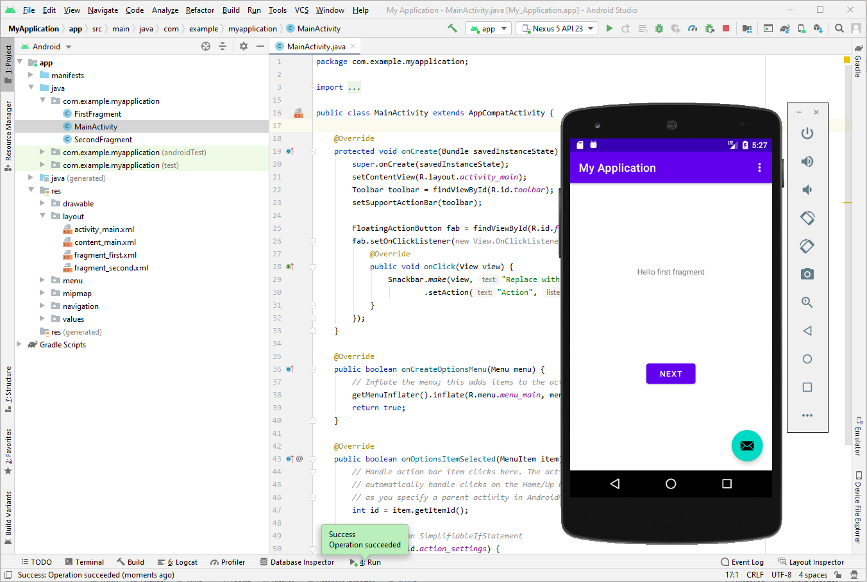

Slide 8
Task 2: Let’s edit the text!
Change the text to anything you want, for example: “My name is X and I am a Next Generation Programmer.”

Slide 9
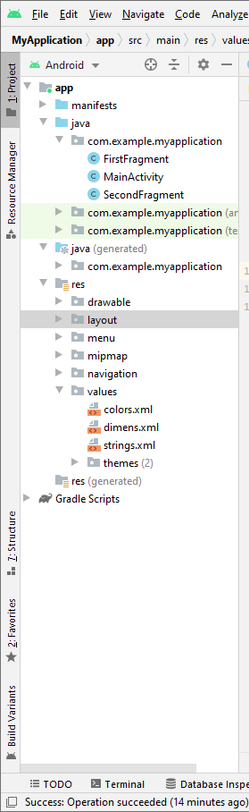
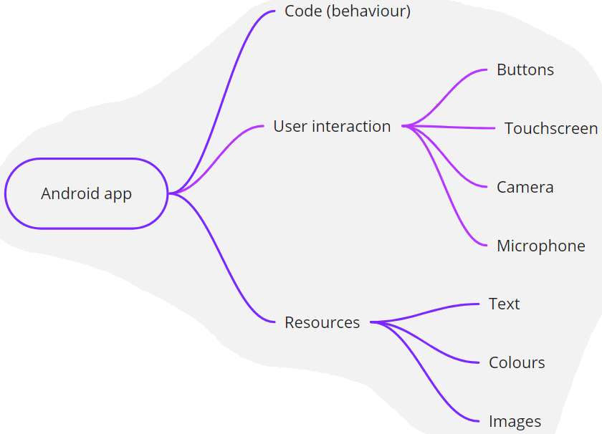

Slide 10
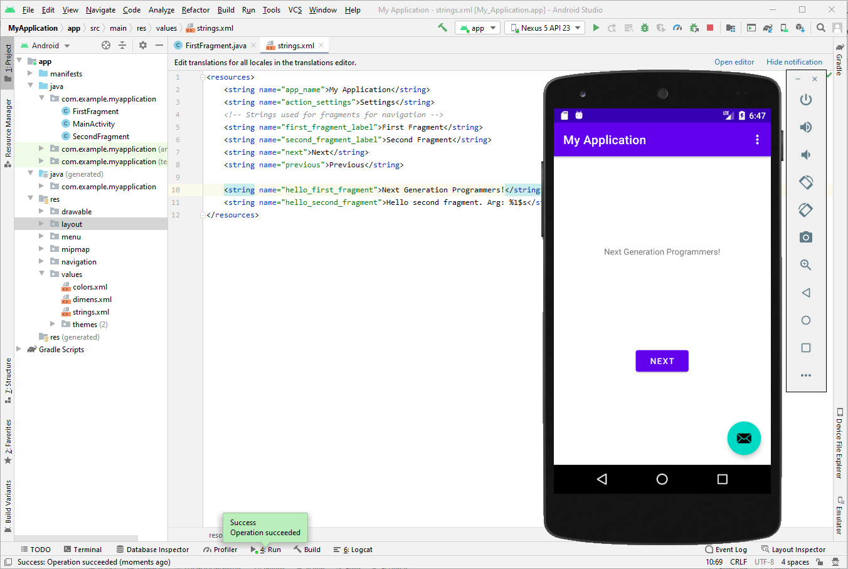

Slide 11
Task 3: Let’s edit the colour!

Slide 12
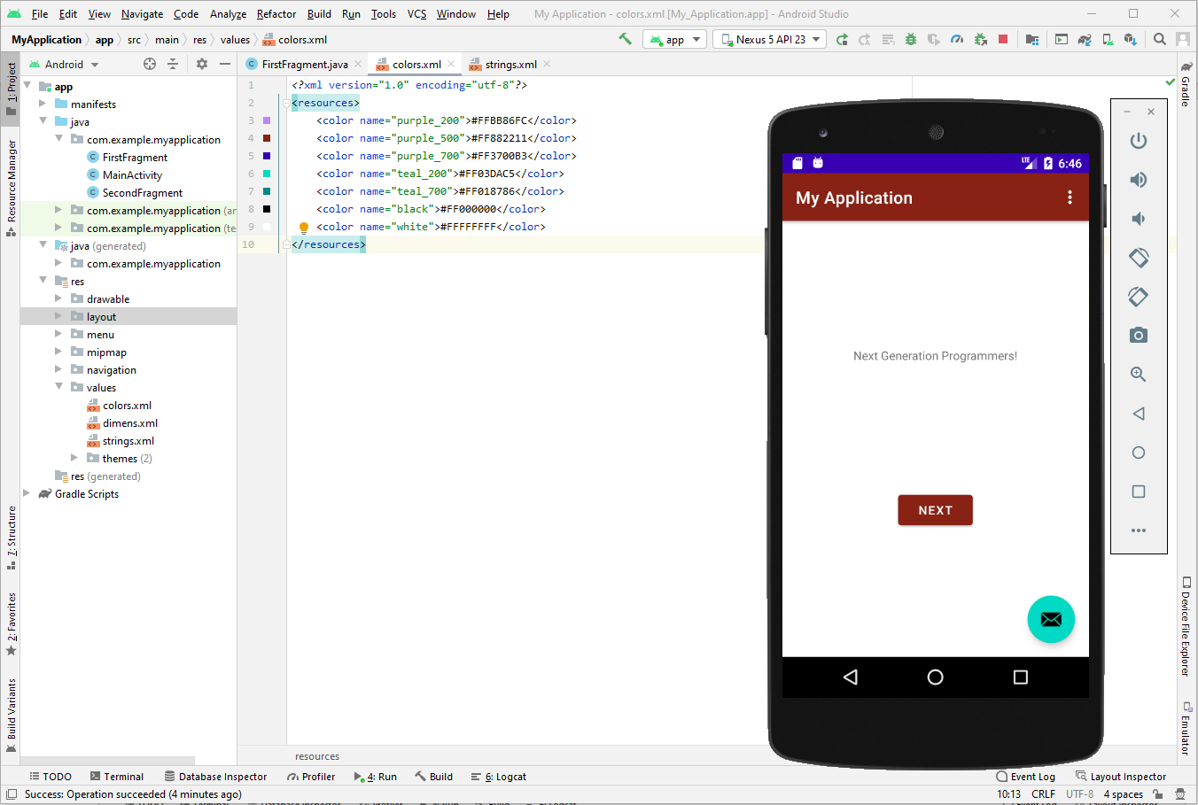

Slide 13
Bonus task: Let’s add another button
Add a button

Slide 14
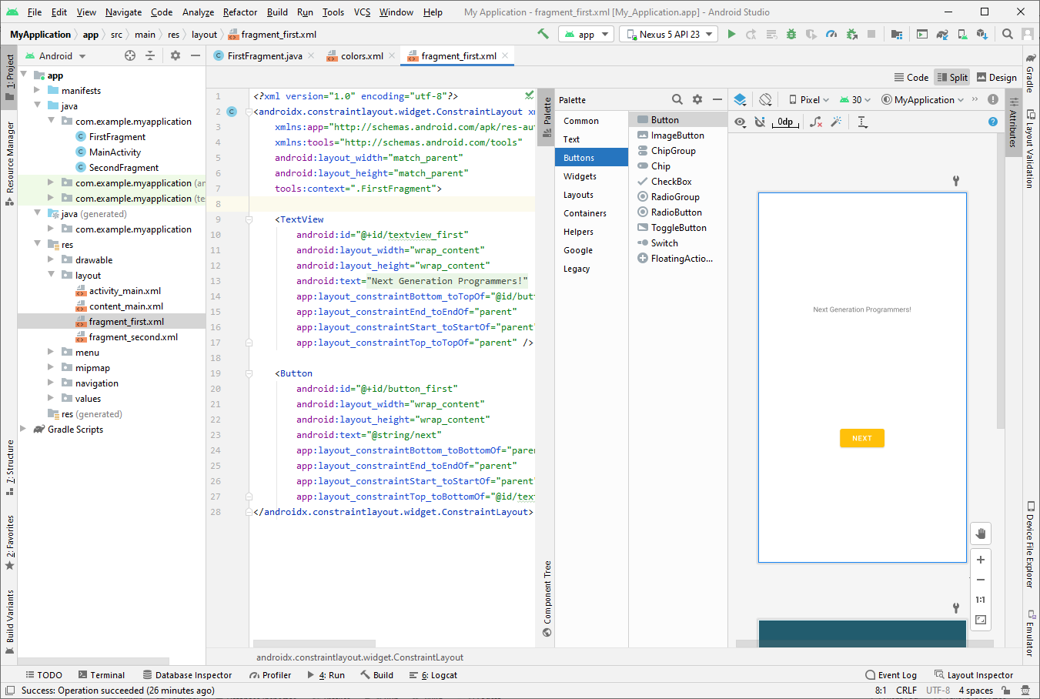

Slide 15
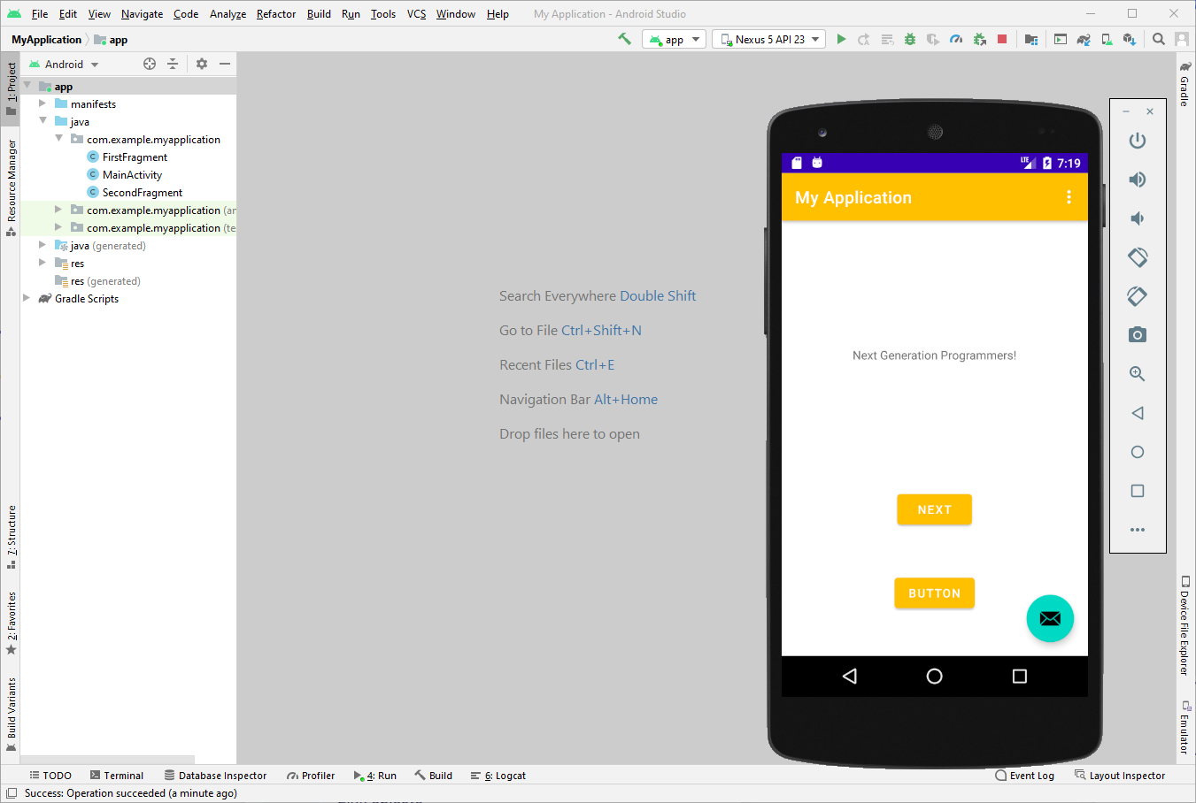

Slide 16
Common glossary
UI / GUI / HMI
Development
Implement
Edit
Test
Run
Debug

