Slide 1
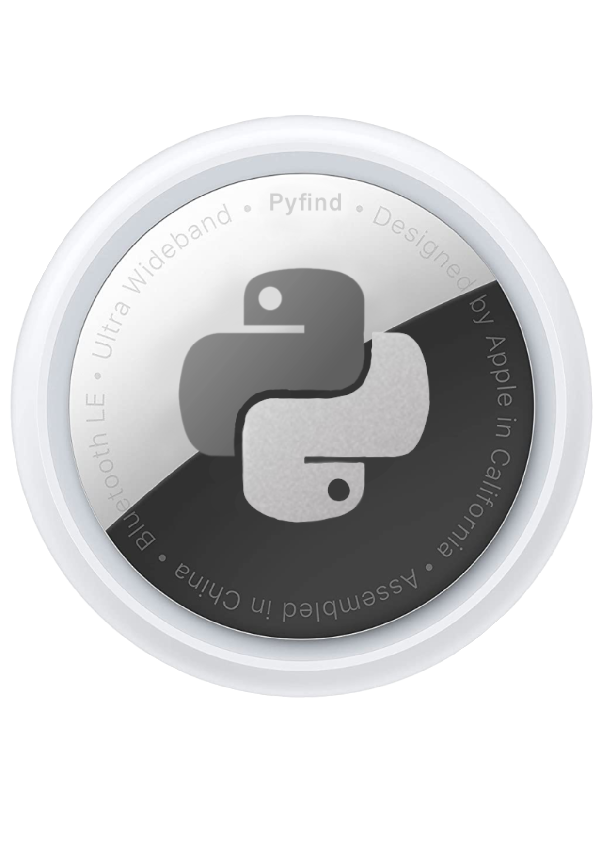
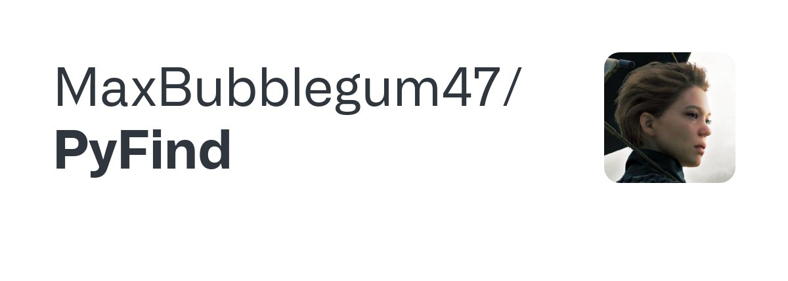
Lorenzo Stigliano, Crittografia Applicata 2023

Slide 2
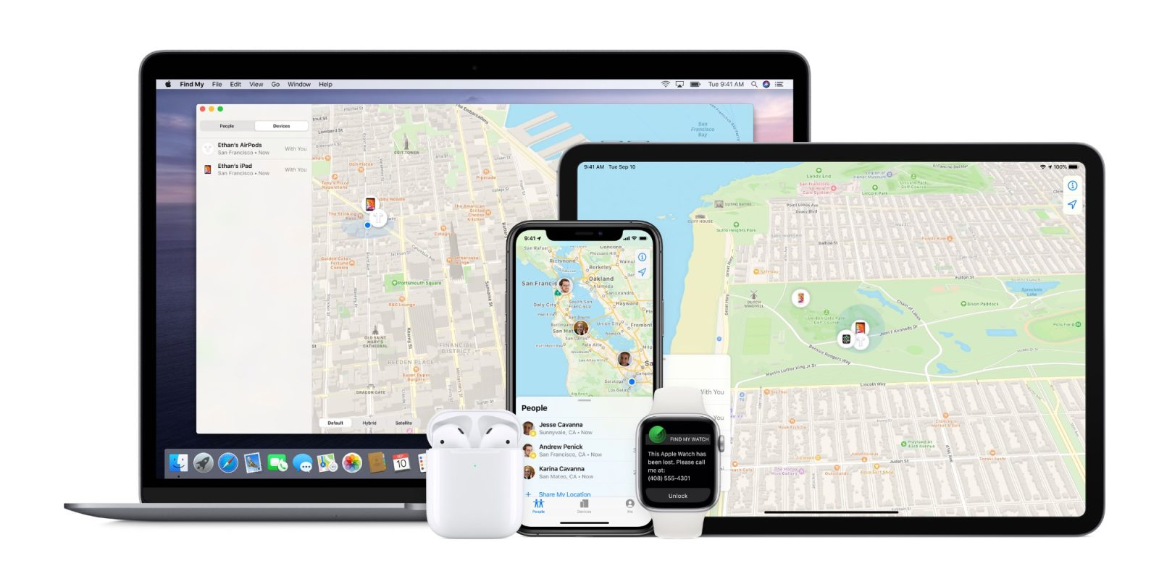
One App to find it all.

Slide 3
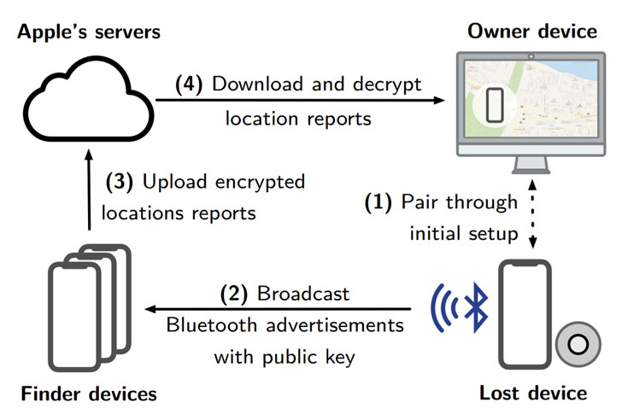
How does it work?

Slide 4
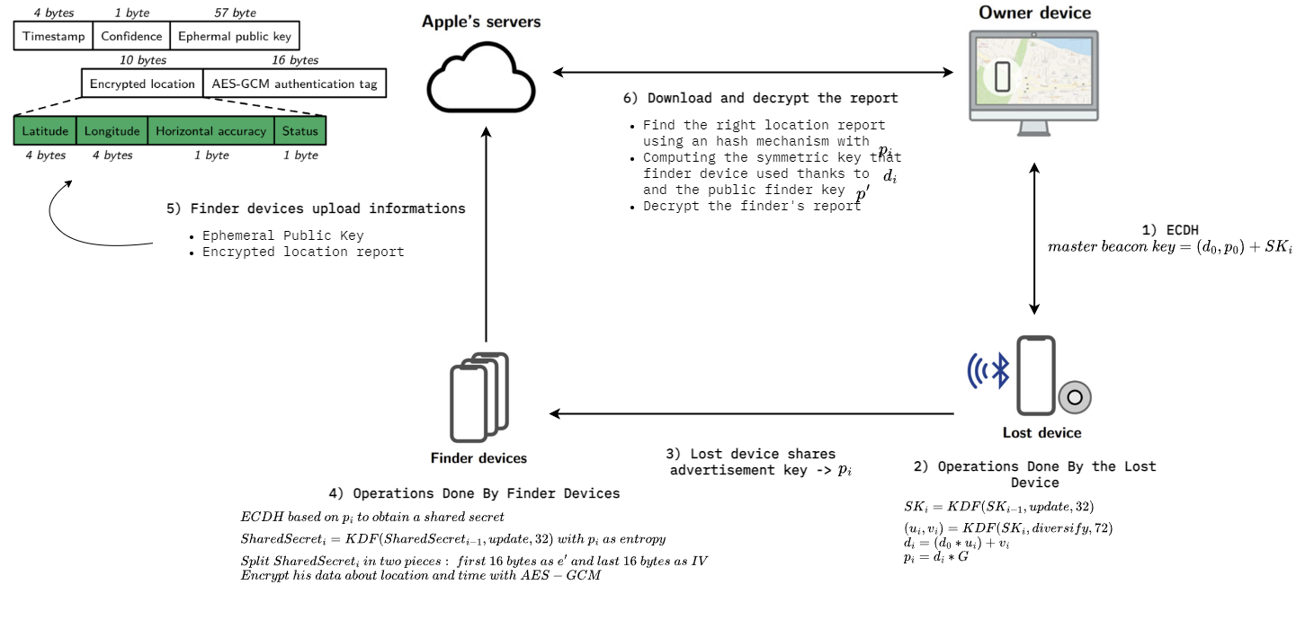
How does it work? [Detailed Edition]

Slide 5
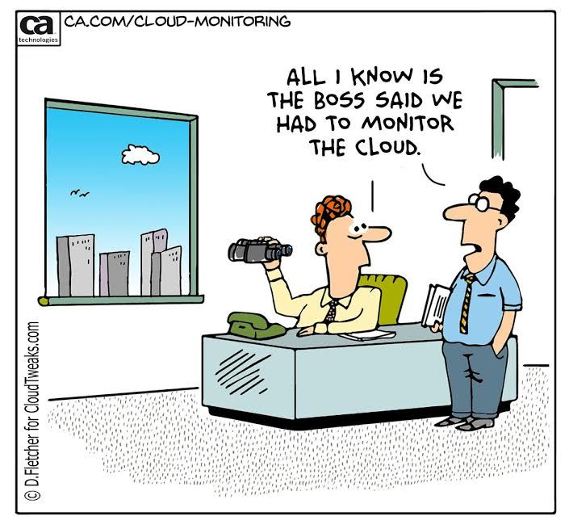
There is something missing…
How do we know the EXACT advertisement key produced by a missing device???

Slide 6
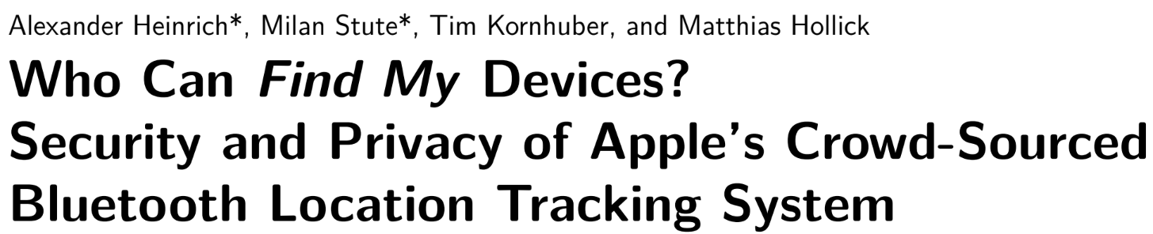
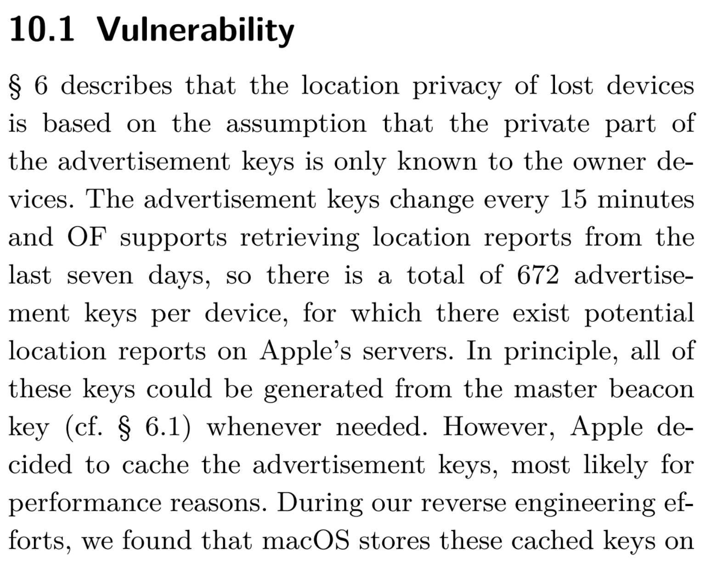
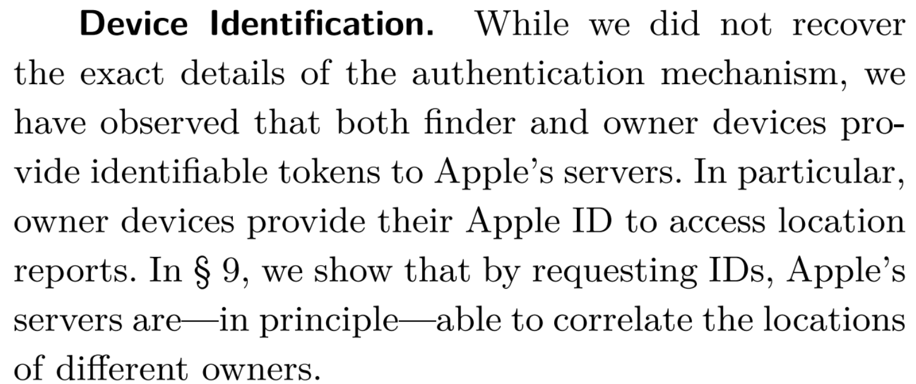
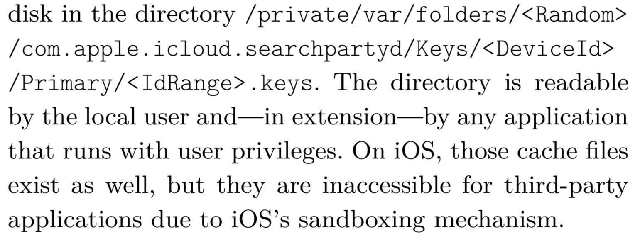









Slide 7
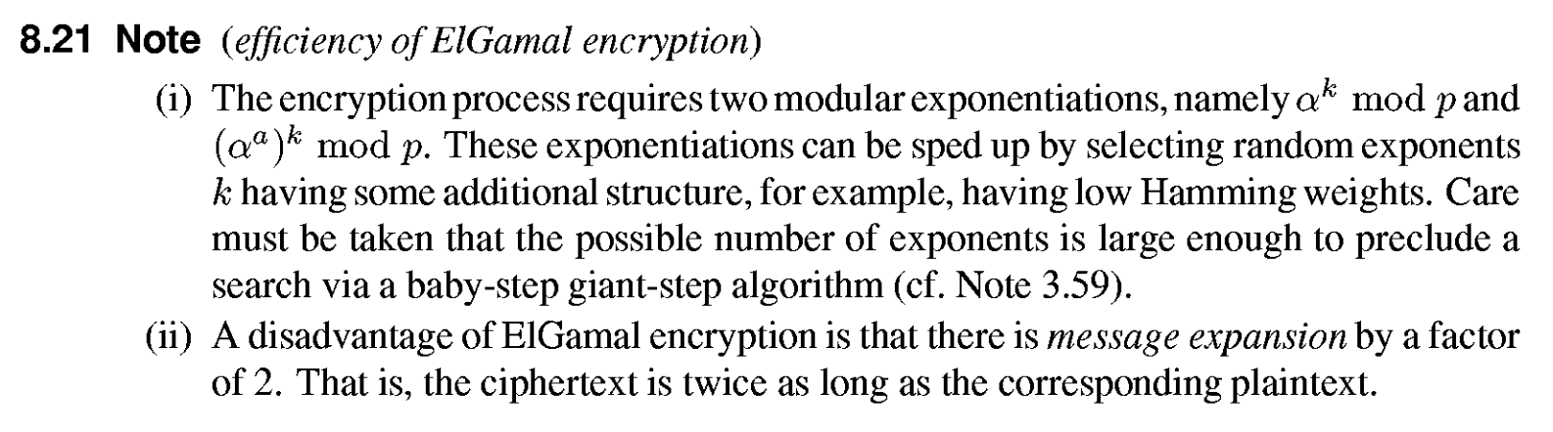
Alternatives to ECDH?
Why do we not use Elgamal??? OVERHEAD

Slide 8
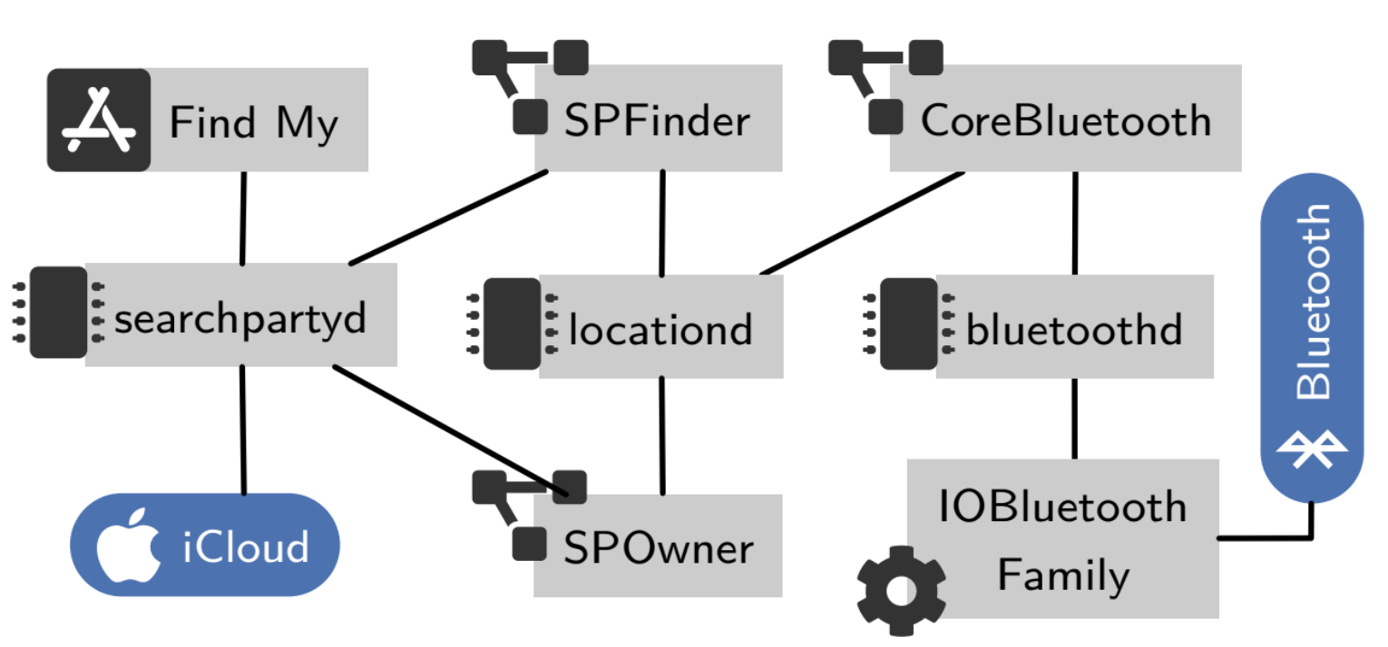
Technical Implementation

Slide 9
Demo Time!

