Slide 1
FreshAirIot
Lorenzo Stigliano, 185534 Modena
July 17th 2024

Slide 2
What is FreshAirIot?

Slide 3





What we breath?

Slide 4
How it works?

Slide 5
01
03
Sense the environment
React
Use senors to collect information about the environment
Use the actuator to display the result of the analysis
02
04
Analyze data
Notify
Gather and analyze all the data collected by the sensors
Notify the user about air pollution forecasting and other information

Slide 6
How it’s done?

Slide 7

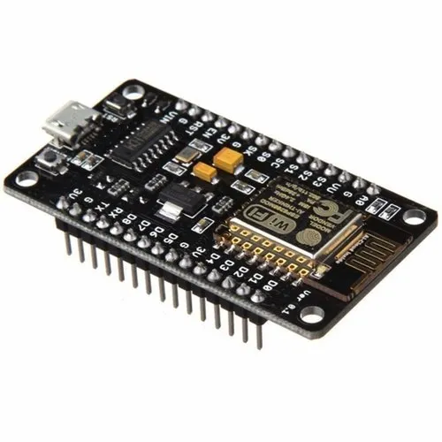
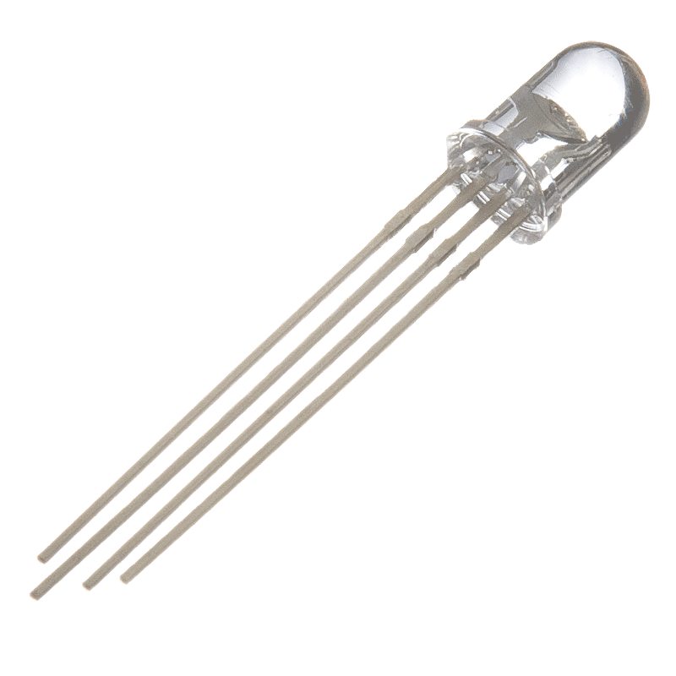
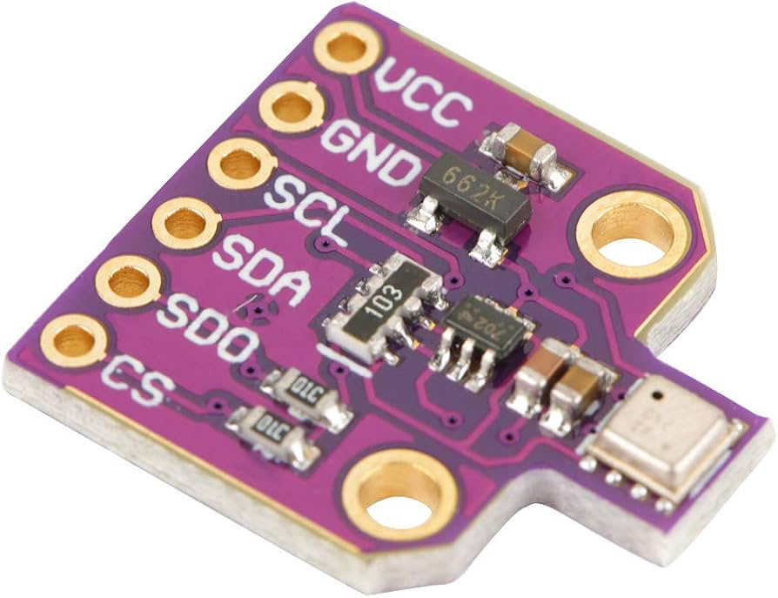
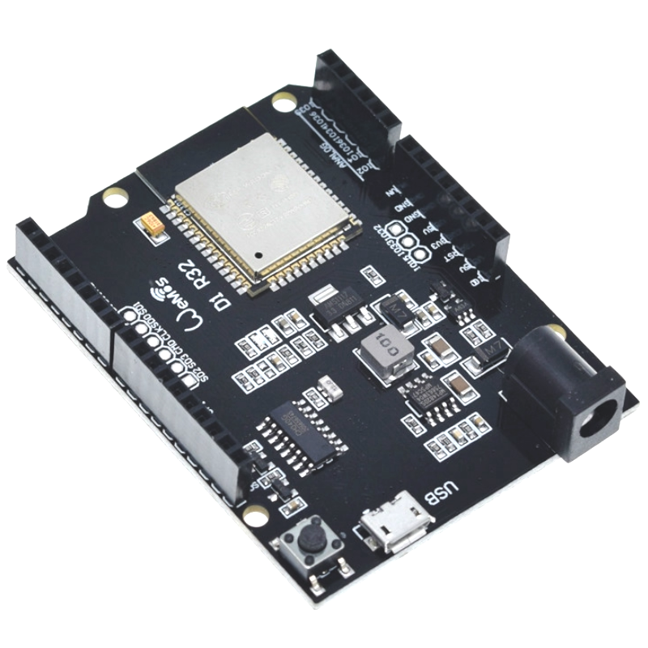
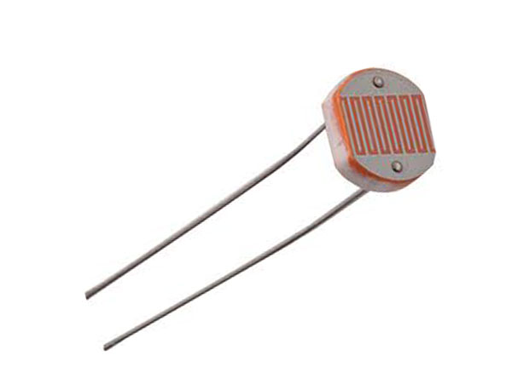


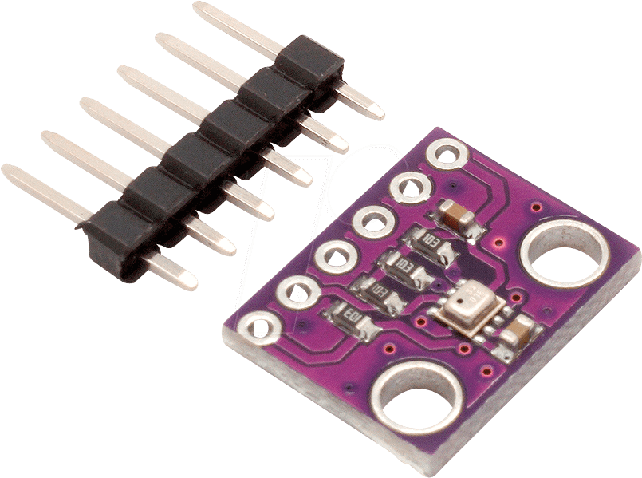
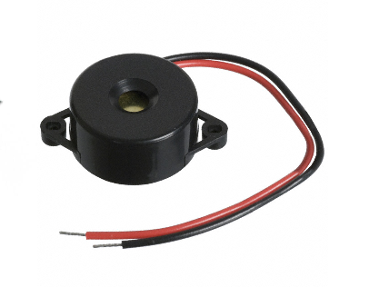
ESP 8266
BME680
ESP32
BME280

Slide 8
What to do next?
Improving CO2 Forecast
GUI option for telegram bot
LORA Implementation
Local MQTT Broker

Slide 9
Thanks!

