Slide 1



AZURE AI FOUNDRY · MULTI-AGENT REFERENCE SOLUTION
MMC Multi-Agent
Manufacturing Assistant
A Magentic manager turns one plant-floor question into a plan — then dispatches a network of 10 portal-managed Foundry prompt agents grounded in policy docs and live Azure SQL rows.
Solution Overview · v1.0 · June 2026

Slide 2



WHAT IT IS
One question in. A cited, ledger-grounded answer out.
10
A user asks a real manufacturing question — e.g. “an open PO for a brake-caliper part is flagged At Risk; which Plant 7 Line 1 PM tasks use it, and is there a backup supplier?”
portal-managed
Foundry prompt agents
A Magentic manager decomposes it into a plan, picks the right specialists from a pool of 10 agents, dispatches them in sequence or parallel, watches every output, replans when a path dead-ends, and synthesizes a final answer with citations down to the individual SQL row.
2
Azure AI Foundry
projects (plant + ent.)
Every plan, hop, and replan streams live to a FastAPI + SSE trace UI — the orchestration is watchable in real time.
283
live SQL rows across
5 change-tracked tables
Midwest Mobility Components · Multi-Agent Manufacturing Demo
02

Slide 3


HOW IT WORKS
Three tiers, one source of truth
Everything below derives from a single profile.yaml — agents, knowledge sources, and tools all live in one place.
TIER 1
TIER 2
TIER 3
Orchestrator
Agents
Knowledge
Magentic manager
10 Foundry prompt agents
Foundry IQ + Azure SQL
Decomposes the question into a plan
Dispatches agents, watches the ledger, replans
Manager (gpt-5.4) + workers (gpt-5.4-mini) on separate deployments
Portal-managed PromptAgentDefinitions — visible & editable in Foundry
5 plant + 5 enterprise specialists
Foundry IQ knowledge baked in as an MCP tool
Policy docs (SOPs, OEM manuals) via doc index
Live operational rows via IndexedSqlKnowledgeSource
Managed-identity auth + SQL change tracking
Midwest Mobility Components · Multi-Agent Manufacturing Demo
03

Slide 4
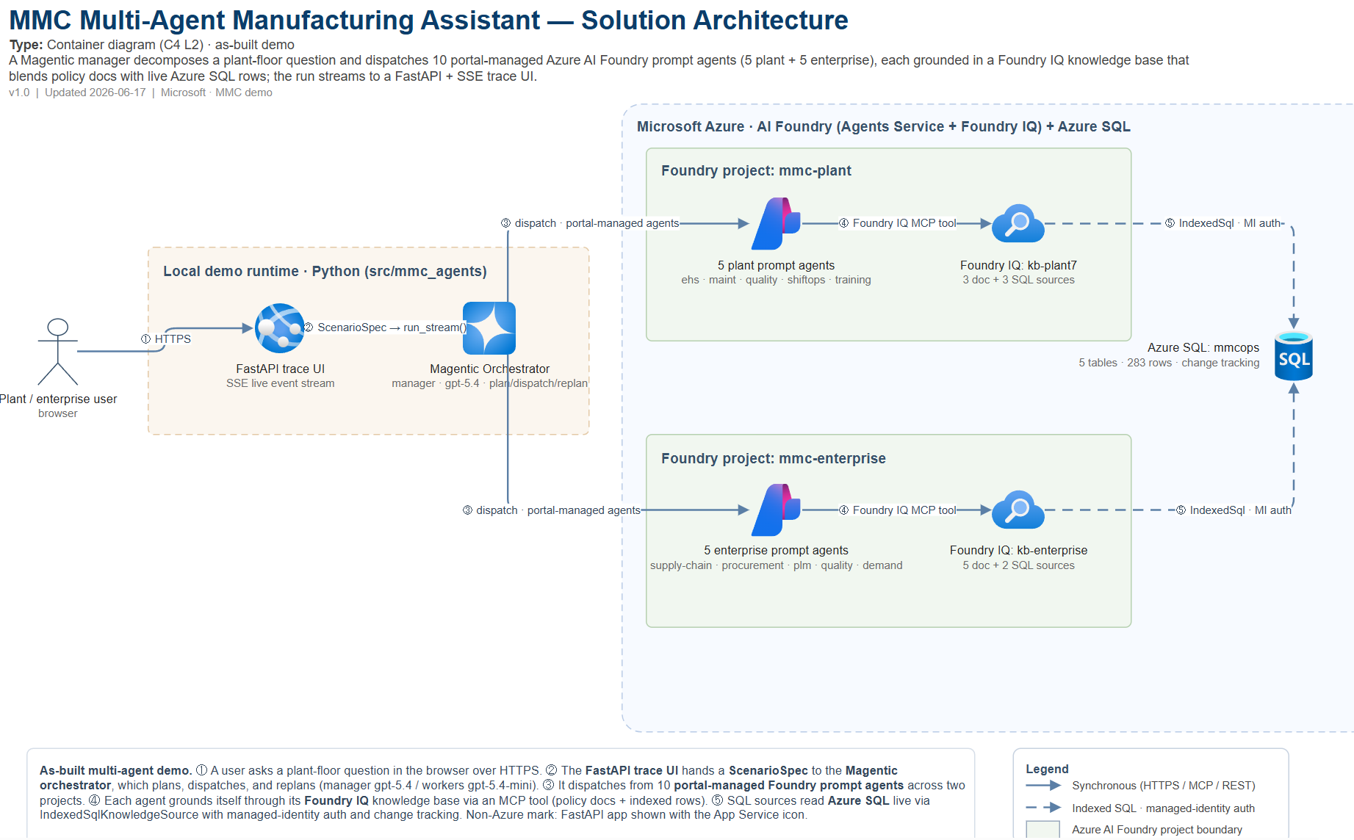
ARCHITECTURE
Solution architecture — Container view (C4 L2)
Midwest Mobility Components · Multi-Agent Manufacturing Demo
04

Slide 5
THE AGENT NETWORK
Ten specialists across two Foundry projects
mmc-plant
mmc-enterprise
Plant 7 floor operations
Cross-plant enterprise functions
plant7-ehs
EHS · machine guarding · incidents
ent-supply-chain
suppliers · logistics · BOM
plant7-maintenance
PM schedules · work orders
ent-procurement
POs · contracts · should-cost
plant7-quality
NCR/CAPA · QA specs
ent-engineering-plm
ECOs · part numbering
plant7-shiftops
changeover · shift handover
ent-quality
warranty · recall thresholds
plant7-training
LOTO certs · competency
ent-demand-program
OEM programs · allocation
The orchestrator merges both pools into one participant set of up to 10 — each scenario whitelists only the agents it needs.
Midwest Mobility Components · Multi-Agent Manufacturing Demo
05

Slide 6


GROUNDED IN TRUTH
Two kinds of knowledge, deliberately split
Policy documents
Operational rows
searchIndex · doc indexer
IndexedSqlKnowledgeSource
SOPs, OEM manuals, regulatory & quality docs
Markdown / PDF pushed to Azure AI Search
Answers the “how / why / per-procedure” questions
Training, PM, incidents, suppliers, POs
Indexed live from Azure SQL, PK as document key
Returns discrete, cited rows — listed verbatim
Why split docs from rows?
When the same data lived in both, the agent paraphrased a doc chunk instead of citing the row — and replanned to max_rounds. Splitting row data into a SQL knowledge source made retrieval return exact, cited rows. That one change made the demo trustworthy.
Midwest Mobility Components · Multi-Agent Manufacturing Demo
06

Slide 7
DEMO SCENARIOS
From a one-agent spot-check to a ten-agent fan-out
Scenario | What it shows | Agents | Scale
training_gap | LOTO certs expiring — cites Training_Log rows | 1 | ~1 hop
po_status | Open POs flagged At Risk — cites po_spend rows | 1 | ~1 hop
pm_check | Line 1 PMs with follow-up work orders this quarter | 1 | ~1 hop
supplier_risk_pm | At-risk PO → dependent PMs → backup supplier (cross-KB) | 3 | 6–10 hops
loto_cluster | Cluster L1 Press near-misses → escalate to ent. quality | 5–6 | ~15 hops
brake_caliper | Full fan-out: delay impact, mitigation, cost + replan | 10 | ~30 hops
Same code, same agents, same data. Only the participant whitelist and max_rounds change — the network scales from a trivial lookup to a full multi-agent investigation.
Midwest Mobility Components · Multi-Agent Manufacturing Demo
07

Slide 8


WHY IT MATTERS
A blueprint for trustworthy, watchable agent networks
Cited, not paraphrased
Portal-managed & composable
Row-level SQL grounding means every claim traces to a specific record — recall thresholds and at-risk POs you can trust.
Agents are Foundry PromptAgentDefinitions, visible and editable in the portal. Add an agent in profile.yaml and re-seed.
Watchable orchestration
Scales by configuration
Plan, every hop, and every replan stream live to the trace UI — the manager's reasoning is observable, not a black box.
One engine spans a 1-hop spot-check to a 10-agent fan-out. Whitelists and caps keep narrow scenarios narrow.
Built on Microsoft Agent Framework · Azure AI Foundry (Agents Service + Foundry IQ) · Azure SQL

