Slide 1

01
The Flint tool
Jabil | Flint
Understanding Downtime Causes
02
The mini pilot
03
Next steps
Appendices
A SEVEN-DAY MINI PILOT PROPOSAL
For shift supervisors and their managers.

Slide 2
01
The Flint tool.
Behavior change in the flow of work, in under nine minutes a week.

Slide 3
One activity a week, run on shift, and coached until it sticks.
1
Flint activity
A short task targeting one behavior, tied to the line’s standard work.
The habit takes hold
Naming causes becomes part of how a shift is run, and reaches the business to act on.
3
2
Log, manager validates
On-the-floor action
They report what happened; the manager confirms it matches what they saw.
The supervisor runs it at their next real downtime event or shift report.
<9 minutes a week in-tool.

Slide 4
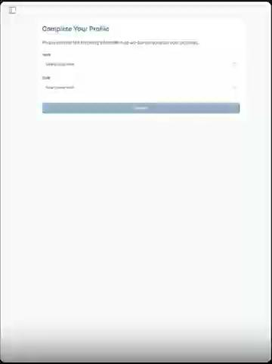
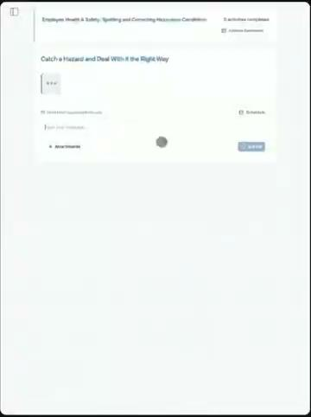
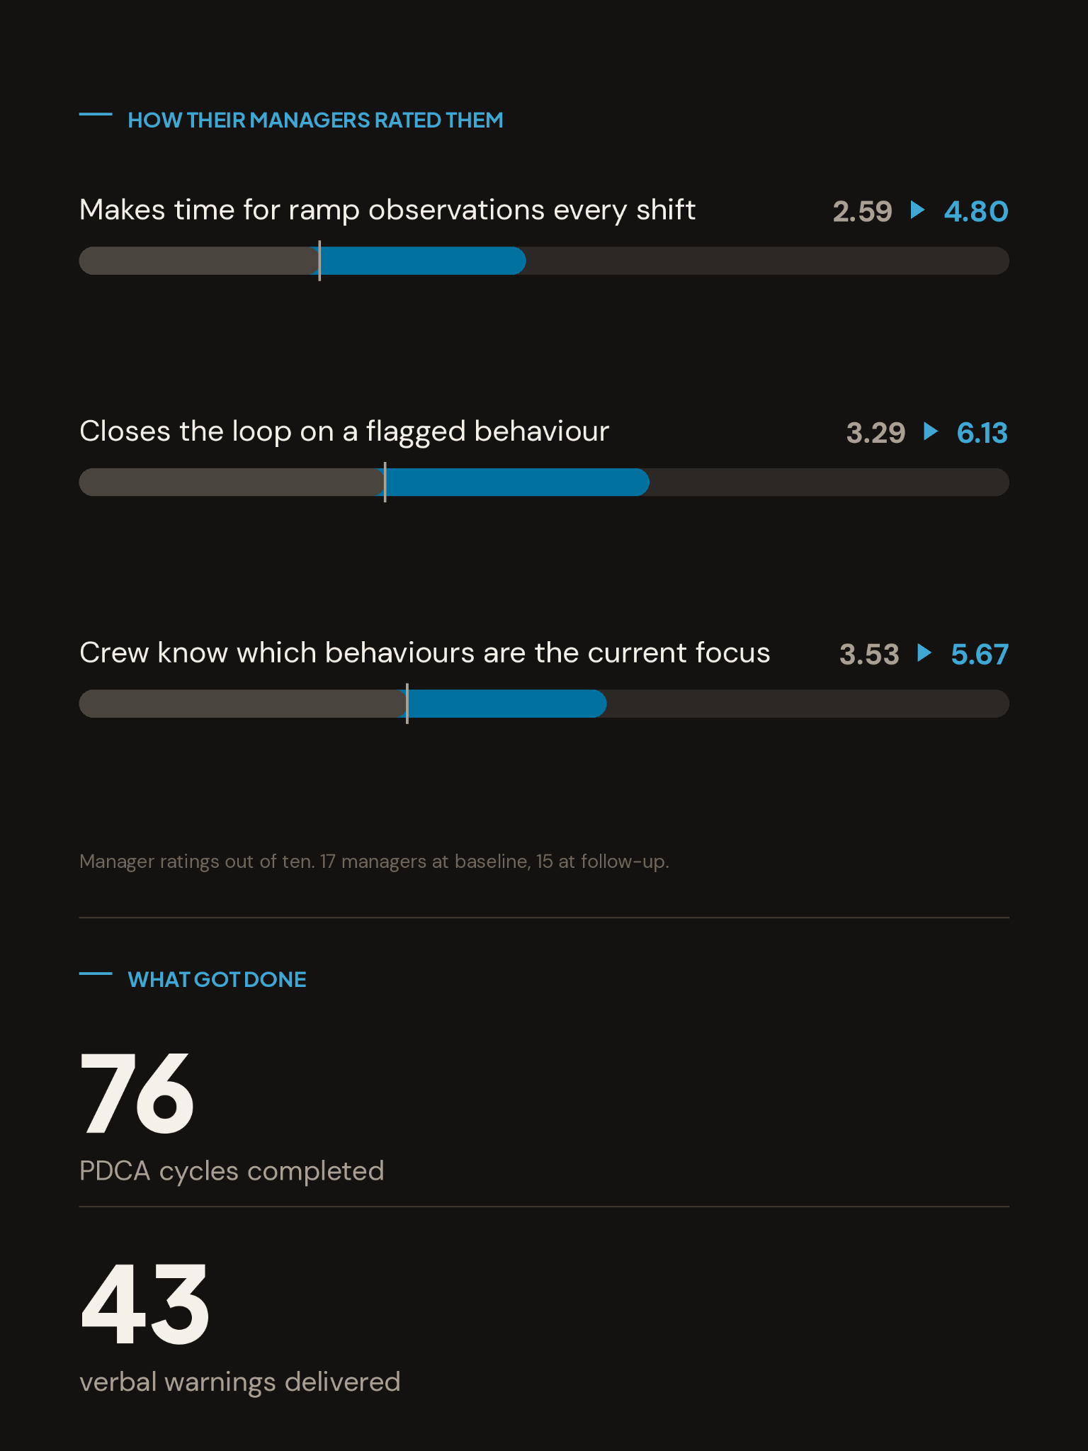
HOW IT WORKS FOR A SHIFT SUPERVISOR
Three steps, and what each one looks like.
STEP ONE
STEP TWO - DURING ~12 WEEK SPRINTS
STEP THREE - FOR THE BUSINESS
Set your baseline
Prep, act, debrief
See the results
A short survey, not a knowledge test. It gives the tool the context to make the activities relevant to you.
1-2x per week. A few minutes to prepare before the shift, the action itself on the job, then a short debrief.
What supervisors did, what validators confirmed, how behaviors changed, and what things got in their way.

Slide 5
ONE ACTIVITY EXAMPLE
PRACTICE ONE
Naming the cause at each downtime event
Activity 1: Log one downtime event with its cause
At your next line stoppage, record what stopped, the cause in your own words, and the minutes lost.
01
Prepare
The tool asks which line and shift, and which cause categories are already in use on the shift report.
02
Try
They engage with the next stoppage on the floor. Noticing, questioning the details of why
03
Debrief
They report what they logged, what they could not categorize, and who they had to call.

Slide 6
02
The mini pilot.
Objectives, what we need from supervisors, what happens each day.

Slide 7
WHY RUN A MINI PILOT
Two goals.
OBJECTIVE ONE
OBJECTIVE TWO
Validate the concept with users
Gather feedback for improvement
Ensure buy-in from top supervisors that this would be a beneficial tool to support plant productivity goals in their workflow.
Identify areas for improvement with the content, flow, and communications around how the tool fits.

Slide 8
THE SUPERVISOR'S SIDE
What we’re asking supervisors to do.
TIME
ENGAGEMENT
FEEDBACK
Spend ~15 minutes in tool over 1 week
Provide honest feedback
Do ~3 activities
A few minutes before the shift, a few minutes after. The action happens in work supervisors already do.
Use the tool as designed. Action the tasks on the job, in the flow of work.
This makes the tool better for everyone else when we roll it out.

Slide 9
THE OVERVIEW
The mini-pilot schedule.
Day 1
Launch call. First activity opens. Supervisors prep in the tool, then work the shift.
Days 2-7
Supervisors run three activities on the job and debrief in the tool.
Day 8
Debrief call with the supervisors to gather further feedback.

Slide 10
03
Next steps.

Slide 11
7-DAY PILOT
Launch setup steps
Four steps from scoping to kickoff.
›
STEP 4 · KICKOFF
›
STEP 3 · SYSTEM ACCESS
›
STEP 2 · LAUNCH PLANNING
Launch meeting
STEP 1 · 2 WEEKS BEFORE
Give access
Test users and manager start in the tool.
Plan the launch
Share the list of test users and managers; confirm IT access.
Train the coach
Schedule the launch meeting with test users and their manager.
Complete scoping, then Flint trains the coach before launch.

Slide 12
READINESS
What we need from you.
01
Nominate top supervisors
A handful, with their email addresses and validator association.
02
Book a launch call
Thirty minutes, run by Flint with the DMs present.
03
Emphasize importance
Help us ensure supervisors engage as intended during the mini-pilot.

