Slide 1
NHS Trust Meeting Calculator
Beamrules - James Elton, Bethany Bradley, Max Knappman, Max Clarke, Will Davies & Beyonce Obazee

Slide 2
HOW DOES OUR SOFTWARE WORK?
STAGE 1: PICK DESTINATION AND ORIGIN POINT
STAGE 2: PRESS THE SUBMIT BUTTON
STAGE 3: THE ALGORITHM WILL CHECK IF THE CALCULATION HAS BEEN DONE BEFORE
STAGE 4: IF IT HAS IT WILL RETURN THE DISTANCE, OTHERWISE GOOGLE DISTANCE MATRIX API CONTACTED & THE POSTCODES WILL BE USED TO CALCULATE THE DISTANCE – STORED IN DATABASE
STAGE 5: RETURN RESULTS TO USER

Slide 3
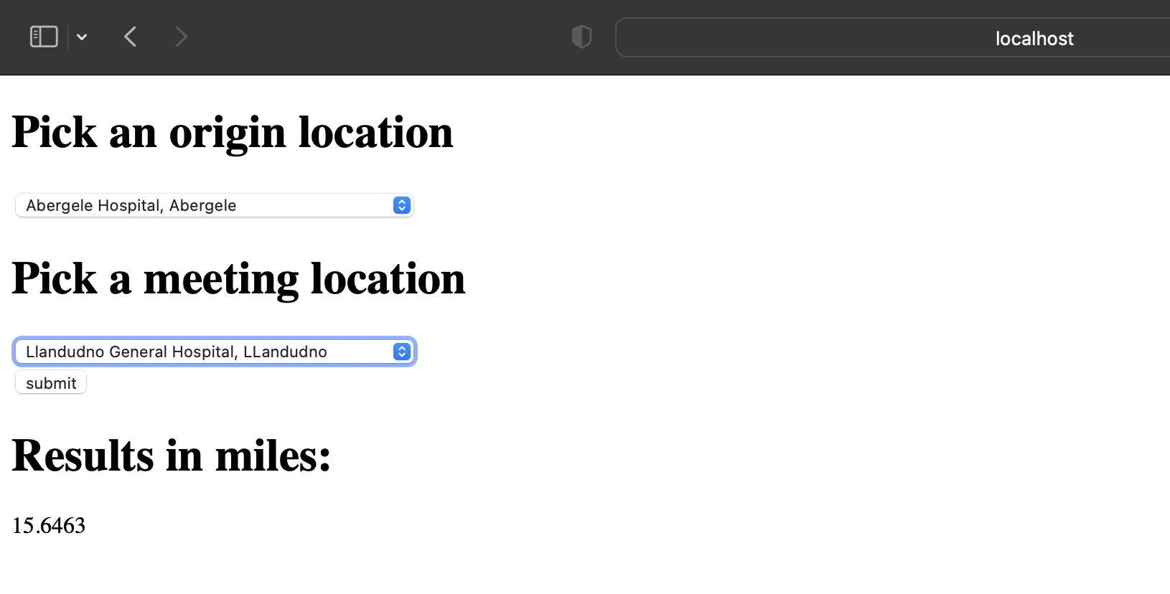
HOW DOES OUR SOFTWARE WORK?

Slide 4
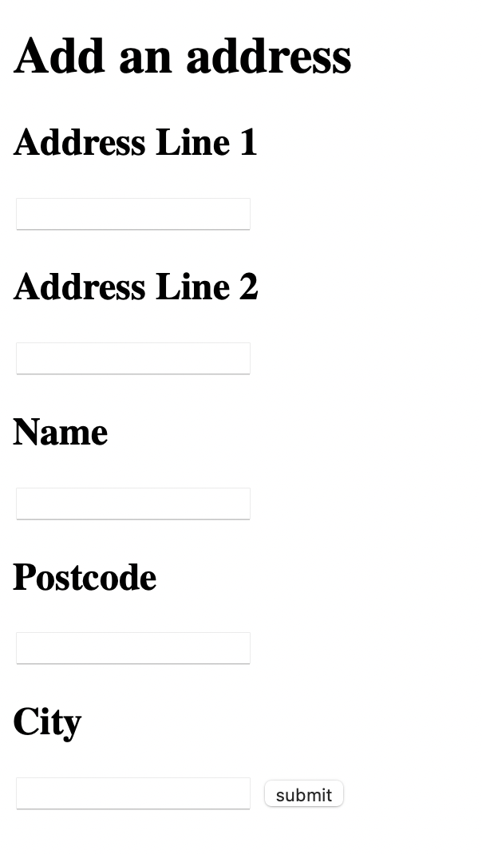
ADMIN PRIVILEGES
YOU WILL HAVE THE ABILITY TO ADD ADDRESSES, DELETE ADDRESSES AND EDIT ADDRESSES

Slide 5
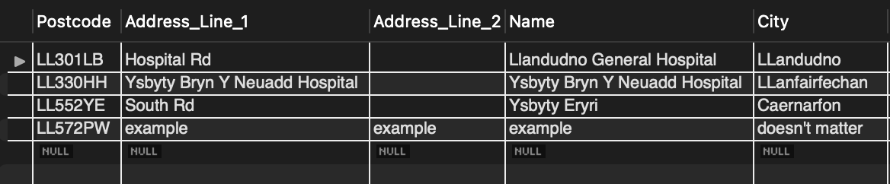
THE DATABASE - ADDRESSES

Slide 6
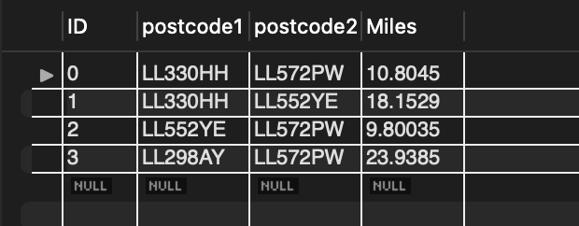
DATABASE - DISTANCE

