Slide 1

Studying local and global loss landscapes in Federated Learning
Group 18:
Finn Vaughankraska
Chenglong Li
Sung Pok Yau

Slide 2

Contents
Introduction
Experiments
Future Work
Conclusion
Notes:
第一部分是 介绍

Slide 3

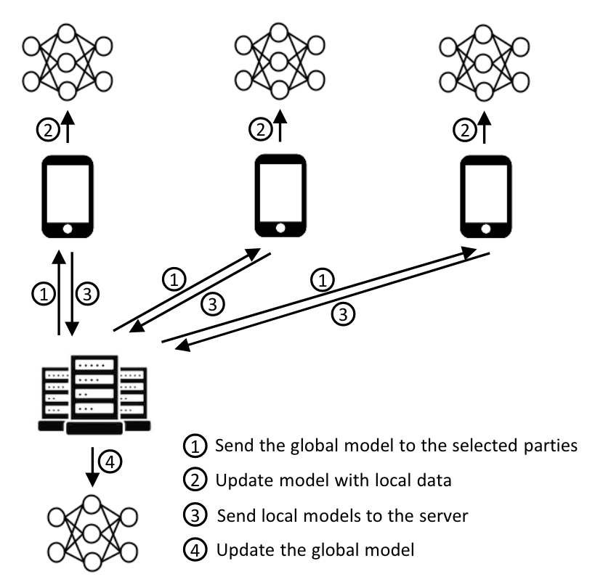
Introduction
Federated learning (FL) is a decentralized approach to machine learning. It tackles the issues of centralized machine learning by allowing models to train on distributed data sources.
Underlying Architecture
Central Server
Parties(Clients)
Communication Framework
Aggregation Algorithm
Parameter-based
Output-based
1 Scaleout: https://docs.scaleoutsystems.com/en/stable/introduction.html
2 A Survey on Federated Learning Systems: Vision, Hype and Reality for Data Privacy and Protection

Slide 4
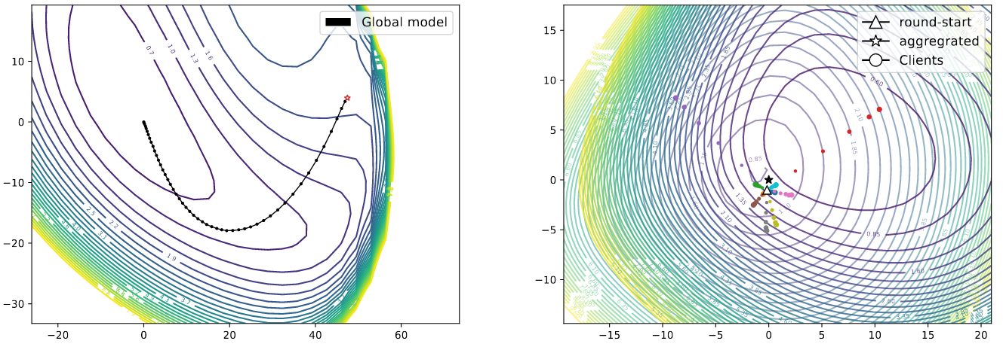
Introduction
Loss landscape analysis is an effective approach for studying the learning dynamics and generalization properties of neural networks in high-dimensional spaces.
1 Visualizing the Loss Landscape of Neural Nets
2 Understanding Federated Learning through Loss Landscape Visualizations: A Pilot Study

Slide 5
Introduction
Our Tasks:
1 Study local and global loss landscapes in federated learning.
2 Compare local loss landscapes and global loss landscapes in federated learning.
3 Understand a local client's contribution to the overall loss landscape.
4 Provide insights to optimize federated learning systems.

Slide 6
Contents
Introduction
Experiments
Future Work
Conclusion

Slide 7
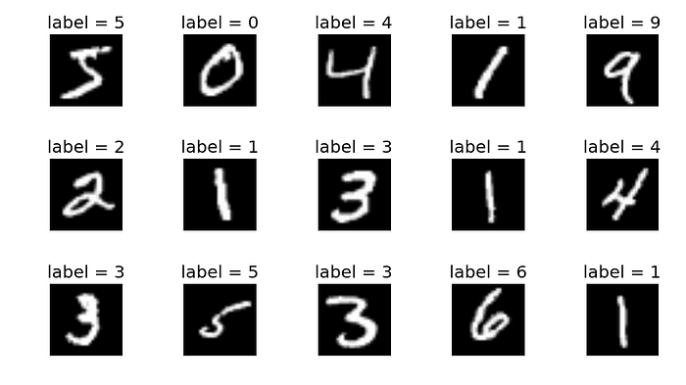
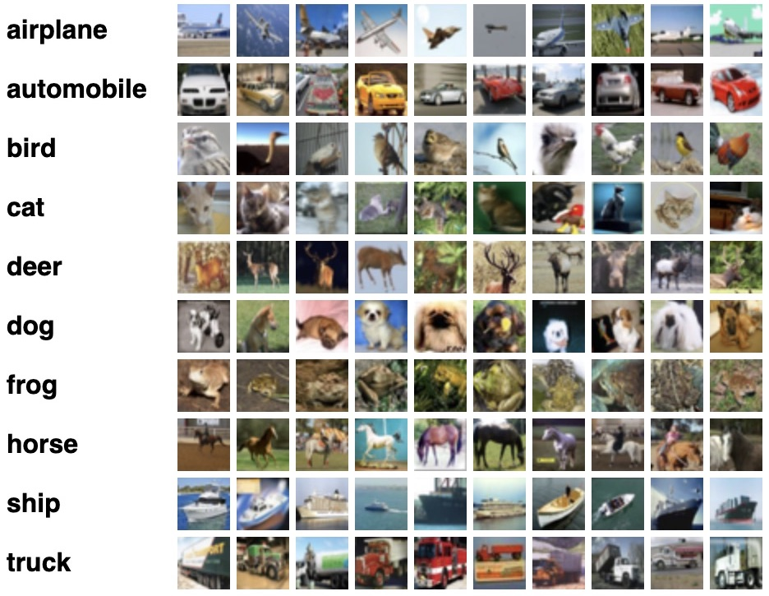
Experiments
Datasets
The MNIST dataset contains 70,000 images, each with dimensions of 28x28 pixels, resulting in 784 features per image. Each feature represents the intensity of a pixel, ranging from 0 to 255.
The CIFAR-100 dataset is a subset of the Tiny Images dataset, containing 60,000 32x32 color images across 100 classes grouped into 20 superclasses. Each class has 600 images, with 500 for training and 100 for testing. Images have both a "fine" label (class) and a "coarse" label (superclass).
1 The MNIST Database of Handwritten Digit Images for Machine Learning Research [Best of the Web]
2 Learning Multiple Layers of Features from Tiny Images

Slide 8
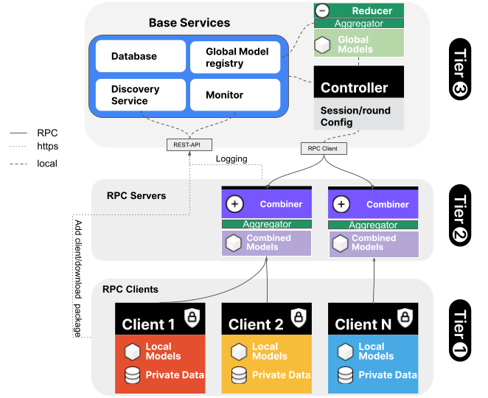
Experiments
Experiment FEDn Architecture
1 Scaleout: https://docs.scaleoutsystems.com/en/stable/architecture.html

Slide 9
Experiments
Experiment Settings
Clients
Samples
Distribution
Experiments
.
.
.
.
.
.
.
2
3
4
5
Balanced
Imbalanced
IID
Non-IID
Clients + Samples + Distribution = Experiments

Slide 10
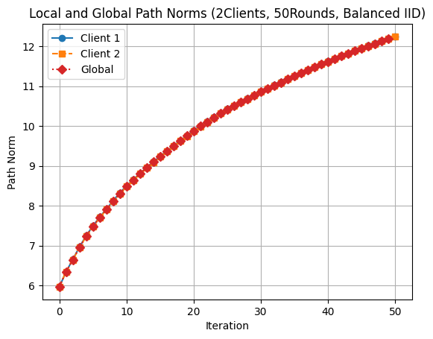
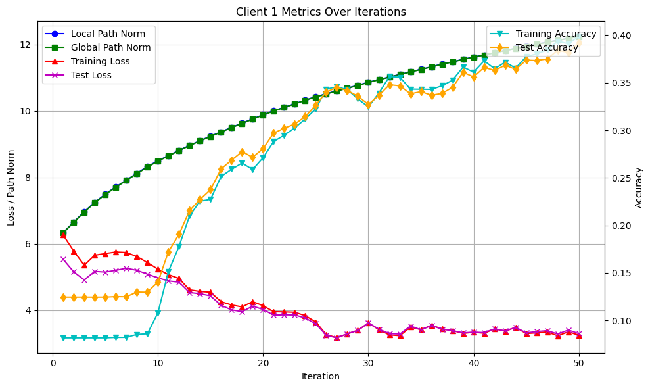
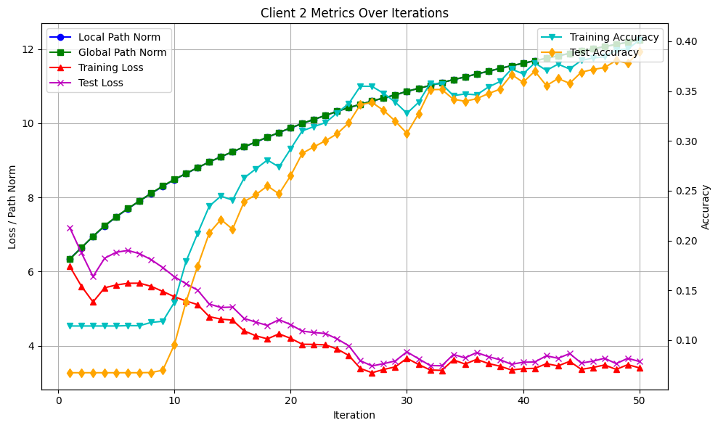
Experiments
2 Clients + Balanced + IID

Slide 11
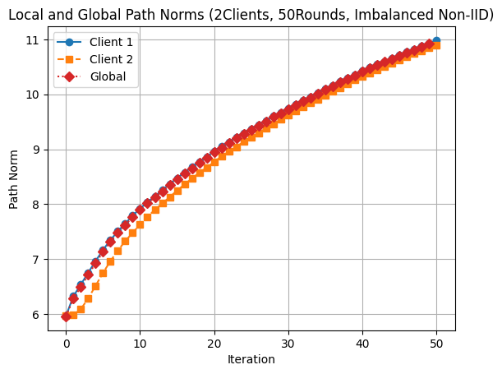
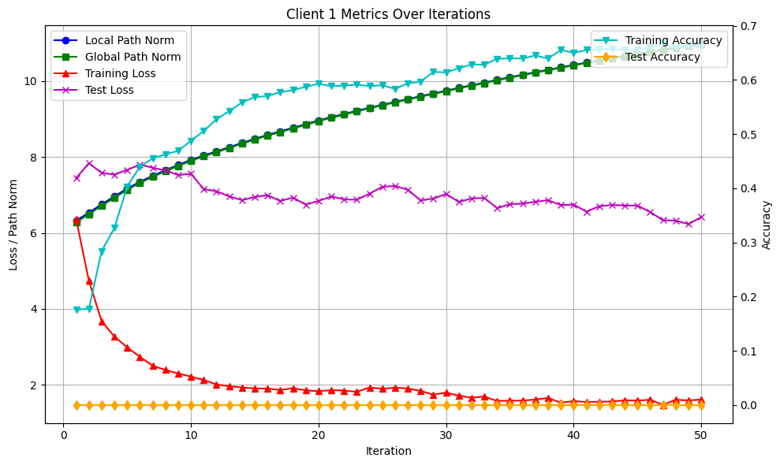
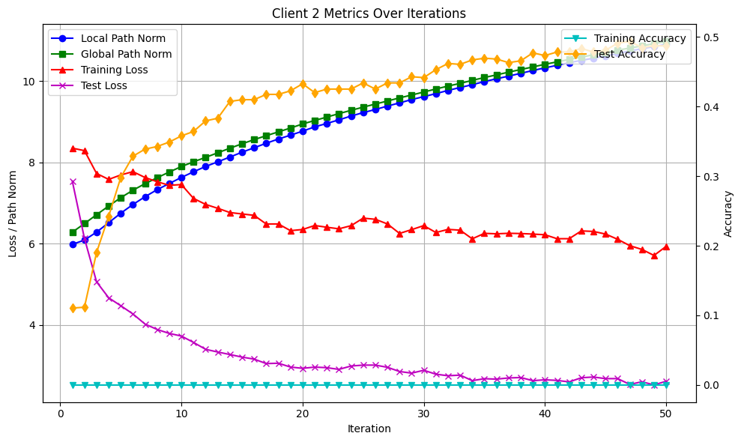
Experiments
2 Clients + Imbalanced + Non-IID

Slide 12
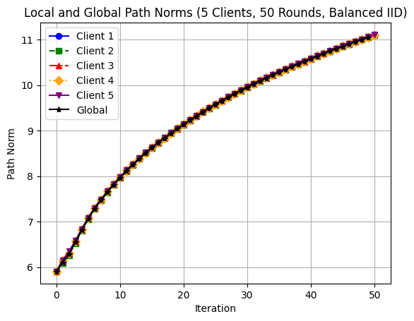
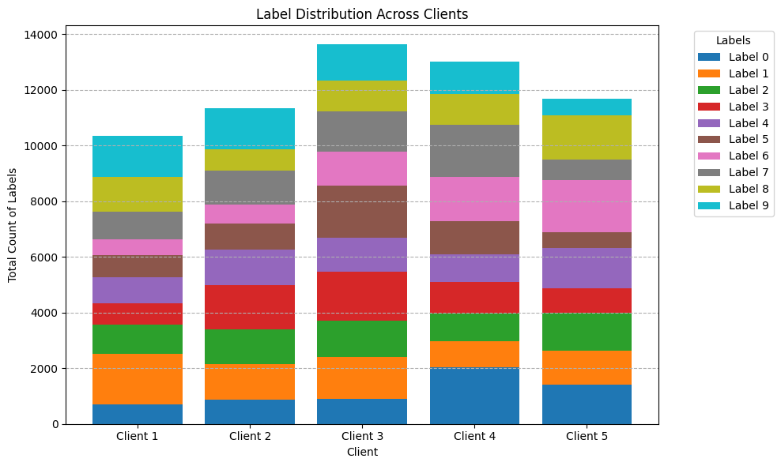
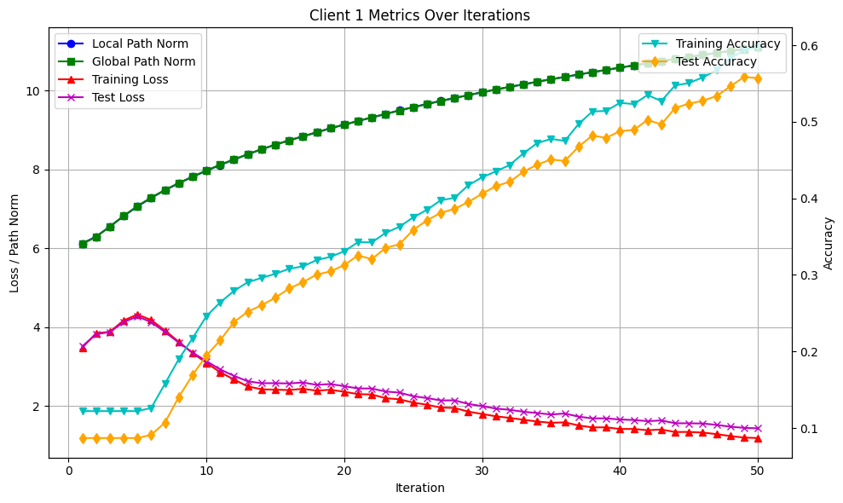
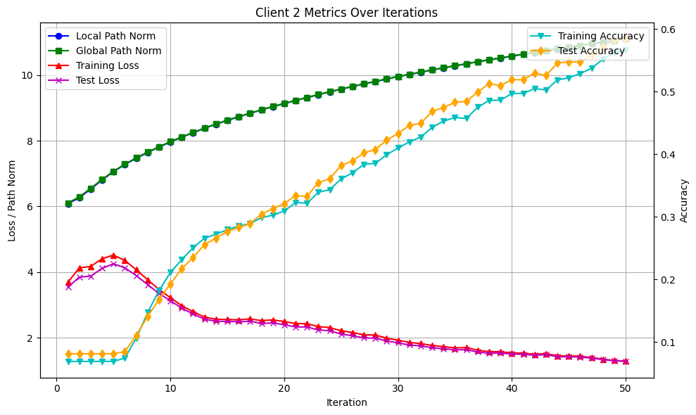
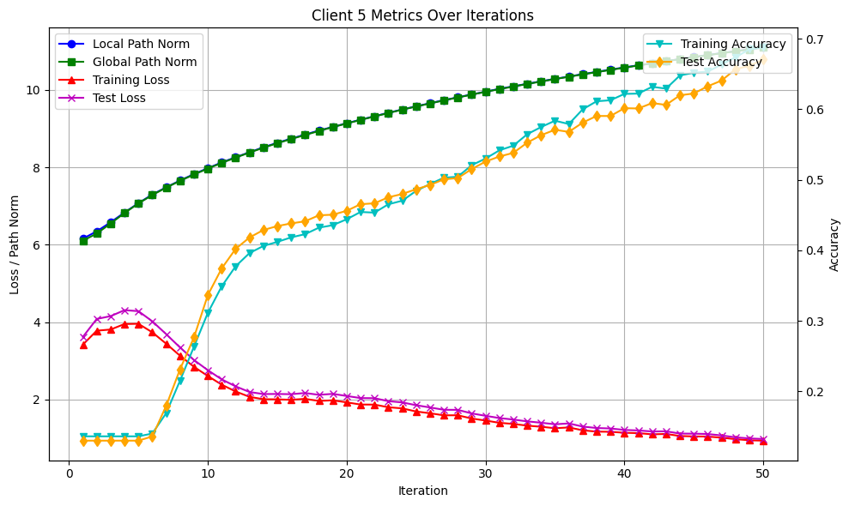
Experiments
5 Clients + Balanced + IID

Slide 13
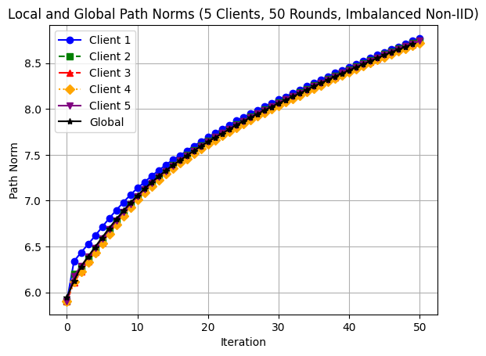
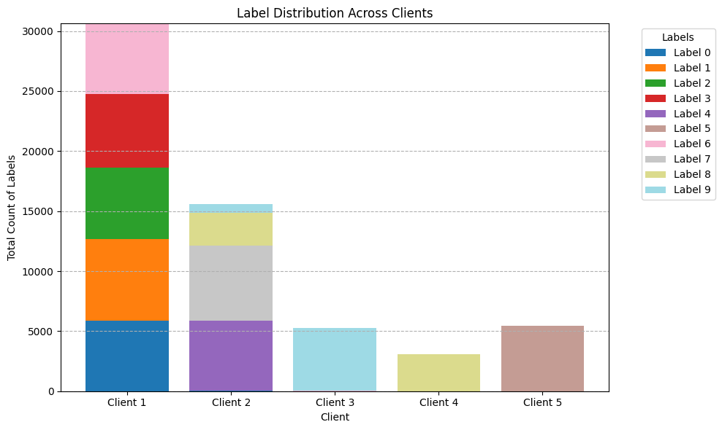
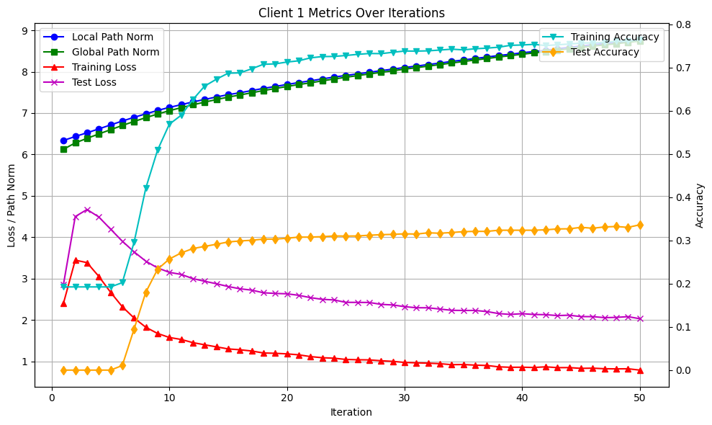
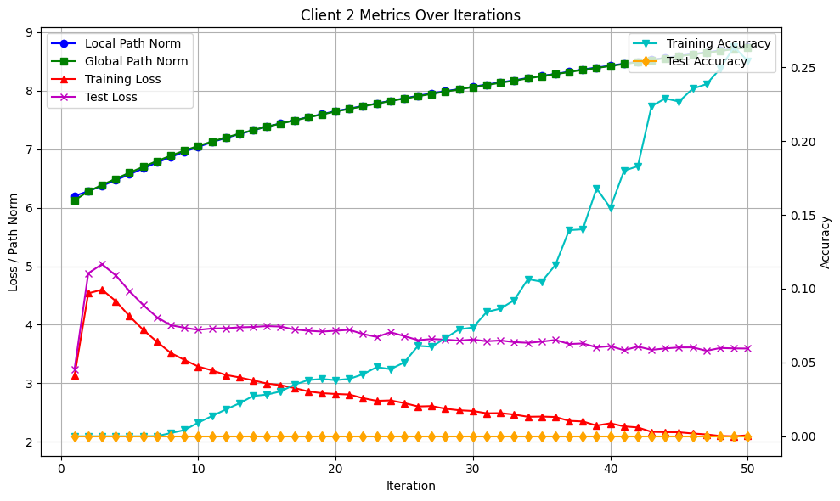
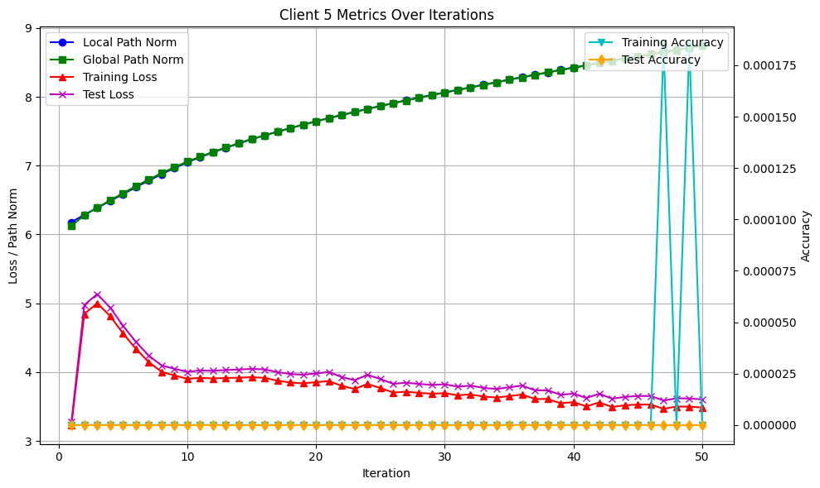
Experiments
5 Clients + Imbalanced + Non-IID

Slide 14
Experiments
Experiment Results Analysis

Slide 15
Contents
Introduction
Experiments
Future Work
Conclusion

Slide 16
Future Wok

Slide 17
Contents
Introduction
Experiments
Future Work
Conclusion

Slide 18
Conclusion

Slide 19
Thanks

