Slide 1
AXMALI
Presentation, Project 1
2 march 2026

Slide 2
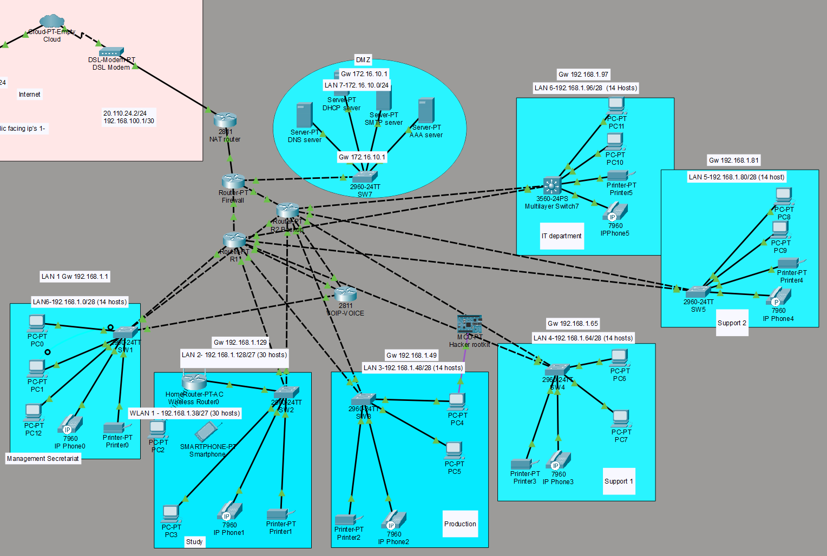
Topology

Slide 3
How we worked
Talk about roles of lily, max, and axel in our fabulous company AXMALI ☺

Slide 4
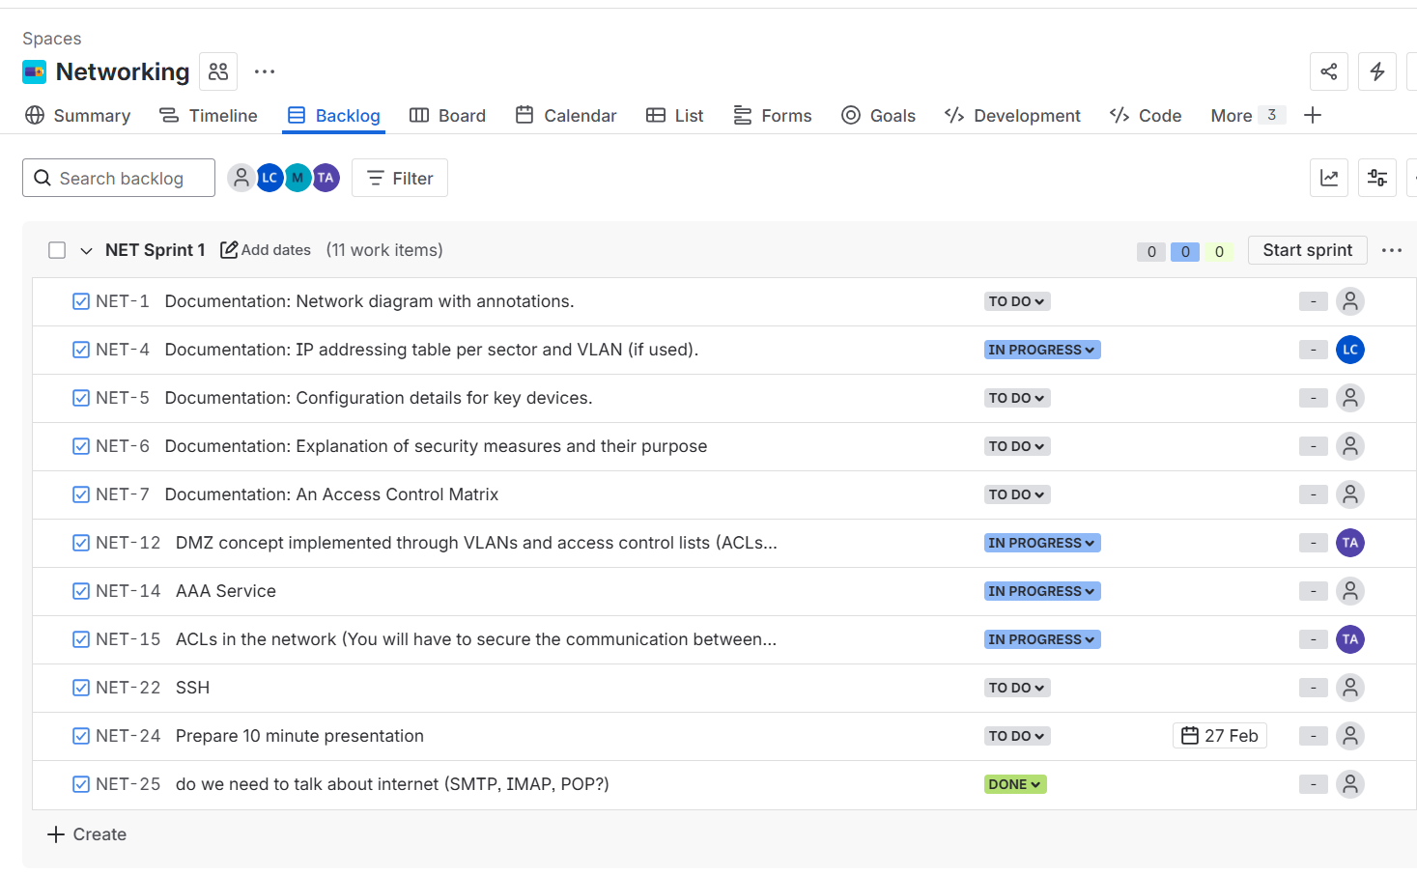
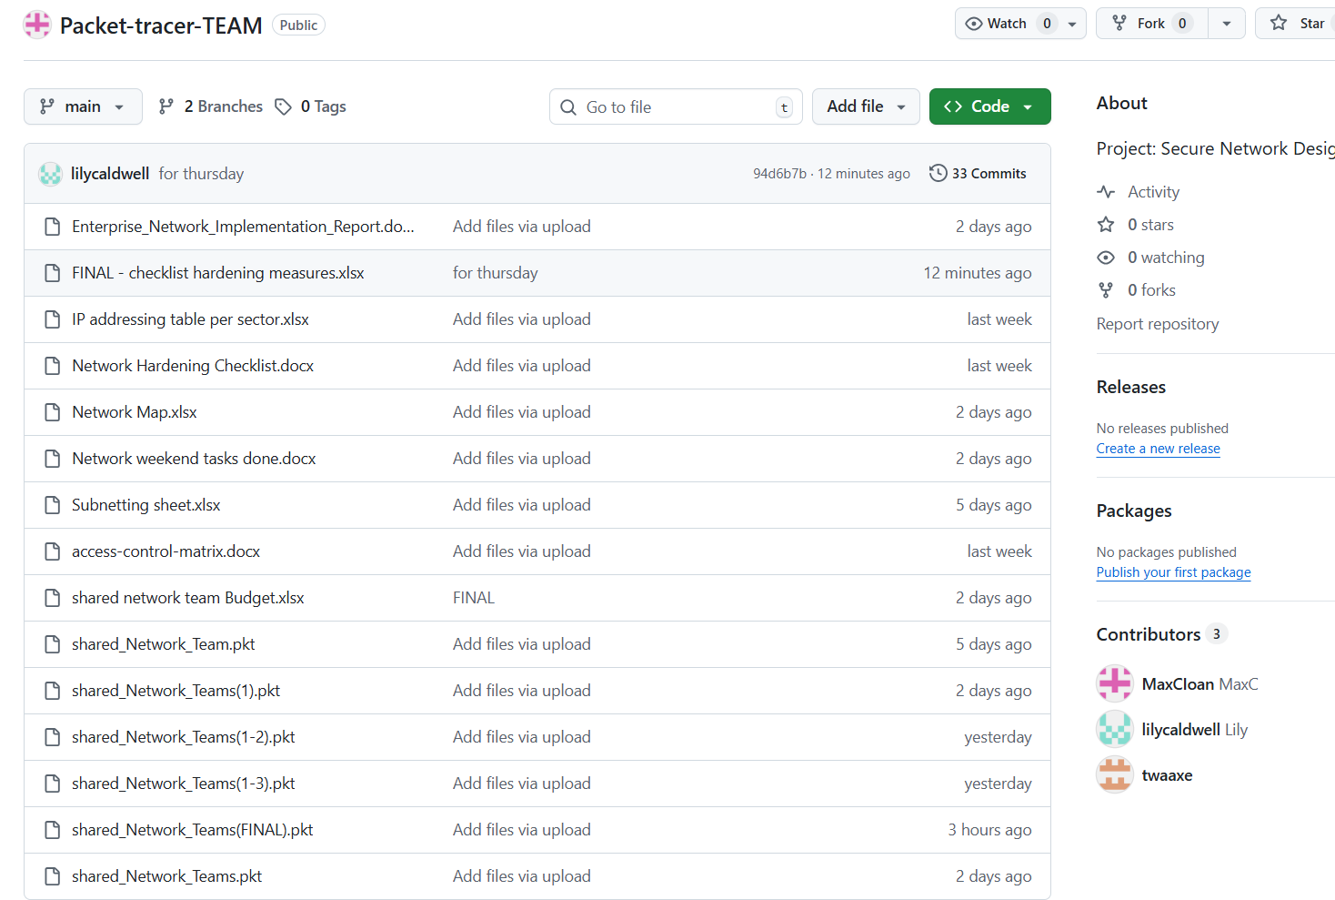
How we worked (cont)
Two main tools used: Jira + Github

Slide 5
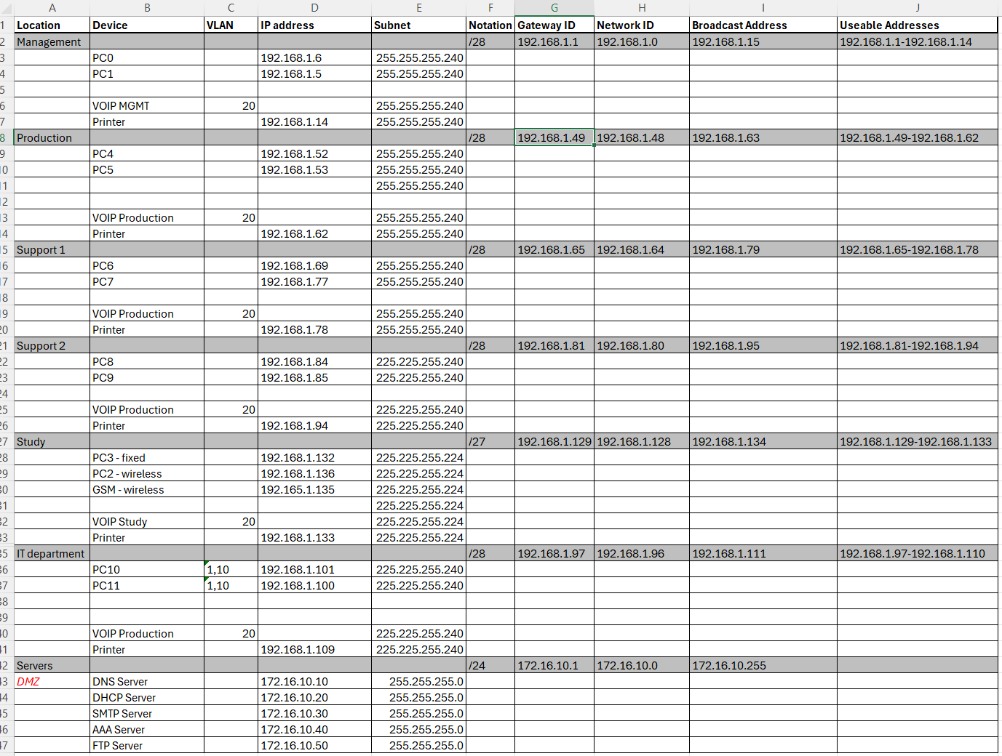
Static IPs + Subnets

Slide 6
ACL / AAA / DMZ / Firewall
Probably 2-3 slides here

Slide 7
Other hardening measures
Things we though of but couldn’t implement and or ran out of time:
2nd subnet (/28…16-48), didn’t work so we had to abandon
VOIP : not supported on Router 8200, a day of troubleshooting
FTP server
VLANs, some but not all (ex VOIP ok, IT1 ok, IT10 no)
Certain codes not accepted on basic servers and routers (logging, disable “too many logins”, quiet mode access list, watch login attacks, min length security passwords…)

Slide 8
Axel : Lessons Learned

Slide 9
Max : Lessons Learned

Slide 10
Lily : Lessons Learned

Slide 11

Fancy meme to make Thomas happy

