Slide 1
Project: Secure Network Design

Slide 2
Secure Network Design Project
Multi-router enterprise Extended-star topology
Diagram / Screenshot
Insert Here
Firewall-controlled DMZ and AAA server
AAA, VLAN, VoIP integration
Notes:
Max

Slide 3
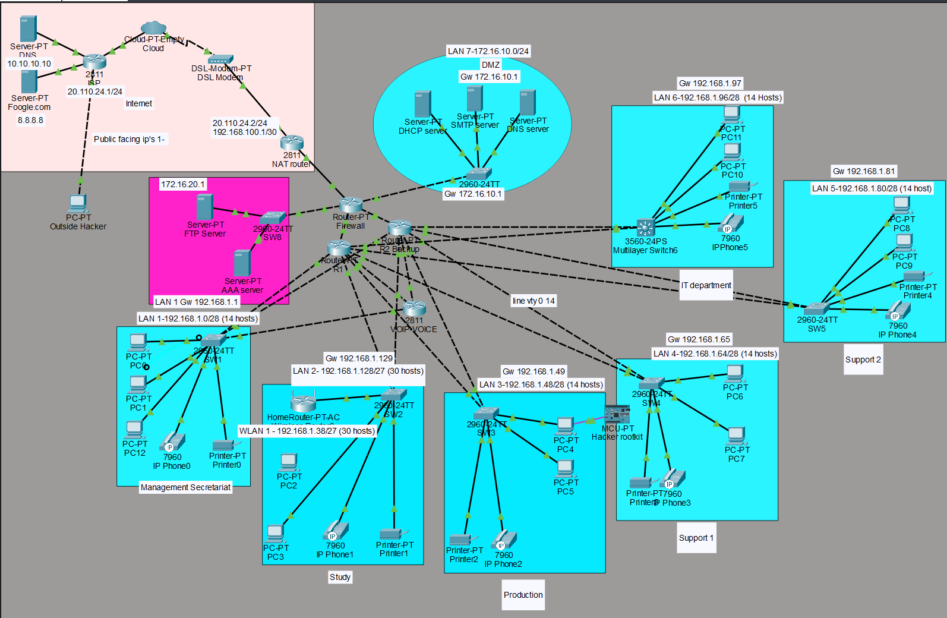
Our topology
Notes:
Axel

Slide 4
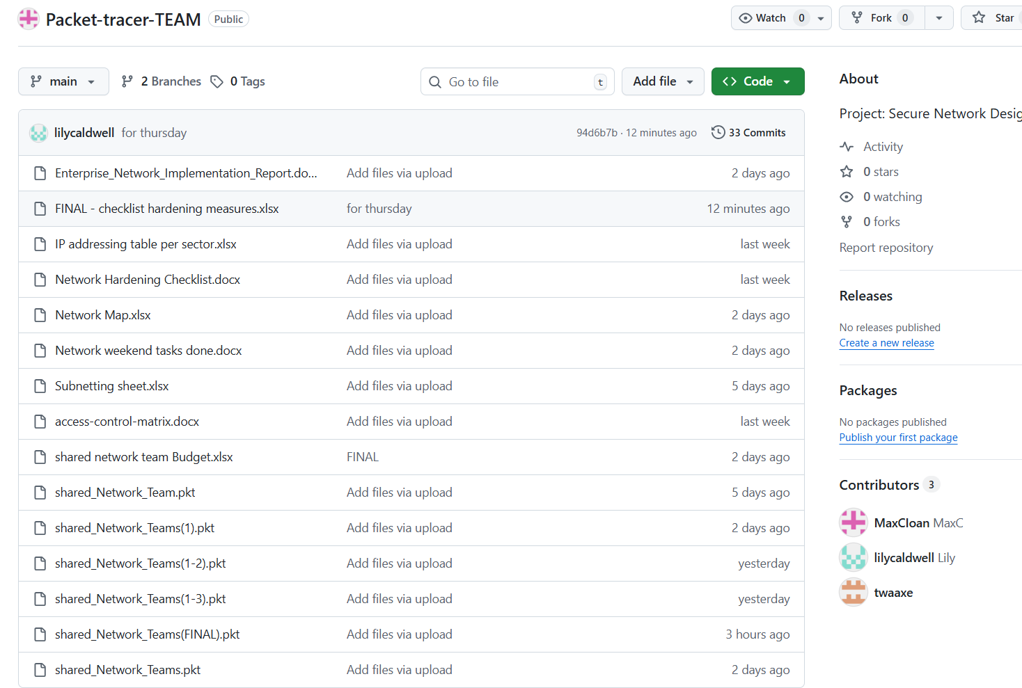
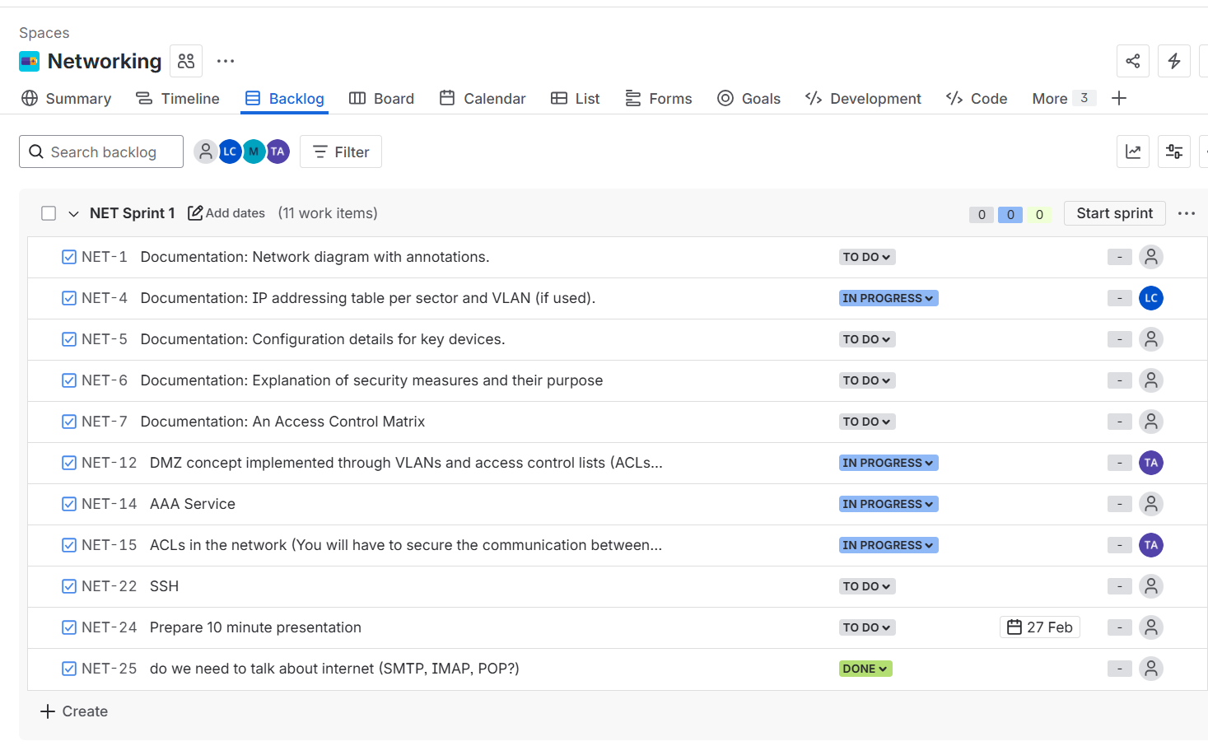
How we worked (cont)
Two main tools used: Jira + Github
Notes:
lily

Slide 5
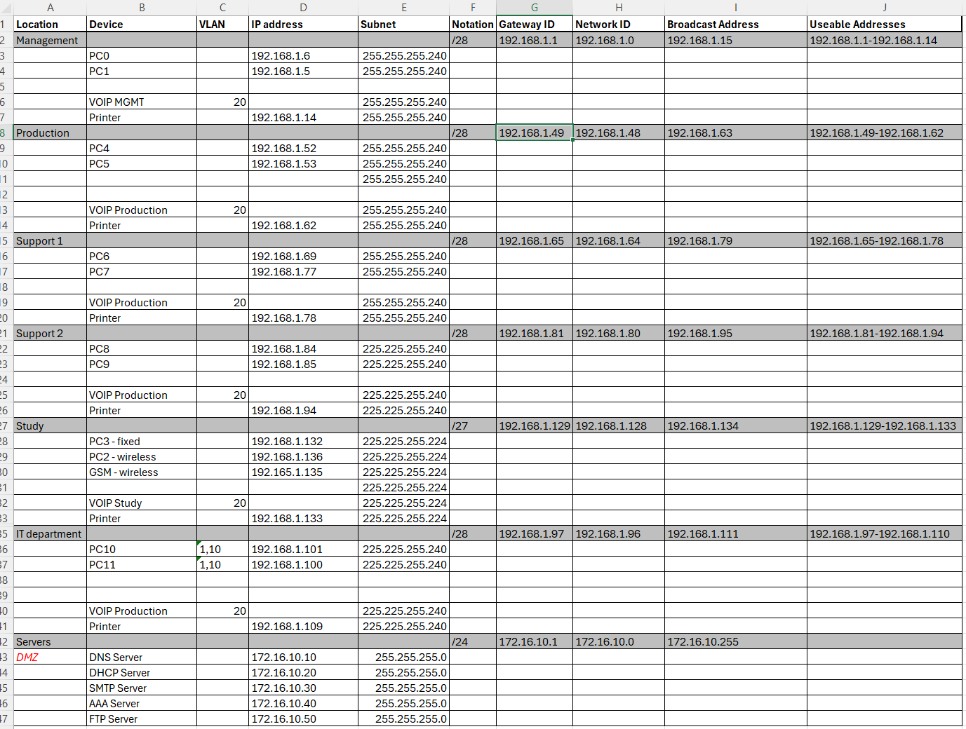
Static IPs + Subnets Scalable talk how
Notes:
lily

Slide 6
Other hardening measures
Things we though of but couldn’t implement and or ran out of time:
2nd subnet (/28…16-48), didn’t work so we had to abandon
VOIP : not supported on Router 8200, a day of troubleshooting
FTP server
VLANs, some but not all (ex VOIP ok, IT1 ok, IT10 no)
Certain codes not accepted on basic servers and routers (logging, disable “too many logins”, quiet mode access list, watch login attacks, min length security passwords…)
Notes:
lily

Slide 7
Network Architecture
Aaa accede les routeur
Transit /30 router links les router 10.1.1.1 et 10.1.2.1
Central firewall gateway tout passe par FW
DMZ services isolated
Diagram / Screenshot
Insert Here
Notes:
axel

Slide 8
Routing Implementation
Static routes between routers
Default route to firewall
Next-hop validation
Bidirectional path correction firewaal 2 direction soit routeur 1 soit routeur 2
Diagram / Screenshot
Insert Here
Notes:
axel

Slide 9
Firewall & ACL Strategy
Permit-before-deny model
Controlled DMZ access
DNS & TACACS explicitly allowed difference between tacacs and radius
Default deny for protection deny any
Diagram / Screenshot
Insert Here
Notes:
Axel RADIUS uses UDP while TACACS+ uses TCP. TCP offers several advantages over UDP. TCP offers a connection-oriented transport, while UDP offers best-effort delivery. RADIUS requires additional programmable variables such as re-transmit attempts and time-outs to compensate for best-effort transport, but it lacks the level of built-in support that a TCP transport offers:

Slide 10
AAA Deployment
Local + TACACS configuration
Fallback method to prevent lockout local login and default login line console 0 fallback and talk about how locked my self out
Fix rommon mode >reset
Diagram / Screenshot
Insert Here
Notes:
max

Slide 11
HSRP
Standby pour routeur 2
While router 1 does main routing
Issue on return to lan subnet throught firewall it prefers taking router 2 route even with standby priority set at 100 and router 1 at 130 higher priority
Diagram / Screenshot
Insert Here
Notes:
max

Slide 12
NAT Deployment
NAT translations
Does not work
So basically foreign addresses pass through nat no ranslation and go to firewall gets blocked so good for preventing translation of unknown ips entering nat cause if it worked then address could be chaanged to our subnet lan network and will pass firewall
Pat intern to communicate to private to public address but public
Diagram / Screenshot
Insert Here
Notes:
max

Slide 13
Major Mistakes Made
Axel : confused with routing and I understood that we can route differently static or vlan j ai recommence l projet inspirant a celui deja fait et a recreees le network entier
Max : routing wrong ports and assigning ip’s with wrong subnet gatewys so routing wasn’t working fixd it added ip route of one port to the next hop port and it works Verify ARP green envelopes arping for testing Confirm return path exists
Lily: thinking of material and modules more some routers gave limited functionality all routing was already done so changing it meant re configuring all or switching to vlan
Diagram / Screenshot
Insert Here
Notes:
max

Slide 14
Axel : Lessons Learned
Static routing and method of troubleshooting
Your method used
En vrai ce qui ma aider cest d’essayer et de faire des trial and error
Et aussi pour comprendre la solution qui a ete implenmentee
Apprendre en pratique mieux que theorie
Notes:
axel

Slide 15
Max : Lessons Learned
Stronger routing logic I learned that port assignment is critical for static routing
Better firewall design thinking blocking any at the top of list will do that and block everything
Enterprise AAA awareness routing fixed and ttl expired too early and nev er reached the switch or router in question.
Notes:
max

Slide 16
Lily : Lessons Learned
Everything ☺ learned lot by double checking work done on packet tracer and fact checking
Will I be ready to make it by my own now maybe not
Notes:
lily

Slide 17
Technical Growth Achieved
Diagram / Screenshot
Insert Here
Notes:
max

Slide 18
How we worked
Roles played
Coordination lily cross-checking chief manager
Max Chief troubleshooter
Axel chief researcher co chief troubleshooter
Notes:
lily

