Slide 1
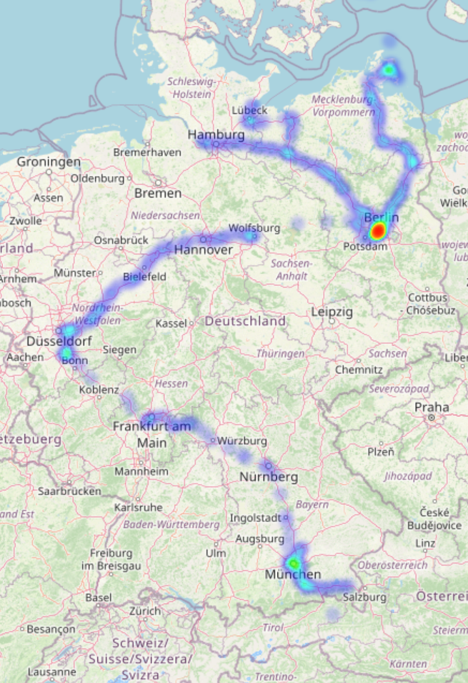
Creating a geoheatmap using your google maps location history and folium

Slide 2
Creating a Geoheatmap using your google maps location history and folium
Tasks:
Get all your data from google (https://takeout.google.com).
Handle JSON files (java script object notation) with python.
Create a geoheatmap with the location history of a fake spiced student (https://github.com/castillogo/Geo_heatmap).
Turn the geoheatmap into a website available to everyone.
Guess all the places in Berlin where the fake spiced student has been and get a prize. ;-)
Ideas for the future:
Use your own map to create a dashboard about yourself?
Complete the dashborad with the rest of the data you get from google? (youtube history, google search history, etc…)
Or use current capital bikeshare location and time data and for the heatmap and dashboard? (https://gbfs.capitalbikeshare.com/gbfs/gbfs.json).
What about a heatmap of airline traffic? (https://aviation-edge.com) ($)

