Slide 1
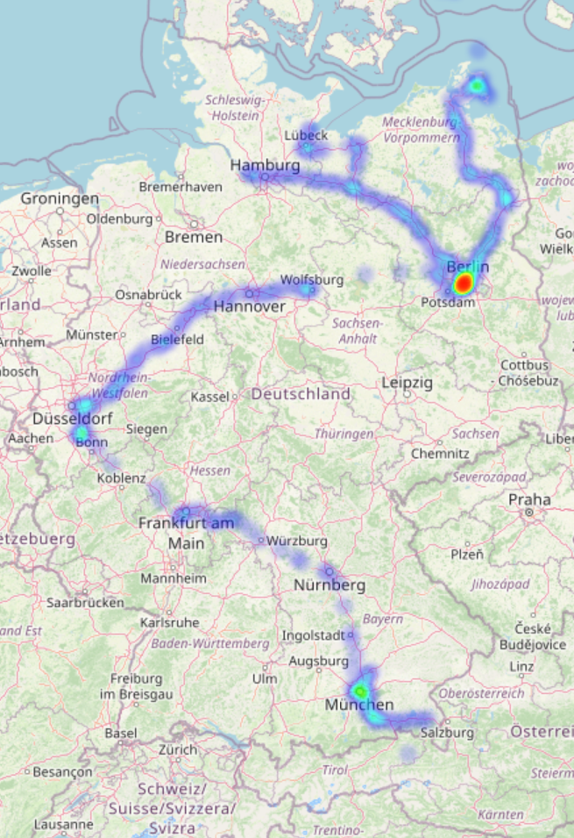
Creating a Geoheatmap using your google maps location history and folium
Aims:
Get all the data google has stored about yourself (https://takeout.google.com).
Handle JSON files (java script object notation) with python.
Create a geoheatmap with the location history of a fake spiced student (https://github.com/castillogo/Geo_heatmap) and save it as an html file.
Play with the Geoheatmap (layout, time range).
Guess all the places where the fake spiced student and get a prize. ;-)
Ideas for the future:
Use your own geoheatmap to create a dashboard about yourself?
Complete the dashborad with the rest of the data you get from google? (youtube history, google search history, etc…)
Modify the script to handle capital bikeshare location and time data and use it for the dashboard? (https://gbfs.capitalbikeshare.com/gbfs/gbfs.json).

