Slide 1
Logistic Regression with
Explanation of Math involved
Dedicated to Almighty!!
Ramendra Kumar

Slide 2
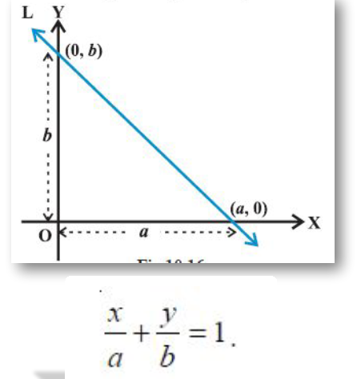
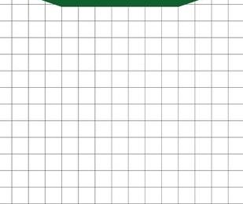

+
-
x+y-2 = 0
$$\left(\frac{x}{2}\right) +\left(\frac{y}{2}\right)=1$$
Any points on the line > Gives value equal to 0
Any points from Positive side > Gives value greater than 0, +ve value
Any points from Negative side > Gives value smaller than 0, -ve value

Slide 3


Now if we represent :
X → X₁ and Y → X₂
Coefficient of X and Y with
θ ₁ and θ ₂, then in
vector Notation:
X=(X₁ , X₂) and θ =(θ₁, θ ₂)
Similary, using ‘b’ for constant
Eqn → x+y-2 = 0
can be written as:
θ ₁*X₁+ θ ₂*X₂+b = 0
In vector form:
θ.X + b=0
In matrix form:
if
x+y-2 = 1
x+y-2 = 2
x+y-2 = -1
+
-
x+y-2 = 0
x+y-2 = -2
Then ,
θ^{T}X+b=0

Slide 4


In other way, if we represent :
X → X₁ and Y → X₂
& Coefficient of X and Y with
θ ₁ and θ ₂ and similarly, using ‘θ₀’ for constant, then Eqn → x+y-2 = 0
can be written as:
₁*X₁+ θ ₂*X₂+ θ₀ = 0
Rewriting above eqn: θ ₀1 + θ ₁*X₁+ θ ₂*X₂ = 0
In vector Notation : X=(1,X₁ , X₂) and θ =(θ₀ ,θ₁, θ ₂)
In vector form:
θ.X =0
In matrix form:
If,
Then , θ^{T}X=0

Slide 5
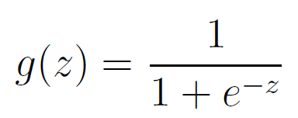
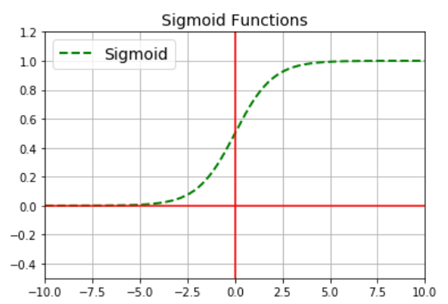

The value of term → θ^{T}x+b ( Or, θ^{T}X), (after putting any point in it) is passed into Sigmoid function g(z), where z = θ^{T}x+b. The result of Sigmoid function lies in between 0 or 1, which acts as probability of that point lying on +ve side.
x+y-2 = 1
x+y-2 = 2
x+y-2 = -1
+
-
x+y-2 = 0
Both ‘θ’ Or ‘W’ are
used for denoting coefficients :
W₁*X₁+ W₂*X₂+b = 0
X=(X₁ , X₂) and W=(W₁, W₂)
W.X + b=0
x+y-2 = -2
we can say predicted output :
y_{p} = g(θ ^{T}x+b) Or, y_{p} = g(W ^{T}x+b)
In notation , y_{p} = Pr (y=1|x)
Probability of any point X lying on +ve side : >
Probability of any point X lying on -ve side Pr (y = 0|x ) = 1 – Pr (y=1|x) =1- y_{p}

Slide 6


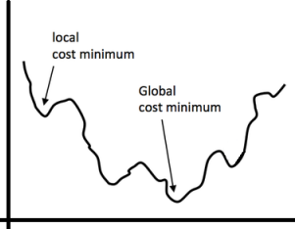
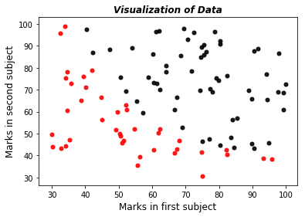
Probability of any point X lying on +ve side
Example of Data Set
With two class →
Student ID | Marks Subj 1 | Marks in Subj2 | Label
0 | 34.62365962 | 78.02469282 | 0
1 | 30.28671077 | 43.89499752 | 0
2 | 35.84740877 | 72.90219803 | 0
3 | 60.18259939 | 86.3085521 | 1
4 | 79.03273605 | 75.34437644 | 1
5 | 45.08327748 | 56.31637178 | 0
6 | 61.10666454 | 96.51142588 | 1
7 | 75.02474557 | 46.55401354 | 1
8 | 76.0987867 | 87.42056972 | 1
9 | 84.43281996 | 43.53339331 | 1
10 | 95.86155507 | 38.22527806 | 0
11 | 75.01365839 | 30.60326323 | 0
12 | 82.30705337 | 76.4819633 | 1
13 | 69.36458876 | 97.71869196 | 1
14 | 39.53833914 | 76.03681085 | 0
15 | 53.97105215 | 89.20735014 | 1
16 | 69.07014406 | 52.74046973 | 1
17 | 67.94685548 | 46.67857411 | 0
y_{p} =
Interpretation:
If y=1 : Pr(y|x)= y_{p} (Probability of point X lying on +ve side)
If y=0 : Pr(y|x)= 1-y_{p} (Probability of point X lying on -ve side)
Putting them together :
Pr (y |x ) =
Cost calculation:
Loss (error) function
Black dots are used for students with label ‘1’ & Red dots for students with label ‘0’.
We have to find a decision function (Blue St. line) which can classify two types of data. →
This becomes Non-Convex problem.
Difficult for Optimization. Don’t use this loss Function.

Slide 7




Finding a different loss/cost function
Using principle of maximum likelihood:
Probability of all the labels in training set=Product of Probability of each training example
(Assuming all training examples are generated independently)
Given data (x^{i},y^{i}),…,(x^{n},y^{n}) ∈R^{d} ×{1,0}, pick θ ∈R^{d} that maximize
Maximizing this is same as maximizing after taking log :
L(θ ) =
Log function is strictly monotonically increasing fn, We have to maximize log of Pr(y|x).
Calculating log of Pr(y|x) for each training example, it is called loss function (l)
Finally, for all training example :
We have to maximize
this function.

Slide 8


We have to maximize
this function.
Instead of maximizing this, we are going to take –ve of this function and then we have to minimize that fn so that
Log of probability will be maximized. We call this as a cost function, that has to be minimized. Dividing by m will just
diminishes the magnitude of cost and it is mathematically convenient.
Note, here

Slide 9













Gradient Calculation of Cost function
Gradient of sigmoid fn:

Slide 10



Now, we have gradient of cost function as :
We can apply Gradient Descent as follow :
Repeat {
}
Or,
Repeat {
Where α is learning rate.
1/m is included in it.
}

Slide 11
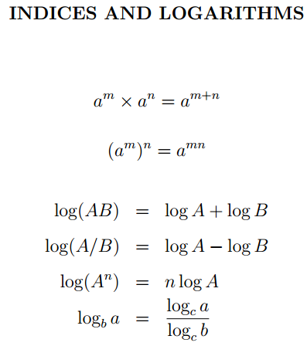
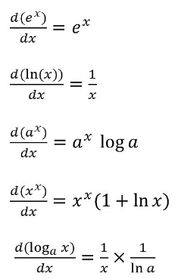
Softmax Regression for Multiclass Classification
http://deeplearning.stanford.edu/tutorial/supervised/SoftmaxRegression/
http://cs229.stanford.edu/notes2020spring/cs229-notes1.pdf
Few formulas that may be helpful in derivations.
Differentiation Rules

Slide 12
THANK YOU!
HAPPY LEARNING!!
https://www.linkedin.com/in/ramendra-kumar-57334478/
https://github.com/Rami-RK

