Slide 1
Bayes & Naïve Bayes
Generative Approach to Classification
With Quick Review of Statistics
Ramendra Kumar
References:
https://ocw.mit.edu/resources/res-6-012-introduction-to-probability-spring-2018/part-i-the-fundamentals/
https://courses.edx.org/courses/course-v1:UCSanDiegoX+DSE210x+1T2018/course/
https://courses.edx.org/courses/course-v1:UCSanDiegoX+DSE220x+1T2020a/course/
(The University of California, San Diego)

Slide 2
Data Description: Descriptive Statistics Numerical Measure of Central Tendency Numerical Measure of Variability
Part 1 .Statistics Quick Review
A measure of central tendency is a summary statistic that represents the center point or typical value of a dataset. These measures indicate where most values in a distribution fall and are also referred to as the central location of a distribution. You can think of it as the tendency of data to cluster around a middle value. In statistics, the three most common measures of central tendency are the mean, median, and mode. Each of these measures calculates the location of the central point using a different method.
Choosing the best measure of central tendency depends on the type of data you have.
There are many ways of describing the variability in some data set. Most widely used are range, quartile and standard deviation.

Slide 3
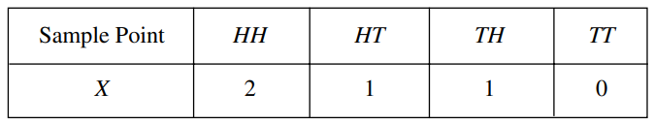







Random Variable
Suppose that a coin is tossed twice so that the sample space is S = {HH, HT, TH, TT}. Let X represent the number of heads that can come up. With each sample point we can associate a number for X as shown in Table below . Thus, for example, in the case of HH (i.e., 2 heads), X =2 while for TH (1 head), X =1. It follows that X is a random variable.
Internet company
Student
Doctor: Physician
Traveler
Everyone
Manufacturing company
In general, to analyze random experiments, we usually focus on some numerical aspects of the experiment. In a nutshell, a random variable is a real-valued variable whose value is determined by an underlying random experiment.

Slide 4
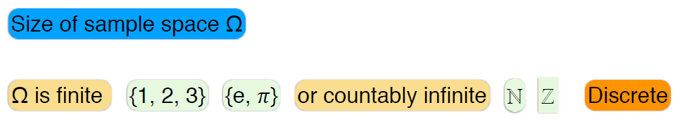
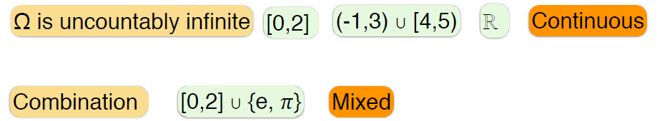
Two Types of Random Variable
1. Discrete Random Variable
Where integers={……,-2,-1,0,1,2……}
Naturals, N={1,2,3……..}
2. Continuous Random Variable

Slide 5
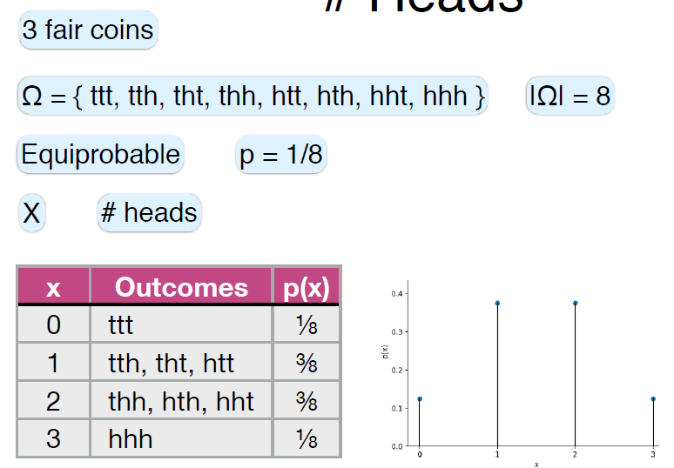
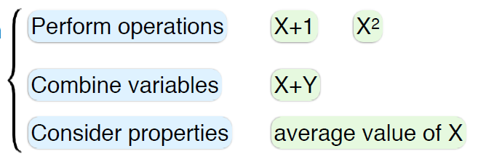
Coin Toss Example
Operations on
Random Variable
(X)

Slide 6


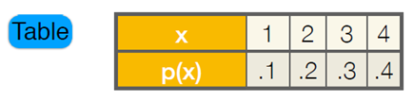

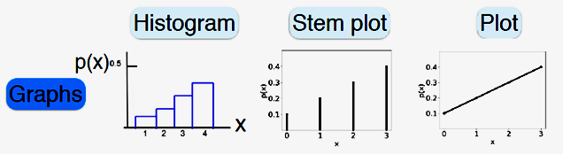
Specification
Suppose we have an unfair tetrahedral dice (4 faced, written 1,2,3,4 on faces)
with following probability of getting each face:
Here random outcomes (variables): X= {1,2,3,4}
The information of probability of random variable X, can be specified in following ways:
In this case, probability of each outcome can be written as a function of outcome, given below

Slide 7
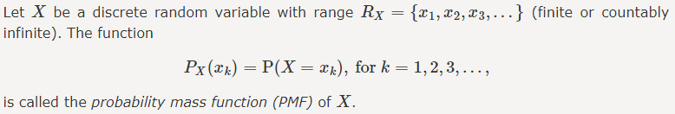
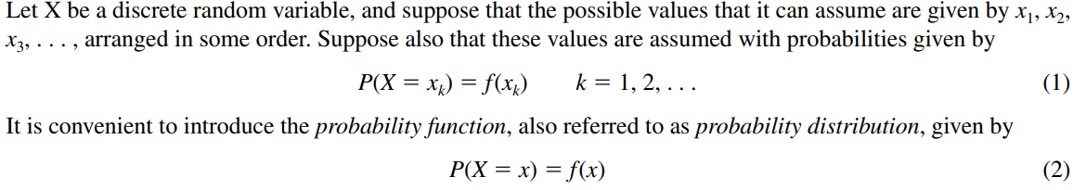
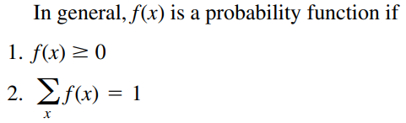
Probability Mass Function (PMF)
Discrete Probability Distribution P(X)

Slide 8
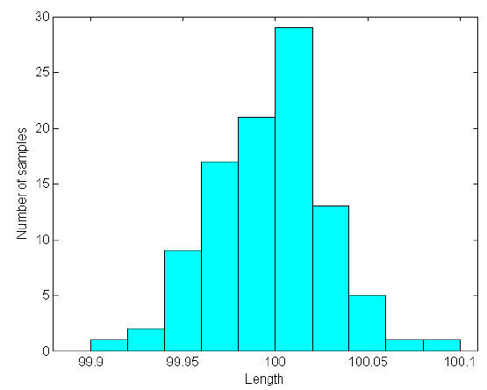
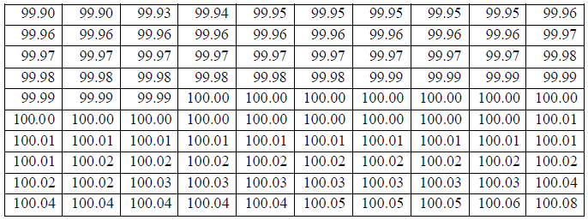
Probability Density Function
Example
For a physical quantity > possible outcomes >within a range of measured values.
The nominal length of a shaft is 100 mm, with manufacturing tolerance is 0.1 mm, the actual length will be within the range of 100 ± 0.1 mm .The length measured vary from 99.90 mm to100.10 mm .
100 sample measurements of the length are given in Table .It range from 99.90 mm to100.10 mm , certain values occur more frequently than others. The values around the nominal length 100 mm occur with a higher chance than the values near both endpoints.
If we divide the range [99.90, 100.10] into several equal segments and plot the number of values of the length that reside the segments, we will have a bar-like graph. This type of graph is called a histogram. It shows the frequency of the values that occur in different segments.

Slide 9
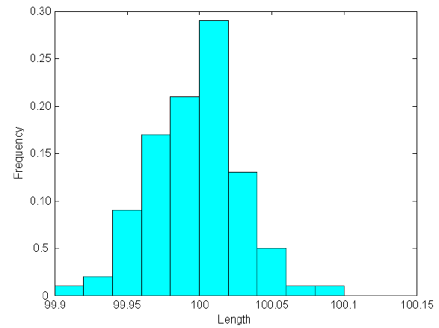
If we plot the number of samples (measurements) divided by the total number of measurements, we obtain a variant of the last histogram. As shown in Fig. below, the vertical axis represents the number of measurements within each segment divided by the total number of measurements (100).
If we have more samples and use more intervals to divide the range of the length, the bars in the last Fig. will approach a smooth curve as shown in Fig. below. This curve is called a probability density function (pdf).

Slide 10

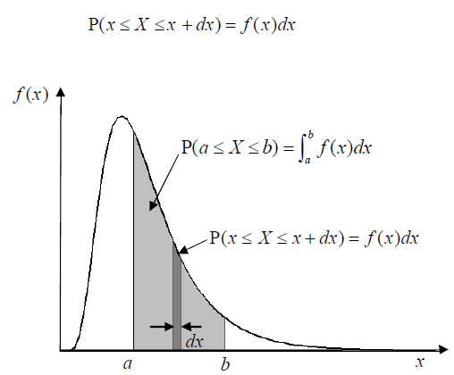


The pdf captures the chance property of a random variable as shown in Fig. below and fully describes a random variable.
f (x) is used the denote a probability density function of random variable X, where x is a realization (a specific value) of X.
The significance of the pdf is that f (x)dx is the probability that the random variable X is in the interval[x, x + dx] (see Fig below), written as
We can also determine the probability of X over a finite interval [ a, b] as
which is the area underneath the curve of f (x) from x = a to x = b (see Fig.)
A pdf must be nonnegative, i.e.
and satisfies the following condition
Note: A function that represents a discrete probability distribution is called a probability mass function. A function that represents a continuous probability distribution is called a probability density function.

Slide 11
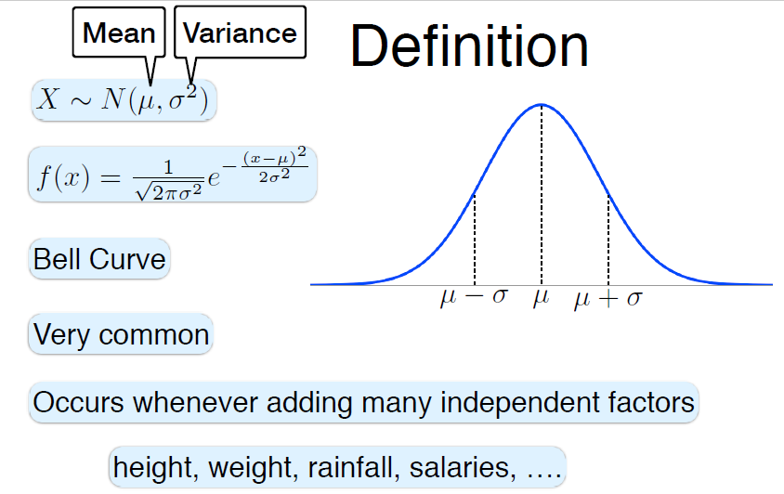
Normal (Gaussian) Distributions

Slide 12
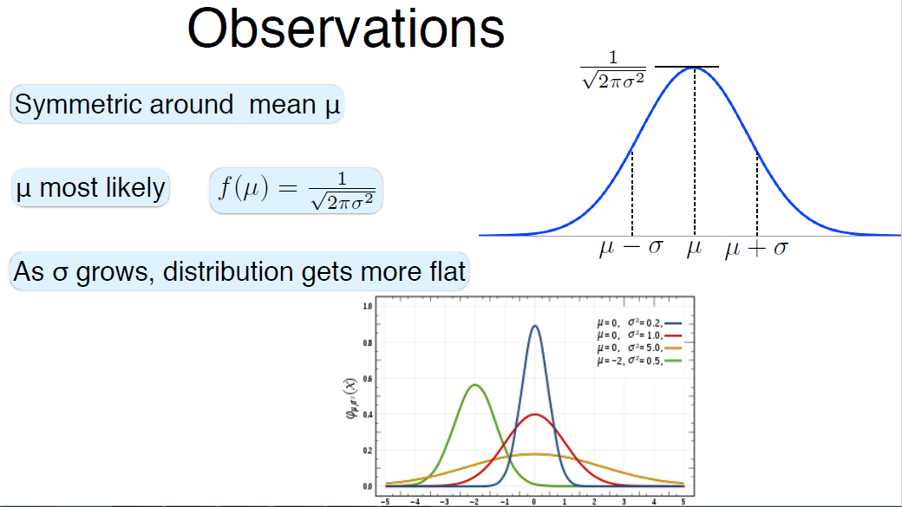

Slide 13
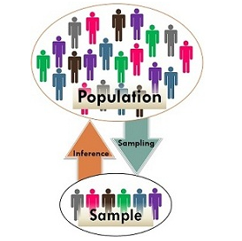
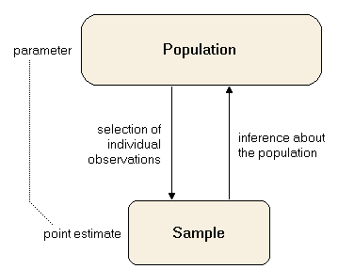






Population Vs Sample
Descriptive statistical measures e.g. the mean or the standard deviation are called parameters if they are calculated from the population.
A subset of the population is called a sample. A descriptive measure referring to a sample is called an estimate (or statistic).
N : Objects in Population
n : Objects in Sample
Sample Population
N

Slide 14
Why, we use (n-1) for standard deviation of sample
It is the issue about degree of freedom.
The degree of freedom is the number of values in a calculation that we can vary.
E.g. To estimate mean, there are N observations in an experiment, but one parameter that needs to be estimated. That leaves N-1 degrees of freedom for estimating variability.
Consider the following question:
Freely assign values to a dataset containing three variables (n=3) and a mean of 10.
Given the variables are X1,X2 & X3 values can be freely assigned only for two of the above variables. Since we need to satisfy the mean, our third variable has to be fixed - not free. Think that you have assigned X1=10 & X2=5. The value for X3 invariably become 15 because:
(X1+X2+X3)/n = 10 :
(10+5+X3)/3 = 10
X3 = (30-15) = 15 ~ X3 is fixed by the values of 'n' and mean
Our degrees of freedom hence is, (n-1) OR (3-1) = 2
In general, degree of freedom = n – no. of parameters estimated
Now, you need to estimate standard deviation, so n-1 is the degree of freedom and need to divide the sum of square-deviations by n-1, while for population standard deviation, it is divided by n instead of n-1.

Slide 15
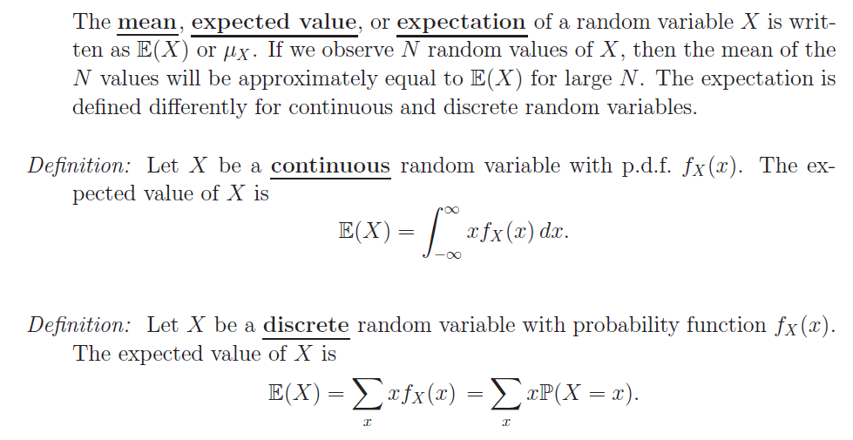
Expectations
The expected value of a random variable is the arithmetic mean of that variable, i.e. E(X) = μ. The idea of the expectation of a random variable began with probability theory in games of chance. Gamblers wanted to know their expected long-run winnings (or losings) if they played a game repeatedly. This term has been retained in mathematical statistics to mean the long-run average for any random variable over an indefinite number of trials or samplings.

Slide 16
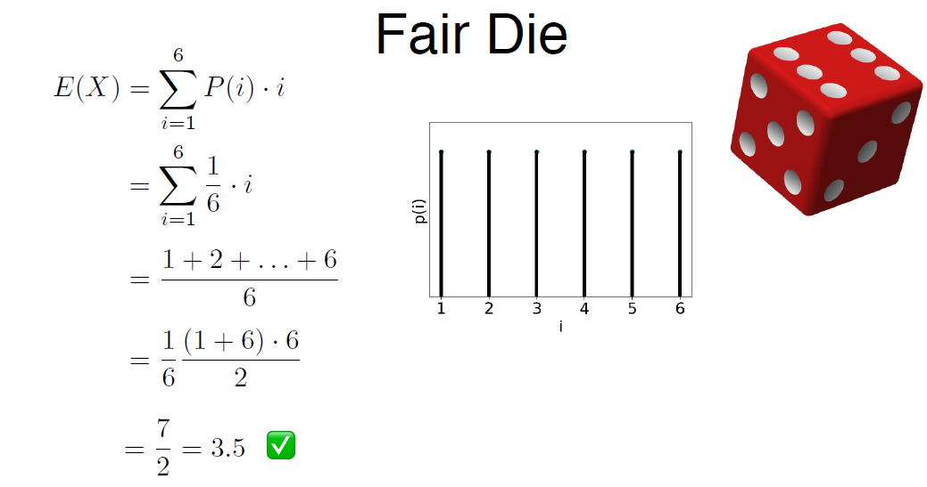
EXPECTATION

Slide 17
Measuring dependence
When are two random variables independent?
Qualitatively assessing dependence
Quantifying dependence: covariance and correlation
Independent random variables
Random variables X;Y are independent if
Pr (X = x; Y = y) = Pr (X = x) Pr (Y = y).
Pick a card out of a standard deck.
X = suit and Y = number.
Pr(X = ♥; Y = 6)=1/52
Pr(X = ♥)=1/4
Pr(Y = 6)=1/13
Flip a fair coin 10 times.
X = # heads and Y = last toss.
Pr (X = 10; Y = T)=0 → Probability of getting all toss as head and last toss as tail
Pr (X = 10)=(1/2)¹⁰ → Probability of getting all head
Pr (Y= T)=1/2 → Probability of getting last toss as tail

Slide 18
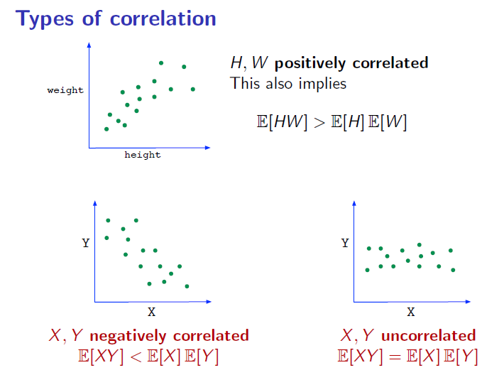
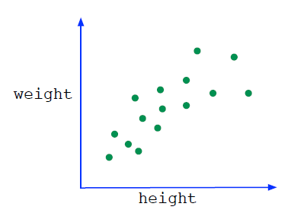
Dependence
Example: Pick a person at random, and take
H = height
W = weight
Independence would mean
Pr(H = h;W = w) = Pr(H = h) Pr(W = w):
Not accurate:
height and weight will be positively correlated.
Positive correlation
H;W are positively correlated
This also implies E[HW] > E[H] E[W].

Slide 19
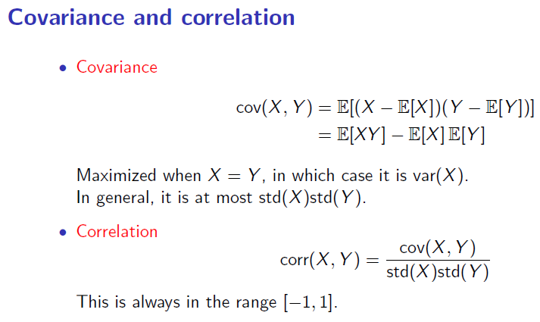
If X;Y independent then cov (X; Y ) = 0.
But the converse need not be true

Slide 20

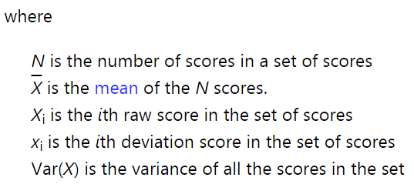
Variance
Variance is a measure of the variability or spread in a set of data. Mathematically, it is the average squared deviation from the mean score. We use the following formula to compute variance.

Slide 21
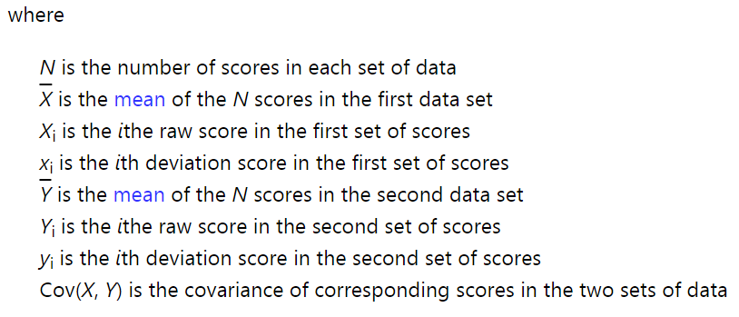
Covariance
Covariance is a measure of the extent to which corresponding elements from two sets of ordered data move in the same direction. We use the following formula to compute covariance.

Slide 22
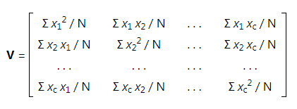
Variance-Covariance Matrix
Variance and covariance are often displayed together in a variance-covariance matrix, (aka, a covariance matrix). The variances appear along the diagonal and covariances appear in the off-diagonal elements, as shown below.

Slide 23
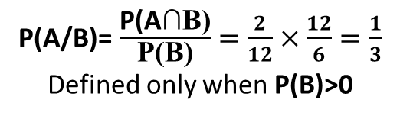
IDEA OF CONDITIONING
Assume 12 equally likely outcomes
Then probability of each outcome
Revised Model:
If told B occurred:
= 1/12
Ω
Ω
Ω
A
A
P(A)=5/12
P(B)=6/12
1/6
B
B
P(A∩B)
P(A/B)=2/6=1/3
Probability of A given that B occurred
Ω
Ω
3/12
A
A
3/12
P(A/B)= $\frac{\text{P}\text{(}\text{A}\text{∩}\text{B}\text{)}}{\text{P}\text{(}\text{B}\text{)}}=\frac{2}{12}×\frac{12}{6}=\frac{1}{3}$
Defined only when P(B)>0
2/12
B
B
2/12
4/12
4/12
This is definition
NOT
Theorem
Out of total probability assigned to B, ( i.e. P(B)) which fraction of that Probability is assigned to outcomes under which event ‘A’ also happens.

Slide 24
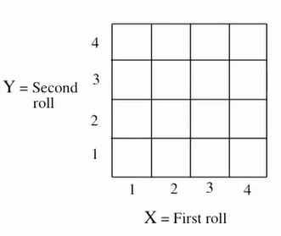
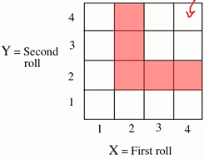
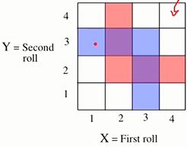
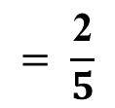
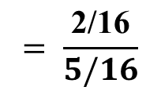
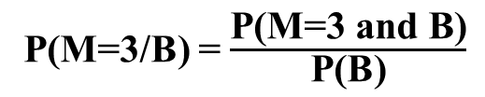
Two rolls of a 4 sided die
Let B be the event : min(X ,Y)=2
Let M=max(X,Y)
P(M=1|B)=0
P(M=3|B)
P(M=3/B) = $\frac{\text{P}\text{(}\text{M}\text{=3 }\text{and} \text{B}\text{)}}{\text{P}\text{(}\text{B}\text{)}}$
1/16
$$= \frac{\text{2/16}}{5/16}$$
$$= \frac{\text{2}}{5}$$

Slide 25


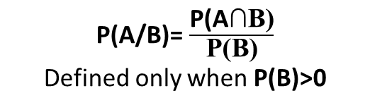
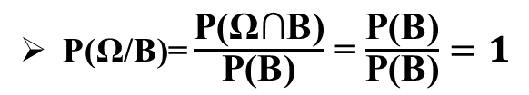
Conditional Probabilities Share Properties of Ordinary Probabilities
P(A/B)= $\frac{\text{P}\text{(}\text{A}\text{∩}\text{B}\text{)}}{\text{P}\text{(}\text{B}\text{)}}$
Defined only when P(B)>0
P(A/B)≥ 0 Assuming P(B)> 0
Ω
C
P(Ω/B)= $\frac{\text{P}\text{(}\text{Ω}\text{∩}\text{B}\text{)}}{\text{P}\text{(}\text{B}\text{)}}$ = $\frac{\text{P}\text{(}\text{B}\text{)}}{\text{P}\text{(}\text{B}\text{)}}=1$
A
B
P(B/B)= $\frac{\text{P}\text{(}\text{B}\text{∩}\text{B}\text{)}}{\text{P}\text{(}\text{B}\text{)}}$ = 1
IF $\text{(}\text{A}\text{∩}\text{C}\text{)}$ = ϕ ,then P((AUC)/B) = P(A/B) + P(C/B)
P(AUC|B) = $\frac{\text{P}\text{(}\text{AUC}\text{)∩}\text{B}}{\text{P}\text{(}\text{B}\text{)}}$ = $\frac{\text{P}\text{( }\text{(}\text{A}\text{∩}\text{B}\text{)}\text{U}\text{(}\text{C}\text{∩}\text{B}\text{) )}}{\text{P}\text{(}\text{B}\text{)}}$ = $\frac{\text{P}\text{(}\text{A}\text{∩}\text{B}\text{)+}\text{P}\text{(}\text{C}\text{∩}\text{B}\text{)}}{\text{P}\text{(}\text{B}\text{)}}=\text{P}\text{(}\text{A}\text{/}\text{B}\text{)+}\text{P}\text{(}\text{C}\text{/}\text{B}\text{)}$

Slide 26
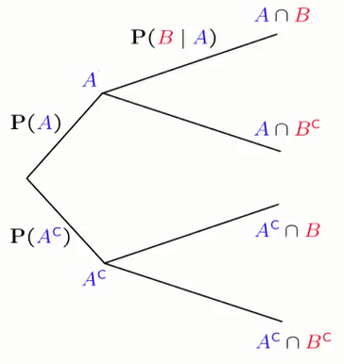
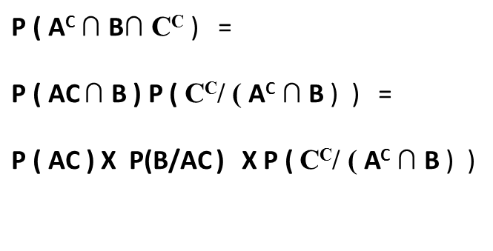




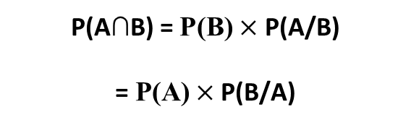
Multiplication Rule
P(A/B) = $\frac{\text{P}\text{(}\text{A}\text{∩}\text{B}\text{)}}{\text{P}\text{(}\text{B}\text{)}}$
$$\text{A} \text{∩} \text{B}\text{∩} \text{C}$$
$\text{P}\text{(}\text{A}\text{∩}\text{B}\text{)}$ = $\text{P}\text{(}\text{B}\text{)}×$ P(A/B)
$\text{=} \text{P}\text{(}\text{A}\text{)}$ $×$ P(B/A)
$\text{P}\text{ ( }\text{A}\text{C} \text{∩ }\text{B}\text{∩ }\text{CC}$ ) =
$\text{P}\text{ ( }\text{AC} \text{∩ }\text{B}\text{ ) }\text{P}\text{ ( }\text{C}\text{C}\text{/ ( }\text{A}\text{C} \text{∩ }\text{B}$ ) ) =
$\text{P}\text{ ( }\text{AC}\text{ ) }\text{X} \text{P}\text{(}\text{B}\text{/}\text{AC} \text{)} \text{X} \text{P}\text{ ( }\text{C}\text{C}\text{/ ( }\text{A}\text{C} \text{∩ }\text{B}$ ) )
P(B/A^{C})
$$\text{A}\text{C} \text{∩} \text{B}\text{∩} \text{CC}$$
$$\text{C}\text{C}\text{ /} \text{AC}\text{∩}\text{B}$$

Slide 27
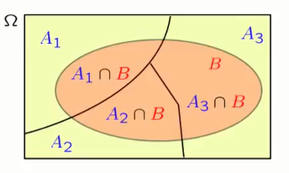
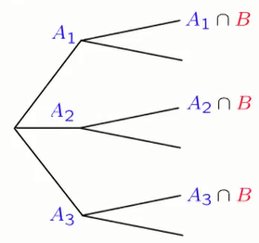


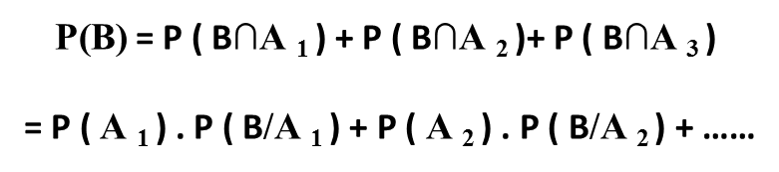
Total Probability Theorem
P(A/B) = $\frac{\text{P}\text{(}\text{A}\text{∩}\text{B}\text{)}}{\text{P}\text{(}\text{B}\text{)}}$
Partition of sample space into A₁, A₂, A_{3 ...}
Have P(A_{i}) , for every i
Have P(B/A_{i}), for every i
$\text{P}\text{(}\text{B}\text{)}$= P ( B∩A ₁ ) + P ( B∩A ₂ )+ P ( B∩A ₃ )
= P ( A ₁ ) . P ( B/A ₁ ) + P ( A ₂ ) . P ( B/A ₂ ) + ……
Weights
Weighted average of conditional probability P ( B/A _{i} )

Slide 28

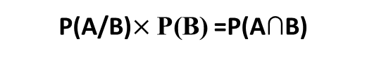

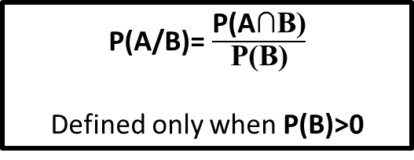
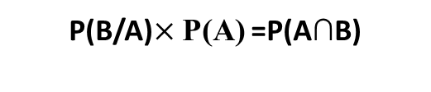
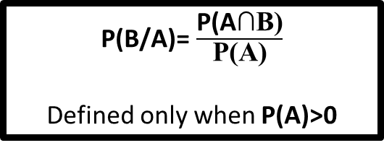
Bayes’ Rule
P(A/B)= $\frac{\text{P}\text{(}\text{A}\text{∩}\text{B}\text{)}}{\text{P}\text{(}\text{B}\text{)}}$
Defined only when P(B)>0
P(B/A)= $\frac{\text{P}\text{(}\text{A}\text{∩}\text{B}\text{)}}{\text{P}\text{(}\text{A}\text{)}}$
Defined only when P(A)>0
P(A/B)$×$ $\text{P}\text{(}\text{B}\text{)}$=P(A∩B)
P(B/A)$×$ $\text{P}\text{(}\text{A}\text{)}$=P(A∩B)
P(A/B)$×$ $\text{P}\text{`}\text{(}\text{B}\text{) = }\text{P}\text{(}\text{A}\text{∩}\text{B}\text{)}$ = P(B/A)$×$ $\text{P}\text{(}\text{A}\text{)}$
P(A/B)$×$ $\text{P}\text{(}\text{B})$= $\text{P}\text{(}\text{A}\text{)}×\text{P}\text{(}\text{B}\text{/}\text{A}\text{)}$
P(A/B) = $\frac{\text{P}\text{(}\text{A}\text{)}×\text{P}\text{(}\text{B}\text{/}\text{A}\text{)}}{\text{P}\text{(}\text{B}\text{)}}$

Slide 29
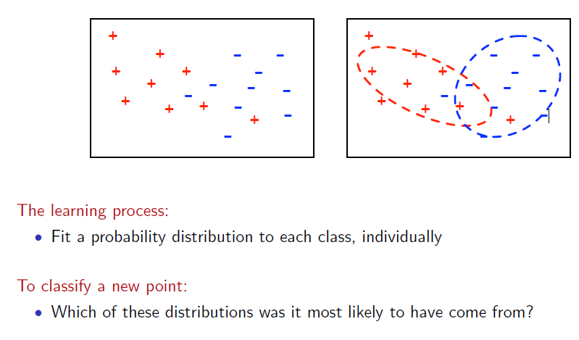
Part :2. Bayes Classifier
Generative approach to Classification
Gaussian Bayes Classifier

Slide 30
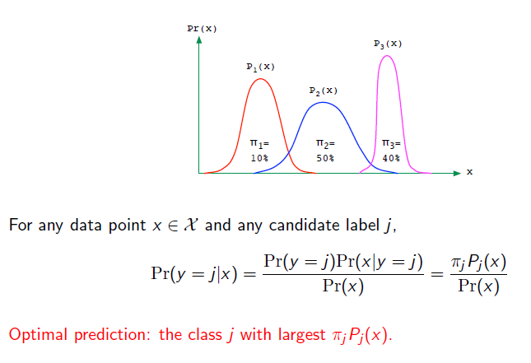

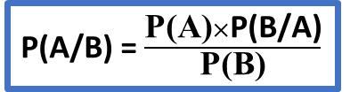
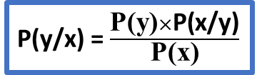
Example of classification → Iris Flower having three class: Setosa, Versicolor, Verginica
P(A/B) = $\frac{\text{P}\text{(}\text{A}\text{)}×\text{P}\text{(}\text{B}\text{/}\text{A}\text{)}}{\text{P}\text{(}\text{B}\text{)}}$
P(y/x) = $\frac{\text{P}\text{(}\text{y}\text{)}×\text{P}\text{(}\text{x}\text{/}\text{y}\text{)}}{\text{P}\text{(}\text{x}\text{)}}$
y=1 for Setosa
y=2 for Versicolor
y=3 for Verginica
Bayes Rule applied

Slide 31
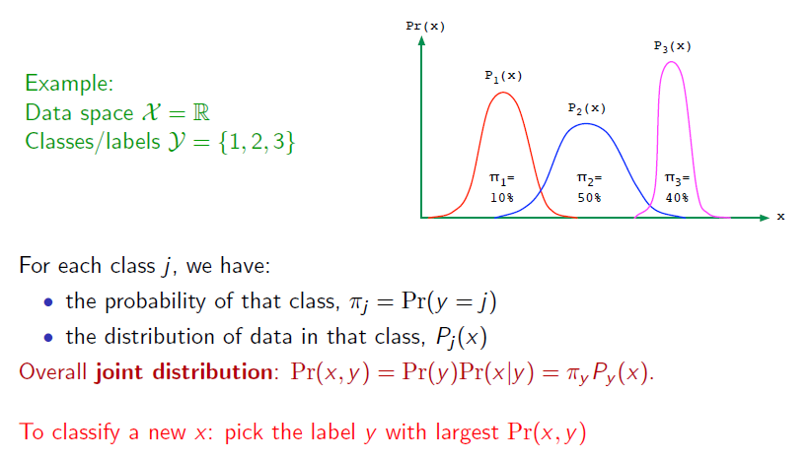
Probability → Pr (y/x)
Calculate : π₁P₁(x) , π₂ P₂(x) , π₃P₃(x) >> Choose the label with highest value

Slide 32


Slide 33



Slide 34


Multivariate Gaussian

Slide 35

NAÏVE BAYES
BAYES RULE
P(y/x) = $\frac{\text{P}\text{(}\text{y}\text{)}×\text{P}\text{(}\text{x}\text{/}\text{y}\text{)}}{\text{P}\text{(}\text{x}\text{)}}$
To model p(x|y), we will make a very strong assumption. We will assume that the xi’s are conditionally independent given y. This assumption is called the Naive Bayes (NB) assumption, and the resulting algorithm is called the Naive Bayes classifier.
Naive Bayes methods are a set of supervised learning algorithms based on applying Bayes’ theorem with the “naive” assumption of conditional independence between every pair of features given the value of the class variable.
https://scikit-learn.org/stable/modules/naive_bayes.html#gaussian-naive-bayes

Slide 36


Slide 37

What we did earlier?
What we did earlier ?
p(x|y)
What we did earlier ?

Slide 38
THANK YOU !
HAPPY LEARNING!!
www.linkedin.com/in/ramendra-kumar-57334478/
https://github.com/Rami-RK

