Slide 1
Vasa Consulting
Min butik kommer att gå under!!!

Slide 2
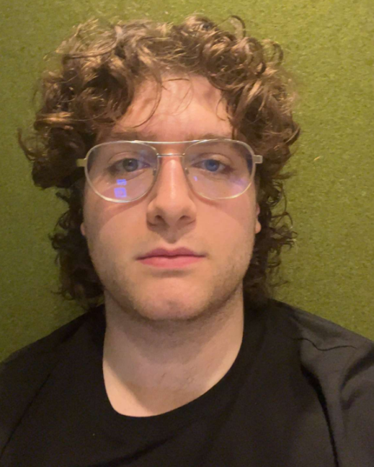
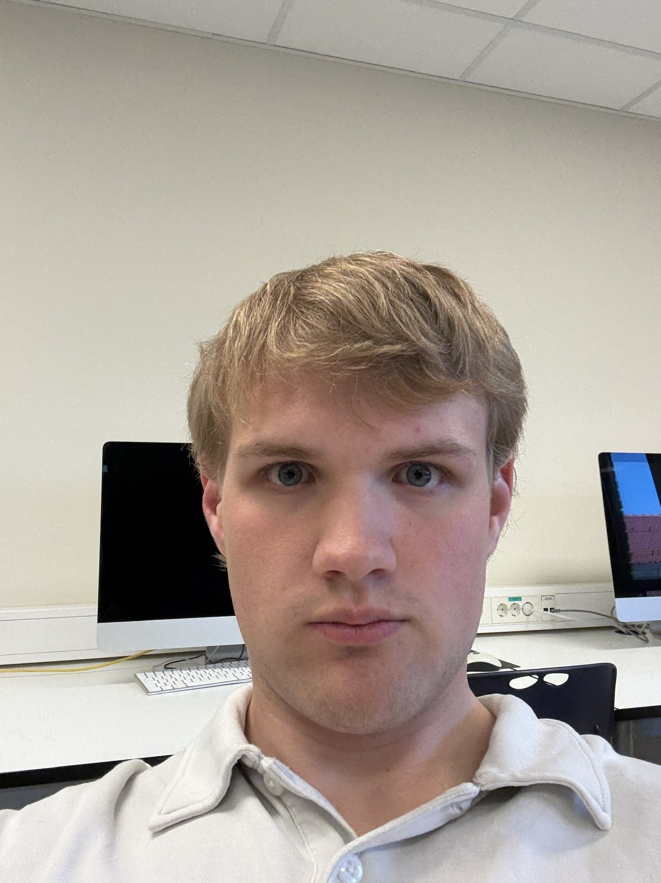

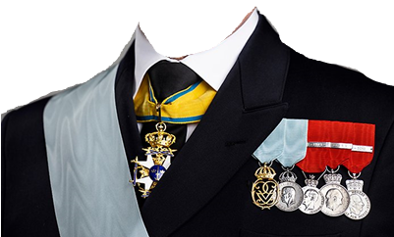
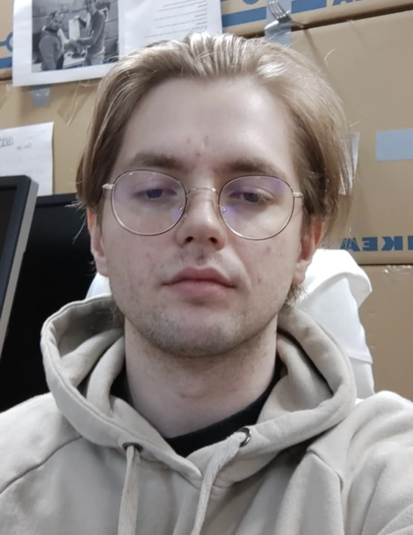
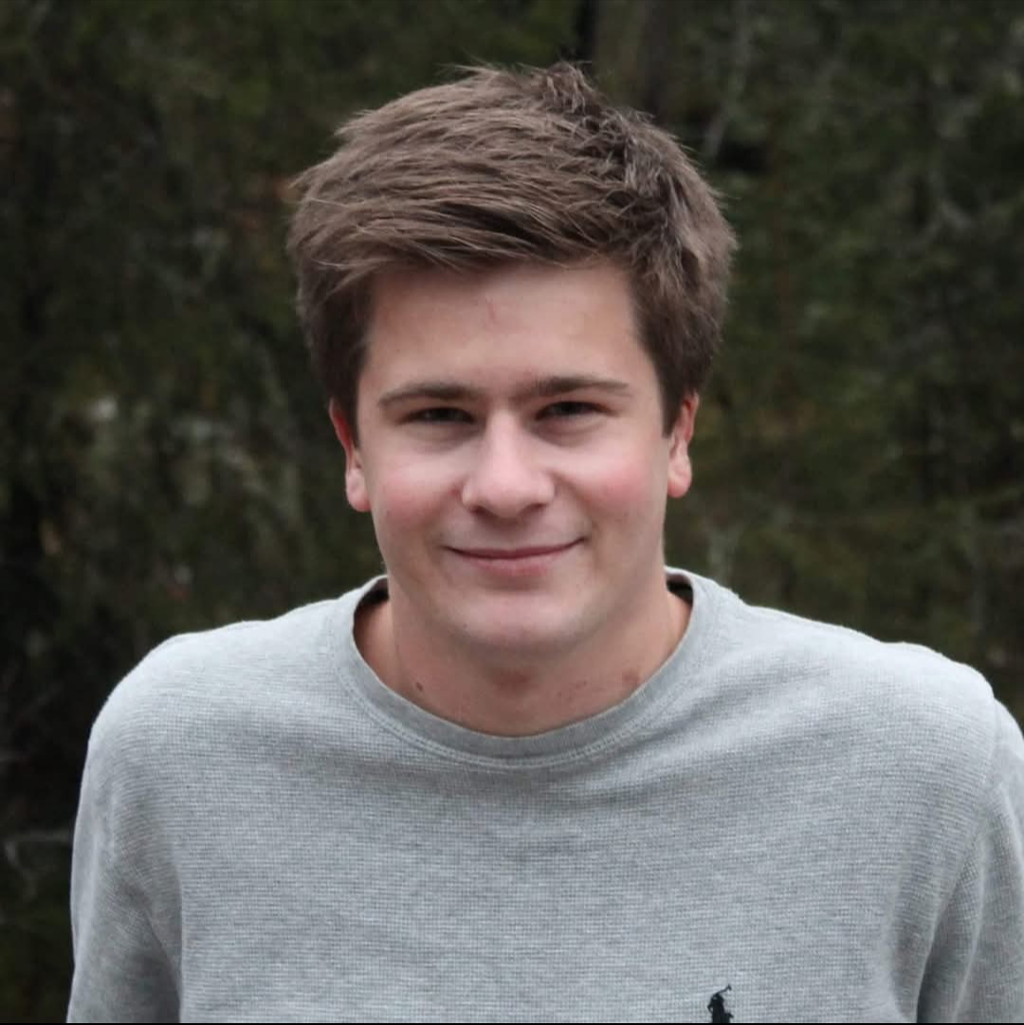
The client: Smutsiga Megastores
Var är min segelbåt?
Founded in 2024, Smutsiga Megastore is your one-stop shop for everything you need. With a wide selection of products across multiple categories, we offer everything from electronics and clothing to home goods and groceries, all at unbeatable prices. Our mission is to provide a convenient and affordable shopping experience for all your everyday needs under one roof. The company is lead by the four excellencies:
Jørgen: Co-founder and Chief Knäckbröds Officer
Torje: Co-founder and Chief Backroom-deals Officer
Larry: Co-founder and Chief DEI hire
Thomas: Co-founder and Chief Insurance Investigator

Slide 3

Smutsiga Business Model
Owns several large retail stores
Several competing stores fall under the Smutsiga umbrella
Order goods from suppliers
Sell the goods in the store
Workers work when told to

Slide 4

Problems
Sales have declined
Profits have stagnated
No segelbåt in sight

Slide 5

Timeline
Send us prices, order-list to supplier and worker schedules by Tuesday at 23:59
Email: smutsigamegastore@gmail.com
You will receive the results of the changes by Wednesday at lunchtime
Report the changes to us by Friday

Slide 6
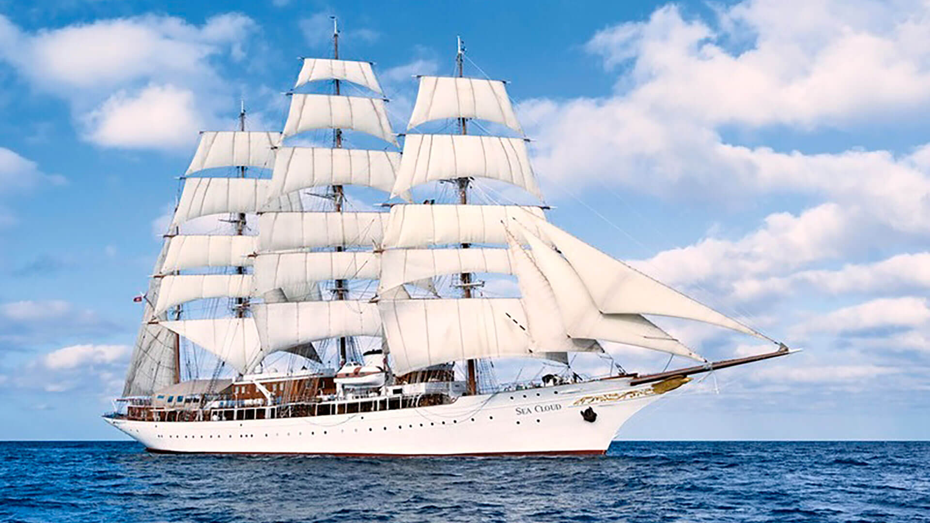
Expectations

Slide 7
Expectations

Slide 8
Expectations

