Slide 1
Dart

Slide 2
Intro
Dart is a general-purpose, high-level modern programming language which is originally developed by Google.
New programming language emerged in 2011, but its stable version was released in June 2017.
It is a dynamic, class-based, object-oriented programming language with closure and lexical scope. Syntactically, it is quite similar to Java, C, and JavaScript.
Dart is an open-source programming language which is widely used to develop the mobile application, modern web-applications, desktop application, and the Internet of Things (IoT) using by Flutter framework.

Slide 3
Compiled language
Supports two types of compilation techniques
AOT (Ahead of Time) - It converts the Dart code in the optimized JavaScript code with the help of the dar2js compiler and runs on all modern web-browser. It compiles the code at build time.
JOT (Just-In-Time) - It converts the byte code in the machine code (native code)

Slide 4
Why Dart?
Dart is a platform-independent language and supports all operating systems such as Windows, Mac, Linux, etc.
It is an open-source language, which means it available free for everyone.
An object-oriented programming language supports all features of oops such as inheritance, interfaces, and optional type features.
Useful in building real-time applications because of its stability.
The stand-alone Dart VM permits Dart code to run in a command-line interface environment.

Slide 5
Points to remember
Everything in Dart is treated as an object including, numbers, Boolean, function, etc. like Python. All objects inherit from the Object class.
Dart tools can report two types of problems while coding, warnings and errors. Warnings are the indication that your code may have some problem, but it doesn't interrupt the code's execution, whereas error can prevent the execution of code.
Dart supports generic types, like List<int>(a list of integers) or List<dynamic> (a list of objects of any type).

Slide 6
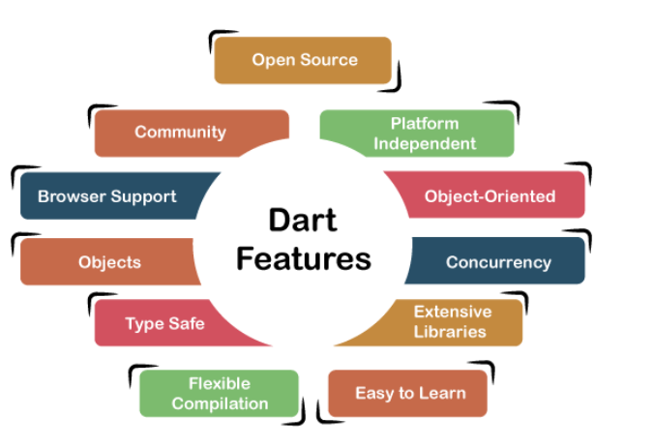
Supports an extensive range of programming utilities such as interface, collections, classes, dynamic and optional typing. It is developed for the server as well as the browser.

Slide 7
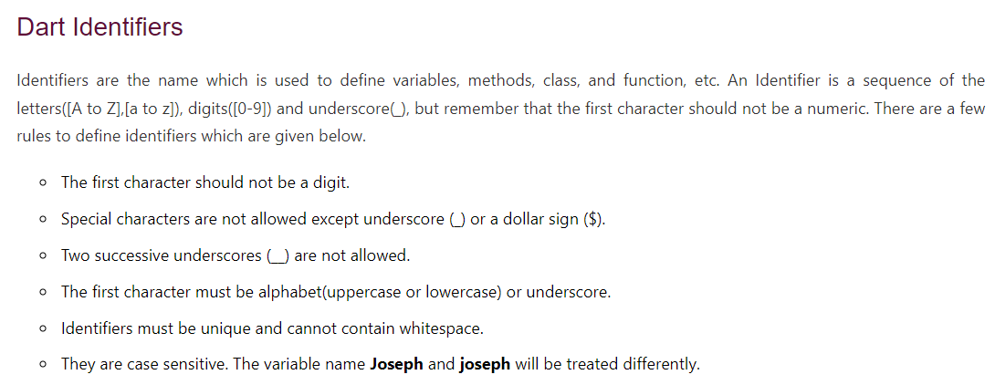

Slide 8
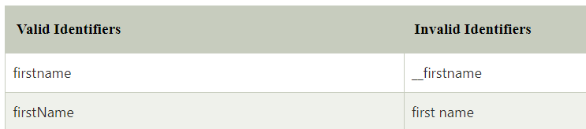
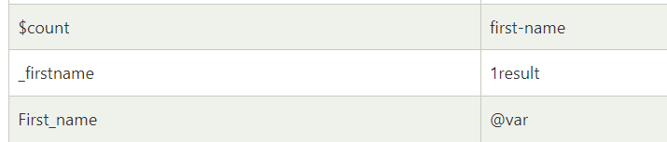

Slide 9

Here is the first program

Slide 10
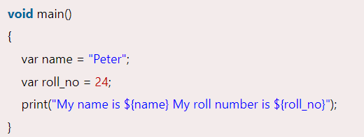
Dart Printing and String Interpolation

Slide 11
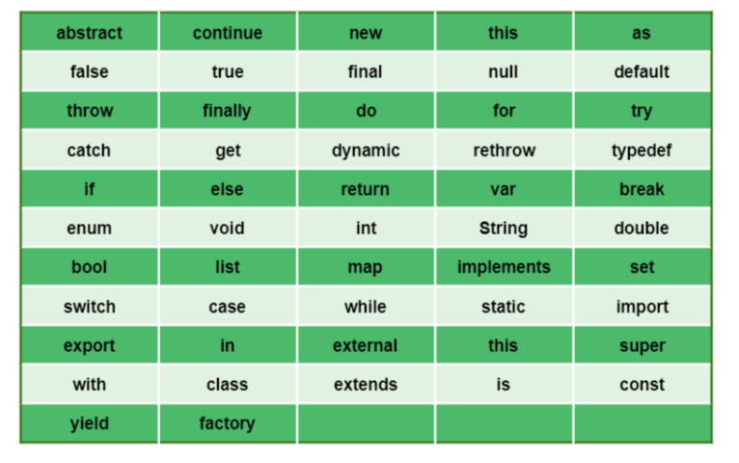
Keywords

Slide 12
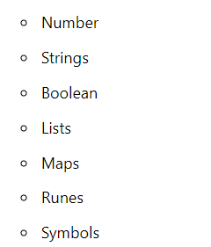
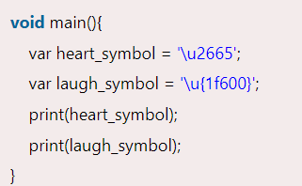

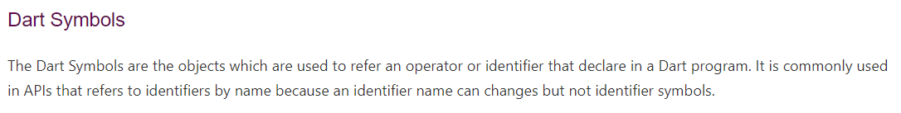
Data Types

Slide 13


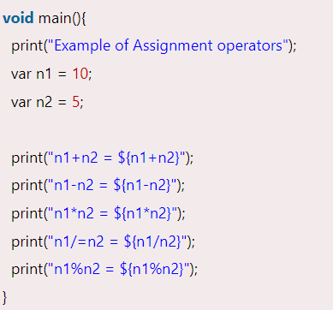
Final and const

Slide 14
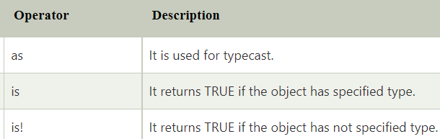
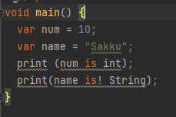

Test Operators

Slide 15
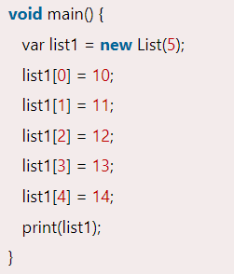
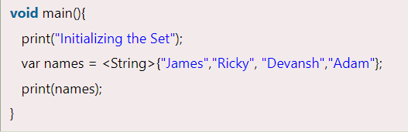
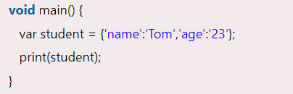
List, Set, Map

Slide 16
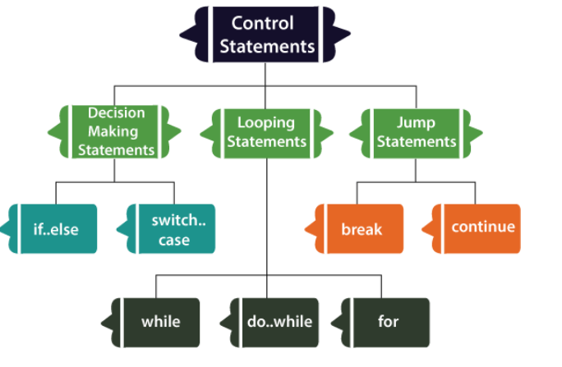
Decision making

Slide 17
Exercise
Find a given number is even or odd
Print the result based on the student’s grades (>85 excellent, between good, <60 fail)
Find the largest of three numbers

Slide 18
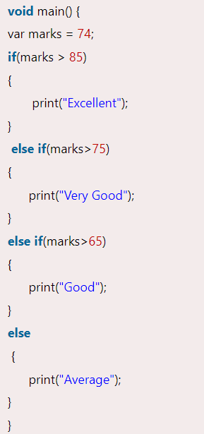
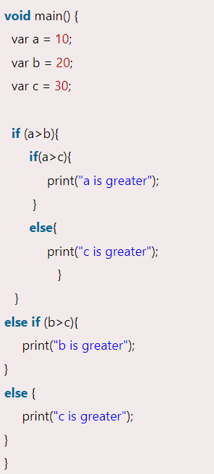
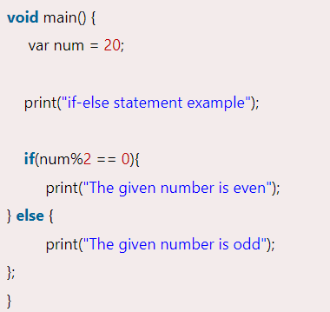

Slide 19
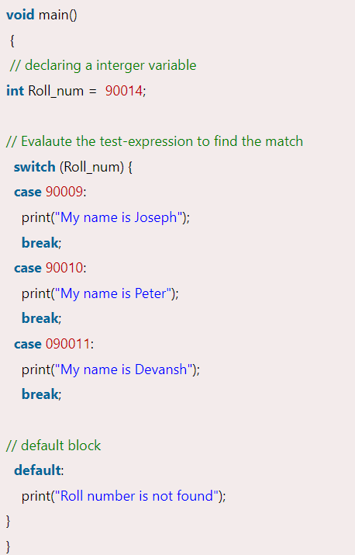
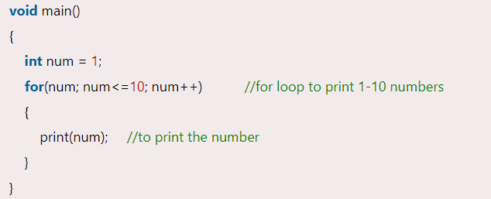
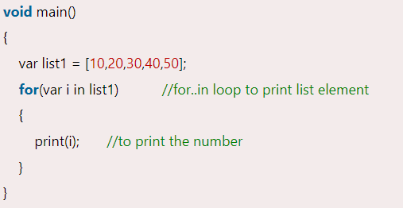
Switch,loop

Slide 20
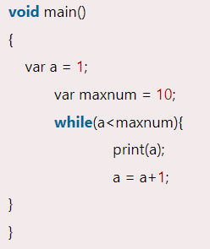
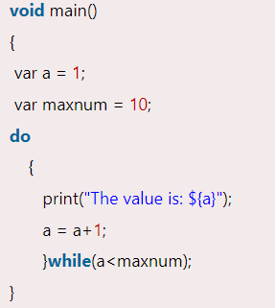
While, do while

Slide 21
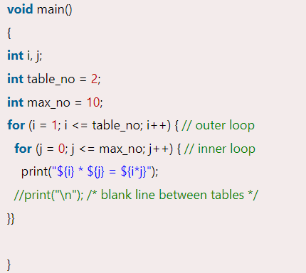
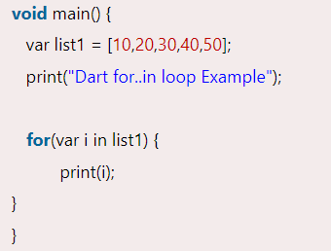
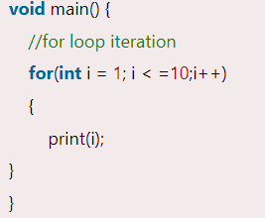
For loop

Slide 22
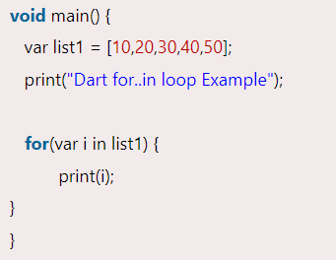
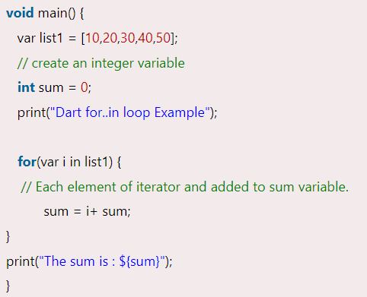
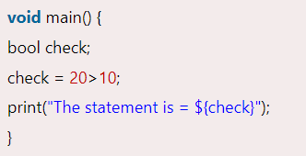
Enhanced For Loop, boolean

Slide 23
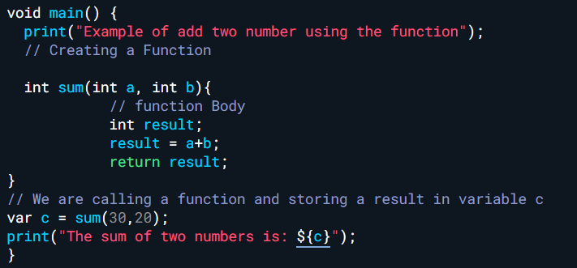
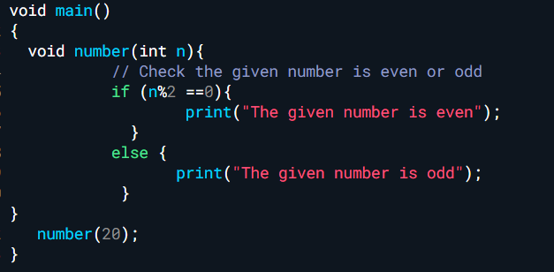
Function

Slide 24
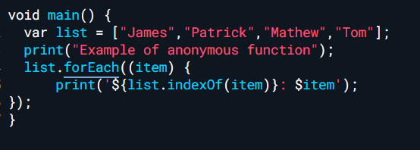
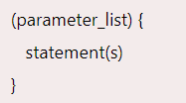
Anonymous function
In the below example, we defined an anonymous function called for each item in the list and printed the strings with its specified index value.

Slide 25
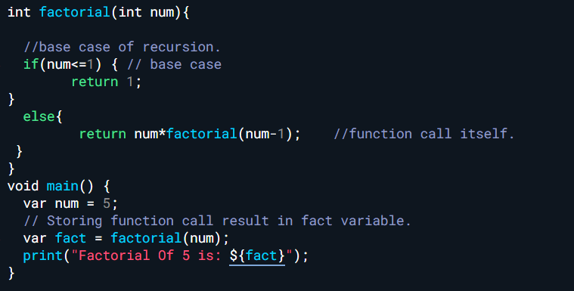
Recursion

Slide 26
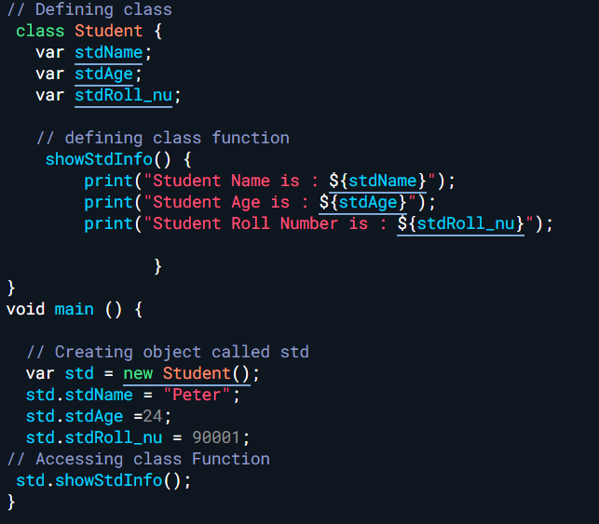
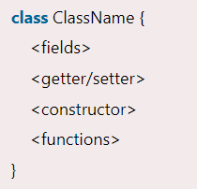
Class and Objects

Slide 27
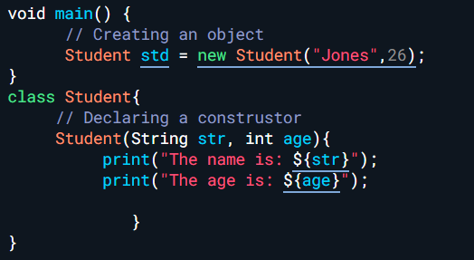
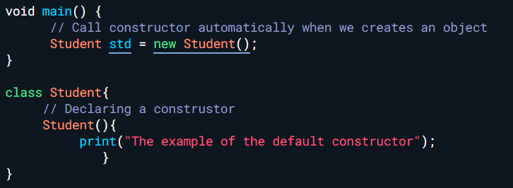
Constructor

Slide 28
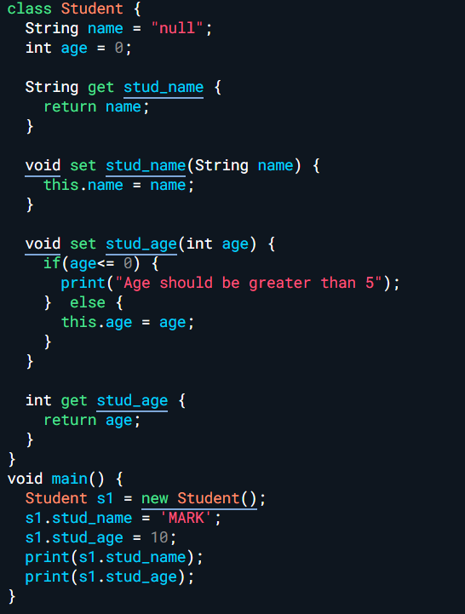

Slide 29
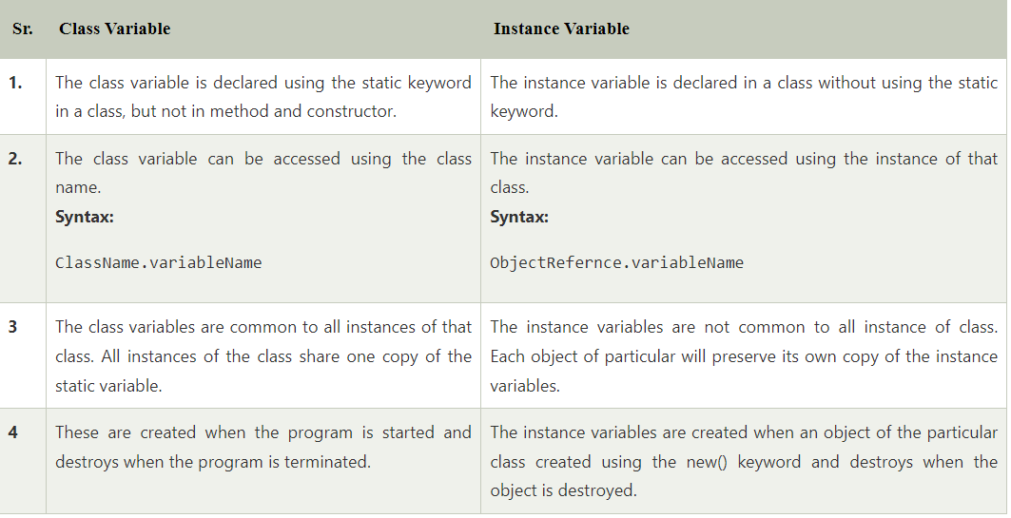
Difference Between Class Variable and Instance Variable

Slide 30
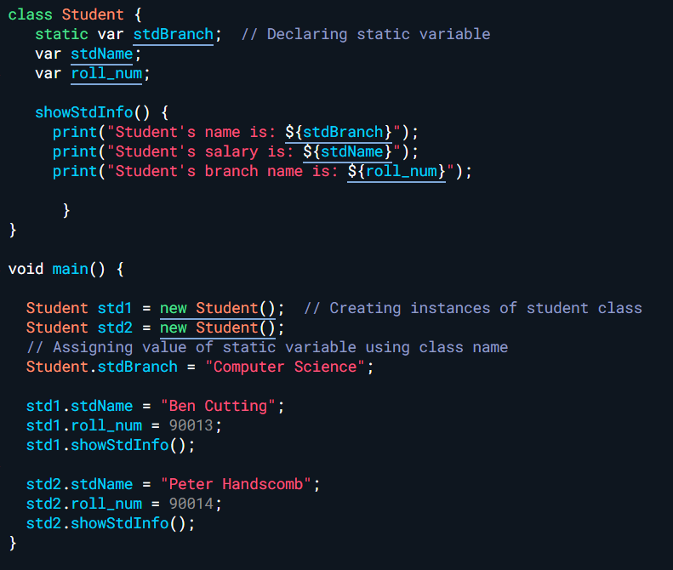
Static keyword

Slide 31
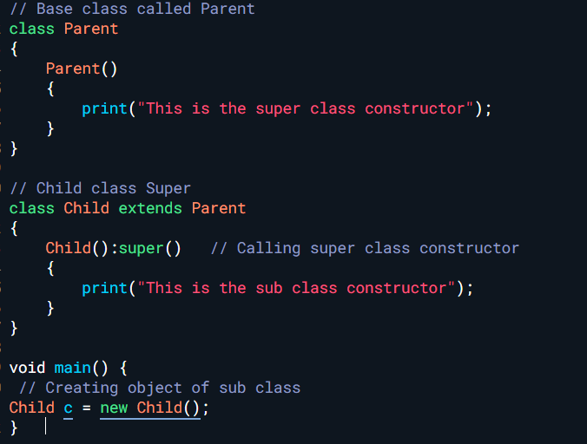
super

Slide 32
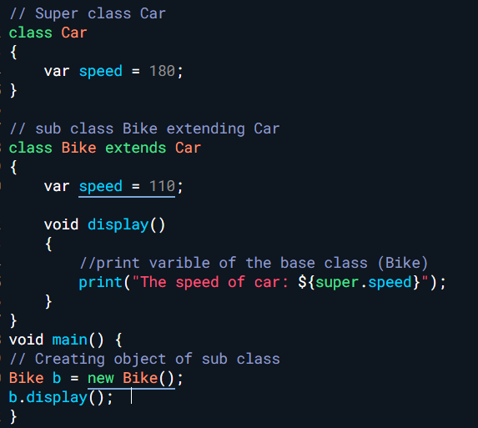
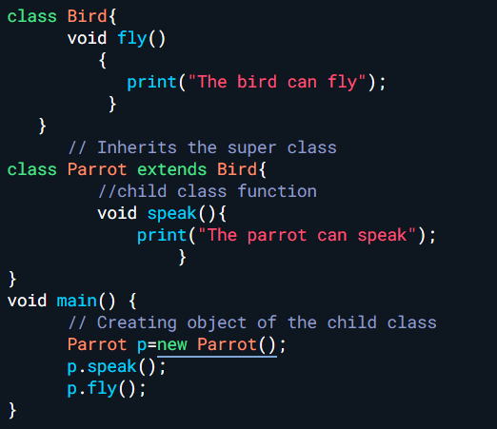
Inheritance

Slide 33
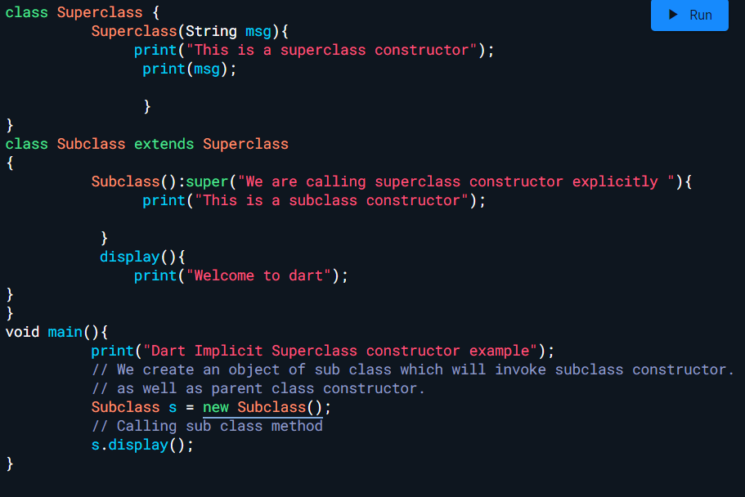
Cascading Super

Slide 34
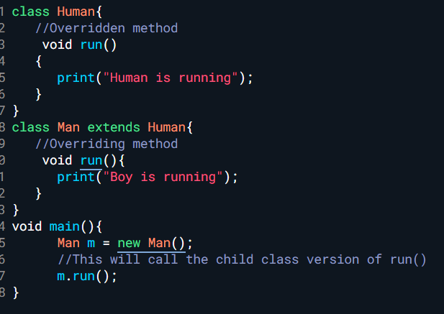
Method overriding

Slide 35
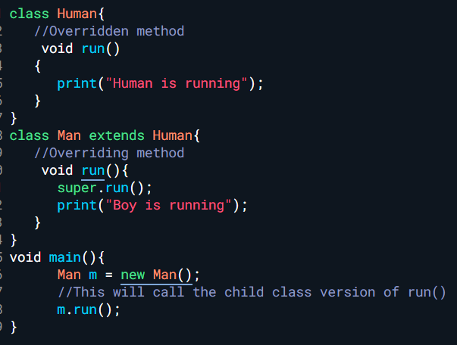
Look at super.run()

Slide 36
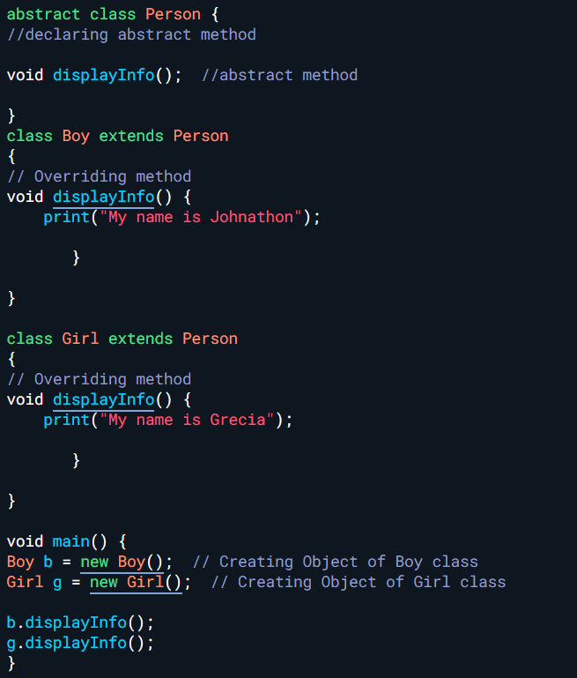
Abstract classes

Slide 37
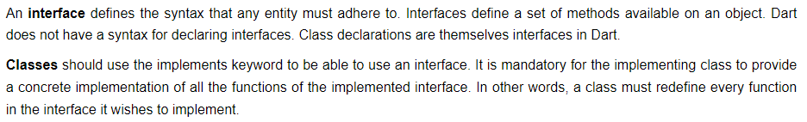

Interface

Slide 38


Getters and setters

Slide 39

Basic calculator

Slide 40


Slide 41

Uppercase to lowercase

Slide 42


Slide 43


Slide 44


Slide 45


Slide 46


Slide 47

Call an Abstract class
Exercise: Area and Perimeter

Slide 48




Exercise
From the given list of number, find the sum and average
Find the factorial
Print the following triangles

