Slide 1
Deep learning based basketball video analysis for intelligent
Team3

Slide 2
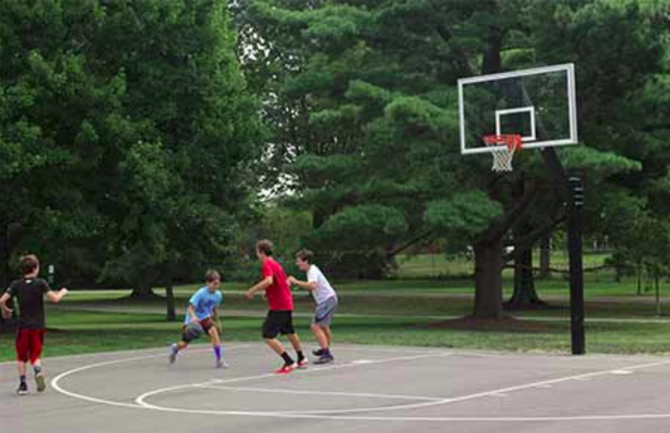
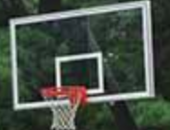
Proposal/Plan: System
Hotspot area detection
Training of hotspot
During training, we annotate the backboard, hoop, and basket as the hotspot examples. And the ACF tool in Piotr’s CV Matlab Toolbox(7) and the AdaBoost are used to train the detector for hotspot areas.
ACF detector: 7 Dollar P, Appel R, Belongie S, Perona P (2014) Fast feature pyramids for object detection. IEEE Trans. Pattern Anal Mach Intell 36(8):1532–
AdaBoost:11 Friedman J, Hastie T, Tibshirani R et al (2000) Additive logistic regression: a statistical view of boosting. Ann Stat 28(2):337–407

Slide 3
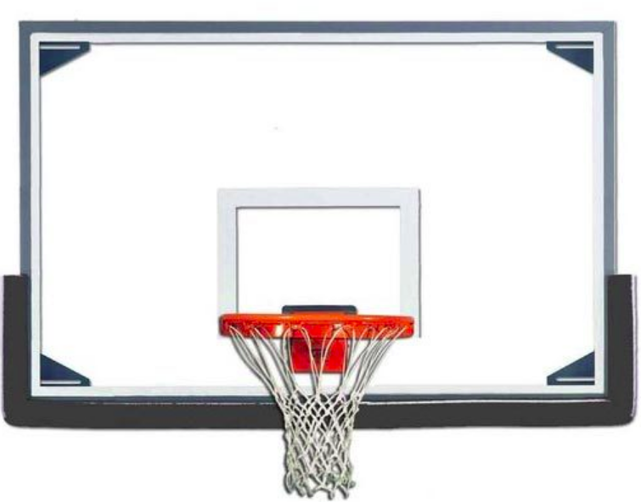
Proposal/Plan: System
Basketball energy image generation and CNN
BEI
A scoring ball pass through the basketball hoop and finish its track in the backboard area, while a non-scoring one would finish its trajectory at the edge of the backboard. So the motion track of the basketball can provide significant cues for identifying scoring from shooting.
We can directly feed the BEI into a CNN to learn an effective model for scoring detection. In our system, we adopt the AlexNet network which is constructed by four convolutional layers and two fully connected layers
Basketball track
CNN: 12. Gan C, Wang N, Yang Y, Yeung D, Hauptmann AG (2015) Devnet: A deep event network for multimedia
CNN: 36. Yan C, Xie H, Yang D, Yin J, Zhang Y, Dai Q (2017) Supervised hash coding with deep neural network for environment perception of intelligent vehicles. IEEE Trans Intell Transp Syst

Slide 4
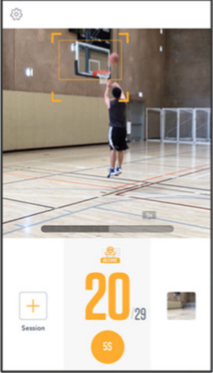
Application
As long as the backboard is captured in the camera, we can detect it automatically. Then with the captured video and detected hotspot area, the basketball energy image is generated and sent into the trained deep learning model.
When scoring is detected, the video clip will be saved into the highlight reels.

