Slide 1

Tutorial 2
COMP5511 Artificial Intelligence Concepts
Haokai Hong
Department of DSAI
haokai.hong@connect.polyu.hk

Slide 2
Search Algorithm

Slide 3
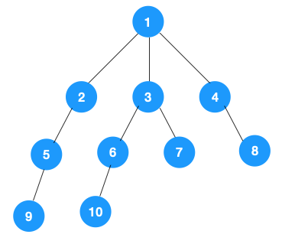
Breadth-first Search
Concept:
3

Slide 4
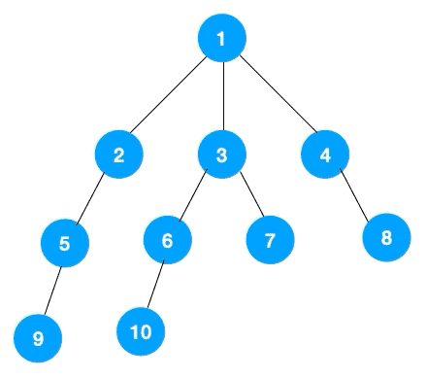
Breadth-first Search
Concept:
Example:
4

Slide 5
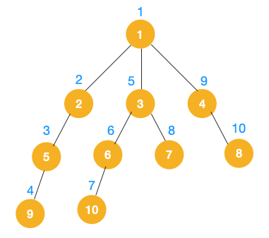
Depth-first Search
Concept:
Example:
5

Slide 6

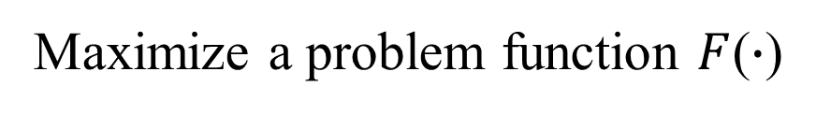
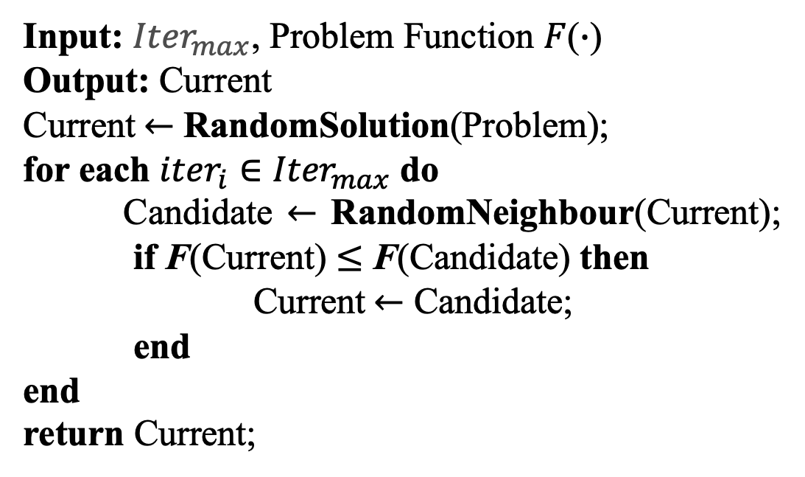
Hill Climbing
Hill climbing is a heuristic search algorithm.
Pseudo Code:
Input: ${Iter}_{max}$, Problem Function $F$($∙$)
Output: Current
Current$←$ RandomSolution(Problem);
for each ${iter}_{i}∈{Iter}_{max}$ do
Candidate $←$ RandomNeighbour(Current);
if F(Current) $≤$ F(Candidate) then
Current$←$ Candidate;
end
end
return Current;
Maximize a problem function $F$($∙$)
6

Slide 7
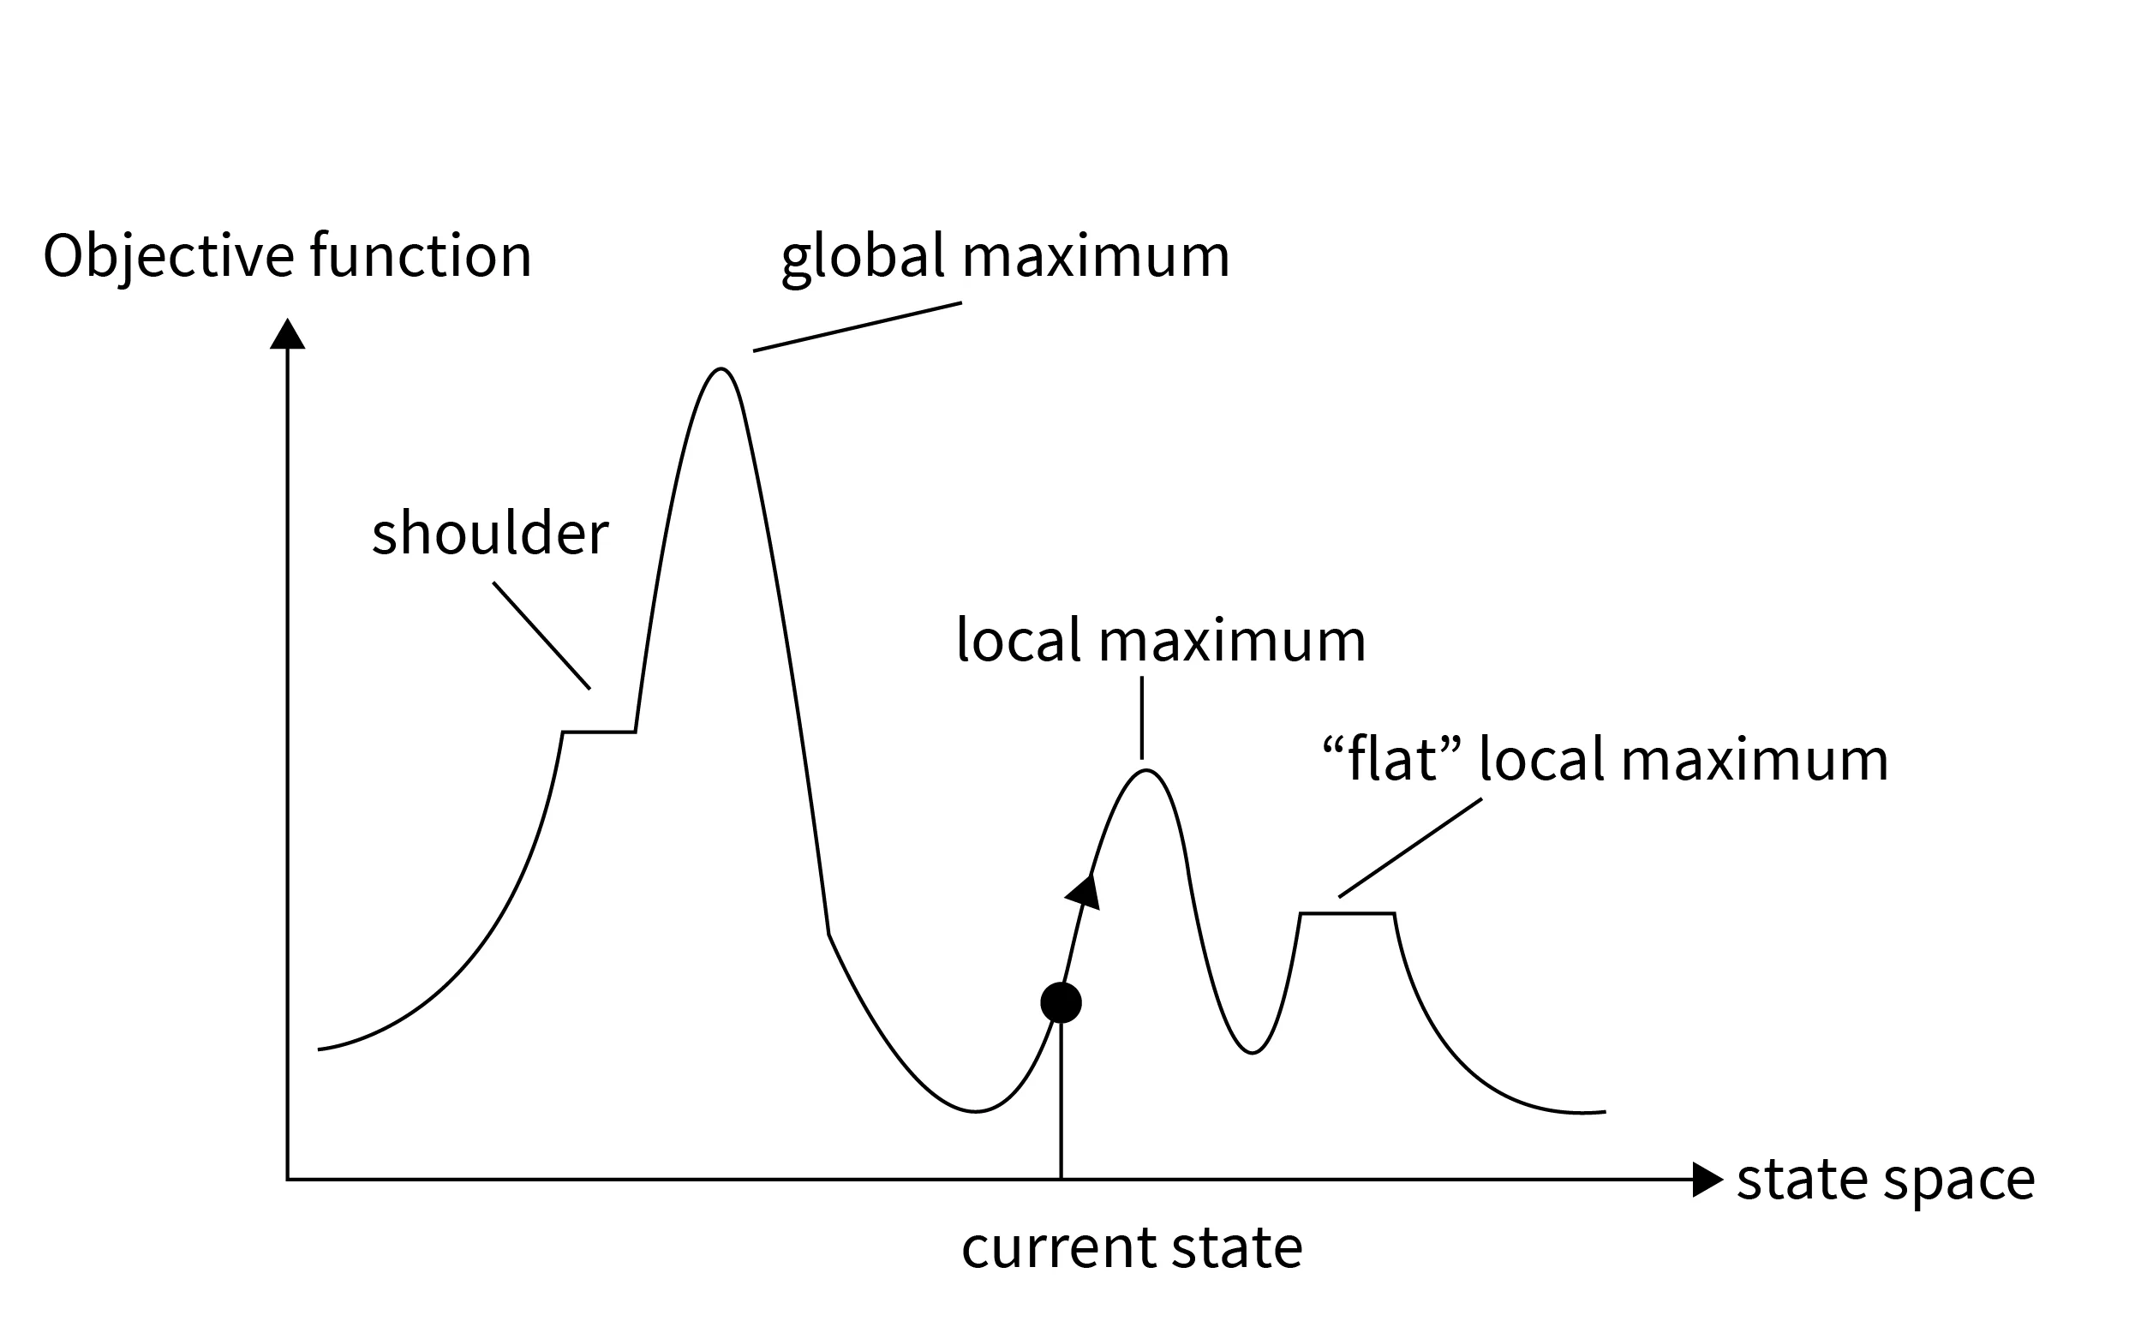
Hill Climbing
Hill climbing algorithm goes uphill along the steepest possible path until can go no further up, which may return a state that is a local maximum.
Maximize the objective function
7

Slide 8
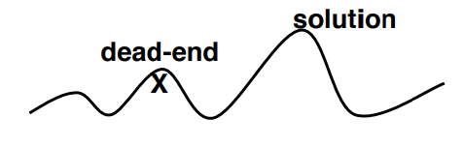
Hill Climbing
Pros:
Avoid traversal and achieve the purpose of improving efficiency.
Cons 1:
Hill climbing will not necessarily find the global maximum, but may instead converge on a local maximum.
8

Slide 9
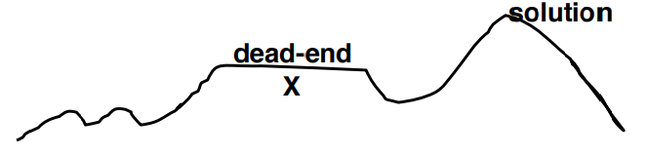
Hill Climbing
Pros:
Avoid traversal and achieve the purpose of improving efficiency.
Cons 2:
In plateau cases, the hill climber may not be able to determine in which direction it should step, and may wander in a direction that never leads to improvement.
9

Slide 10
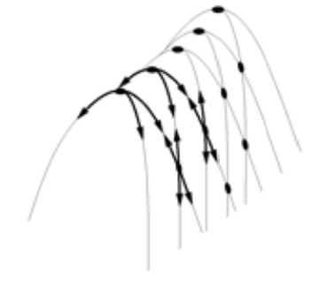
Hill Climbing
Pros:
Avoid traversal and achieve the purpose of improving efficiency.
Cons 3:
Ridges problem: If the target function creates a narrow ridge that ascends in a non-axis-aligned direction, then the hill climber can only ascend the ridge by zig-zagging.
10

Slide 11
Exercise

Slide 12
Exercise 1
B
D
Given the problem-solution graph in Figure 1, perform a breadth-first search starting from the initial state A and ending in the goal state F.
A
F
If there are two or more nodes of the same preference, then handle the nodes alphabetically.
C
E
Figure 1

Slide 13
Exercise 1
Breadth first search
B
D
A
A
F
B
C
D
C
E
Figure 1
E
F

Slide 14
Exercise 2
B
D
Given the problem-solution graph in Figure 1, perform a depth-first search starting from the initial state A and ending in the goal state F.
A
F
If there are two or more nodes of the same preference, then handle the nodes in descending (rather than ascending) alphabetical order.
C
E
Figure 1

Slide 15
Exercise 2
Depth first search
A
B
D
D
A
F
C
E
F
E
Figure 1
B
C

Slide 16
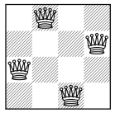
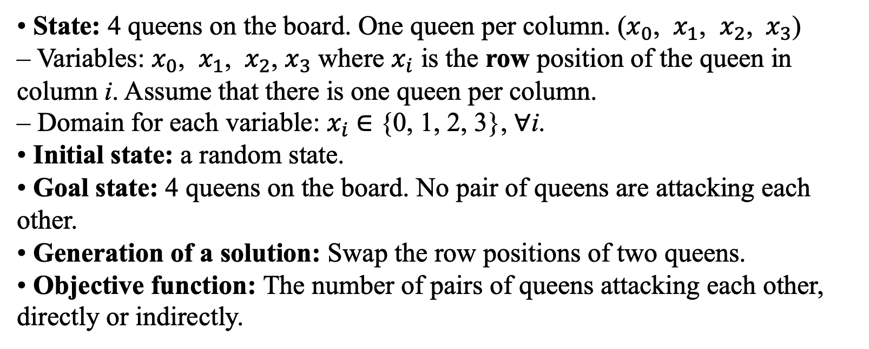
Exercise 3
The 4 queens problem consists of a 4 x 4 chessboard with 4 queens. The goal is to place the 4 queens on the chessboard such that no two queens can attack each other. Each queen attacks anything in the same row, in the same column, or in the same diagonal.
• State: 4 queens on the board. One queen per column. ($x_{0}$, $x_{1}$, $x_{2}$, ${ x}_{3}$)
– Variables: $x_{0}$, $x_{1}$, $x_{2}$, $x_{3}$ where $x_{i}$ is the row position of the queen in column i. Assume that there is one queen per column.
– Domain for each variable: $x_{i}$ ∈ {0, 1, 2, 3}, ∀i.
• Initial state: a random state.
• Goal state: 4 queens on the board. No pair of queens are attacking each other.
• Generation of a solution: Swap the row positions of two queens.
• Objective function: The number of pairs of queens attacking each other, directly or indirectly.
(2,0,3,1)

Slide 17

Exercise 3
Start with the initial state $x_{0}$ = 3, $x_{1}$ = 1, $x_{2}$ = 2, $x_{3}$ = 0. Show the steps of executing the hill climbing algorithm until it terminates.
The way for generating a new solution: swap the row positions of two queens.
If multiple solutions have the same objective value, select the solution where the pair of queens swapped has the smallest subscript/column number.
For example, when we can swap either ($x_{0}$, $x_{1}$) or ($x_{2}$, $x_{3}$), we will swap ($x_{0}$, $x_{1}$). When we can swap either ($x_{2}$, $x_{3}$) or ($x_{1}$, $x_{3}$) we will swap ($x_{1}$, $x_{3}$).
$x_{0}$ $x_{1}$ $x_{2}$ $x_{3}$
0
1
2
3
 |  |  | Q
 | Q
 |  | Q
Q

Slide 18

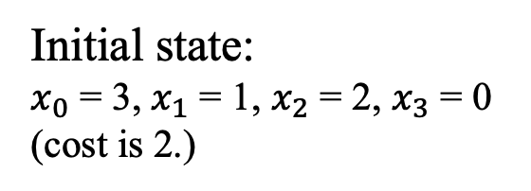





Exercise 3
Solutions:
 |  |  | Q
Q
 |  | Q
 | Q
$x_{0}$ = 1, $x_{1}$ = 3, $x_{2}$ = 2, $x_{3}$ = 0 cost is 1.
$x_{0}$ = 2, $x_{1}$ = 1, $x_{2}$ = 3, $x_{3}$ = 0
 |  |  | Q
 | Q
 |  | Q
Q
$x_{0}$ = 0, $x_{1}$ = 1, $x_{2}$ = 2, $x_{3}$ = 3
$x_{0}$ = 3, $x_{1}$ = 2, $x_{2}$ = 1, $x_{3}$ = 0
Initial state:
$x_{0}$ = 3, $x_{1}$ = 1, $x_{2}$ = 2, $x_{3}$ = 0
(cost is 2.)
$x_{0}$ = 3, $x_{1}$ = 0, $x_{2}$ = 2, $x_{3}$ = 1
$x_{0}$ = 3, $x_{1}$ = 1, $x_{2}$ = 0, $x_{3}$ = 2

Slide 19





Exercise 3
Solutions:
 |  |  | Q
Q
 |  | Q
 | Q
$x_{0}$ = 1, $x_{1}$ = 3, $x_{2}$ = 2, $x_{3}$ = 0 cost is 1.
$x_{0}$ = 2, $x_{1}$ = 1, $x_{2}$ = 3, $x_{3}$ = 0 cost is 1.
 |  |  | Q
 | Q
 |  | Q
Q
$x_{0}$ = 0, $x_{1}$ = 1, $x_{2}$ = 2, $x_{3}$ = 3 cost is 6.
Q
 | Q
 |  | Q
 |  |  | Q
$x_{0}$ = 3, $x_{1}$ = 2, $x_{2}$ = 1, $x_{3}$ = 0 cost is 6.
Initial state:
$x_{0}$ = 3, $x_{1}$ = 1, $x_{2}$ = 2, $x_{3}$ = 0
(cost is 2.)
$x_{0}$ = 3, $x_{1}$ = 0, $x_{2}$ = 2, $x_{3}$ = 1 cost is 1.
$x_{0}$ = 3, $x_{1}$ = 1, $x_{2}$ = 0, $x_{3}$ = 2 cost is 1.

Slide 20

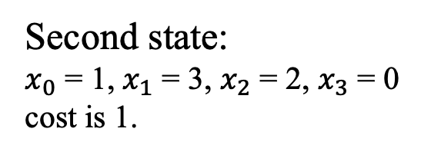





Exercise 3
Solutions:
$x_{0}$ = 3, $x_{1}$ = 1, $x_{2}$ = 2, $x_{3}$ = 0
$x_{0}$ = 2, $x_{1}$ = 3, $x_{2}$ = 1, $x_{3}$ = 0
 |  |  | Q
Q
 |  | Q
 | Q
$x_{0}$ = 0, $x_{1}$ = 3, $x_{2}$ = 2, $x_{3}$ = 1
$x_{0}$ = 1, $x_{1}$ = 2, $x_{2}$ = 3, $x_{3}$ = 0
Second state:
$x_{0}$ = 1, $x_{1}$ = 3, $x_{2}$ = 2, $x_{3}$ = 0 cost is 1.
$x_{0}$ = 1, $x_{1}$ = 0, $x_{2}$ = 2, $x_{3}$ = 3
$x_{0}$ = 1, $x_{1}$ = 3, $x_{2}$ = 0, $x_{3}$ = 2

Slide 21






Exercise 3
Solutions:
$x_{0}$ = 3, $x_{1}$ = 1, $x_{2}$ = 2, $x_{3}$ = 0 cost is 2.
Q
 |  |  | Q
 |  | Q
 | Q
$x_{0}$ = 2, $x_{1}$ = 3, $x_{2}$ = 1, $x_{3}$ = 0 cost is 2.
 |  |  | Q
Q
 |  | Q
 | Q
$x_{0}$ = 0, $x_{1}$ = 3, $x_{2}$ = 2, $x_{3}$ = 1 cost is 4.
$x_{0}$ = 1, $x_{1}$ = 2, $x_{2}$ = 3, $x_{3}$ = 0 cost is 4.
Second state:
$x_{0}$ = 1, $x_{1}$ = 3, $x_{2}$ = 2, $x_{3}$ = 0 cost is 1.
$x_{0}$ = 1, $x_{1}$ = 0, $x_{2}$ = 2, $x_{3}$ = 3 cost is 2.
 |  | Q
Q
 |  |  | Q
 | Q
$x_{0}$ = 1, $x_{1}$ = 3, $x_{2}$ = 0, $x_{3}$ = 2 cost is 0.

Slide 22
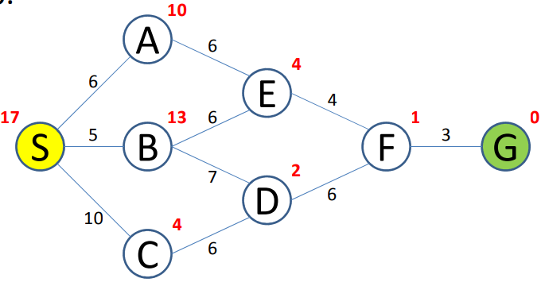
Exercise 4
Perform the A* Algorithm on the following graph. Explicitly write down the queue at each step, where the red figure means the heuristic value, and the black figure is the path cost.

Slide 23




Exercise 4
i | c | open_list | close_list
0 |  | S
openList
open_list = [], close_list = []
open_list.append(start)
while True:
cccccurrent_node = min(open_list, key=lambda x: x.f)
ccccclose_list.append(current_node)
ccccif current_node == end: return
ccccfor neighbour in current_node.neighbours:
ccccccccif neighbour not in [open_list, close_list]:
ccccccccccccopen_list.append(neighbour)
ccccccccelif (neighbour in open_list).f >= neighbour.f:
cccccccccccc(neighbour in open_list) = neighbour
ccccccccelif (neighbour in close_list).f >= neighbour.f:
Ccccccccccccclose_list.pop(neighbour) and open_list.append(neighbour)
actual cost $g$
$$f=g+h$$
heuristic value $h$

Slide 24
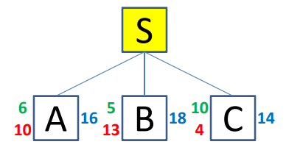
Exercise 4
i | c | open_list | close_list
0 |  | S
1 | S | ABC | S
openList
open_list = [], close_list = []
open_list.append(start)
while True:
cccccurrent_node = min(open_list, key=lambda x: x.f)
ccccclose_list.append(current_node)
ccccif current_node == end: return
ccccfor neighbour in current_node.neighbours:
ccccccccif neighbour not in [open_list, close_list]:
ccccccccccccopen_list.append(neighbour)
ccccccccelif (neighbour in open_list).f >= neighbour.f:
cccccccccccc(neighbour in open_list) = neighbour
ccccccccelif (neighbour in close_list).f >= neighbour.f:
Ccccccccccccclose_list.pop(neighbour) and open_list.append(neighbour)

Slide 25
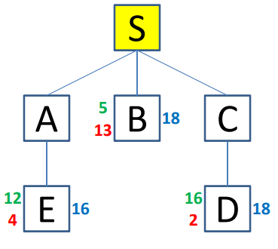
Exercise 4
i | c | open_list | close_list
0 |  | S
1 | S | ABC | S
2 | C | ABD | SC
3 | A | EBD | SCA
openList
open_list = [], close_list = []
open_list.append(start)
while True:
cccccurrent_node = min(open_list, key=lambda x: x.f)
ccccclose_list.append(current_node)
ccccif current_node == end: return
ccccfor neighbour in current_node.neighbours:
ccccccccif neighbour not in [open_list, close_list]:
ccccccccccccopen_list.append(neighbour)
ccccccccelif (neighbour in open_list).f >= neighbour.f:
cccccccccccc(neighbour in open_list) = neighbour
ccccccccelif (neighbour in close_list).f >= neighbour.f:
Ccccccccccccclose_list.pop(neighbour) and open_list.append(neighbour)

Slide 26
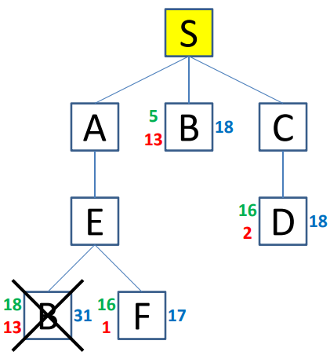
Exercise 4
i | c | open_list | close_list
0 |  | S
1 | S | ABC | S
2 | C | ABD | SC
3 | A | EBD | SCA
4 | E | BDF | SCAE
openList
open_list = [], close_list = []
open_list.append(start)
while True:
cccccurrent_node = min(open_list, key=lambda x: x.f)
ccccclose_list.append(current_node)
ccccif current_node == end: return
ccccfor neighbour in current_node.neighbours:
ccccccccif neighbour not in [open_list, close_list]:
ccccccccccccopen_list.append(neighbour)
ccccccccelif (neighbour in open_list).f >= neighbour.f:
cccccccccccc(neighbour in open_list) = neighbour
ccccccccelif (neighbour in close_list).f >= neighbour.f:
Ccccccccccccclose_list.pop(neighbour) and open_list.append(neighbour)

Slide 27
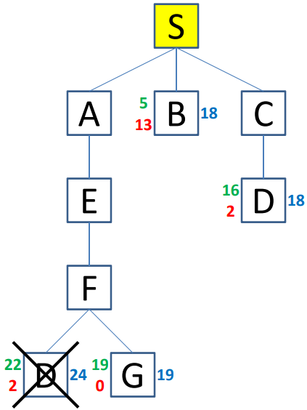
Exercise 4
i | c | open_list | close_list
0 |  | S
1 | S | ABC | S
2 | C | ABD | SC
3 | A | EBD | SCA
4 | E | BDF | SCAE
5 | F | BDG | SCAEF
openList
open_list = [], close_list = []
open_list.append(start)
while True:
cccccurrent_node = min(open_list, key=lambda x: x.f)
ccccclose_list.append(current_node)
ccccif current_node == end: return
ccccfor neighbour in current_node.neighbours:
ccccccccif neighbour not in [open_list, close_list]:
ccccccccccccopen_list.append(neighbour)
ccccccccelif (neighbour in open_list).f >= neighbour.f:
cccccccccccc(neighbour in open_list) = neighbour
ccccccccelif (neighbour in close_list).f >= neighbour.f:
Ccccccccccccclose_list.pop(neighbour) and open_list.append(neighbour)

Slide 28
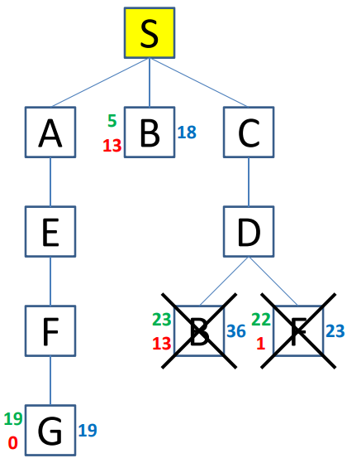
Exercise 4
i | c | open_list | close_list
0 |  | S
1 | S | ABC | S
2 | C | ABD | SC
3 | A | EBD | SCA
4 | E | BDF | SCAE
5 | F | BDG | SCAEF
6 | D | BG | SCAEFD
openList
open_list = [], close_list = []
open_list.append(start)
while True:
cccccurrent_node = min(open_list, key=lambda x: x.f)
ccccclose_list.append(current_node)
ccccif current_node == end: return
ccccfor neighbour in current_node.neighbours:
ccccccccif neighbour not in [open_list, close_list]:
ccccccccccccopen_list.append(neighbour)
ccccccccelif (neighbour in open_list).f >= neighbour.f:
cccccccccccc(neighbour in open_list) = neighbour
ccccccccelif (neighbour in close_list).f >= neighbour.f:
Ccccccccccccclose_list.pop(neighbour) and open_list.append(neighbour)

Slide 29
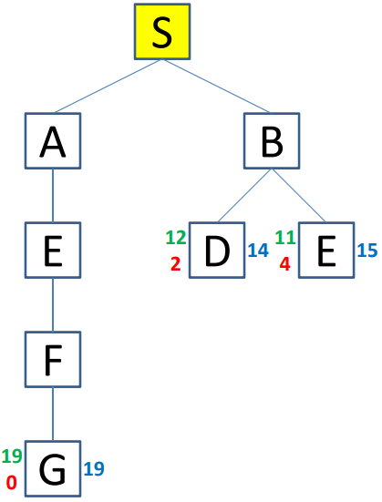
Exercise 4
i | c | open_list | close_list
0 |  | S
1 | S | ABC | S
2 | C | ABD | SC
3 | A | EBD | SCA
4 | E | BDF | SCAE
5 | F | BDG | SCAEF
6 | D | BG | SCAEFD
7 | B | GDE | SCAFB
openList
open_list = [], close_list = []
open_list.append(start)
while True:
cccccurrent_node = min(open_list, key=lambda x: x.f)
ccccclose_list.append(current_node)
ccccif current_node == end: return
ccccfor neighbour in current_node.neighbours:
ccccccccif neighbour not in [open_list, close_list]:
ccccccccccccopen_list.append(neighbour)
ccccccccelif (neighbour in open_list).f >= neighbour.f:
cccccccccccc(neighbour in open_list) = neighbour
ccccccccelif (neighbour in close_list).f >= neighbour.f:
Ccccccccccccclose_list.pop(neighbour) and open_list.append(neighbour)

Slide 30
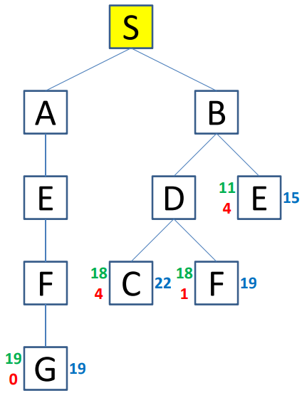
Exercise 4
i | c | open_list | close_list
0 |  | S
1 | S | ABC | S
2 | C | ABD | SC
3 | A | EBD | SCA
4 | E | BDF | SCAE
5 | F | BDG | SCAEF
6 | D | BG | SCAEFD
7 | B | GDE | SCAFB
8 | D | GE | SCAFBD
openList
16
open_list = [], close_list = []
open_list.append(start)
while True:
cccccurrent_node = min(open_list, key=lambda x: x.f)
ccccclose_list.append(current_node)
ccccif current_node == end: return
ccccfor neighbour in current_node.neighbours:
ccccccccif neighbour not in [open_list, close_list]:
ccccccccccccopen_list.append(neighbour)
ccccccccelif (neighbour in open_list).f >= neighbour.f:
cccccccccccc(neighbour in open_list) = neighbour
ccccccccelif (neighbour in close_list).f >= neighbour.f:
Ccccccccccccclose_list.pop(neighbour) and open_list.append(neighbour)

Slide 31
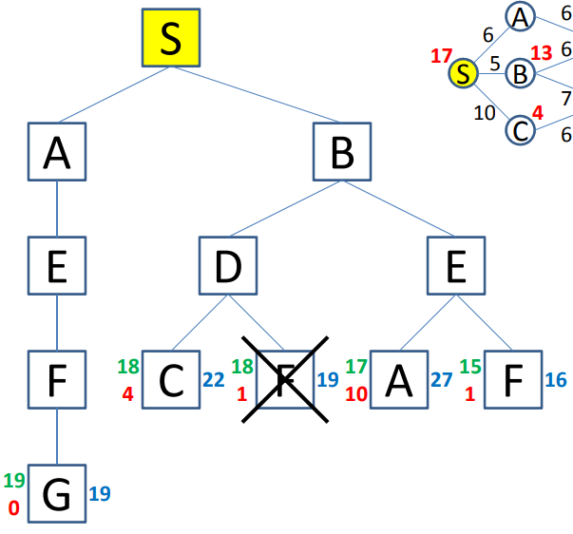
Exercise 4
i | c | open_list | close_list
0 |  | S
1 | S | ABC | S
2 | C | ABD | SC
3 | A | EBD | SCA
4 | E | BDF | SCAE
5 | F | BDG | SCAEF
6 | D | BG | SCAEFD
7 | B | GDE | SCAFB
8 | D | GE | SCAFBD
9 | E | GF | SCABDE
openList
open_list = [], close_list = []
open_list.append(start)
while True:
cccccurrent_node = min(open_list, key=lambda x: x.f)
ccccclose_list.append(current_node)
ccccif current_node == end: return
ccccfor neighbour in current_node.neighbours:
ccccccccif neighbour not in [open_list, close_list]:
ccccccccccccopen_list.append(neighbour)
ccccccccelif (neighbour in open_list).f >= neighbour.f:
cccccccccccc(neighbour in open_list) = neighbour
ccccccccelif (neighbour in close_list).f >= neighbour.f:
Ccccccccccccclose_list.pop(neighbour) and open_list.append(neighbour)

Slide 32
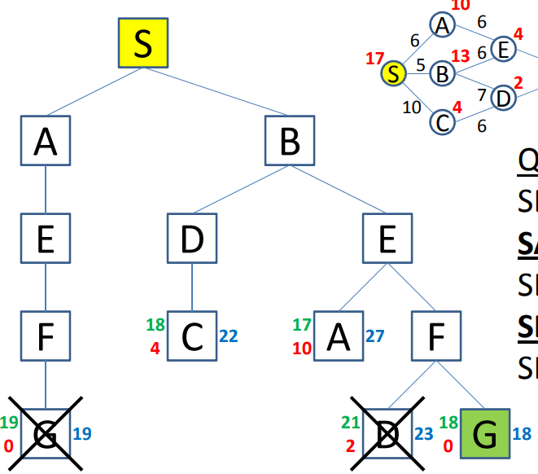
Exercise 4
i | c | open_list | close_list
0 |  | S
1 | S | ABC | S
2 | C | ABD | SC
3 | A | EBD | SCA
4 | E | BDF | SCAE
5 | F | BDG | SCAEF
6 | D | BG | SCAEFD
7 | B | GDE | SCAFB
8 | D | GE | SCAFBD
9 | E | GF | SCABDE
10 | F | G | SCABDEF
openList
open_list = [], close_list = []
open_list.append(start)
while True:
cccccurrent_node = min(open_list, key=lambda x: x.f)
ccccclose_list.append(current_node)
ccccif current_node == end: return
ccccfor neighbour in current_node.neighbours:
ccccccccif neighbour not in [open_list, close_list]:
ccccccccccccopen_list.append(neighbour)
ccccccccelif (neighbour in open_list).f >= neighbour.f:
cccccccccccc(neighbour in open_list) = neighbour
ccccccccelif (neighbour in close_list).f >= neighbour.f:
Ccccccccccccclose_list.pop(neighbour) and open_list.append(neighbour)

Slide 33
Thanks for your time

