Slide 1

Tutorial 6
COMP 5511: Artificial Intelligence Concepts
Haokai HONG
Department of DSAI
haokai.hong@connect.polyu.hk

Slide 2
Outlines
Review
Overfitting and Underfitting
Exercise

Slide 3
Review
Feature templates
A feature template is a group of features all computed in a similar way.
Non-linear features
Feature scaling
Overfitting
Underfitting
K-mean
A classical unsupervised learning method;
Clustering aims at discovering structure in unlabeled data;

Slide 4
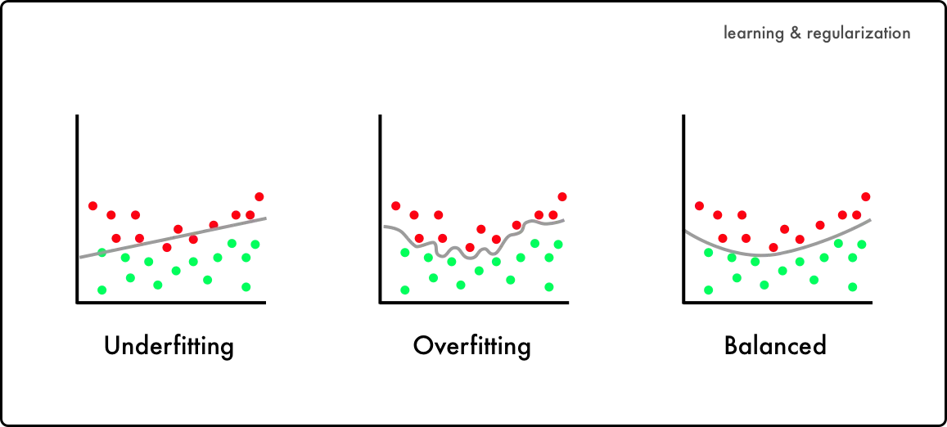
Overfitting and Underfitting

Slide 5
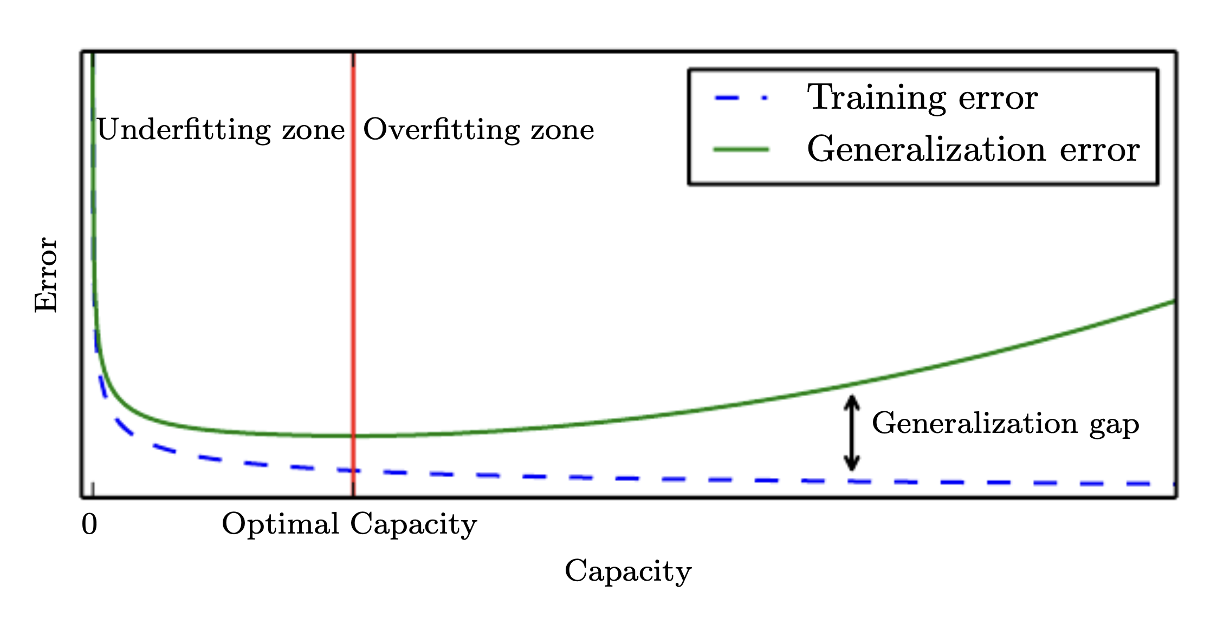
Overfitting and Underfitting

Slide 6
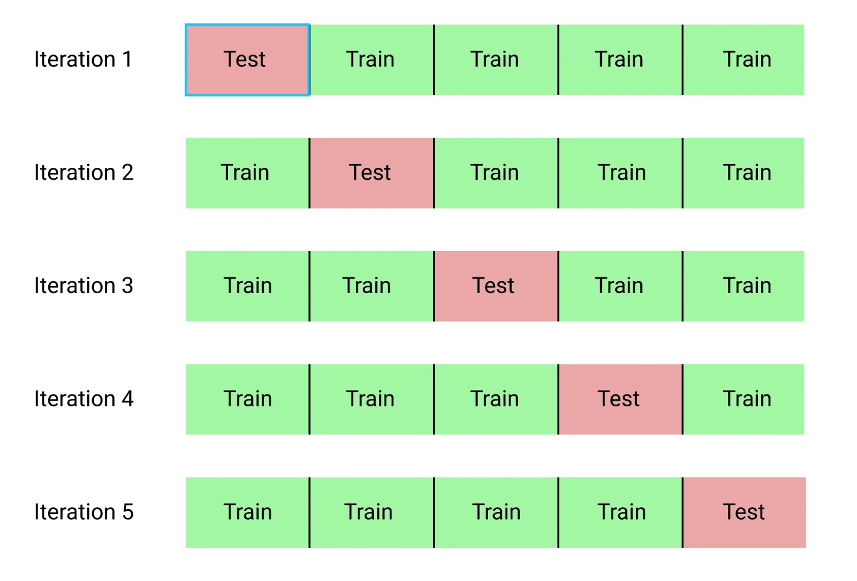
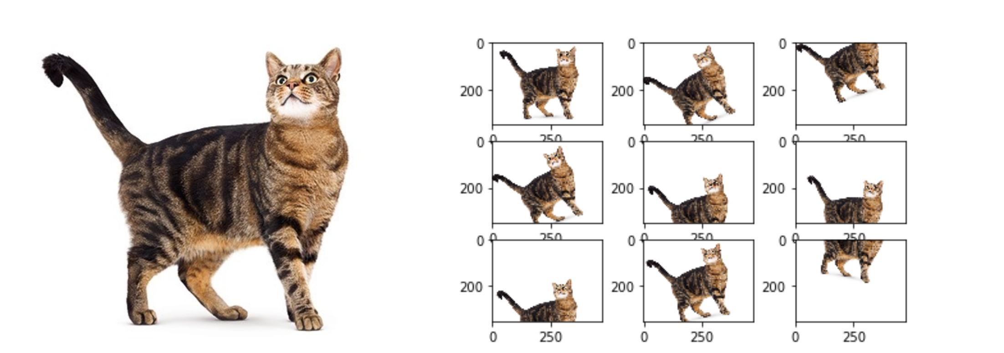
Methods for Overfitting
More methods for addressing overfitting
Hold-out: Rather than using all of our data for training, we can simply split our dataset into two sets: training and testing.
Cross-validation: We can split our dataset into k groups (k-fold cross-validation). We let one of the groups to be the testing set (please see hold-out explanation) and the others as the training set, and repeat this process until each individual group has been used as the testing set (e.g., k repeats).
Data Augmentation: a technique that artificially increases the size of the training set by applying transformations to the existing data.
Cross-validation
Data Augmentation

Slide 7
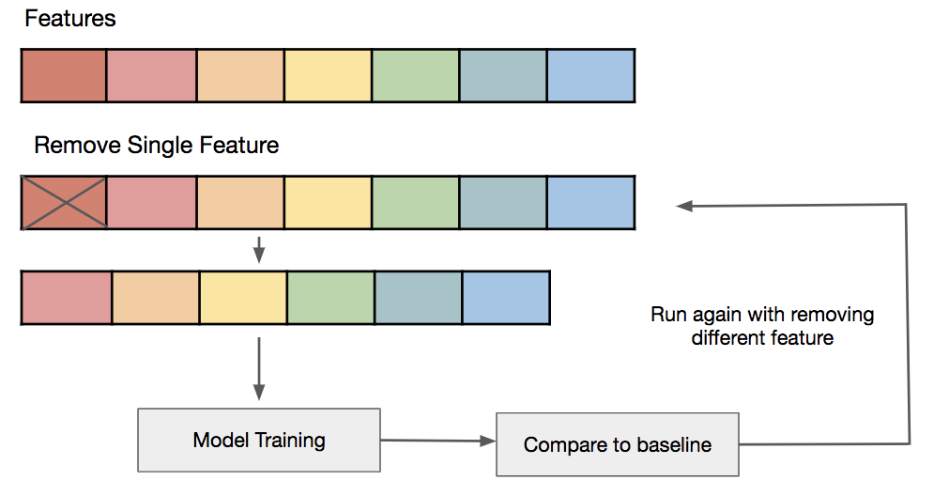
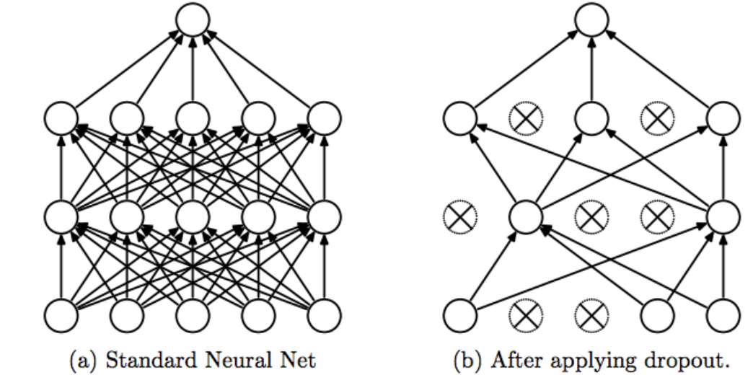
Methods for Overfitting
More methods for addressing overfitting
Feature selection: Manual selecting which features to keep (by domain knowledge)
Remove layers/number of units per layer
Dropout: randomly deactivates a fraction of neurons during training, preventing over-reliance on specific features.
Early stopping: Once the validation loss begins to degrade (e.g., stops decreasing but rather begins increasing), we stop the training
L1 / L2 regularization: Keep all features, but reduce their influence by giving smaller values to the parameter.

Slide 8
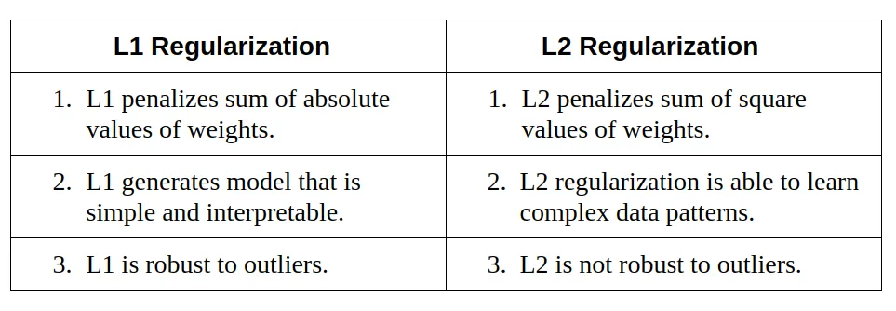

Methods for Overfitting
More methods for addressing overfitting
Feature selection: Manual selecting which features to keep (by domain knowledge)
Remove layers/number of units per layer
Dropout: randomly deactivates a fraction of neurons during training, preventing over-reliance on specific features.
Early stopping: Once the validation loss begins to degrade (e.g., stops decreasing but rather begins increasing), we stop the training
L1 / L2 regularization: Keep all features, but reduce their influence by giving smaller values to the parameter.
L1 Regularization =$λ ∗ (|w_{1}| + |w_{2}| + … + |w_{n}|)$
L2 Regularization =$λ ∗ (w_{1}^{2}\text{ +}w_{2}^{2}\text{+ ... +}w_{n}^{2})$

Slide 9
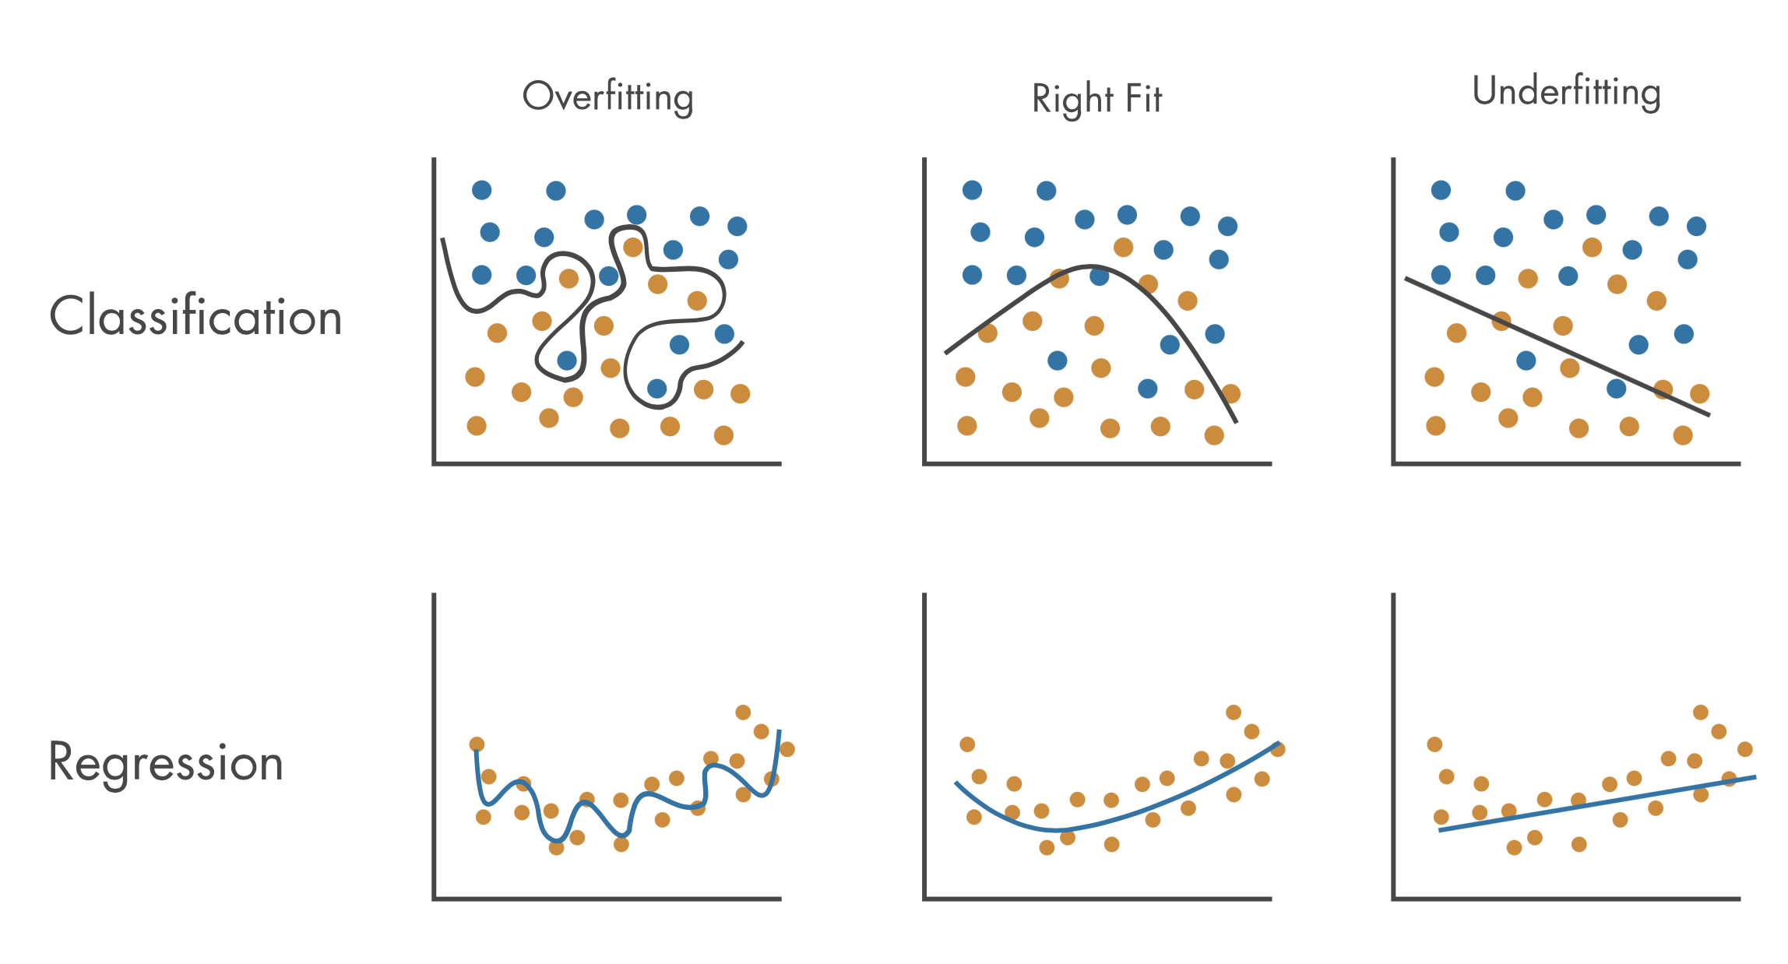
Methods for Underfitting
Three classical methods for underfitting
More data
More powerful model
Ensemble Learning: combines multiple models to create a stronger predictor by averaging or majority voting.
Transfer Learning: leverages knowledge from pre-trained models on similar tasks to boost performance on new tasks.

Slide 10
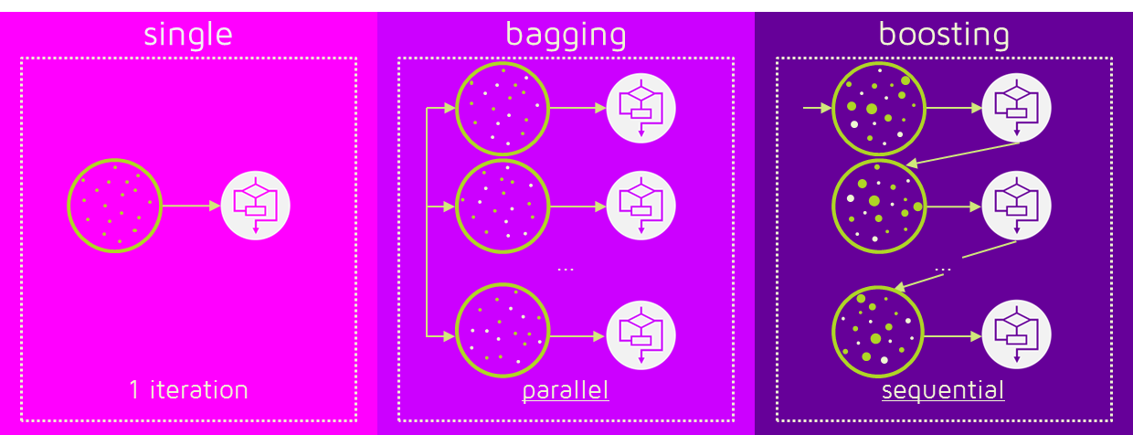
Methods for Underfitting
Ensemble Learning
Bagging: Combines predictions from multiple independently trained models;
Boosting: Sequentially trains a series of models, where each subsequent model focuses on correcting the mistakes made by the previous models.

Slide 11
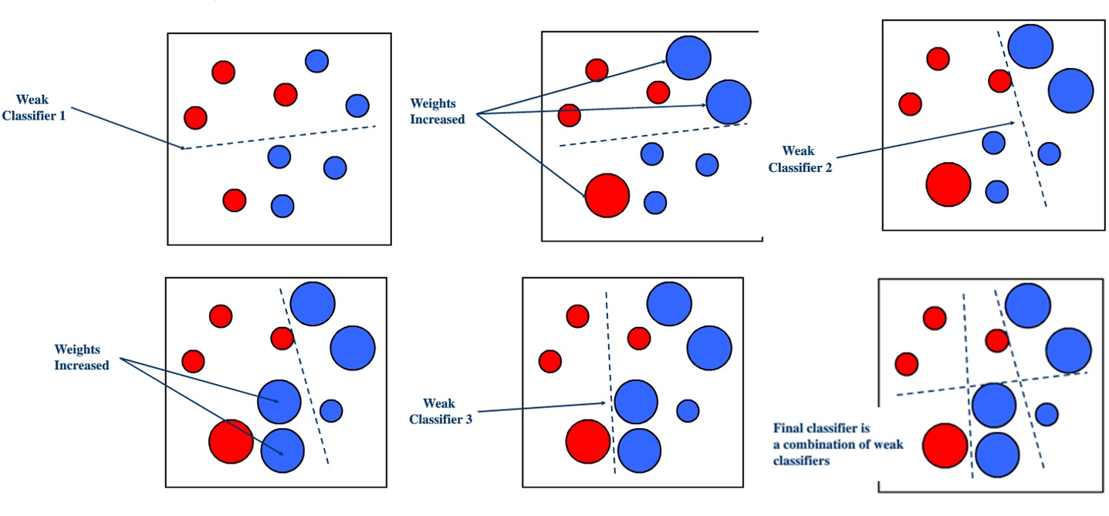
Methods for Underfitting
Ensemble Learning
Boosting: AdaBoost:
Step 1: Initialization
Step 2: Weak Learner Training
Step 3: Weight Update
Step 4: Iteration
Step 5: Combining Weak Learners
Notes:
Step 1: Initialization - Keyword: Weights
Assign initial weights to each training sample.
Step 2: Weak Learner Training - Keyword: Learning
Train a weak learner (e.g., decision stump) on the weighted training data.
Step 3: Weight Update - Keyword: Adjustments
Adjust the weights of misclassified samples to emphasize their importance in the next iteration.
Step 4: Iteration - Keyword: Iterative
Repeat steps 2 and 3 for a specified number of iterations or until a stopping criterion is met.
Step 5: Combining Weak Learners - Keyword: Aggregation
Combine the predictions of the weak learners, typically through weighted voting, to form the final strong learner.

Slide 12
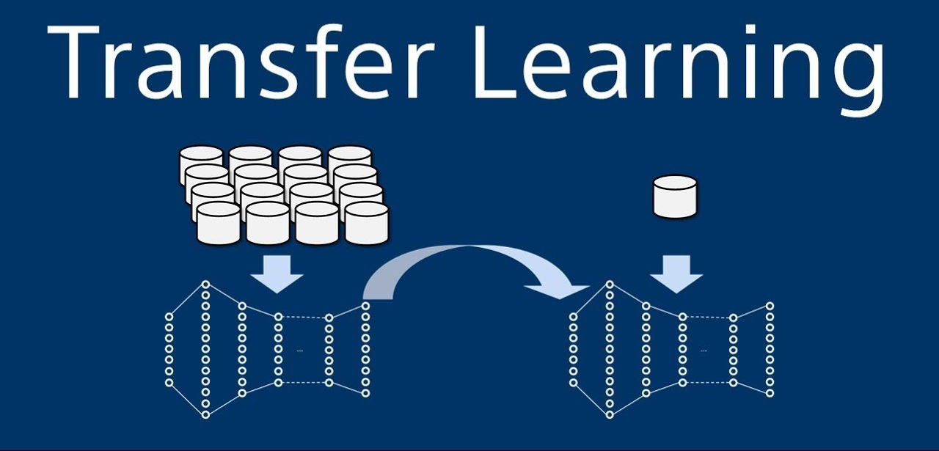
Methods for Underfitting
Transfer Learning
Transfer learning is a technique that utilizes a trained model's knowledge to learn another set of data.

Slide 13
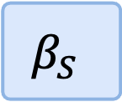
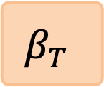
Methods for Underfitting
Transfer Learning
Transfer learning is a technique that utilizes a trained model's knowledge to learn another set of data.
$$β_{S}$$
Transfer learning
$$β_{T}$$

Slide 14
Exercise

Slide 15
Exercise 1: Feature Scaling
Consider a dataset with two features:
height (in centimeters) and weight (in kilograms). The height values range from 150 to 190, while the weight values range from 50 to 100. Apply min-max scaling to these features.

Slide 16
Exercise 1: Feature Scaling
Consider a dataset with two features:
height (in centimeters) and weight (in kilograms). The height values range from 150 to 190, while the weight values range from 50 to 100. Apply min-max scaling to these features.
To apply min-max scaling, we need to transform the features to a common range, usually between 0 and 1. Let's calculate the scaled values:
  Scaled Height = (Height - Min(Height)) / (Max(Height) - Min(Height))
  Scaled Weight = (Weight - Min(Weight)) / (Max(Weight) - Min(Weight))
Let's plug in the values:
  Scaled Height = (Height - 150) / (190 - 150)
  Scaled Weight = (Weight - 50) / (100 - 50)

Slide 17
Exercise 2: Overfitting & Underfitting
Suppose we have a dataset with 100 samples and a simple linear regression model with only one feature.
The model has 10 parameters (including the bias term). Is this model prone to overfitting or underfitting?

Slide 18
Exercise 2: Overfitting & Underfitting
Suppose we have a dataset with 100 samples and a simple linear regression model with only one feature.
The model has 10 parameters (including the bias term). Is this model prone to overfitting or underfitting?
In this case, the model has more parameters (10) and insufficient samples (100).
This suggests that the model is more complex than necessary and may lead to overfitting.
Overfitting occurs when a model has too much capacity relative to the available data.

Slide 19
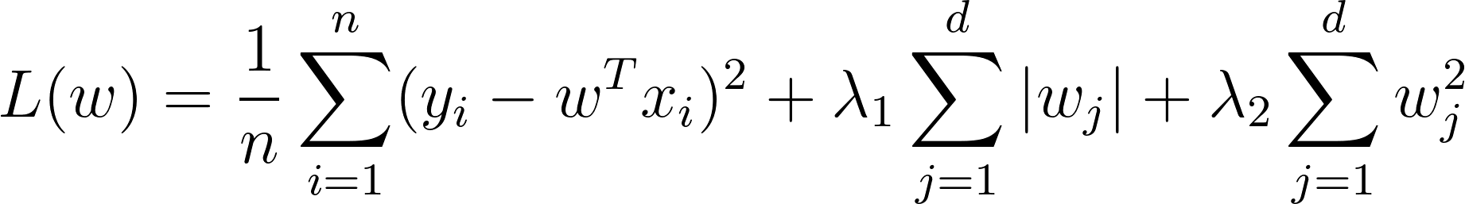
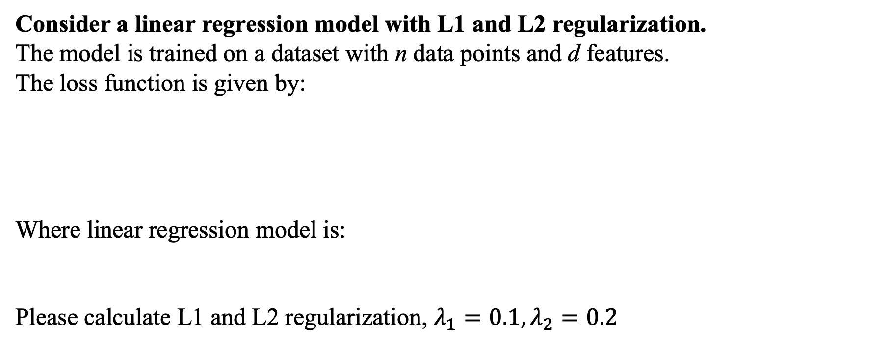
Exercise 3: Overfitting & Underfitting
Consider a linear regression model with L1 and L2 regularization.
The model is trained on a dataset with n data points and d features.
The loss function is given by:
Where linear regression model is:
Please calculate L1 and L2 regularization, $λ_{1}=0.1, λ_{2}=0.2$

Slide 20
Exercise 3: Overfitting & Underfitting
Consider a linear regression model with L1 and L2 regularization.
The model is trained on a dataset with n data points and d features.
The loss function is given by:
Where linear regression model is:
Please calculate L1 and L2 regularization, $λ_{1}=0.1, λ_{2}=0.2$

Slide 21
Exercise 4: K-means
Consider the following dataset with five data points: [2, 4], [3, 6], [8, 1], [9, 3], and [10, 2].
Apply the K-means algorithm with K=2, starting with random initial cluster centroids ([3, 6] and [10, 2]). Perform two iterations of the algorithm and calculate the final cluster centroids.

Slide 22
Exercise 4: K-means
Consider the following dataset with five data points: [2, 4], [3, 6], [8, 1], [9, 3], and [10, 2].
Apply the K-means algorithm with K=2, starting with random initial cluster centroids ([3, 6] and [10, 2]). Perform two iterations of the algorithm and calculate the final cluster centroids.
Iteration 1:
Assign each data point to the nearest centroid:
[2, 4] is closer to [3, 6], so it belongs to Cluster 1.
[3, 6] is already the centroid of Cluster 1.
[8, 1] is closer to [10, 2], so it belongs to Cluster 2.
[9, 3] is closer to [10, 2], so it belongs to Cluster 2.
[10, 2] is already the centroid of Cluster 2.
Recalculate the cluster centroids:
Cluster 1 centroid: ([2, 4] + [3, 6]) / 2 = [2.5, 5]
Cluster 2 centroid: ([8, 1] + [9, 3] + [10, 2]) / 3 = [9, 2]

Slide 23
Exercise 4: K-means
Consider the following dataset with five data points: [2, 4], [3, 6], [8, 1], [9, 3], and [10, 2].
Apply the K-means algorithm with K=2, starting with random initial cluster centroids ([3, 6] and [10, 2]). Perform two iterations of the algorithm and calculate the final cluster centroids.
Iteration 2: [2.5, 5] and [9, 2]
Assign each data point to the nearest centroid:
[2, 4] is closer to [2.5, 5], so it belongs to Cluster 1.
[3, 6] is closer to [2.5, 5], so it belongs to Cluster 1.
[8, 1] is closer to [9, 2], so it belongs to Cluster 2.
[9, 3] is closer to [9, 2], so it belongs to Cluster 2.
[10, 2] is closer to [9, 2], so it belongs to Cluster 2.
Recalculate the cluster centroids:
Cluster 1 centroid: ([2, 4] + [3, 6]) / 2 = [2.5, 5]
Cluster 2 centroid: ([8, 1] + [9, 3] + [10, 2]) / 3 = [9, 2]

Slide 24
Thanks for your time

