Slide 1

Tutorial 1
COMP5511 Artificial Intelligence Concepts
Haokai Hong
DSAI
haokai.hong@connect.polyu.hk

Slide 2




How to search a paper?
Outline
How to read a paper?
Mainly for AI papers
How to write a paper?
How to present a paper?

Slide 3
How to search a paper

Slide 4
How to search a paper
Narrow the search scope: top conferences and journals
  Papers are published in journals with a high Impact Factor (IF).
  Papers are published in conferences recommended by China Computer Federation (CCF).
  Papers are in the recommended list of the Department of Computing.
  (https://intranet.comp.polyu.edu.hk/DeptInfo/JournalConferenceLists)

Slide 5

How to search a paper
Top journals with high IFs
IEEE Transactions on Pattern Analysis and Machine Intelligence
IEEE Transactions on Cybernetics
IEEE Transactions on Evolutionary Computation
IEEE Transactions on Neural Networks and Learning Systems
IEEE Transactions on Image Processing
IEEE Transactions on Knowledge and Data Engineering
…

Slide 6
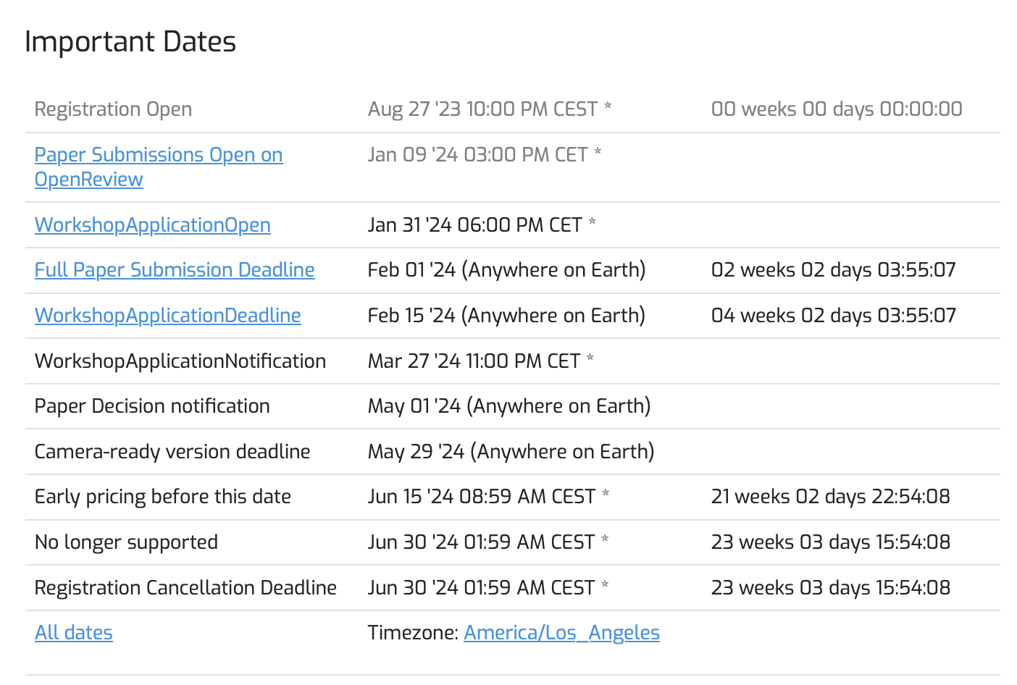

How to search a paper
Top conferences recommended by CCF
Database/Data Mining/Content Retrieval
ACM Knowledge Discovery and Data Mining
IEEE International Conference on Data Engineering
ACM Conference on Management of Data
……
Artificial Intelligence
IEEE Conference on Computer Vision and Pattern Recognition
International Conference on Computer Vision
International Conference on Machine Learning
AAAI Conference on Artificial Intelligence
…….
Other scopes: https://www.ccf.org.cn/Academic_Evaluation/By_category/)

Slide 7



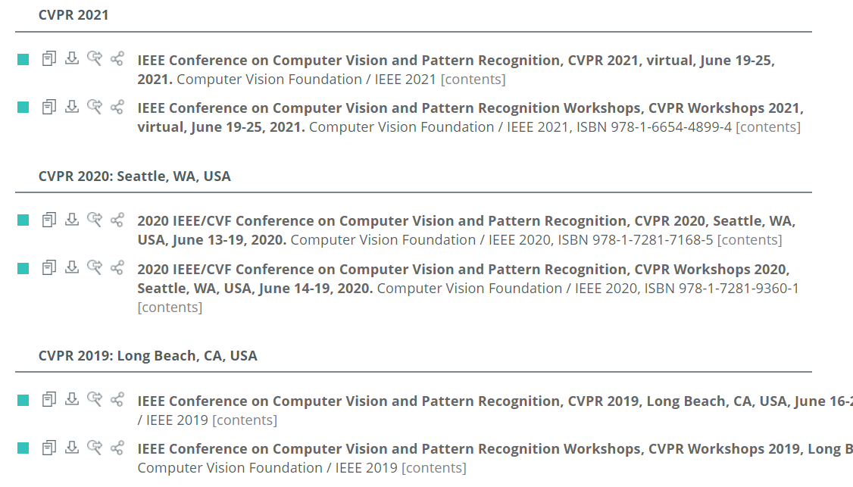

How to search a paper
DBLP
Google Scholar
IEEE Xplore

Slide 8
Online communities
How to search a paper
Latest research
  Discussion about preprinted/published papers.
Comments from other researchers
  Pros and Cons.
  Detailed Explanations.
PaperWeekly
AI Era
Google AI Blog
MIT News - Machine learning

Slide 9
How to read a paper

Slide 10
How to read a paper
According to Andrew Ng^{[1]}:
Compile a paper list：
5-20 papers: Basic understanding of the research area.
50-100 papers: Very good understanding about the research area.
[1] https://www.youtube.com/watch?v=733m6qBH-jI

Slide 11
How to read a paper
You should read paper in multiple times^{[1]}:
The first time you read:
Title
Abstract
Pipelines and figures
[1] https://www.youtube.com/watch?v=733m6qBH-jI

Slide 12
How to read a paper
You should read paper in multiple times^{[1]}:
The second time you read:
Introduction
Conclusions
Look at pipelines and figures again
[1] https://www.youtube.com/watch?v=733m6qBH-jI

Slide 13
How to read a paper
You should read paper in multiple times^{[1]}:
The third time you read:
Whole thing, but skip math.
[1] https://www.youtube.com/watch?v=733m6qBH-jI

Slide 14
How to read a paper
You should read paper in multiple times^{[1]}:
The fourth time you read:
Whole thing, but skip parts that don’t make sense.
[1] https://www.youtube.com/watch?v=733m6qBH-jI

Slide 15
How to read a paper
When reading, keep in mind^{[1]}:
What did the authors try to accomplish?
What are the key elements of the approach?
What can you use for your own research?
What other references do you want to follow?
[1] https://www.youtube.com/watch?v=733m6qBH-jI

Slide 16
How to write a paper

Slide 17
How to write a paper
Why write paper
Goal: to infect the mind of your reader with your idea, like a virus
The greatest ideas are (literally) worthless if you keep them to yourself

Slide 18
How to write a paper
Idea
Do research
Write paper

Slide 19
How to write a paper
Idea
Do research
Write paper
Idea
Write paper
Do research
Forces us to be clear, focused
Crystallises what we don’t understand
Opens the way to dialogue with others: reality check, critique, and collaboration

Slide 20
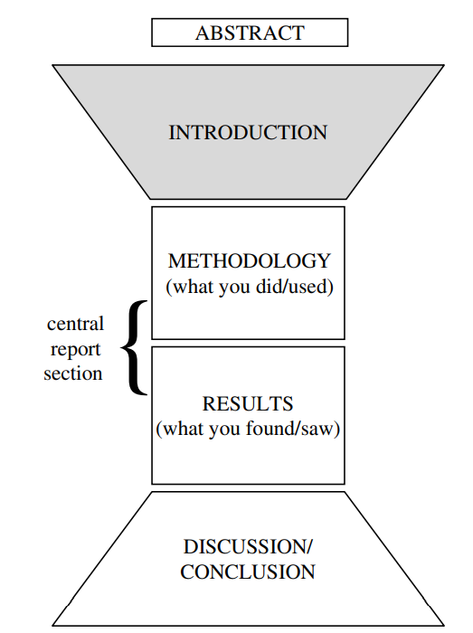

How to write a paper
Paper structure

Slide 21
How to write a paper: Abstract
One-paragraph summary of the entire study^{[1]}.
  Research background
  Research problem
Briefly
Model
Experiment results
Conclusion
[1] https://psychology.ucsd.edu/undergraduate-program/undergraduate-resources/academic-writing-resources/writing-research-papers/research-paper- structure.html#References

Slide 22
How to write a paper: Introduction
Background
Goals and methods
What is the research context?
What are the operational goals of this paper?
What is the state of the art?
How are they achieved?
Results
Problem
Contributions
What is missing?
What are the drawbacks?
Paper Overview
Outline of the rest of the paper

Slide 23
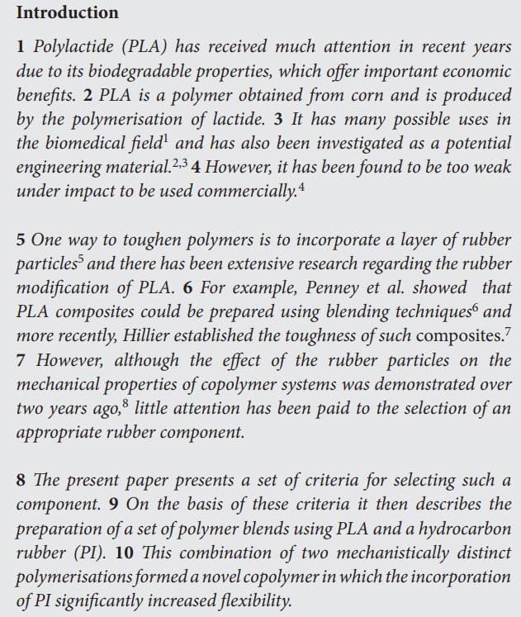
How to write a paper: Introduction
Paradigm
Sentence 1 and Sentence 2: Establish the importance of this research topic, and provide general background information.
Sentence 3: Do the same as in Sentences 1 and 2, but in a more specific/detailed way.
Sentence 4: Describe the general problem area of the field.
Sentence 5 and Sentence 6 : Provide the literature review.
Sentence 7: Describe a gap in the research.
Sentence 8 and Sentence 9: Describe the paper itself, and give details about the methodology reported in the paper.
Sentence 10: Announce the findings.
Notes:
5

Slide 24



How to write a paper: Methodology
Provide an overview of the method itself.
Provide details about what was done and continues to describe what was done in detail.
Mention a possible difficulty in the methodology.
Proposed Model
Reason of this design

Slide 25


How to write a paper: Experiment
Give a general overview of the results.
Invite the reader to view results, e.g., graph/figure/table.
Select specific results in detail with explanations.
Compare with results in other research.
Mention a problem in the results.
Experiment Result
Discussion

Slide 26
How to write a paper: Conclusion
Problem
Conclude this paper
Goals and methods
Results
Notes:
2

Slide 27
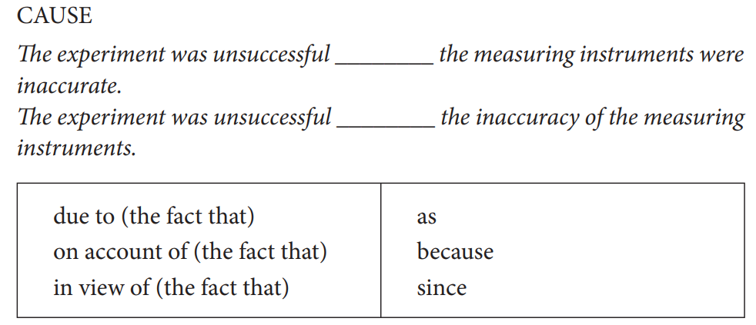
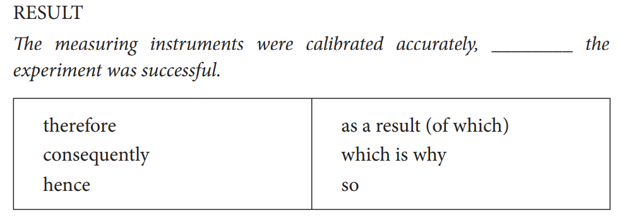
How to write a paper: Signaling language
Tip: Signaling language makes the paper more logical

Slide 28
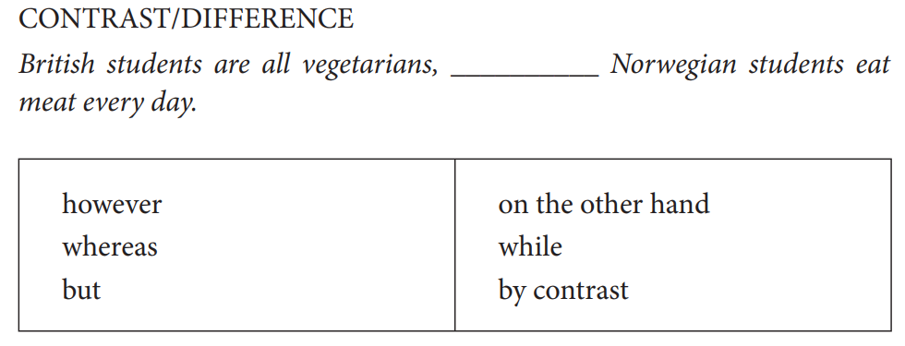
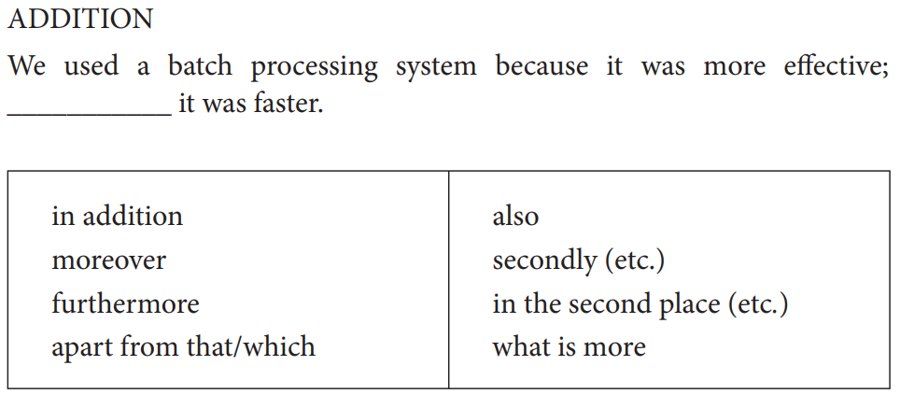
How to write a paper: Signaling language

Slide 29
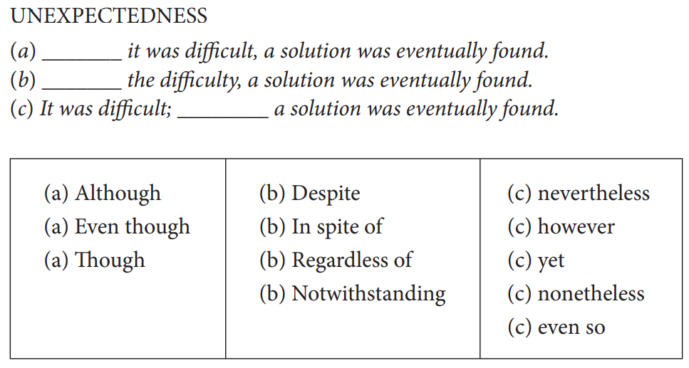
How to write a paper: Signaling language
Notes:
5

Slide 30
How to write a paper: Review
Treat every review like gold dust
Be (truly) grateful for criticism as well as praise
This is really, really, really hard
But it’s
really, really, really, really, really, really, really, really, really, really
important
Notes:
5

Slide 31
How to write a paper: Review
Treat every review like gold dust
Be (truly) grateful for criticism as well as praise
Read every criticism as a positive suggestion for something you could explain more clearly
DO NOT respond “you stupid person, I meant X”. Fix the paper so that X is apparent even to the stupidest reader.
Thank them warmly. They have given up their time for you.
Notes:
5

Slide 32
How to present a paper

Slide 33

How to present a paper
Delivering a Poster Presentation at International Conferences
Notes:
5

Slide 34
How to present a paper
Don’ts
Don’t put
everything in the poster.
Don’t leave
your poster during the poster session.
Don’t stand
in front of your poster.
Don’t read
your poster to your audience but talk to them.
Don’t bore
your audience with a long walkthrough, no more than 3 minutes.
Notes:
5

Slide 35
How to present a paper
Dos
Use
Use your poster as a tool for communicating with your audience.
Prepare
Prepare a brief but informative way to present the information in your poster.
Stand
Stand to the left of your poster at the beginning of your walkthrough and to the right of your poster at the end.
Stand by
Stay by your poster to meet and interact with poster session attendees.
Notes:
5

Slide 36
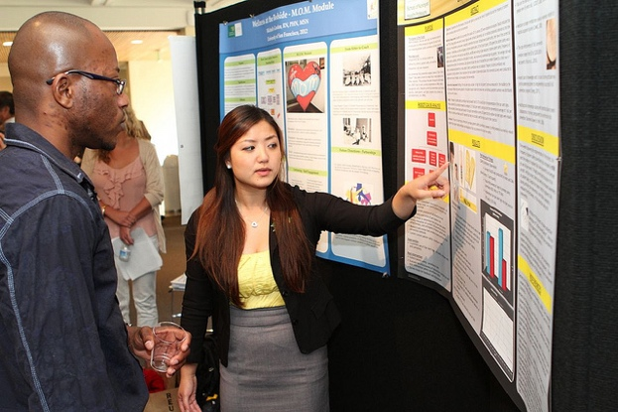
Effective
Poster Presentation
How to present a paper
Introduce yourself and your research topic.
Provide a brief introduction to the study (perhaps 2-3 sentences)
  e.g. “Previous studies have demonstrated A, but seldom efforts have been made in the intersection of A and B. The goal of the research is to narrow this research gap”.
Explain briefly the methods you used.
Describe results with a rationale conclusion
  e.g. “We first decided to examine... To investigate this we... We found that... This means that...”.
Summarize the main conclusions of your study, usually 2-4 points.
Provide a brief statement about future directions.
Thank your visitors for stopping by your poster.
Notes:
5

Slide 37

Research with large language model
Searching a Paper:
Find relevant information on a wide range of topics.
Reading a Paper:
Assist in understanding complex language or concepts in a paper.
Writing a Paper:
Help generate content for the paper based on the information provided.
Particularly in structuring the paper, formulating arguments, and ensuring the language is clear and concise.
Presenting a Paper:
Prepare a presentation by providing tips on how to structure the talk, what points to emphasize, and how to engage the audience.
Notes:
5

Slide 38
Research with large language model
Searching a Paper:
Find relevant information on a wide range of topics.
Reading a Paper:
Assist in understanding complex language or concepts in a paper.
Writing a Paper:
Help generate content for the paper based on the information provided.
Particularly in structuring the paper, formulating arguments, and ensuring the language is clear and concise.
Presenting a Paper:
Prepare a presentation by providing tips on how to structure the talk, what points to emphasize, and how to engage the audience.
Notes:
5

Slide 39
Thank you.
May the journey of
your research be filled with
insightful discoveries and
prolific publications
Haokai Hong
DSAI
haokai.hong@connect.polyu.hk

