Slide 1
Assignment 4 UML for Online Discussion Forum
By Paul Kotys and Max Humes

Slide 2
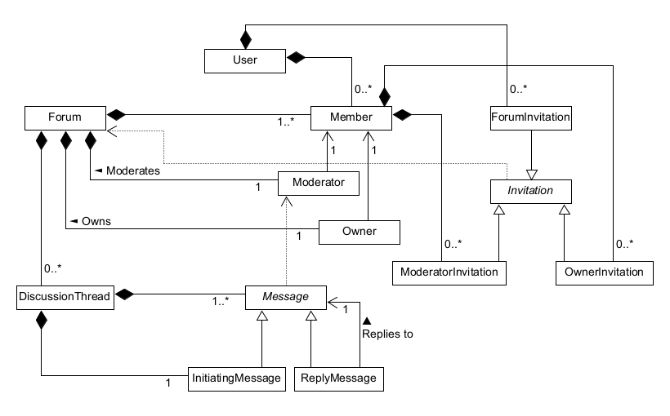

Slide 3
+ User
username: String userID: BigInteger
+ showMemberships(): List<Member> + showForumInvites() : List<ForumInvitation> + joinForum(forum : Forum) : void + createForum(forumName: String): void
Class | Data Structure
User | List<Member> memberOf;
User | List<ForumInvitation> forumInvites;

Slide 4
+ Member
+ showInvites(): List<Invitation> + showMessages(): List<Messages> + createDiscussionThread(firstMessage: InitiatingMessage): void + replyToMessage(replyTo : Message; myReply: ReplyMessage): void + filterByAuthor(author: Member): List<Messages> + filterByThread(thread: InitiatingMessage): List<Messages> + filterByThisDate(data: Date): List<Messages> + filterByDateRange(startDate: Date; endDate: Date): List<Messages> + sortByAuthor(sortTheseMessages: List<Messages>): List<Messages> + sortByDate(sortTheseMessages: List<Messages>): List<Messages> + sortByThread(): List<Messages> + leave(): void
*Inputs to sort methods could come from filter methods*
Class | Data Structure
Member | User user;
Member | Forum forum;
Member | List<Message> myMessages;
Member | List<Invitation> invites;

Slide 5
+ Forum
forumName: String
+ addMember(member: Member): void + changeModerator(member: Member): void + changeOwner(member: Member): void + showThreads(): List<DiscussionThread> + createThread(firstMessage: InitiatingMessage): void + delete(): void
Class | Data Structure
Forum | Owner owner;
Forum | Moderator moderator;
Forum | List<Member> members;
Forum | List<DiscussionThread> threads;

Slide 6
+ Moderator
+ approveMessage(message: Message): boolean + resignByEmail(): void
Class | Data Structure
Moderator | Member member;
Moderator | Forum forum;

Slide 7
+ Owner
+ sendJoinInvite(user: User): void + sendModeratorInvite(member: Member): void + sendOwnerInvite(member: Member): void + deleteForum(): void
Class | Data Structure
Owner | Member member;
Owner | Forum forum;

Slide 8
+ DiscussionThread
- threadID: BigInteger
+ showMessages(): List<Message> messages + postMessage(message ReplyMessage): void + deleteThread(): void
Class | Data Structure
DiscussionThread | InitiatingMessage initiatingMessage;
DiscussionThread | List<Message> messages;

Slide 9
+ Message
messageID: BigInteger content: String postedOn: Date
+ delete(): void
+ InitiatingMessage
threadSubject: String
*Reply message stores reference to the message that it replied to.*
+ ReplyMessage
Class | Data Structure
Message | Member messageAuthor;
Message | DiscussionThread parentThread;
ReplyMessage | Message replyTo;

Slide 10
Invitation
inviteID: BigInteger InviteText: String
+ acceptInvitation(): void + declineInvitation(): void
Class | Data Structure
Invitation | Forum forum;

Slide 11
ForumInvitation
+ acceptInvitation(): void + declineInvitation(): void
ModeratorInvitation
+ acceptInvitation(): void + declineInvitation(): void
OwnerInvitation
+ acceptInvitation(): void + declineInvitation(): void
Class | Data Structure
ForumInvitation | User user;
ModeratorInvitation | Member member;
OwnerInvitation | Member member;

Slide 12
Templates for UML

