Slide 1
Decision Trees and Random Forests
DSCI 4520
Introduction to Data Mining
Russell R. Torres

Slide 2
Some Quote.
Some Person

Slide 3
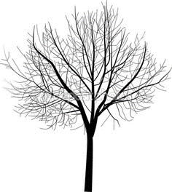
Decision Tree
A decision tree is a set of nested tests which we use to “divide and conquer” a prediction problem
Each branch represents a test
Each node represents the result of a test
Each leaf (terminal node) represents a class assignment
Once developed, a decision tree can be used to classify new instances

Slide 4
A Simple Example
We want a model that tells us if a prospective borrower is likely to default on a loan
We have historical data about past borrowers than can be used to train a model
Balance
<50K
>=50K
Default
Age
Name | Balance | Age | Default
Mike | $23,000 | 30 | Yes
Mary | $51,000 | 40 | Yes
Bill | $68,000 | 55 | No
Jim | $74,000 | 46 | No
Dave | $23,000 | 47 | Yes
Anne | $100,000 | 49 | No
>45
<=45
Not Default
Default

Slide 5
A Simple Example
Now we are presented with new data and asked to make a prediction
Mark, age 40, has an account balance of $88,000
Would you predict Mark will default or not default?
Balance
<50K
>=50K
Default
Age
>45
<=45
Not Default
Default

Slide 6
Decision Tree Construction
Tree construction is performed in a top-down, recursive, divide-and-conquer manner
All training examples begin in the root node
Attributes are assumed to be nominal (could be discretized interval) variables
Examples are partitioned recursively based on selected attributes
Decision tree algorithms are considered greedy because they make locally optimal decisions

Slide 7
Decision Tree Algorithm
The most commonly used algorithm was discovered independently by two separate researchers
CaRT – Breimanetal 1984
ID3 – Quinlan 1986
The algorithm consists of the following:
Using your training data, select the best attribute to split on
Identify all possible values for that attribute
For each value, create a new child node
Allocate the observations to the appropriate child node
For each child node
If the node is pure, STOP
Else, recursively call the algorithm to split again

Slide 8
An Example of Decision Tree Classification
Outlook | Temp | Humidity | Windy | Play?
Sunny | Hot | High | False | No
Sunny | Hot | High | True | No
Overcast | Hot | High | False | Yes
Rainy | Mild | High | False | Yes
Rainy | Cool | Normal | False | Yes
Rainy | Cool | Normal | True | No
Overcast | Cool | Normal | True | Yes
Sunny | Mild | High | False | No
Sunny | Cool | Normal | False | Yes
Rainy | Mild | Normal | False | Yes
Sunny | Mild | Normal | True | Yes
Overcast | Mild | High | True | Yes
Overcast | Hot | Normal | False | Yes
Rainy | Mild | High | True | No
Task: Develop a decision to predict if John will play tennis
9 Yes
5 No
14 Total

Slide 9
Building our Decision Tree
9 Yes / 5 No
Outlook
Outlook | Temp | Humidity | Windy
Sunny | Hot | High | False
Sunny | Hot | High | True
Overcast | Hot | High | False
Rainy | Mild | High | False
Rainy | Cool | Normal | False
Rainy | Cool | Normal | True
Overcast | Cool | Normal | True
Sunny | Mild | High | False
Sunny | Cool | Normal | False
Rainy | Mild | Normal | False
Sunny | Mild | Normal | True
Overcast | Mild | High | True
Overcast | Hot | Normal | False
Rainy | Mild | High | True
Overcast
Sunny
Rainy
Outlook | Temp | Humidity | Windy
Overcast | Hot | High | False
Overcast | Cool | Normal | True
Overcast | Mild | High | True
Overcast | Hot | Normal | False
Outlook | Temp | Humidity | Windy
Sunny | Hot | High | False
Sunny | Hot | High | True
Sunny | Mild | High | False
Sunny | Cool | Normal | False
Sunny | Mild | Normal | True
Outlook | Temp | Humidity | Windy
Rainy | Mild | High | False
Rainy | Cool | Normal | False
Rainy | Cool | Normal | True
Rainy | Mild | Normal | False
Rainy | Mild | High | True

Slide 10
Building our Decision Tree
9 Yes / 5 No
Outlook
Overcast
Sunny
Rainy
Outlook | Temp | Humidity | Windy
Overcast | Hot | High | False
Overcast | Cool | Normal | True
Overcast | Mild | High | True
Overcast | Hot | Normal | False
Humidity
Windy
High
Normal
True
False
Temp | Humidity | Windy
Hot | High | False
Hot | High | True
Mild | High | False
Temp | Humidity | Windy
Cool | Normal | False
Mild | Normal | True
Temp | Humidity | Windy
Cool | Normal | True
Mild | High | True
Temp | Humidity | Windy
Mild | High | False
Cool | Normal | False
Mild | Normal | False

Slide 11
Building our Decision Tree
9 Yes / 5 No
Outlook
2 Yes / 3 No
3 Yes / 2 No
Overcast
Sunny
Rainy
4 Yes / 0 No
Humidity
Windy
High
Normal
True
False
0 Yes / 3 No
2 Yes / 0 No
0 Yes / 2 No
3 Yes / 0 No
Outlook | Temp | Humidity | Windy | Play?
Sunny | Cool | High | True | ?

Slide 12
Selecting the Best Attributes for Splits
Outlook
Temp
2 Yes / 3 No
3 Yes / 2 No
2 Yes / 2 No
3 Yes / 1 No
Sunny
Rainy
Hot
Cool
Overcast
Mild
4 Yes / 0 No
4 Yes / 2 No
Humidity
Windy
3 Yes / 4 No
6 Yes / 1 No
3 Yes / 3 No
6 Yes / 2 No
High
Normal
True
False

Slide 13
A Criterion for Attribute Selection
A heuristic for attribute selection is simply to choose the attribute that minimizes the number of splits in the tree
However, it would be nice to have a measure to identify the best attribute
Selecting the best attribute largely involves assessing certainty
For a node with 4 Yes/0 No or 0 Yes/4 No, we are relatively certain
For a node with 2 Yes/2 No, we are not certain at all
So for pure nodes, we are very certain and for impure nodes we are not
A popular (im)purity criterion is information
Specifically, how much additional information is needed to be sure about a classification
It takes a low value of information for pure nodes and a high value for impure nodes
Strategy: Choose the attribute that results in the highest degree of certainty
Information gain is the commonly used approach
It is equivalent (and faster) to select the smallest total weighted entropy

Slide 14
Relationship between Purity and Certainty
Predictive Certainty
Node Purity

Slide 15
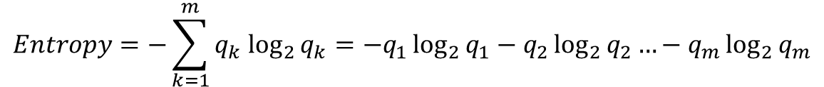

Computing Entropy
Entropy is the information required to predict an event with certainty
Information is measured in bits
Where
$m$ is the number of classes
$q_{k}$ is the proportion of records belonging to class $k$
$$Entropy=−\sum_{k=1}^{m}{q_{k} \log_{2}{q_{k}}}=−q_{1}\log_{2}{q_{1}}−q_{2}\log_{2}{q_{2}}…−q_{m}\log_{2}{q_{m}}$$

Slide 16



Computing Entropy
KNOW THIS. ON THE TESTTTT!!!!!!!!!!!!!
Outlook
2 Yes / 3 No
3 Yes / 2 No
Sunny
Rainy
$${Entropy}_{Sunny}=−\frac{2}{5}\log_{2}{\frac{2}{5}−\frac{3}{5}\log_{2}{\frac{3}{5}}}$$
Overcast
$${Entropy}_{Sunny}=0.53+0.44=0.97 bits$$
4 Yes / 0 No
$${Entropy}_{Overcast}=−\frac{4}{4}\log_{2}{\frac{4}{4}−\frac{0}{4}\log_{2}{\frac{0}{4}}}$$
q | -q log2 q
1 | 0.00
1/2 | 0.50
1/3 | 0.53
2/3 | 0.39
1/4 | 0.50
3/4 | 0.31
1/5 | 0.46
2/5 | 0.53
3/5 | 0.44
4/5 | 0.26
1/6 | 0.43
5/6 | 0.22
$${Entropy}_{Overcast}=0.00+undefined=0.00 bits$$
$${Entropy}_{Rainy}=−\frac{3}{5}\log_{2}{\frac{3}{5}−\frac{2}{5}\log_{2}{\frac{2}{5}}}$$
$${Entropy}_{Rainy}=0.44+0.53=0.97 bits$$
$${TWE}_{Outlook}=\frac{5}{14}⋅0.97+\frac{4}{14}⋅0+\frac{5}{14}⋅0.97=0.69 bits$$

Slide 17




Comparing Total Weighted Entropies
The total weighted entropy is a measure of uncertainty if we select the associated node for splitting
Given the total weighted entropies for the tennis attributes, which attribute should we split on?
$${TWE}_{Outlook}=0.69 bits$$
Outlook has the smallest total weighted entropy (i.e. it requires the least amount of information to be certain about prediction)a
$${TWE}_{Temperature}=0.91 bits$$
$${TWE}_{Humidity}=0.79 bits$$
$${TWE}_{Windy}=0.89 bits$$

Slide 18










Another Example
Person | Hair Length | Weight | Age | Class
Homer | 0” | 250 | 36 | M
Marge | 10” | 150 | 34 | F
Bart | 2” | 90 | 10 | M
Lisa | 6” | 78 | 8 | F
Maggie | 4” | 20 | 1 | F
Abe | 1” | 170 | 70 | M
Selma | 8” | 160 | 41 | F
Otto | 10” | 180 | 38 | M
Krusty | 6” | 200 | 45 | M
Comicbook Guy | 8” | 290 | 38 | ???

Slide 19



Splitting on Hair Length
$${Entropy}_{≤5}=−\frac{1}{4}\log_{2}{\frac{1}{4}−\frac{3}{4}\log_{2}{\frac{3}{4}}}=0.81 bits$$
$${Entropy}_{>5}=−\frac{3}{5}\log_{2}{\frac{3}{5}−\frac{2}{5}\log_{2}{\frac{2}{5}}}=0.97 bits$$
Hair Length ≤ 5”
Hair Length > 5”
$${TWE}_{Hair}=\frac{4}{9}⋅0.81+\frac{5}{9}⋅0.97=0.90 bits$$
1F, 3M
3F, 2M

Slide 20



Splitting on Weight
$${Entropy}_{≤160}=−\frac{4}{5}\log_{2}{\frac{4}{5}−\frac{1}{5}\log_{2}{\frac{1}{5}}}=0.72 bits$$
$${Entropy}_{>160}=−\frac{0}{4}\log_{2}{\frac{0}{4}−\frac{4}{4}\log_{2}{\frac{4}{4}}}=0.00 bits$$
Weight ≤ 160
Weight > 160
$${TWE}_{Hair}=\frac{5}{9}⋅0.72+\frac{4}{9}⋅0.00=0.40 bits$$
4F, 1M
0F, 4M

Slide 21



Splitting on Age
$${Entropy}_{≤40}=−\frac{3}{6}\log_{2}{\frac{3}{6}−\frac{3}{6}\log_{2}{\frac{3}{6}}}=1.00 bits$$
$${Entropy}_{>40}=−\frac{1}{3}\log_{2}{\frac{1}{3}−\frac{2}{3}\log_{2}{\frac{2}{3}}}=0.92 bits$$
Age ≤ 40
Age > 40
$${TWE}_{Age}=\frac{6}{9}⋅1.00+\frac{3}{9}⋅0.92=0.97 bits$$
3F, 3M
1F, 2M

Slide 22
Splitting on weight yields the lowest TWE (0.40 bits versus 0.90 for hair length or 0.97 for age)
The weight ≤ 160 node is not pure, therefore recursively call the algorithm
At the next level, split on hair length ≤ 2 is best
Weight ≤ 160
Weight > 160
Hair Length ≤ 2”
Hair Length > 2”

Slide 23
Trees are Easily Converted to Rules
IF (Weight > 160) THEN Male
ELSE IF (Hair Length ≤ 2”) THEN Male
ELSE Female
So what about Comicbook Guy?
Hair Length: 8”
Weight: 290
Age: 38
Class:
Weight ≤ 160
Weight > 160
Male
Hair Length ≤ 2”
Hair Length > 2”

Slide 24
Overfitting
Test…he was enthusiastic about this
Remember that for supervised techniques, we typically use one part of our data to train the model and another part of our data to test its performance
Overfitting occurs when we use an overly flexible model that accommodates the nuances of the random noise in the training data
As a result, the model performs poorly when presented with the testing data
Too flexible
Not flexible enough

Slide 25
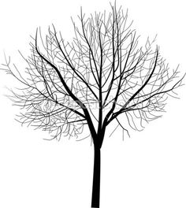
Overfitting Trees
In the context of decision trees, overfitting occurs when the tree has too many branches
You end up fitting noise
Great fit for training data, poor accuracy for unseen samples
Avoiding Overfitting
Pre-pruning (Stunting)
Stop splitting if the number of cases in a node falls below a
specified limit
Stop splitting if the split is not statistically significant at a specified level
It is difficult to choose a criterion
Post-pruning
Remove branches from a “fully grown” tree
Select from a sequence of progressively pruned trees

Slide 26
Some Common Issue
Learning things that aren’t true - Patterns may not represent any underlying rule or the rule may be obscure event where a relationship is known to exist (vanilla ice cream → car trouble)
Self-selection bias – 97% of eBay online reviews are positive
Data may be at the wrong level of detail – Simpson’s paradox
Learning things that are true, but not useful – Most rules learned are normal business rules (already known)
Data integrity issues

Slide 27
Strengths and Weaknesses
Strengths
Weaknesses
Easily interpreted
Easy to implementation
Relatively efficient
Can handle mixed measurement scales
Can handle missing values
Relatively robust
Extremely popular
Volatile
Sensitive to outliers
Can result in large error

Slide 28
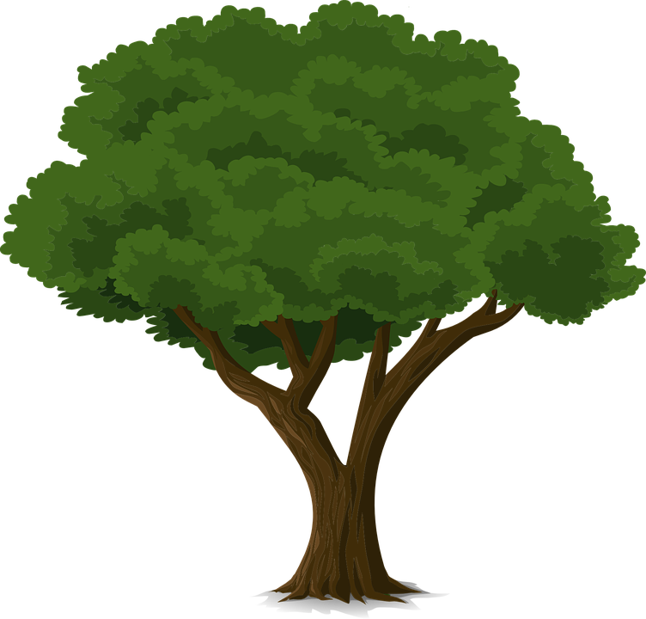
What is Better than One Decision Tree?
A Forest

Slide 29
Random Forest
Random Forests are an ensemble approach to classification
Rather than using a single decision tree, multiple trees are constructed
Each tree performs the classification and the results are aggregated
Called random, because of variations in the construction of the trees
Each tree predicts the target variable using a random subset of the available predictors
Each tree uses a random sample of the available data
Results of each tree are examined collectively and majority rules

Slide 30
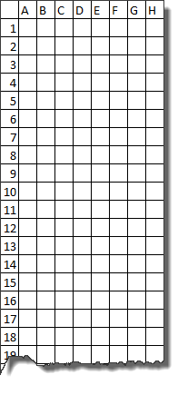

A Simple Random Forest Example
Tree 1
Predictors: A, C, D, F
1
Observations: 2, 3, 6, 8, 12, 16, 17, …
Tree 2
Predictors: B, D, E, G
0
1
Observations: 1, 2, 5, 7, 10, 14, 18, …
Tree 3
Predictors: B, C, E, G
1
Observations: 3, 4, 8, 9, 11, 13, 15, …

