Slide 1
Evaluating Classifiers
DSCI 4520
Introduction to Data Mining
Russell R. Torres

Slide 2
True genius resides in the capacity for evaluation of uncertain, hazardous, and conflicting information.
Winston Churchill

Slide 3
Gathering Data for Model Evaluation
Given the tools available, creating multiple models of a given phenomenon is generally easy to accomplish
In order to maximize the utility of our data mining efforts, we must choose the “best” model
There are multiple methods commonly used to gather data for the evaluation of classification models
Hold out
Cross validation
Bootstrapping

Slide 4
Holdout
Separate data into training, validation, and test datasets
The training data set is used to construct the classification model
The validation data set is used to fine tune the models, assess their performance, and select the “best” model for a given phenomenon
The test data set is used to estimate the accuracy/future performance of the selected model
It is assumed that each data set is representative of the underlying phenomenon
Generally
More training data → better classifier (to a point)
More testing data → more accurate error estimate

Slide 5
Holdout
1 | 2 | 3 | 4 | 5 | 6 | 7 | 8 | 9 | 10 | 11 | 12 | 13 | 14 | 15 | 16 | 17 | 18 | 19 | 20 | 21 | 22 | 23 | 24 | 25 | 26 | 27 | 28 | 29 | 30 | 31 | 32 | 33 | 34 | 35 | 36 | 37 | 38 | 39 | 40
1 | 2 | 3 | 4 | 5 | 6 | 7 | 8 | 9 | 10 | 11 | 12 | 13 | 14 | 15 | 16 | 17 | 18 | 19 | 20 | 21 | 22 | 23 | 24 | 25 | 26 | 27 | 28 | 29 | 30 | 31 | 32 | 33 | 34 | 35 | 36 | 37 | 38 | 39 | 40
n = 40
50/50
 | Original Data
 | Training
 | Testing

Slide 6
Holdout Variations
Stratified Holdout
It is possible that a class is rare and may not be represented in the training set
This would prevent a model from being trained to accurately predict such cases
Divide original data into strata by class labels and then sample with each stratus for training and testing sets
i.e., oversample rare event or undersample frequent event
Repeated Holdout (Monte Carlo Cross-Validation)
Repeat the holdout procedure with different randomly selected subsamples
Different test sets may overlap
Error rates are averaged to produce an overall error rate

Slide 7
Rare Events
1 | 2 | 3 | 4 | 5 | 6 | 7 | 8 | 9 | 10 | 11 | 12 | 13 | 14 | 15 | 16 | 17 | 18 | 19 | 20 | 21 | 22 | 23 | 24 | 25 | 26 | 27 | 28 | 29 | 30 | 31 | 32 | 33 | 34 | 35 | 36 | 37 | 38 | 39 | 40
1 | 2 | 3 | 4 | 5 | 6 | 7 | 8 | 9 | 10 | 11 | 12 | 13 | 14 | 15 | 16 | 17 | 18 | 19 | 20 | 21 | 22 | 23 | 24 | 25 | 26 | 27 | 28 | 29 | 30 | 31 | 32 | 33 | 34 | 35 | 36 | 37 | 38 | 39 | 40
This won’t work!
None of the rare events we are trying to predict actually show up in our training data!
n = 40
50/50
 | Original Data – 1
 | Original Data – 0
 | Training
 | Testing

Slide 8
Stratified Holdout
1 | 2 | 3 | 4 | 5 | 6 | 7 | 8 | 9 | 10 | 11 | 12 | 13 | 14 | 15 | 16 | 17 | 18 | 19 | 20 | 21 | 22 | 23 | 24 | 25 | 26 | 27 | 28 | 29 | 30 | 31 | 32 | 33 | 34 | 35 | 36 | 37 | 38 | 39 | 40
Stratify and randomly undersample the frequent event
3 | 5 | 13 | 15 | 17 | 21 | 33 | 40
3 | 5 | 13 | 15 | 17 | 21 | 33 | 40
n = 40
50/50
 | Original Data – 1
 | Original Data – 0
 | Training
 | Testing

Slide 9
Repeated Holdout
1 | 2 | 3 | 4 | 5 | 6 | 7 | 8 | 9 | 10 | 11 | 12 | 13 | 14 | 15 | 16 | 17 | 18 | 19 | 20 | 21 | 22 | 23 | 24 | 25 | 26 | 27 | 28 | 29 | 30 | 31 | 32 | 33 | 34 | 35 | 36 | 37 | 38 | 39 | 40
1 | 2 | 3 | 4 | 5 | 6 | 7 | 8 | 9 | 10 | 11 | 12 | 13 | 14 | 15 | 16 | 17 | 18 | 19 | 20 | 21 | 22 | 23 | 24 | 25 | 26 | 27 | 28 | 29 | 30 | 31 | 32 | 33 | 34 | 35 | 36 | 37 | 38 | 39 | 40
1 | 2 | 3 | 4 | 5 | 6 | 7 | 8 | 9 | 10 | 11 | 12 | 13 | 14 | 15 | 16 | 17 | 18 | 19 | 20 | 21 | 22 | 23 | 24 | 25 | 26 | 27 | 28 | 29 | 30 | 31 | 32 | 33 | 34 | 35 | 36 | 37 | 38 | 39 | 40
…
1 | 2 | 3 | 4 | 5 | 6 | 7 | 8 | 9 | 10 | 11 | 12 | 13 | 14 | 15 | 16 | 17 | 18 | 19 | 20 | 21 | 22 | 23 | 24 | 25 | 26 | 27 | 28 | 29 | 30 | 31 | 32 | 33 | 34 | 35 | 36 | 37 | 38 | 39 | 40
1 | 2 | 3 | 4 | 5 | 6 | 7 | 8 | 9 | 10 | 11 | 12 | 13 | 14 | 15 | 16 | 17 | 18 | 19 | 20 | 21 | 22 | 23 | 24 | 25 | 26 | 27 | 28 | 29 | 30 | 31 | 32 | 33 | 34 | 35 | 36 | 37 | 38 | 39 | 40
n = 40
50/50
 | Original Data
 | Training
 | Testing

Slide 10
Cross Validation
k-Fold Cross Validation
Data is randomly split into k subsets of (approximately) equal size
For each iteration, one subset is used for testing and the rest are used for training
Cross validation uses sampling without replacement, thus test sets will not overlap
10-fold has been shown to be among the best schemes
Error rates of different iterations are averaged to yield overall error rate
Leave-One-Out Cross Validation
A special case of k-fold where k=n, the number of observations in the data set
For each iteration, one observation is used for testing with the rest used for training
Computationally expensive

Slide 11
k-Fold Cross Validation
1 | 2 | 3 | 4 | 5 | 6 | 7 | 8 | 9 | 10 | 11 | 12 | 13 | 14 | 15 | 16 | 17 | 18 | 19 | 20 | 21 | 22 | 23 | 24 | 25 | 26 | 27 | 28 | 29 | 30 | 31 | 32 | 33 | 34 | 35 | 36 | 37 | 38 | 39 | 40
1 | 2 | 3 | 4 | 5 | 6 | 7 | 8 | 9 | 10 | 11 | 12 | 13 | 14 | 15 | 16 | 17 | 18 | 19 | 20 | 21 | 22 | 23 | 24 | 25 | 26 | 27 | 28 | 29 | 30 | 31 | 32 | 33 | 34 | 35 | 36 | 37 | 38 | 39 | 40
1 | 2 | 3 | 4 | 5 | 6 | 7 | 8 | 9 | 10 | 11 | 12 | 13 | 14 | 15 | 16 | 17 | 18 | 19 | 20 | 21 | 22 | 23 | 24 | 25 | 26 | 27 | 28 | 29 | 30 | 31 | 32 | 33 | 34 | 35 | 36 | 37 | 38 | 39 | 40
…
1 | 2 | 3 | 4 | 5 | 6 | 7 | 8 | 9 | 10 | 11 | 12 | 13 | 14 | 15 | 16 | 17 | 18 | 19 | 20 | 21 | 22 | 23 | 24 | 25 | 26 | 27 | 28 | 29 | 30 | 31 | 32 | 33 | 34 | 35 | 36 | 37 | 38 | 39 | 40
1 | 2 | 3 | 4 | 5 | 6 | 7 | 8 | 9 | 10 | 11 | 12 | 13 | 14 | 15 | 16 | 17 | 18 | 19 | 20 | 21 | 22 | 23 | 24 | 25 | 26 | 27 | 28 | 29 | 30 | 31 | 32 | 33 | 34 | 35 | 36 | 37 | 38 | 39 | 40
n = 40
k = 10
4 test observations per iteration
 | Original Data
 | Training
 | Testing

Slide 12
Leave One Out Cross Validation
1 | 2 | 3 | 4 | 5 | 6 | 7 | 8 | 9 | 10 | 11 | 12 | 13 | 14 | 15 | 16 | 17 | 18 | 19 | 20 | 21 | 22 | 23 | 24 | 25 | 26 | 27 | 28 | 29 | 30 | 31 | 32 | 33 | 34 | 35 | 36 | 37 | 38 | 39 | 40
1 | 2 | 3 | 4 | 5 | 6 | 7 | 8 | 9 | 10 | 11 | 12 | 13 | 14 | 15 | 16 | 17 | 18 | 19 | 20 | 21 | 22 | 23 | 24 | 25 | 26 | 27 | 28 | 29 | 30 | 31 | 32 | 33 | 34 | 35 | 36 | 37 | 38 | 39 | 40
1 | 2 | 3 | 4 | 5 | 6 | 7 | 8 | 9 | 10 | 11 | 12 | 13 | 14 | 15 | 16 | 17 | 18 | 19 | 20 | 21 | 22 | 23 | 24 | 25 | 26 | 27 | 28 | 29 | 30 | 31 | 32 | 33 | 34 | 35 | 36 | 37 | 38 | 39 | 40
…
1 | 2 | 3 | 4 | 5 | 6 | 7 | 8 | 9 | 10 | 11 | 12 | 13 | 14 | 15 | 16 | 17 | 18 | 19 | 20 | 21 | 22 | 23 | 24 | 25 | 26 | 27 | 28 | 29 | 30 | 31 | 32 | 33 | 34 | 35 | 36 | 37 | 38 | 39 | 40
1 | 2 | 3 | 4 | 5 | 6 | 7 | 8 | 9 | 10 | 11 | 12 | 13 | 14 | 15 | 16 | 17 | 18 | 19 | 20 | 21 | 22 | 23 | 24 | 25 | 26 | 27 | 28 | 29 | 30 | 31 | 32 | 33 | 34 | 35 | 36 | 37 | 38 | 39 | 40
n = 40
k = 40
1 test observation per iteration
 | Original Data
 | Training
 | Testing

Slide 13
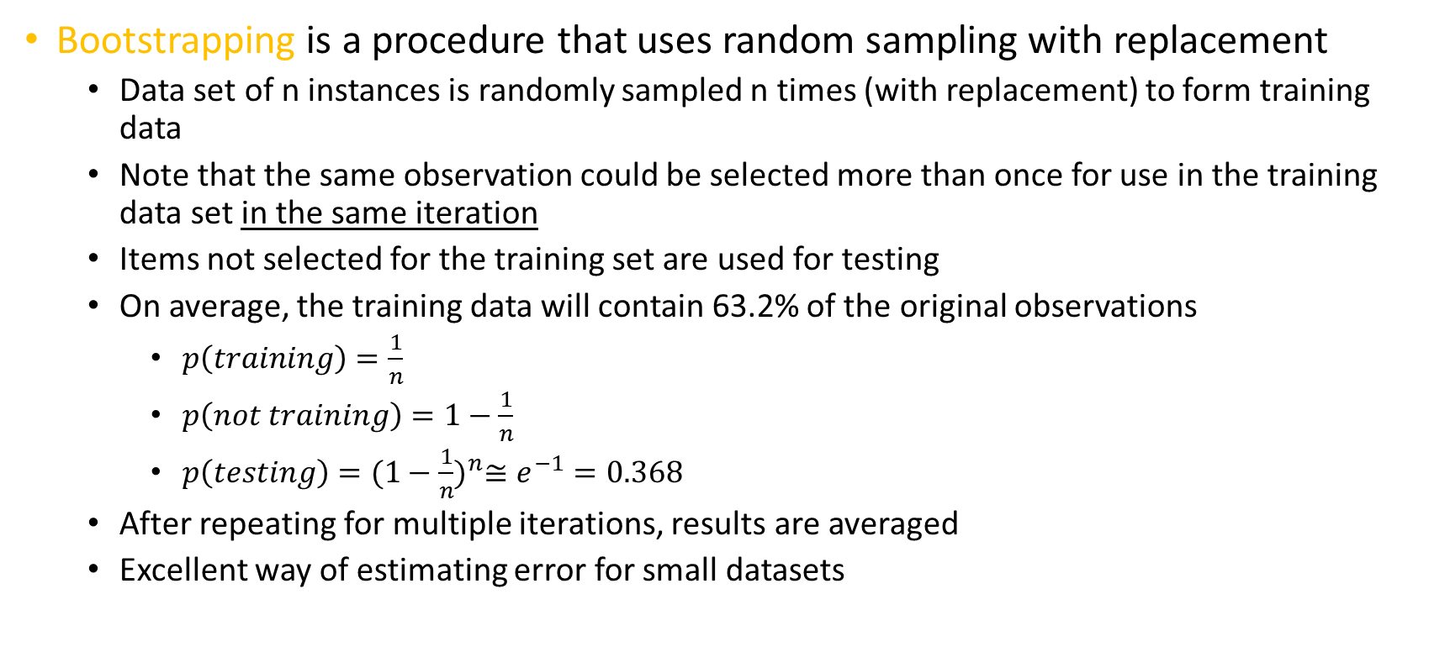
Bootstrapping
Bootstrapping is a procedure that uses random sampling with replacement
Data set of n instances is randomly sampled n times (with replacement) to form training data
Note that the same observation could be selected more than once for use in the training data set in the same iteration
Items not selected for the training set are used for testing
On average, the training data will contain 63.2% of the original observations
$p\left(training\right)=\frac{1}{n}$
$p\left(not training\right)=1−\frac{1}{n}$
$p\left(testing\right)={(1−\frac{1}{n})}^{n}≅e^{−1}=0.368$
After repeating for multiple iterations, results are averaged
Excellent way of estimating error for small datasets

Slide 14
(0.632) Bootstrapping
1 | 2 | 3 | 4 | 5 | 6 | 7 | 8 | 9 | 10 | 11 | 12 | 13 | 14 | 15 | 16 | 17 | 18 | 19 | 20 | 21 | 22 | 23 | 24 | 25 | 26 | 27 | 28 | 29 | 30 | 31 | 32 | 33 | 34 | 35 | 36 | 37 | 38 | 39 | 40
1 | 2 | 5 | 5 | 5 | 6 | 6 | 8 | 9 | 10 | 13 | 15 | 16 | 17 | 17 | 17 | 18 | 18 | 18 | 20 | 21 | 21 | 21 | 23 | 24 | 25 | 27 | 27 | 28 | 28 | 29 | 29 | 30 | 31 | 32 | 33 | 34 | 34 | 35 | 40
60.0%
…
3 | 4 | 7 | 11 | 12 | 14 | 19 | 22 | 26 | 36 | 37 | 38 | 39
1 | 4 | 4 | 5 | 5 | 6 | 6 | 8 | 11 | 13 | 16 | 16 | 17 | 17 | 19 | 20 | 20 | 20 | 20 | 20 | 22 | 22 | 23 | 23 | 24 | 24 | 25 | 26 | 27 | 29 | 30 | 32 | 32 | 33 | 33 | 34 | 35 | 35 | 40 | 40
67.5%
2 | 3 | 7 | 9 | 10 | 12 | 14 | 15 | 18 | 21 | 28 | 31 | 36 | 37 | 38 | 39
 | Original Data
 | Training
 | Testing
n = 40

Slide 15
Model Evaluation
Once we have (one way or another) divided our dataset into training and testing sets, we must evaluate performance of the model for the test set
Many methods exist for comparing models
Confusion matrix
Mean Squared Error (MSE)
Root Mean Squared Error (RMSE)
Model Assessment Charts
% Response Charts
Lift Charts
Gains Charts
ROC Charts

Slide 16
Some Thoughts on Model Accuracy…
Assume the typical response rate from a mailing campaign is 1%
A highly paid data analyst has produced two models:
Model A accurately classifies 90% of all observations in the validation set
Model B accurately classifies 99% of all observations in the validation set
Which model would you choose?

Slide 17
Some Thoughts on Model Accuracy…
What if I told you that Model B is a naïve model that predicts that no customer will respond?
Classification accuracy is 99% because only about 1% of customers respond
The model ends up being very accurate but entirely useless!
You need to know the source of error, not just the error rate.

Slide 18
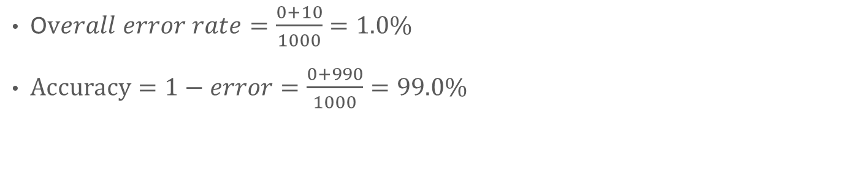
The Confusion Matrix
 |  | Predicted
 |  | Respond | Don’t Respond
Actual | Respond | 0 | 10
 | Don’t Respond | 0 | 990
O$verall error rate=\frac{0+10}{1000}=1.0\%$
$Accuracy=1−error=\frac{0+990}{1000}=99.0\%$

Slide 19
So What is a Confusion Matrix?
 |  | Predicted
 |  | Positive | Negative
Actual | Positive | a | b
 | Negative | c | d
a: number of positive instances predicted as positive (true positive)
b: number of positive instances predicted as negative (false negative)
c: number of negative instances predicted as positive (false positive)
d: number of negative instances predicted as negative (true negative)

Slide 20
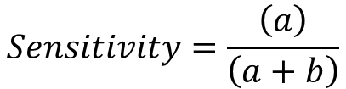
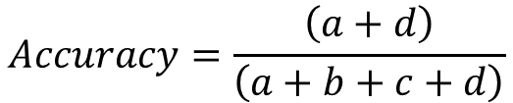
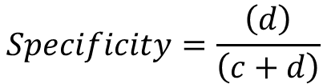
Confusion Matrix Terms
 |  | Predicted
 |  | + | -
Actual | + | a | b
 | - | c | d
Accuracy: Proportion of correct predictions
Sensitivity (True Positive Rate): Proportion of positive cases correctly classified as positive
Specificity (True Negative Rate): Proportion of negative cases correctly classified as negative
$$Accuracy=\frac{\left(a+d\right)}{\left(a+b+c+d\right)}$$
$$Sensitivity=\frac{\left(a\right)}{\left(a+b\right)}$$
$$Specificity=\frac{\left(d\right)}{\left(c+d\right)}$$

Slide 21
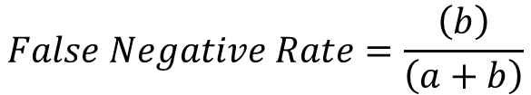
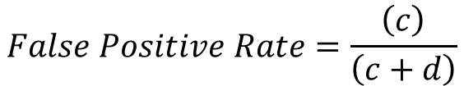
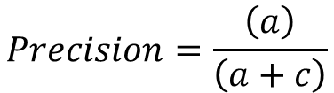
Confusion Matrix Terms
 |  | Predicted
 |  | + | -
Actual | + | a | b
 | - | c | d
False Positive Rate: Proportion of negative cases incorrectly
classified as positive
False Negative Rate: Proportion of positive cases incorrectly classified as negative
Precision: Proportion of predicted positive cases that were correctly classified
$$False Positive Rate=\frac{\left(c\right)}{\left(c+d\right)}$$
$$False Negative Rate=\frac{\left(b\right)}{\left(a+b\right)}$$
$$Precision=\frac{\left(a\right)}{\left(a+c\right)}$$

Slide 22


















Confusion Matrix Example
Miiiiight need to know these equations, not memorize but know how to use them
 |  | Predicted
 |  | Defaulter | Non-defaulter
Actual | Defaulter | 15 | 10
 | Non-defaulter | 5 | 70
 |  | Predicted
 |  | Defaulter | Non-defaulter
Actual | Defaulter | 20 | 20
 | Non-defaulter | 0 | 60
$$Accuracy=$$
$$\frac{\left(70+15\right)}{\left(100\right)}=0.85$$
$$Accuracy=\frac{\left(60+20\right)}{\left(100\right)}=0.80$$
$$\frac{\left(15\right)}{\left(15+10\right)}=0.60$$
$$Sensitivity=\frac{\left(20\right)}{\left(20+20\right)}=0.50$$
$$Sensitivity=$$
$$Specificity=$$
$$\frac{\left(70\right)}{\left(5+70\right)}=0.93$$
$$Specificity=\frac{\left(60\right)}{\left(0+60\right)}=1.00$$
$$FPR=$$
$$\frac{\left(5\right)}{\left(5+70\right)}=0.07$$
$$FPR=\frac{\left(0\right)}{\left(0+60\right)}=0.00$$
$$FNR=$$
$$\frac{\left(10\right)}{\left(15+10\right)}=0.40$$
$$FNR=\frac{\left(20\right)}{\left(20+20\right)}=0.50$$
$$\frac{\left(15\right)}{\left(15+5\right)}=0.75$$
$$Precision=\frac{\left(20\right)}{\left(20+0\right)}=1.00$$
$$Precision=$$

Slide 23
Confusion Matrix Example
 |  | Predicted
 |  | Defaulter | Non-defaulter
Actual | Defaulter | 15 | 10
 | Non-defaulter | 5 | 70
 |  | Predicted
 |  | Defaulter | Non-defaulter
Actual | Defaulter | 20 | 20
 | Non-defaulter | 0 | 60
Assume:
It costs our organization $20,000 when we loan to a defaulter
We lose $5,000 in revenue when we refuse a loan to a non-defaulter
But what if:
It costs our organization $4,000 when we loan to a defaulter
We lose $10,000 in revenue when we refuse a loan to a non-defaulter
$$Cost=10×\$20,000+5×\$5,000=\$225,000$$
$$Cost=20×\$20,000+0×\$5,000=\$400,000$$
$$Cost=10×\$4,000+5×\$10,000=\$90,000$$
$$Cost=20×\$4,000+0×\$10,000=\$80,000$$

Slide 24

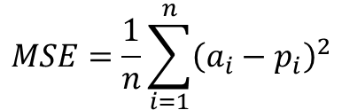
Mean Squared Error (MSE)
Mean squared error (MSE) measures the mean difference between actual and predicted values
The root mean squared error (RMSE) is also often used as it has the same dimension as the original data
Applicable for classifiers that produce some continuous score which are converted to class labels using a threshold
$$MSE=\frac{1}{n}\sum_{i=1}^{n}{{\left(a_{i}−p_{i}\right)}^{2}}$$
$$RMSE=\sqrt{\frac{1}{n}\sum_{i=1}^{n}{{\left(a_{i}−p_{i}\right)}^{2}}}$$

Slide 25
Creating Model Assessment Charts
Using the model, produce estimated probabilities for the target event for each case
Sort all cases by decreasing estimated probability.
Split the cases into n bins so that bin #1 has the highest probabilities and Bin #n the lowest probabilities
Now look at the number of cases where the target event actually happens
Calculate statistic of interest for each bin

Slide 26
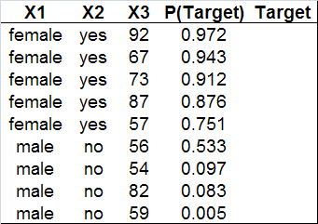
Creating Model Assessment Charts
Event Occurred
Event Did Not Occur
Assume:
n = 180
Count ( ) = 40
Count ( ) = 140

Slide 27
Looking Inside the Bins
Good models assign high probabilities to cases which will actually have the target event (defaulting, donating, etc.)
Bin #1
(high probabilities)
Bin #10
(low probabilities)
= target event has ACTUALLY occurred
= target event has actually not occurred

Slide 28

% Response
%Response shows you what percentage of each bin’s contents are target cases (defaulters, donors, etc.)
For example, 83% of cases that ended up in the 1st bin (because they had high probabilities) were observed to actually exhibit the target event
$$\frac{15}{18}=0.83$$

Slide 29
% Response Charts

Slide 30
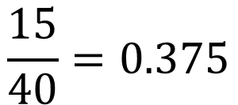
% Captured Response
%Captured Response shows you what percentage of all target cases (defaulters, donors, etc.) are “captured” by each bin
For example, 37.5% of all defaulters may have been captured by the first bin
$$\frac{15}{40}=0.375$$

Slide 31
% Captured Response Chart

Slide 32
The Baseline Model
What if we assigned cases into the 10 bins randomly? This would create a “baseline” model against which we could measure the performance of our model

Slide 33
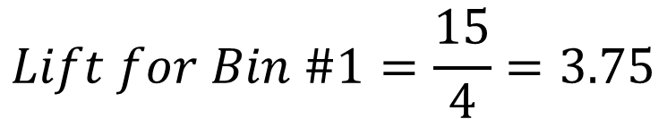
Lift
For each bin, get the ratio of target cases in the model’s bin over target cases in the baseline
Model
Baseline
$$Lift for Bin \#1=\frac{15}{4}=3.75$$
A 1 means theres no advantage of using your model, less than one means its worse than randomly guessing

Slide 34
Lift Charts

Slide 35
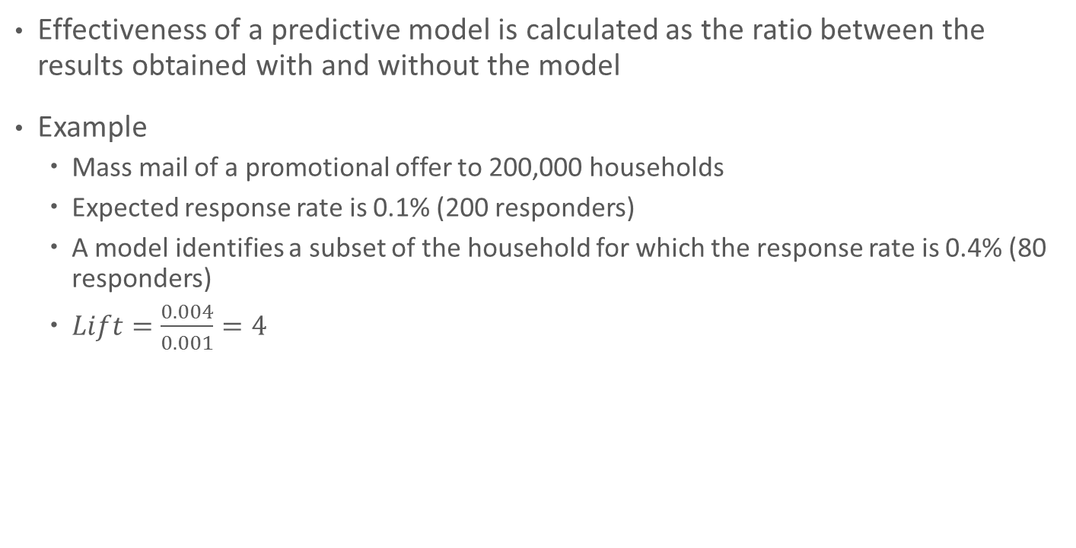
Lift Chart Example
Effectiveness of a predictive model is calculated as the ratio between the results obtained with and without the model
Example
Mass mail of a promotional offer to 200,000 households
Expected response rate is 0.1% (200 responders)
A model identifies a subset of the household for which the response rate is 0.4% (80 responders)
$Lift=\frac{0.004}{0.001}=4$

Slide 36
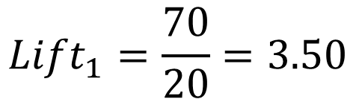
Lift Chart Example
Decile | # of Cases | # Responses | # Responses Expected | Lift
1 | 20,000 | 70 | 20 | 3.50
2 | 20,000 | 40 | 20 | 2.00
3 | 20,000 | 30 | 20 | 1.50
4 | 20,000 | 20 | 20 | 1.00
5 | 20,000 | 15 | 20 | 0.75
6 | 20,000 | 10 | 20 | 0.50
7 | 20,000 | 5 | 20 | 0.25
8 | 20,000 | 5 | 20 | 0.25
9 | 20,000 | 3 | 20 | 0.15
10 | 20,000 | 2 | 20 | 0.10
$${Lift}_{1}=\frac{70}{20}=3.50$$
200 target cases distributed evenly among 10 bins → 20 cases per bin

Slide 37
Lift Chart Example

Slide 38
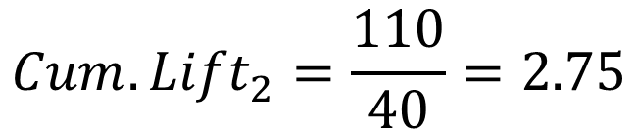
Constructing Cumulative Lift Charts
Decile | Cum. # Cases | Cum. # Responses | Cum. # Responses Expected | Cum. Lift
1 | 20,000 | 70 | 20 | 3.50
2 | 40,000 | 110 | 40 | 2.75
3 | 60,000 | 140 | 60 | 2.33
4 | 80,000 | 160 | 80 | 2.00
5 | 100,000 | 175 | 100 | 1.75
6 | 120,000 | 185 | 120 | 1.54
7 | 140,000 | 190 | 140 | 1.36
8 | 160,000 | 195 | 160 | 1.22
9 | 180,000 | 198 | 180 | 1.10
10 | 200,000 | 200 | 200 | 1.00
$${Cum. Lift}_{2}=\frac{110}{40}=2.75$$
200 target cases distributed evenly among 10 bins → 20 cases per bin. This is 2 bins worth.

Slide 39
Constructing Cumulative Lift Charts

Slide 40
Think About Lift from a Cost Perspective…
Every business action involves costs
In our mailing example, each promotional offer costs us money
Design
Production
Mailing
Lets assume we are trying to reach 100 new responders
Without the model, we have to send out 100,000 promotional offers
With the model, we have to send approximately 40,000 promotional offers
That is a HUGE cost savings for this activity

Slide 41
Constructing Gains Charts
Decile | # Cases | Cum. # Cases | # Responses | Cum. # Responses | Responses Expected | Cum. # Responses Expected
1 | 20,000 | 20,000 | 70 | 70 | 20 | 20
2 | 20,000 | 40,000 | 40 | 110 | 20 | 40
3 | 20,000 | 60,000 | 30 | 140 | 20 | 60
4 | 20,000 | 80,000 | 20 | 160 | 20 | 80
5 | 20,000 | 100,000 | 15 | 175 | 20 | 100
6 | 20,000 | 120,000 | 10 | 185 | 20 | 120
7 | 20,000 | 140,000 | 5 | 190 | 20 | 140
8 | 20,000 | 160,000 | 5 | 195 | 20 | 160
9 | 20,000 | 180,000 | 3 | 198 | 20 | 180
10 | 20,000 | 200,000 | 2 | 200 | 20 | 200

Slide 42
Gains Chart
Savings
GREAT chart to show savings to bosses.

Slide 43
The Importance of Cutoffs in Classification
The notion of cutoffs is integral to classification
A cutoff is a value which determines to which class a given observation should be assigned
For each record
Compute probability of belonging to class “1”
Compare probability to cutoff value and classify accordingly
Assume cutoff is 0.50
If probability >= 0.50 then classify as “1”
If probability < 0.50 then classify as “0”
When evaluating models, the cutoff values of the models in question can have a HUGE impact

Slide 44
Cutoff Example
Obs | Actual Class | Prob. of “1” |  | Obs | Actual Class | Prob. of “1”
1 | 1 | 0.996 |  | 13 | 1 | 0.506
2 | 1 | 0.988 |  | 14 | 0 | 0.471
3 | 1 | 0.984 |  | 15 | 0 | 0.337
4 | 1 | 0.980 |  | 16 | 1 | 0.218
5 | 1 | 0.948 |  | 17 | 0 | 0.199
6 | 1 | 0.889 |  | 18 | 0 | 0.149
7 | 1 | 0.848 |  | 19 | 0 | 0.048
8 | 0 | 0.762 |  | 20 | 0 | 0.038
9 | 1 | 0.707 |  | 21 | 0 | 0.025
10 | 1 | 0.681 |  | 22 | 0 | 0.022
11 | 1 | 0.656 |  | 23 | 0 | 0.016
12 | 0 | 0.622 |  | 24 | 0 | 0.004
If cutoff is 0.50, 13 records are classified as “1”
If cutoff is 0.80, 7 records are classified as “1”

Slide 45
The Receiver Operating Characteristics (ROC) Curve
The Receiver Operating Characteristics (ROC) Curve is used in signal detection to characterize the tradeoff between hit rate and false alarm rate
Characterizes the performance of a model using a wide range of cutoff values
Plots performance of classifier in terms of its true positive (vertical axis) and false positive (horizontal axis) rates
True positive rate – the percentage of cases that are positive and are correctly predicted as positive among all the positive cases
False positive rate – the percentage of cases that are negative and are incorrectly predicted as positive among all negative cases

Slide 46






ROC Curve Example
Consider a T4 test used to predict whether patients have hypothyroidism which ranges from 0 to 14
Cutoff 1
If T4<5, then disease
Cutoff 2
If T4<7, then disease
Cutoff 3
If T4<9, then disease
 |  | Predicted
 |  | Yes | No
Actual | Yes | 18 | 14
 | No | 1 | 92
 |  | Predicted
 |  | Yes | No
Actual | Yes | 25 | 7
 | No | 18 | 75
 |  | Predicted
 |  | Yes | No
Actual | Yes | 29 | 3
 | No | 54 | 39
$$TPR=\frac{\left(18\right)}{\left(18+14\right)}=56.25\%$$
$$TPR=\frac{\left(25\right)}{\left(25+7\right)}=78.13\%$$
$$TPR=\frac{\left(29\right)}{\left(29+3\right)}=90.63\%$$
$$FPR=\frac{\left(1\right)}{\left(1+92\right)}=1.08\%$$
$$FPR=\frac{\left(18\right)}{\left(18+75\right)}=19.35\%$$
$$FPR=\frac{\left(54\right)}{\left(54+39\right)}=58.06\%$$

Slide 47




ROC Curve Example
What about extreme values for cutoffs?
Cutoff 0
If T4<0, then disease
Cutoff 4
If T4<14, then disease
 |  | Predicted
 |  | Yes | No
Actual | Yes | 0 | 32
 | No | 0 | 93
 |  | Predicted
 |  | Yes | No
Actual | Yes | 32 | 0
 | No | 93 | 0
$$TPR=\frac{\left(0\right)}{\left(0+32\right)}=0.00\%$$
$$TPR=\frac{\left(32\right)}{\left(32+0\right)}=100.00\%$$
$$FPR=\frac{\left(0\right)}{\left(0+93\right)}=0.00\%$$
$$FPR=\frac{\left(93\right)}{\left(93+0\right)}=100.00\%$$

Slide 48
ROC Curve Example
Cutoff | True Positive Rate | False Positive Rate
Very Low | 0.00% | 0.00%
5 | 56.25% | 1.08%
7 | 78.25% | 19.35%
9 | 90.63% | 58.06%
Very High | 100.00% | 100.00%

Slide 49
Key Aspects of the ROC Curve
Perfect
Prediction
Predict
all “1”
True Positive Rate
Below the diagonal → Worse than random guessing
Predict
all “0”
False Positive Rate

Slide 50
Comparing Model Evaluation Techniques
No measure is categorically better than the others
Other relevant factors:
Speed & Scalability
Robustness to noise and missing values
Interpretability

