Slide 1
Dimension Reduction
DSCI 4520
Introduction to Data Mining
Russell R. Torres

Slide 2
“I don’t look at a problem and put variables in there that don’t affect it.”
Bill Parcells

Slide 3
Dimension Reduction

Slide 4
Dimensionality Reduction
Dimensionality reduction is a set of techniques used to reduce the amount of data necessary for prediction while still providing accurate models
Many data mining techniques are not effective for high-dimensional data
Intrinsic dimension often small, we may not need too many explanatory variables
Airplane Deicing Costs
Snowplow Costs
Heat stroke
Temperature?

Slide 5
The Curse of Dimensionality (Bellman 1961)
Statistical methods count observations that occur in a given space
As dimension increase
The data needed to make accurate inferences grows exponentially
The observations become sparser
Model performance often suffers as dimensionality increases
Classifier Performance
Dimensionality

Slide 6
Applications
Dimension reduction is useful anytime there is high-dimension data that may be simplified
Text mining
Image retrieval
Intelligent character recognition
Facial recognition
Dimension reduction is used in the business world when producing models with large datasets
Customers
Products
Etc.

Slide 7
Main Approaches
Manual Feature Selection – The data analyst can examine the available dimensions and exclude those they feel are not useful for modeling purposes
Feature Selection based on Objective Function – A modeling approach is used to identify the features that appear to have the most influence on the dependent variable
Feature Extraction – Maps high dimensional data onto a lower dimensional subspace (i.e., combines variables)

Slide 8
Goal
Reduce dimensionality
Reduce noise
Improve speed of learning
Improve predictive accuracy

Slide 9
Principal Components Analysis

Slide 10


Dimension Reduction and PCA
Principal Components Analysis (PCA) is a classical linear approach to dimension reduction
PCA projects high-dimensional data onto a lower dimensional sub-space using linear transformation
All dimension reduction techniques involve some degree of information loss
Goal of PCA is to reduce dimensionality while retaining as much information (variation) as possible in the dataset
$$X=\left[\begin{matrix}a_{1} \\ a_{2} \\ … \\ a_{N}\end{matrix}\right]⇒PCA ⇒Y=\left[\begin{matrix}b_{1} \\ b_{2} \\ … \\ b_{K}\end{matrix}\right]$$
$$where K≪N$$

Slide 11
PCA Requirements
PCA, when used for dimension reduction, only involves predictors
PCA can only be performed on dimensions which are at least interval in nature

Slide 12


Slide 13


Some Matrix Terminology
Matrix: a rectangular array of rows (m) and columns (n)
If m=n, the matrix is square
Principal: Diagonal from upper-left to lower right of a matrix
Principal elements: Elements of the principal
Trace: Sum of the principal elements
Principal (Diagonal)
$$\left[\begin{matrix}5 & 2 & 4 \\ −3 & 6 & 2 \\ 3 & −3 & 1\end{matrix}\right]$$
$$trace=\left(5+6+1\right)=12$$

Slide 14


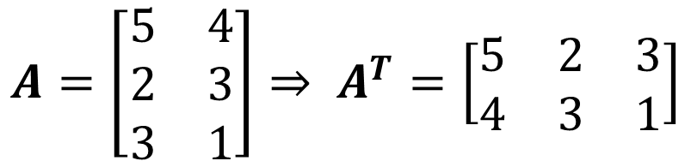

More Matrix Terminology
Diagonal matrix: Matrix in which all non-diagonal elements are zero
Scalar matrix: Diagonal matrix in which all diagonal elements are equal
Identity/Unity matrix: Scalar matrix in which all diagonal elements equal 1
Transpose matrix A^{T} of matrix A obtained by converting rows to columns and columns to rows
$$\left[\begin{matrix}5 & 0 & 0 \\ 0 & 6 & 0 \\ 0 & 0 & 1\end{matrix}\right]$$
$$\left[\begin{matrix}1 & 0 & 0 \\ 0 & 1 & 0 \\ 0 & 0 & 1\end{matrix}\right]$$
$$\left[\begin{matrix}5 & 0 & 0 \\ 0 & 5 & 0 \\ 0 & 0 & 5\end{matrix}\right]$$
$$A=\left[\begin{matrix}5 & 4 \\ 2 & 3 \\ 3 & 1\end{matrix}\right]⇒ A^{T}=\left[\begin{matrix}5 & 2 & 3 \\ 4 & 3 & 1\end{matrix}\right]$$

Slide 15

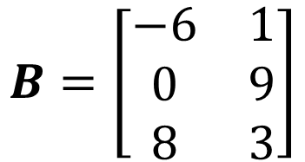

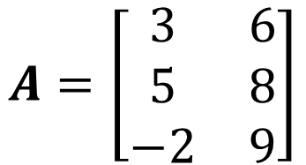
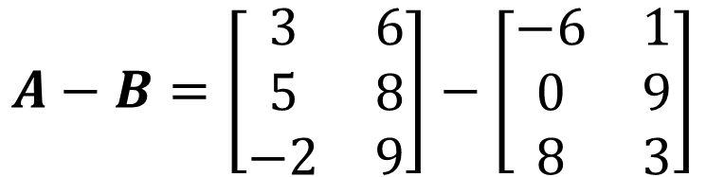

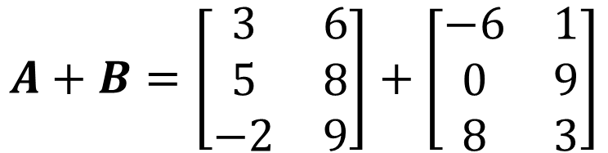

Matrix Operations
$$A=\left[\begin{matrix}3 & 6 \\ 5 & 8 \\ −2 & 9\end{matrix}\right]$$
$$B=\left[\begin{matrix}−6 & 1 \\ 0 & 9 \\ 8 & 3\end{matrix}\right]$$
Addition:
Subtraction:
$$Z=A+B⟺z_{ij}=a_{ij}+b_{ij}$$
$$Z=A−B⟺z_{ij}=a_{ij}−b_{ij}$$
$$A+B=\left[\begin{matrix}3 & 6 \\ 5 & 8 \\ −2 & 9\end{matrix}\right]+\left[\begin{matrix}−6 & 1 \\ 0 & 9 \\ 8 & 3\end{matrix}\right]$$
$$A−B=\left[\begin{matrix}3 & 6 \\ 5 & 8 \\ −2 & 9\end{matrix}\right]−\left[\begin{matrix}−6 & 1 \\ 0 & 9 \\ 8 & 3\end{matrix}\right]$$
$$=\left[\begin{matrix}−3 & 7 \\ 5 & 17 \\ 6 & 12\end{matrix}\right]$$
$$=\left[\begin{matrix}9 & 5 \\ 5 & −1 \\ −10 & 6\end{matrix}\right]$$

Slide 16









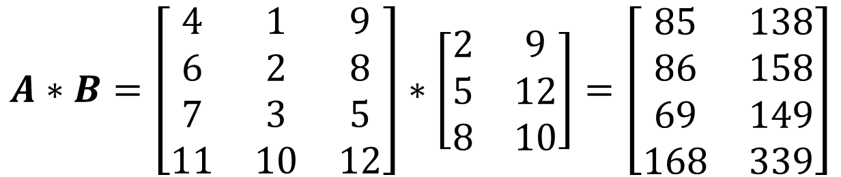


Matrix Operations
Multiplication: $Z=A∗B$ defined if number of columns in $A$ equals the number of rows in $B$
$$Z=A∗B ⟺z_{ij}=a_{i1}∗b_{1j}+a_{i2}∗b_{2j}+a_{i3}∗b_{3j}+…a_{im}∗b_{nj}$$
$$A=\left[\begin{matrix}4 & 1 & 9 \\ 6 & 2 & 8 \\ 7 & 3 & 5 \\ 11 & 10 & 12\end{matrix}\right]$$
$$B=\left[\begin{matrix}2 & 9 \\ 5 & 12 \\ 8 & 10\end{matrix}\right]$$
$$A∗B=\left[\begin{matrix}4 & 1 & 9 \\ 6 & 2 & 8 \\ 7 & 3 & 5 \\ 11 & 10 & 12\end{matrix}\right]∗\left[\begin{matrix}2 & 9 \\ 5 & 12 \\ 8 & 10\end{matrix}\right]=\left[\begin{matrix}85 & 138 \\ 86 & 158 \\ 69 & 149 \\ 168 & 339\end{matrix}\right]$$
$$(4∗2$$
$$+ 1∗5$$
$$+ 9∗8)$$
$$=85$$
$$(4∗9$$
$$+ 1∗12$$
$$+ 9∗10)$$
$$=138$$

Slide 17






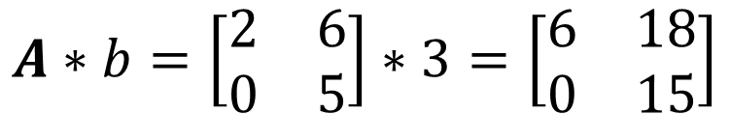

Matrix Operations
Multiplication: $Z=A∗b$ where $b$ is a scalar
$$Z=A∗b ⟺z_{ij}=a_{i1}∗b+a_{i2}∗b+…a_{im}∗b$$
$$A=\left[\begin{matrix}2 & 6 \\ 0 & 5\end{matrix}\right]$$
$$b=3$$
$$A∗b=\left[\begin{matrix}2 & 6 \\ 0 & 5\end{matrix}\right]∗3=\left[\begin{matrix}6 & 18 \\ 0 & 15\end{matrix}\right]$$
$$2∗3=6$$
$$6∗3=18$$
$$0∗3=0$$
$$5∗3=15$$

Slide 18
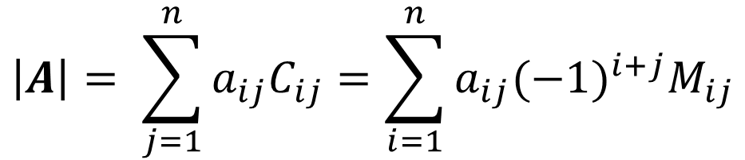
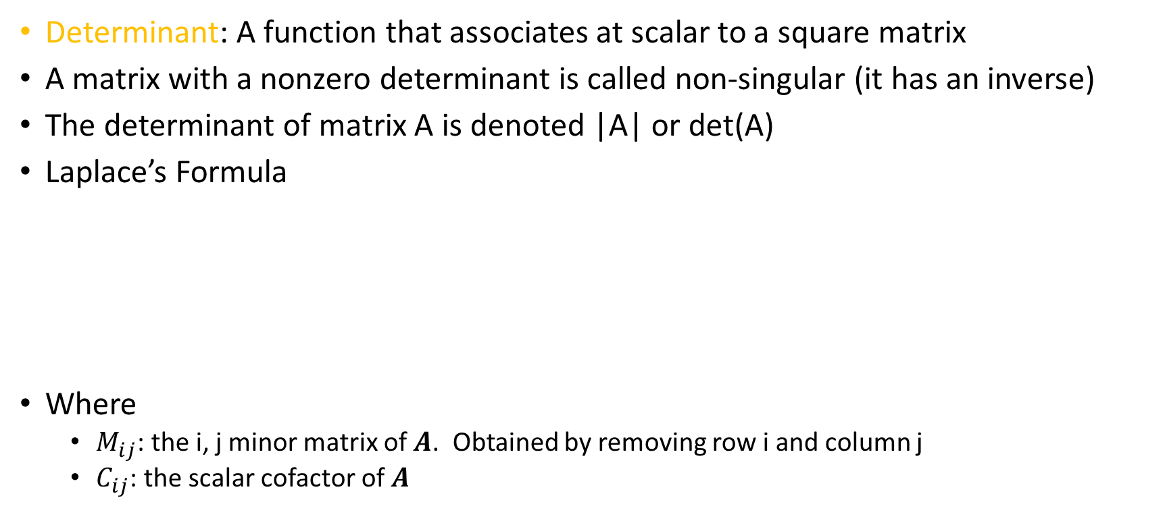
Determinant
Determinant: A function that associates at scalar to a square matrix
A matrix with a nonzero determinant is called non-singular (it has an inverse)
The determinant of matrix A is denoted |A| or det(A)
Laplace’s Formula
Where
$M_{ij}$: the i, j minor matrix of $A$. Obtained by removing row i and column j
$C_{ij}$: the scalar cofactor of $A$
$$\left|A\right|= \sum_{j=1}^{n}{a_{ij}C_{ij}}=\sum_{i=1}^{n}{a_{ij}{(−1)}^{i+j}M_{ij}}$$

Slide 19



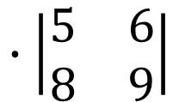

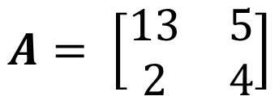

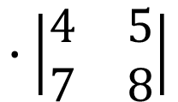

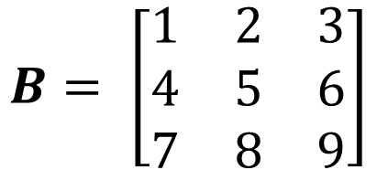

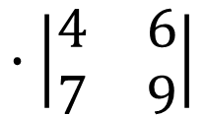

Determinant Example
2 x 2 Matrix
3 x 3 Matrix
$$A= \left[\begin{matrix}13 & 5 \\ 2 & 4\end{matrix}\right]$$
$$B= \left[\begin{matrix}1 & 2 & 3 \\ 4 & 5 & 6 \\ 7 & 8 & 9\end{matrix}\right]$$
$$∙\left|\begin{matrix}5 & 6 \\ 8 & 9\end{matrix}\right|$$
$$∙\left|\begin{matrix}4 & 6 \\ 7 & 9\end{matrix}\right|$$
$$∙\left|\begin{matrix}4 & 5 \\ 7 & 8\end{matrix}\right|$$
$$\left|A\right|=a_{11}a_{22}−a_{12}a_{21}$$
$$\left|B\right|=$$
$$1$$
$$−2$$
$$+3$$
$$\left|B\right|=1∙\left(\left(5∗9\right)−(8∗6)\right)$$
$$−2∙\left(\left(4∗9\right)−(7∗6)\right)$$
$$\left|A\right|=\left(13\right)\left(4\right)−\left(5\right)\left(2\right)=42$$
$$3∙\left(\left(4∗8\right)−\left(7∗5\right)\right)=0$$

Slide 20
PCA Methodology
Step 1: Calculate the mean of each dimension
Step 2: Calculate the variance/covariance matrix
Calculate the variance of each attribute
Calculate the covariance of the attributes
Construct the matrix
Step 3: Compute the Eigenvalues of the covariance matrix and order them from largest to smallest
Step 4: Compute the Eigenvectors of the covariance matrix for the associated with the Eigenvalues
Step 5: Keep terms corresponding to the K largest Eigenvalues

Slide 21
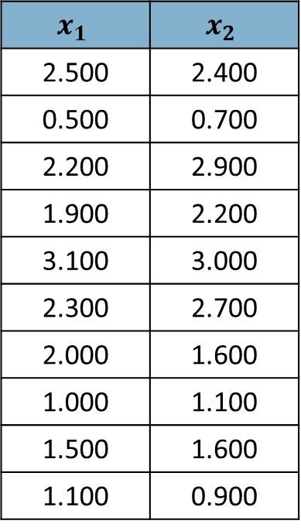
Example Data
$$x_{1}$$ | $$x_{2}$$
2.500 | 2.400
0.500 | 0.700
2.200 | 2.900
1.900 | 2.200
3.100 | 3.000
2.300 | 2.700
2.000 | 1.600
1.000 | 1.100
1.500 | 1.600
1.100 | 0.900

Slide 22
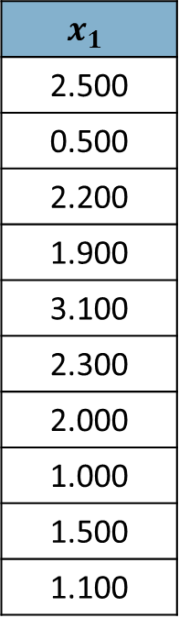
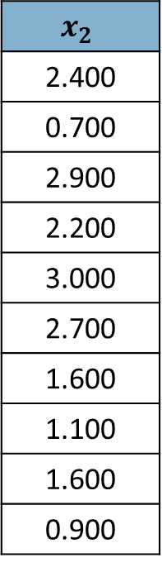
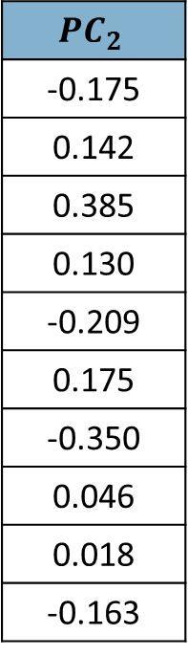
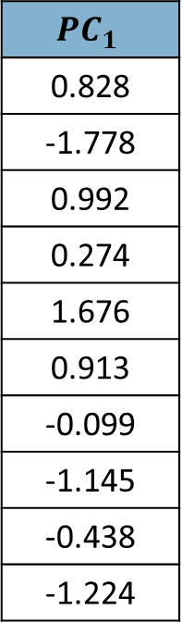
Example Data
$$x_{1}$$
2.500
0.500
2.200
1.900
3.100
2.300
2.000
1.000
1.500
1.100
$$x_{2}$$
2.400
0.700
2.900
2.200
3.000
2.700
1.600
1.100
1.600
0.900
$${PC}_{1}$$
0.828
-1.778
0.992
0.274
1.676
0.913
-0.099
-1.145
-0.438
-1.224
$${PC}_{2}$$
-0.175
0.142
0.385
0.130
-0.209
0.175
-0.350
0.046
0.018
-0.163

Slide 23
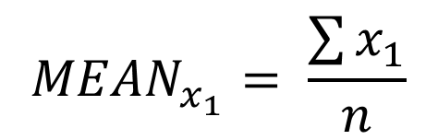
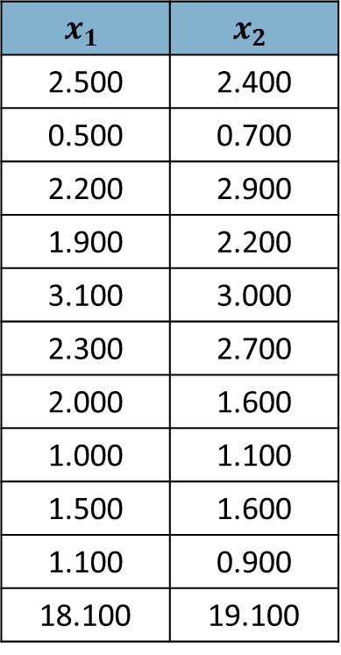

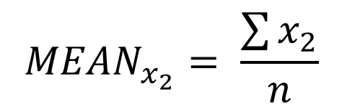
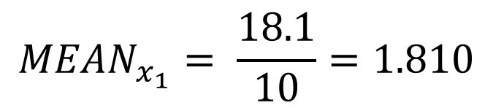
Step 1: Calculate Means
$$x_{1}$$ | $$x_{2}$$
2.500 | 2.400
0.500 | 0.700
2.200 | 2.900
1.900 | 2.200
3.100 | 3.000
2.300 | 2.700
2.000 | 1.600
1.000 | 1.100
1.500 | 1.600
1.100 | 0.900
18.100 | 19.100
$${MEAN}_{x_{1}}= \frac{\sum{x_{1}}}{n}$$
$${MEAN}_{x_{1}}= \frac{18.1}{10}=1.810$$
$${MEAN}_{x_{2}}= \frac{\sum{x_{2}}}{n}$$
$${MEAN}_{x_{2}}= \frac{19.1}{10}=1.910$$
Sum:

Slide 24
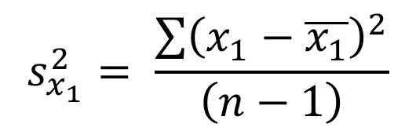
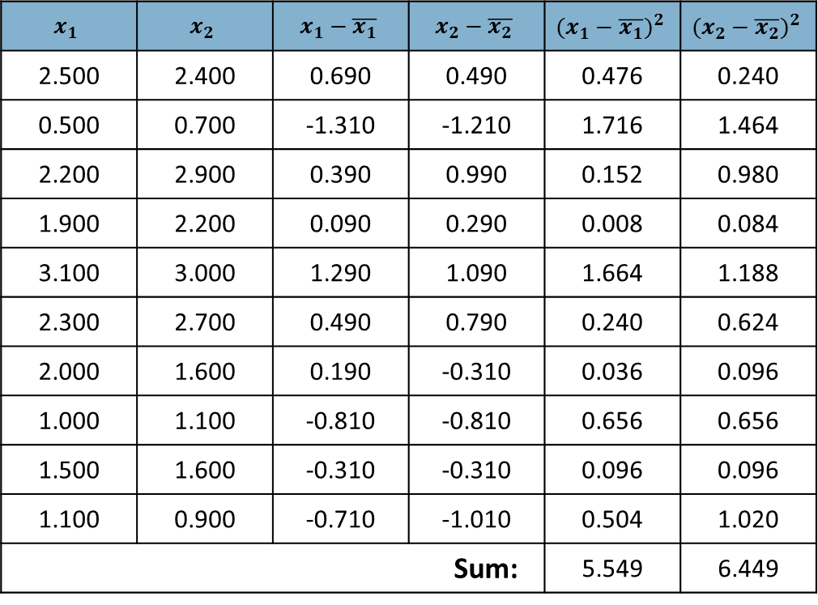
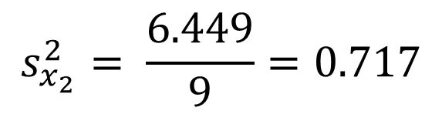
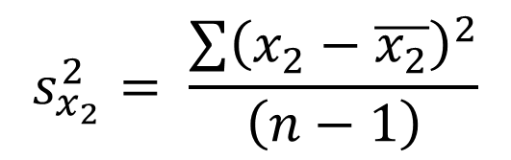
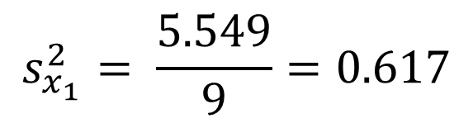
Step 2a: Calculate Variances
$$x_{1}$$ | $$x_{2}$$ | $$x_{1}−\overline{x_{1}}$$ | $$x_{2}−\overline{x_{2}}$$ | $${(x_{1}−\overline{x_{1}})}^{2}$$ | $${(x_{2}−\overline{x_{2}})}^{2}$$
2.500 | 2.400 | 0.690 | 0.490 | 0.476 | 0.240
0.500 | 0.700 | -1.310 | -1.210 | 1.716 | 1.464
2.200 | 2.900 | 0.390 | 0.990 | 0.152 | 0.980
1.900 | 2.200 | 0.090 | 0.290 | 0.008 | 0.084
3.100 | 3.000 | 1.290 | 1.090 | 1.664 | 1.188
2.300 | 2.700 | 0.490 | 0.790 | 0.240 | 0.624
2.000 | 1.600 | 0.190 | -0.310 | 0.036 | 0.096
1.000 | 1.100 | -0.810 | -0.810 | 0.656 | 0.656
1.500 | 1.600 | -0.310 | -0.310 | 0.096 | 0.096
1.100 | 0.900 | -0.710 | -1.010 | 0.504 | 1.020
Sum: |  |  |  | 5.549 | 6.449
$$s_{x_{1}}^{2}= \frac{\sum{{\left(x_{1}−\overline{x_{1}}\right)}^{2}}}{\left(n−1\right)}$$
$$s_{x_{1}}^{2}= \frac{5.549}{9}=0.617$$
$$s_{x_{2}}^{2}= \frac{\sum{{\left(x_{2}−\overline{x_{2}}\right)}^{2}}}{\left(n−1\right)}$$
$$s_{x_{2}}^{2}= \frac{6.449}{9}=0.717$$

Slide 25
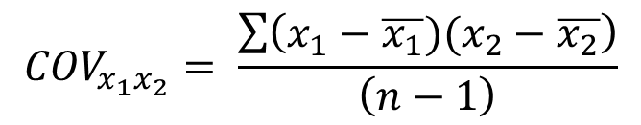
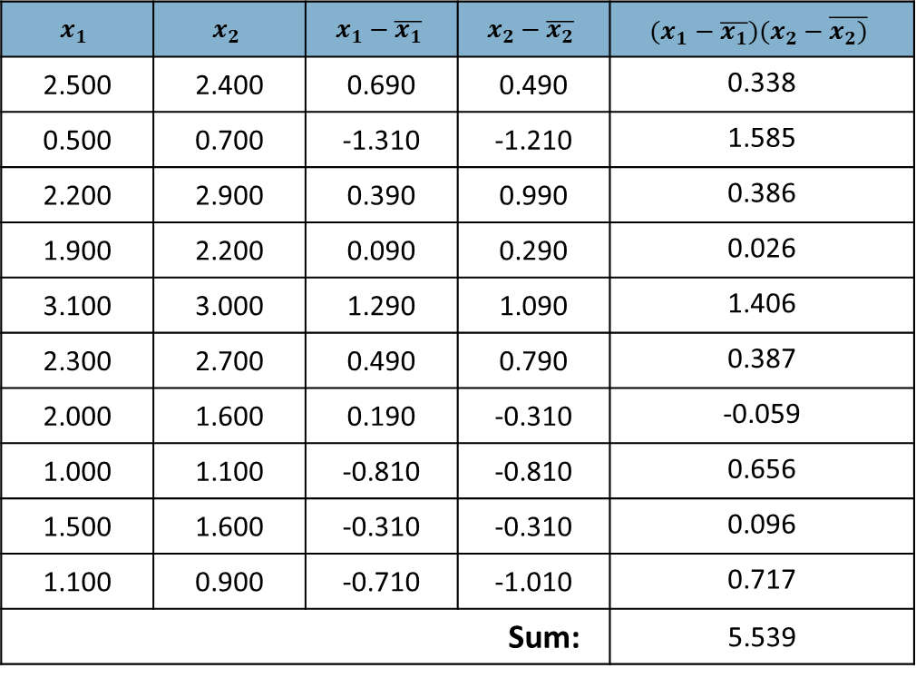
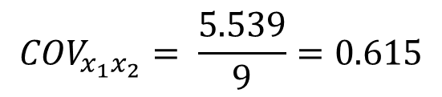
Step 2b: Calculate Covariance
$$x_{1}$$ | $$x_{2}$$ | $$x_{1}−\overline{x_{1}}$$ | $$x_{2}−\overline{x_{2}}$$ | $$(x_{1}−\overline{x_{1}})(x_{2}−\overline{x_{2})}$$
2.500 | 2.400 | 0.690 | 0.490 | 0.338
0.500 | 0.700 | -1.310 | -1.210 | 1.585
2.200 | 2.900 | 0.390 | 0.990 | 0.386
1.900 | 2.200 | 0.090 | 0.290 | 0.026
3.100 | 3.000 | 1.290 | 1.090 | 1.406
2.300 | 2.700 | 0.490 | 0.790 | 0.387
2.000 | 1.600 | 0.190 | -0.310 | -0.059
1.000 | 1.100 | -0.810 | -0.810 | 0.656
1.500 | 1.600 | -0.310 | -0.310 | 0.096
1.100 | 0.900 | -0.710 | -1.010 | 0.717
Sum: |  |  |  | 5.539
$${COV}_{x_{1}x_{2}}= \frac{\sum{\left(x_{1}−\overline{x_{1}})(x_{2}−\overline{x_{2}}\right)}}{\left(n−1\right)}$$
$${COV}_{x_{1}x_{2}}= \frac{5.539}{9}=0.615$$

Slide 26
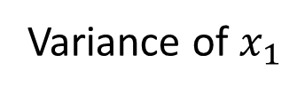
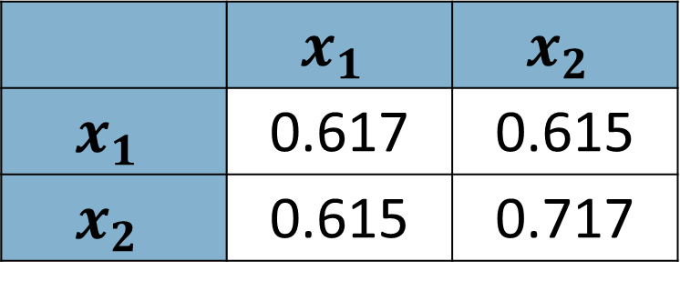
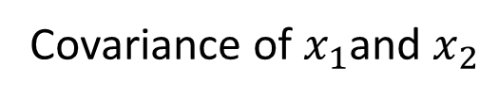
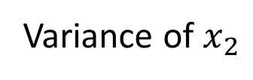
Step 2c: Construct Variance/Covariance Matrix
Variance of $x_{1}$
 | $$x_{1}$$ | $$x_{2}$$
$$x_{1}$$ | 0.617 | 0.615
$$x_{2}$$ | 0.615 | 0.717
Variance of $x_{2}$
Covariance of $x_{1}$and $x_{2}$

Slide 27
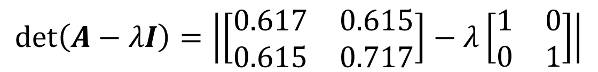
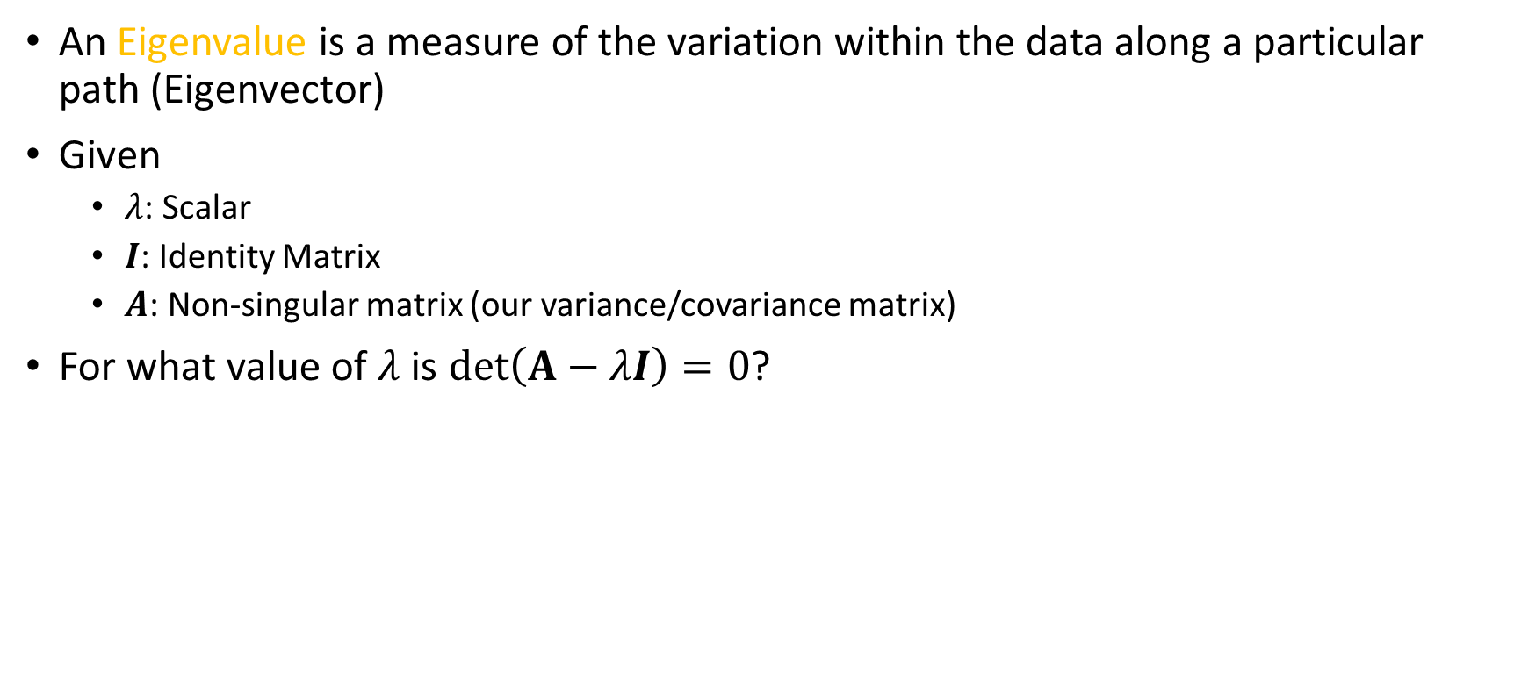
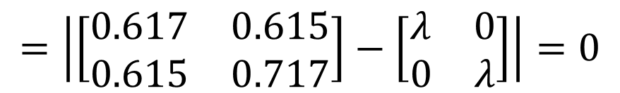
Step 3: Compute Eigenvalues
An Eigenvalue is a measure of the variation within the data along a particular path (Eigenvector)
Given
$λ$: Scalar
$I$: Identity Matrix
$A$: Non-singular matrix (our variance/covariance matrix)
For what value of $λ$ is $det\left(A−λI\right)=0$?
$$\det\left(A−λI\right)=\left|\left[\begin{matrix}0.617 & 0.615 \\ 0.615 & 0.717\end{matrix}\right]−λ\left[\begin{matrix}1 & 0 \\ 0 & 1\end{matrix}\right]\right|$$
$$=\left|\left[\begin{matrix}0.617 & 0.615 \\ 0.615 & 0.717\end{matrix}\right]−\left[\begin{matrix}λ & 0 \\ 0 & λ\end{matrix}\right]\right|=0$$

Slide 28


Step 3: Compute Eigenvalues
$$=\left|\left[\begin{matrix}0.617−λ & 0.615 \\ 0.615 & 0.717−λ\end{matrix}\right]\right|=0$$
F
L
$$=\left(0.617−λ\right)\left(0.717−λ\right)−{0.615}^{2}=0$$
Characteristic Equation
I
O
$$=\left(0.442\right)−\left(0.617λ\right)−\left(0.717λ\right)+λ^{2}−{0.615}^{2}=0$$
F
O
I
L
$$=λ^{2}−1.333λ+0.063=0$$

Slide 29







Step 3: Compute Eigenvalues
$$=λ^{2}−1.333λ+0.063=0$$
$$a=1$$
$$\frac{−b±\sqrt{b^{2}−4ac}}{2a}=0$$
$$b=−1.333$$
$$c=0.063$$
$$λ_{1}=\frac{−\left(−1.333\right)+\sqrt{{(−1.333)}^{2}−4(1)(0.063)}}{2(1)}=1.284$$
$$λ_{2}=\frac{−\left(−1.333\right)−\sqrt{{(−1.333)}^{2}−4(1)(0.063)}}{2(1)}=0.050$$

Slide 30



Observation
$$A=\left[\begin{matrix}0.617 & 0.615 \\ 0.615 & 0.717\end{matrix}\right]$$
$$trace\left(A\right)=\left(0.617+0.717\right)=1.334$$
$${(λ}_{1}+λ_{2})=\left(1.284+0.050\right)=1.334$$
You can write Eigenvalues as a percentage of trace(A)
$$\frac{λ_{1}}{trace(A)}∗100=\frac{1.284}{1.334}∗100=96.25\%$$
$$\frac{λ_{2}}{trace(A)}∗100=\frac{0.050}{1.334}∗100=3.75\%$$
The largest Eigenvalue ($λ_{1}$) is referred to as the principal Eigenvalue

Slide 31

Another Observation
The product of the Eigenvalues is the determinant of the matrix
$$A=\left[\begin{matrix}0.617 & 0.615 \\ 0.615 & 0.717\end{matrix}\right]$$
$$det\left(A\right)=\left(0.617∗0.717\right)−(0.615∗0.615)=0.064$$
$${(λ}_{1}∗λ_{2})=\left(1.284∗0.050\right)=0.064$$

Slide 32


Step 4: Calculate Eigenvectors
An Eigenvector is the magnitude and direction of a path through the data
For each Eigenvalue $λ_{i}$, there is a set of associated Eigenvectors
The number of Eigenvectors in the set is infinite
Eigenvectors corresponding to different Eigenvalues are linearly independent
Given $λ_{i}$, find a vector $\vec{Z}$such that $\left(A−λ_{i}I\right)\vec{Z}=0$
$$A−λI=\left[\begin{matrix}0.617−λ & 0.615 \\ 0.615 & 0.717−λ\end{matrix}\right]$$

Slide 33






Step 4: Calculate Eigenvectors
Consider $λ_{1}=1.284$
$$A−λ_{1}I=A−1.284I=\left[\begin{matrix}0.617−1.284 & 0.615 \\ 0.615 & 0.717−1.284\end{matrix}\right]$$
$$=\left[\begin{matrix}−0.667 & 0.615 \\ 0.615 & −0.567\end{matrix}\right]$$
$$\left(A−λ_{1}I\right)\vec{Z}=0⇒\left[\begin{matrix}−0.667 & 0.615 \\ 0.615 & −0.567\end{matrix}\right]\left[\begin{matrix}z_{1} \\ z_{2}\end{matrix}\right]=\left[\begin{matrix}0 \\ 0\end{matrix}\right]$$
$$−0.667z_{1}+0.615z_{2}=0$$
$$z_{1}$$ | 0.922 | 1.844 | 2.766 | …
$$z_{2}$$ | 1 | 2 | 3 | …
$$z_{1}=0.922z_{2}$$
$$0.615z_{1}+(−0.567)z_{2}=0$$

Slide 34







Step 4: Calculate Eigenvectors
Consider $λ_{2}=0.050$
$$A−λ_{2}I=A−0.050I=\left[\begin{matrix}0.617−0.050 & 0.615 \\ 0.615 & 0.717−0.050\end{matrix}\right]$$
$$=\left[\begin{matrix}0.567 & 0.615 \\ 0.615 & 0.667\end{matrix}\right]$$
$$\left(A−λ_{1}I\right)\vec{Z}=0⇒\left[\begin{matrix}0.567 & 0.615 \\ 0.615 & 0.667\end{matrix}\right]\left[\begin{matrix}z_{1} \\ z_{2}\end{matrix}\right]=\left[\begin{matrix}0 \\ 0\end{matrix}\right]$$
$$0.567z_{1}+0.615z_{2}=0$$
$$z_{1}$$ | -1.085 | -2.170 | -3.255 | …
$$z_{2}$$ | 1 | 2 | 3 | …
$$−z_{1}=1.085z_{2}$$
$$0.615z_{1}+0.667z_{2}=0$$

Slide 35









Normalizing Eigenvectors
$$[z_{1s},z_{2s}]=\frac{[z_{1}, z_{2}]}{\sqrt{z_{1}^{2}+z_{2}^{2}}}$$
Dealing with infinite sets is difficult
Statistical packages typically normalize Eigenvectors
$$z_{1s}=\frac{z_{1}}{\sqrt{z_{1}^{2}+z_{2}^{2}}}=\frac{0.922}{\sqrt{{0.922}^{2}+1^{2}}}=0.678$$
$$z_{1}$$ | 0.922 | 1.844 | 2.766 | …
$$z_{2}$$ | 1 | 2 | 3 | …
$$λ_{1}$$
$$z_{2s}=\frac{z_{2}}{\sqrt{z_{1}^{2}+z_{2}^{2}}}=\frac{1}{\sqrt{{0.922}^{2}+1^{2}}}=0.735$$
$$z_{1s}=\frac{z_{1}}{\sqrt{z_{1}^{2}+z_{2}^{2}}}=\frac{−1.085}{\sqrt{{−1.085}^{2}+1^{2}}}=−0.735$$
$$z_{1}$$ | -1.085 | -2.170 | -3.255 | …
$$z_{2}$$ | 1 | 2 | 3 | …
$$λ_{2}$$
$$z_{2s}=\frac{x_{2}}{\sqrt{z_{1}^{2}+z_{2}^{2}}}=\frac{1}{\sqrt{{−1.085}^{2}+1^{2}}}=0.678$$

Slide 36
Eigenvalues and Eigenvectors
For our example:
It is clear that PC1 is associated with significantly more variation than PC2
Discarding PC2 allows us to reduce dimensions (2 → 1) and doesn’t cost us much information
In an example with two dimensions this is easy… what if we had two hundred dimensions? How many should we keep?
Component | Eigenvalue | Normalized Eigenvectors
PC1 | 1.284 | 0.678 | 0.735
PC2 | 0.050 | -0.735 | 0.678

Slide 37


Choosing K
There are two common approaches for choosing how many principal components to keep
Threshold – Determine how much of the information you want to retain, keep enough components to satisfy that threshold
Scree Plot – Order Eigenvalues in descending order
and plot the kth Eigenvalue against k
$$\frac{\sum_{i=1}^{K}{λ_{i}}}{trace}>Threshold (e.g., 0.9 or 0.95)$$

Slide 38


Calculating Principal Component Values
New reduced dimension are created by multiplying the matrix of retained Eigenvectors by a matrix of the original dimensions minus their means
$$x_{1}$$ | $$x_{2}$$ | $$x_{1}−\overline{x_{1}}$$ | $$x_{2}−\overline{x_{2}}$$
2.500 | 2.400 | 0.690 | 0.490
0.500 | 0.700 | -1.310 | -1.210
2.200 | 2.900 | 0.390 | 0.990
1.900 | 2.200 | 0.090 | 0.290
3.100 | 3.000 | 1.290 | 1.090
2.300 | 2.700 | 0.490 | 0.790
2.000 | 1.600 | 0.190 | -0.310
1.000 | 1.100 | -0.810 | -0.810
1.500 | 1.600 | -0.310 | -0.310
1.100 | 0.900 | -0.710 | -1.010
Dimensions
Eigenvector
Component
$$\left[\begin{matrix}0.69 & 0.49 \\ −1.31 & −1.21 \\ 0.39 & 0.99 \\ 0.09 & 0.29 \\ 1.29 & 1.09 \\ 0.49 & 0.79 \\ 0.19 & −0.31 \\ −0.81 & −0.81 \\ −0.31 & −0.31 \\ −0.71 & −1.01\end{matrix}\right]∙\left[\begin{matrix}0.6779 \\ 0.7352\end{matrix}\right]=\left[\begin{matrix}0.828 \\ −1.778 \\ 0.992 \\ 0.274 \\ 1.676 \\ 0.913 \\ −0.099 \\ −1.145 \\ −0.438 \\ −1.224\end{matrix}\right]$$

Slide 39



Calculating a Component Matrix (Loadings)
Loadings are Eigenvectors normalized to their respective Eigenvalues
Loadings generally tell you how strongly a given independent variable is associated with a given component
General Formula is:
For our example:
$$L_{x_{i}, {PC}_{j}}=z_{i}∗\sqrt{λ_{j}}$$
 | PC1 | PC2
 | $$λ_{1}=1.284$$ $$z_{1}=0.678$$ $$z_{2}=0.735$$ | $$λ_{2}=0.050$$ $$z_{1}=−0.735$$ $$z_{2}=0.678$$
x1 | $$L_{x_{1},{PC}_{1}}=z_{1}∗\sqrt{λ_{1}}$$ | $$L_{x_{1},{PC}_{2}}=z_{1}∗\sqrt{λ_{2}}$$
x2 | $$L_{x_{2},{PC}_{1}}=z_{2}∗\sqrt{λ_{1}}$$ | $$L_{x_{2},{PC}_{2}}=z_{2}∗\sqrt{λ_{2}}$$
 | PC1 | PC2
x1 | 0.768 | -0.163
x2 | 0.833 | 0.150
Unstandardized → $L_{std}=\frac{L}{\sqrt{S_{i}^{2}}}$

Slide 40
A Note on PCA and Classification
PCA works well when the target variable is interval
If the target is nominal, care must be used if PCA will be employed on the independent variables
Projection axes chosen by PCA may not give good discrimination power
PCA maintains what is common in the data, not what differentiates them
Thus, PCA may reduce the efficacy of classification algorithms if not used with care
Linear discriminant analysis may be advisable in these situations

Slide 41
Some Issues
Covariance is sensitive to large values
Dimensions with large scales dominate
Such dimensions are likely to become principal components
Normalization can help reduce this issue
PCA assumes the underlying subspace is linear and thus transformations may be required

Slide 42
Some Useful Resources
Eigenvalue and Eigenvector Calculator
Principal Component Analysis 4 Dummies: Eigenvectors, Eigenvalues and Dimension Reduction

