Slide 1
Naïve Bayes
DSCI 4520
Introduction to Data Mining
Russell R. Torres

Slide 2
But to us, probability is the very guide of life.
Bishop Joseph Butler

Slide 3
Probability
Probability: a numerical measurement of the likelihood of an event occurring
Probabilities range from
0: We are certain the event will not occur
1: We are certain the event will occur
We often use probabilities to reduce uncertainty in decision making
Should I take that class?
What is the probability that I will get an A?
Should I speed while driving?
What is the probability I will get a ticket?
Should my company extend a loan to that customer?
What is the probability they will not default?

Slide 4
Probability
Probability can be applied to discrete or continuous variables
Discrete variables – Have a finite number of values
Nominal variables are discrete
Ex. State in which a customer may live
Continuous variables – Have an infinite number of possible values
Interval variables are continuous
Ex. Outstanding debt held by a customer
We will focus on discrete probabilities, but naïve bayes can be applied to either type of data

Slide 5
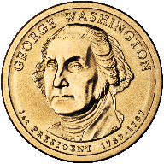
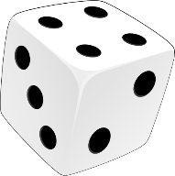



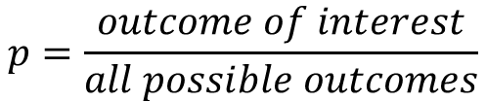

Calculating Discrete Probabilities
$$p=\frac{outcome of interest}{all possible outcomes}$$
$$p\left(heads\right)=\frac{1}{2}=0.5$$
$$p\left(1 or 6\right)=\frac{2}{6}=0.333$$
$$p\left(club\right)=\frac{13}{52}=0.25$$

Slide 6
Statistical Independence
We are often concerned with patterns of events
Sometimes the occurrence of one event influences the likelihood of another event
Consider a customer making purchases
Chips & Salsa
Hot dogs & hot dog buns
Lettuce & DVD player
This same notion of relationships among events often occurs in our datasets
$$P\left(purchase\right)=f(Income+Homeowner+…+Carowner)$$

Slide 7

Joint Probabilities
If events A and B are statistically independent, the probability of both events occurring is equal to the product of their individual probabilities
$$P\left(A∩B\right)=P\left(A\right)∗P(B)$$
?
?
Coin 1
Coin 2
$$P\left({Heads}_{Coin1}∩{Heads}_{Coin2}\right)=P\left({Heads}_{Coin1}\right)∗P({Heads}_{Coin2})$$
$$P\left({Heads}_{Coin1}∩{Heads}_{Coin2}\right)=0.5∗0.5=0.25$$

Slide 8

Conditional Probabilities
If events A and B are statistically independent, the probability of event B occurring given that event A has already occurred is equal to the probability of event B
$$P\left(B|A\right)=P\left(B\right)$$
Probability of me buying a DVD player(b) has nothing to do with lettuce (a)
?
Coin 1
Coin 2
$$P\left({Heads}_{Coin2}|{Heads}_{Coin1}\right)=P({Heads}_{Coin2})$$
$$P\left({Heads}_{Coin2}|{Heads}_{Coin1}\right)=0.5$$

Slide 9

Naïve Bayes
Naïve Bayes is a type of Bayesian classifier
Bayesian classifiers use a probabilistic approach to identify to what class a given observation belongs
Examine existing evidence
For each dependent variable level (class), compute probability
Choose the class with the largest probability
$$\hat{y}=⁡\operatorname{argmax}{P\left(y|x\right)}$$

Slide 10
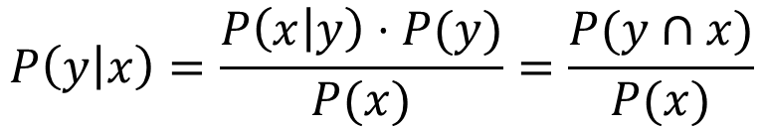
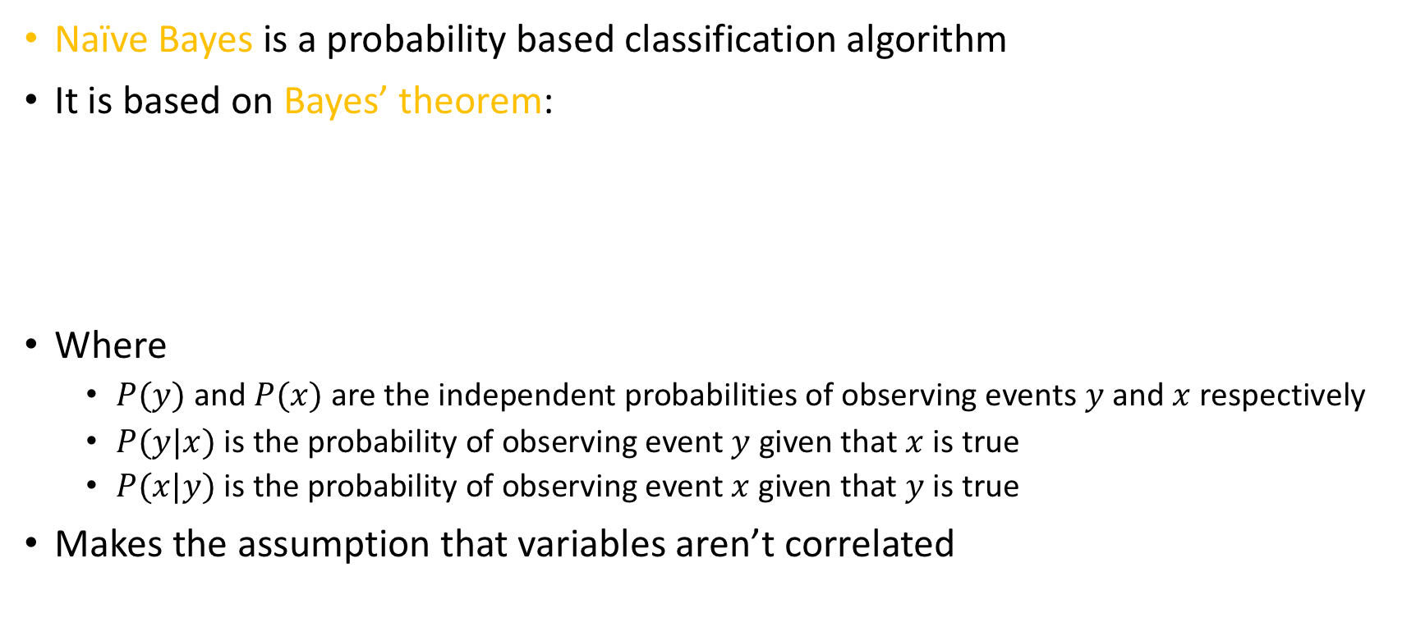
Naïve Bayes
Naïve Bayes is a probability based classification algorithm
It is based on Bayes’ theorem:
Where
$P(y)$ and $P(x)$ are the independent probabilities of observing events $y$ and $x$ respectively
$P(y|x)$ is the probability of observing event $y$ given that $x$ is true
$P(x|y)$ is the probability of observing event $x$ given that $y$ is true
Makes the assumption that variables aren’t correlated
$$P\left(y | x\right)=\frac{P\left(x | y\right)⋅P(y)}{P(x)}=\frac{P(y∩x)}{P(x)}$$

Slide 11

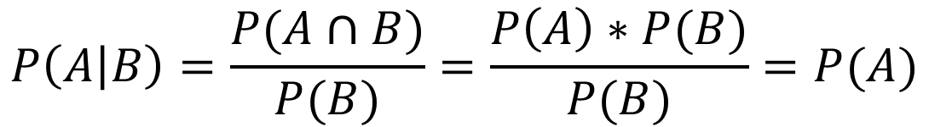
Assumptions of Naïve Bayes
Naïve Bayes is called “naïve” because it relies on the assumption that predictors are statistically independent
This is generally not the case
Predictors almost always have some degree of correlation with one another
Remember that if A and B are independent:
This is relevant due to the way the algorithm works…
$$P\left(A∩B\right)=P\left(A\right)∗P(B)$$
$$P\left(A | B\right)=\frac{P(A∩B)}{P(B)}=\frac{P\left(A\right)∗P(B)}{P(B)}=P(A)$$

Slide 12

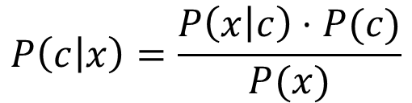
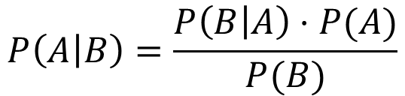
Probabilistic Modeling using Naïve Bayes
Where
$P(c|x)$ is the posterior probability of a class given a predictor
$P(c)$ is the class prior probability
$P(x|c)$ is the likelihood of the predictor given a class
$P(x)$ is the predictor prior probability (Not always available)
$x$is one or more predictors
Bayes’ Theorem
Naïve Bayes
$$P\left(A | B\right)=\frac{P\left(B | A\right)⋅P(A)}{P(B)}$$
$$P\left(c | x\right)=\frac{P\left(x | c\right)⋅P(c)}{P(x)}$$
$$P\left(c | x\right)=P\left(x_{1} | c\right)⋅P\left(x_{2} | c\right)⋅…⋅P\left(x_{n} | c\right)⋅P(c)$$

Slide 13
An Example of Naïve Bayes Classification
Outlook | Temp | Humidity | Windy | Play?
Sunny | Hot | High | False | No
Sunny | Hot | High | True | No
Overcast | Hot | High | False | Yes
Rainy | Mild | High | False | Yes
Rainy | Cool | Normal | False | Yes
Rainy | Cool | Normal | True | No
Overcast | Cool | Normal | True | Yes
Sunny | Mild | High | False | No
Sunny | Cool | Normal | False | Yes
Rainy | Mild | Normal | False | Yes
Sunny | Mild | Normal | True | Yes
Overcast | Mild | High | True | Yes
Overcast | Hot | Normal | False | Yes
Rainy | Mild | High | True | No
Task: Develop a decision to predict if John will play tennis
9 Yes
5 No
14 Total

Slide 14




Calculating Probability
Outlook | Play?
Sunny | No
Sunny | No
Overcast | Yes
Rainy | Yes
Rainy | Yes
Rainy | No
Overcast | Yes
Sunny | No
Sunny | Yes
Rainy | Yes
Sunny | Yes
Overcast | Yes
Overcast | Yes
Rainy | No
$$P\left(x | c\right)=P\left(Sunny | Yes\right)=\frac{2}{9}=0.22$$
Outlook | Yes | No
Sunny | 2/9 | 3/5 | 5/14
Overcast | 4/9 | 0/5 | 4/14
Rainy | 3/9 | 2/5 | 5/14
 | 9/14 | 5/14
$$P\left(x\right)=P\left(Sunny\right)=\frac{5}{14}=0.36$$
$$P(c)=P(Yes)=\frac{9}{14}=0.64$$
$$P\left(c | x\right)=P\left(Yes | Sunny\right)=\frac{0.22×0.64 }{0.36}=0.49$$

Slide 15
Example of Naïve Bayes Prediction
Outlook | Yes | No
Sunny | 2/9 | 3/5 | 5/14
Overcast | 4/9 | 0/5 | 4/14
Rainy | 3/9 | 2/5 | 5/14
 | 9/14 | 5/14
Temp | Yes | No
Hot | 2/9 | 2/5 | 4/14
Mild | 4/9 | 2/5 | 6/14
Cool | 3/9 | 1/5 | 4/14
 | 9/14 | 5/14
Humidity | Yes | No
High | 3/9 | 4/5 | 6/14
Normal | 6/9 | 1/5 | 8/14
 | 9/14 | 5/14
Windy | Yes | No
True | 3/9 | 3/5 | 6/14
False | 6/9 | 2/5 | 8/14
 | 9/14 | 5/14

Slide 16

Likelihood of Yes
Outlook | Temp | Humidity | Windy | Play?
Sunny | Cool | High | True | ?
$${Likelihood}_{Yes}=P_{Outlook}(Sunny|Yes)⋅P_{Temp}(Cool|Yes)⋅P_{Humidity}(High|Yes)⋅P_{Windy}(True|Yes)⋅P(Yes)$$
$${Likelihood}_{Yes}=\frac{2}{9}⋅\frac{3}{9}⋅\frac{3}{9}⋅\frac{3}{9}⋅\frac{9}{14}=0.005291$$
Outlook | Yes | No
Sunny | 2/9 | 3/5 | 5/14
Overcast | 4/9 | 0/5 | 4/14
Rainy | 3/9 | 2/5 | 5/14
 | 9/14 | 5/14
Temp | Yes | No
Hot | 2/9 | 2/5 | 4/14
Mild | 4/9 | 2/5 | 6/14
Cool | 3/9 | 1/5 | 4/14
 | 9/14 | 5/14
Humidity | Yes | No
High | 3/9 | 4/5 | 7/14
Normal | 6/9 | 1/5 | 7/14
 | 9/14 | 5/14
Windy | Yes | No
True | 3/9 | 3/5 | 6/14
False | 6/9 | 2/5 | 8/14
 | 9/14 | 5/14

Slide 17

Likelihood of No
Outlook | Temp | Humidity | Windy | Play?
Sunny | Cool | High | True | ?
$${Likelihood}_{No}=P_{Outlook}(Sunny|No)⋅P_{Temp}(Cool|No)⋅P_{Humidity}(High|No)⋅P_{Windy}(True|No)⋅P(No)$$
$${Likelihood}_{No}=\frac{3}{5}⋅\frac{1}{5}⋅\frac{3}{5}⋅\frac{4}{5}⋅\frac{5}{14}=0.020571$$
Outlook | Yes | No
Sunny | 2/9 | 3/5 | 5/14
Overcast | 4/9 | 0/5 | 4/14
Rainy | 3/9 | 2/5 | 5/14
 | 9/14 | 5/14
Temp | Yes | No
Hot | 2/9 | 2/5 | 4/14
Mild | 4/9 | 2/5 | 6/14
Cool | 3/9 | 1/5 | 4/14
 | 9/14 | 5/14
Humidity | Yes | No
High | 3/9 | 4/5 | 7/14
Normal | 6/9 | 1/5 | 7/14
 | 9/14 | 5/14
Windy | Yes | No
True | 3/9 | 3/5 | 6/14
False | 6/9 | 2/5 | 8/14
 | 9/14 | 5/14

Slide 18

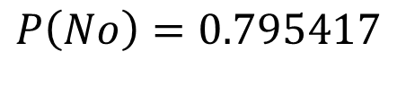
Standardization
$$P\left(Yes\right)= \frac{{Likelihood}_{Yes}}{{Likelihood}_{Yes}+{Likelihood}_{No}}=\frac{0.005291}{0.005291+0.020571}$$
$$P\left(Yes\right)=0.204583$$
$$P\left(No\right)= \frac{{Likelihood}_{No}}{{Likelihood}_{Yes}+{Likelihood}_{No}}=\frac{0.015429}{0.005291+0.020571}$$
$$P\left(No\right)=0.795417$$

Slide 19
What about Overcast Days?
Outlook | Yes | No
Sunny | 2/9 | 3/5 | 5/14
Overcast | 4/9 | 0/5 | 4/14
Rainy | 3/9 | 2/5 | 5/14
 | 9/14 | 5/14
This is a problem!
Temp | Yes | No
Hot | 2/9 | 2/5 | 4/14
Mild | 4/9 | 2/5 | 6/14
Cool | 3/9 | 1/5 | 4/14
 | 9/14 | 5/14
Humidity | Yes | No
High | 3/9 | 4/5 | 7/14
Normal | 6/9 | 1/5 | 7/14
 | 9/14 | 5/14
Windy | Yes | No
True | 3/9 | 3/5 | 6/14
False | 6/9 | 2/5 | 8/14
 | 9/14 | 5/14

Slide 20

Likelihood of Overcast No
Outlook | Temp | Humidity | Windy | Play?
Overcast | Cool | High | True | ?
$${Likelihood}_{No}=P_{Outlook}(Overcast|No)⋅P_{Temp}(Cool|No)⋅P_{Humidity}(High|No)⋅P_{Windy}(True|No)⋅P(No)$$
$${Likelihood}_{No}=\frac{0}{5}⋅\frac{1}{5}⋅\frac{3}{5}⋅\frac{3}{5}⋅\frac{5}{14}=0.0$$
Outlook | Yes | No
Sunny | 2/9 | 3/5 | 5/14
Overcast | 4/9 | 0/5 | 4/14
Rainy | 3/9 | 2/5 | 5/14
 | 9/14 | 5/14
Temp | Yes | No
Hot | 2/9 | 2/5 | 4/14
Mild | 4/9 | 2/5 | 6/14
Cool | 3/9 | 1/5 | 4/14
 | 9/14 | 5/14
Humidity | Yes | No
High | 3/9 | 3/5 | 6/14
Normal | 6/9 | 2/5 | 8/14
 | 9/14 | 5/14
Windy | Yes | No
True | 3/9 | 3/5 | 6/14
False | 6/9 | 2/5 | 8/14
 | 9/14 | 5/14

Slide 21
Zero Frequency Problem
If a given scenario for a single predictor has not been observed, its frequency is zero
Therefore the likelihood associated with the overall scenario is estimated at zero, regardless of what other predictors suggest
The solution is to prevent zero frequencies
Variety of possible solutions exist
Most common is Laplace smoothing – add a small positive number to all frequencies (almost always 1) ASSURES WE WILL NEVER HAVE A ZERO

Slide 22
Laplace Smoothing
Original
Step 1
Step 2
Outlook | Yes | No
Sunny | 2/9 | 3/5 | 5/14
Overcast | 4/9 | 0/5 | 4/14
Rainy | 3/9 | 2/5 | 5/14
 | 9/14 | 5/14
Outlook | Yes | No
Sunny | 2+1=3 | 3+1=4
Overcast | 4+1=5 | 0+1=1
Rainy | 3+1=4 | 2+1=3
Outlook | Yes | No
Sunny | 3 | 4 | 3+4=7
Overcast | 5 | 1 | 5+1=6
Rainy | 4 | 3 | 4+3=7
 | 3+5+4=12 | 4+1+3=8
Step 3
Smoothed
Outlook | Yes | No
Sunny | 3/12 | 4/8 | 7
Overcast | 5/12 | 1/8 | 6
Rainy | 4/12 | 3/8 | 7
 | 12 | 8 | 12+8=20
Outlook | Yes | No
Sunny | 3/12 | 4/8 | 7/20
Overcast | 5/12 | 1/8 | 6/20
Rainy | 4/12 | 3/8 | 7/20
 | 12/20 | 8/20

Slide 23
Zero Frequency Problem
Outlook | Yes | No
Sunny | 3/12 | 4/8 | 7/20
Overcast | 5/12 | 1/8 | 6/20
Rainy | 4/12 | 3/8 | 7/20
 | 12/20 | 8/20
Temp | Yes | No
Hot | 3/12 | 3/8 | 6/20
Mild | 5/12 | 3/8 | 8/20
Cool | 4/12 | 2/8 | 6/20
 | 12/20 | 8/20
Humidity | Yes | No
High | 4/11 | 5/7 | 9/18
Normal | 7/11 | 2/7 | 9/18
 | 11/18 | 7/18
Windy | Yes | No
True | 4/11 | 4/7 | 8/18
False | 7/11 | 3/7 | 10/18
 | 11/18 | 7/18

Slide 24
Advantages and Disadvantages
Advantages
Disadvantages
Easy to build
Easy to understand
Fast/useful for large datasets
Robust to irrelevant features
Handles both nominal and interval data
Assumes (often incorrectly) independence of features

