Slide 1
Neural Networks
DSCI 4520
Introduction to Data Mining
Russell R. Torres

Slide 2
Computers will overtake humans with AI at some [point] within the next 100 years. When that happens, we need to make sure the computers have goals aligned with ours.
Stephen Hawking

Slide 3

What comes to mind when you think about AI?

Slide 4
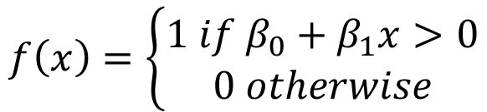
Neural Networks
Neural Networks are a mysterious and powerful modeling technique
They have a long history but we still have much to learn about their design and application
Origins in the 1950’s at the dawn of machine learning (perceptron)
Fell out of favor due to inability to predict complex situations
Reborn in 1980’s after perceptrons were linked together for predictions
Fell out of favor again due to a limited number of experts who could make them work
Reborn again in 2010’s with improved understanding and increased computing power
$$f\left(x\right)=\left\{\begin{aligned}1 if β_{0}+β_{1}x>0 \\ 0 otherwise\end{aligned}\right.$$

Slide 5
What are Neural Networks
Neural networks learn by example
Model “learns” the structure of the data from a representative sample
The user needs to have some
Heuristic knowledge of how to select/prepare data
How to select an appropriate neural network
How to interpret the results
But, user knowledge for successfully building neural networks is lower than it might be for other techniques
Uses a series of weights and hidden neurons to detect complex relationships
Can perform well in the presence of complicated, noisy, and/or imprecise data
Appropriate for – classification, regression, time series analysis and clustering

Slide 6
Artificial Neural Networks
“Artificial” indicates that neural networks are a (poor) approximation of real, biological neural networks
Neural networks are useful for data mining and decision-support applications
People are good at generalizing from experience
Computers excel at following explicit instructions over and over
Neural networks bridge this gap by modeling, on a computer, the neural behavior of human brains

Slide 7


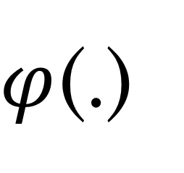


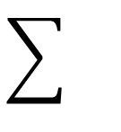



The Perceptron: A Mathematical Neuron
$$X_{1}$$
$$w_{1}$$
$φ$(.)
$$X_{2}$$
$$w_{2}$$
$$Y$$
$$X_{3}$$
$$w_{3}$$
Input
Combination
Activation
Output
$$φ(b+w_{1}X_{1}+ w_{2}X_{2}+w_{3}X_{3})=Y$$
This is equivalent to Logistic Regression

Slide 8
This Isn’t New
The most typical form of the model is, in fact, a natural extension of a regression model:
A generalized linear model on a set of derived inputs
These derived inputs are themselves a generalized linear model on the original outputs
The usual link/activation function for the derived input’s model is inverse hyperbolic tangent, a shift and rescaling of the logit function
Ability to approximate virtually any continuous association between the inputs and the target
You simply need to specify the correct number of derived inputs

Slide 9
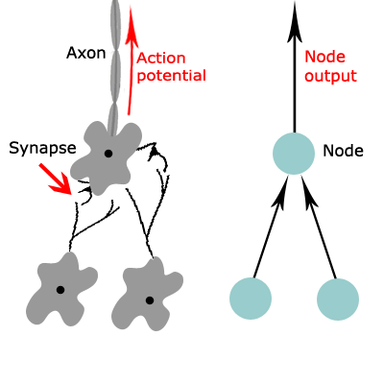
Input Layer, Hidden Layer, Output Layer
Multi-layer perceptron models were originally inspired by neurophysiology and the interconnections between neurons. The basic model form arranges neurons in layers.
The input layer connects to a layer of neurons called a hidden layer, which, in turn, connects to a final layer called the output layer.
The structure of a multi-layer perceptron lends itself to a graphical representation called a network diagram.
H₁
x₁
H₂
Y
x₂
H₃

Slide 10







An Example
INPUT
HIDDEN
OUTPUT
ACTIVATION
AGE
$$\tanh^{−1}{(β_{1}+β_{2}Age+β_{3}Inc)}=A$$
COMBINATION
$$β_{1}+β_{2}Age+β_{3}Inc$$
RESPONSE TO PROMOTION
ACTIVATION
$$\tanh^{−1}{(β_{4}+β_{5}Age+β_{6}Inc)}=B$$
INCOME
COMBINATION
COMBINATION
$$β_{4}+β_{5}Age+β_{6}Inc$$
$$β_{10}+β_{11}A+β_{12}B+β_{13}C=Y$$
COMBINATION
ACTIVATION
$$β_{7}+β_{8}Age+β_{9}Inc$$
$$\tanh^{−1}{(β_{7}+β_{8}Age+β_{9}Inc)}=C$$

Slide 11
Neural Networks as the Universal Approximator
Universal Approximation Theorem
The standard multilayer feed-forward network with a single hidden layer, which contains finite number of hidden neurons, is a universal approximator among continuous functions on compact subsets of Rn, under mild assumptions on the activation function.
See: http://neuralnetworksanddeeplearning.com/chap4.html
6+A-2B+3C
A
B
C

Slide 12
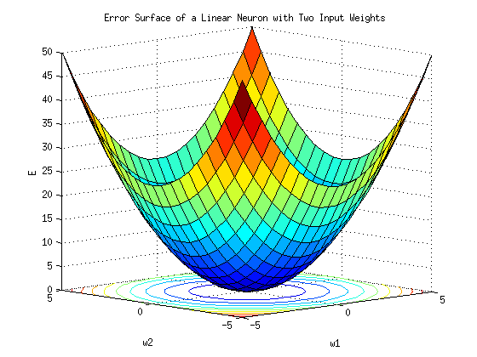
Training a Neural Network
Neural Networks are trained iteratively
Initial weights (betas) may be chosen at random
A (continuous) objective function (of model error) is used to evaluate model performance
Weights are iteratively adjusted to descend down the error function
Called gradient decent
Usually employing a back propagation algorithm

Slide 13
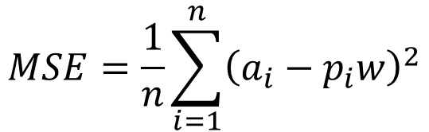
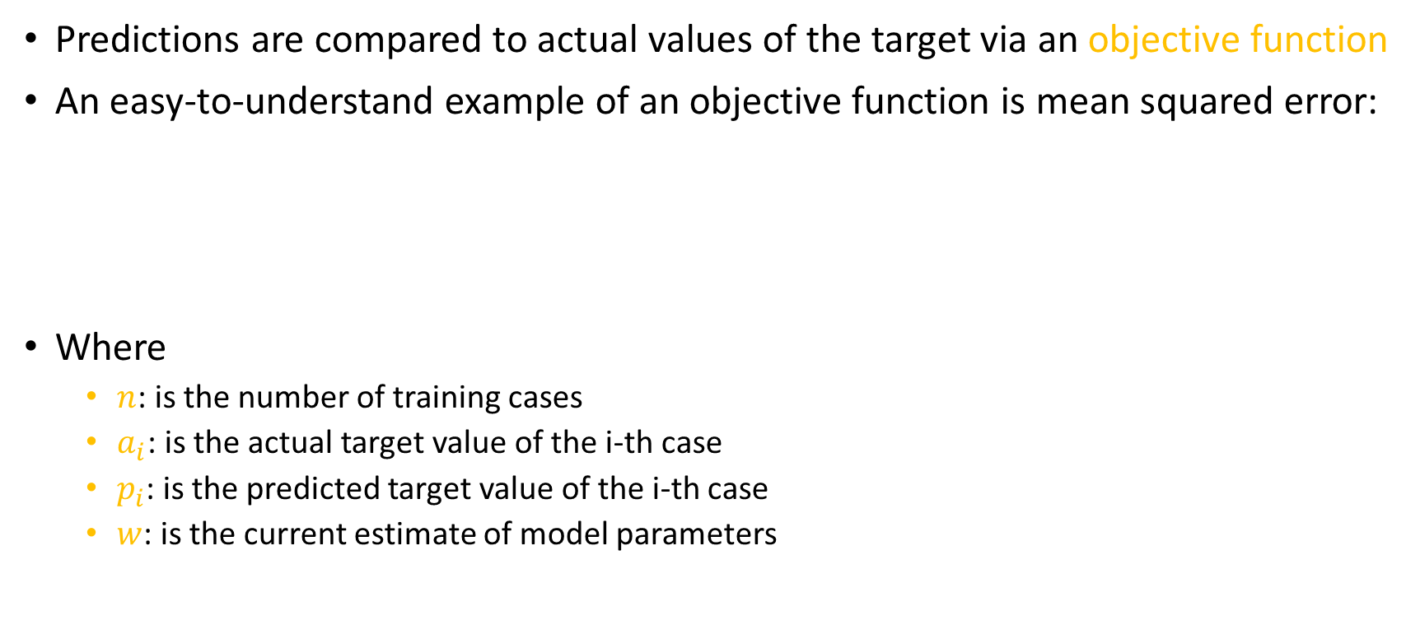
Objective Function
Predictions are compared to actual values of the target via an objective function
An easy-to-understand example of an objective function is mean squared error:
Where
$n$: is the number of training cases
$a_{i}$: is the actual target value of the i-th case
$p_{i}$: is the predicted target value of the i-th case
$w$: is the current estimate of model parameters
$$MSE=\frac{1}{n}\sum_{i=1}^{n}{{\left(a_{i}−p_{i}w\right)}^{2}}$$

Slide 14
Neural Network Model
p
( )
x₂
log
=
w₀₀ + w₀₁H₁ + w₀₂H₂ + w₀₃H₃
1 - p
tanh⁻¹( H₁ ) = w₁₀ + w₁₁x₁ + w₁₂x₂
tanh⁻¹( H₂ ) = w₂₀ + w₂₁x₁ + w₂₂x₂
tanh⁻¹( H₃ ) = w₃₀ + w₃₁x₁ + w₃₂x₂
1
tanh(x)
0
x
x₁
-1
Training Data

Slide 15










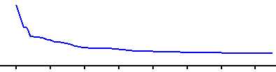
Neural Network Training
p
( )
x₂
log
=
w₀₀ + w₀₁H₁ + w₀₂H₂ + w₀₃H₃
1 - p
tanh⁻¹( H₁ ) = w₁₀ + w₁₁x₁ + w₁₂x₂
tanh⁻¹( H₂ ) = w₂₀ + w₂₁x₁ + w₂₂x₂
tanh⁻¹( H₃ ) = w₃₀ + w₃₁x₁ + w₃₂x₂
Objective function (w)
x₁
0
10
20
30
40
50
60
70
Training Data

Slide 16
Convergence
Training concludes when small changes in the parameter values no longer decrease the value of the objective function
The network is said to have reached a local minimum in the objective

Slide 17
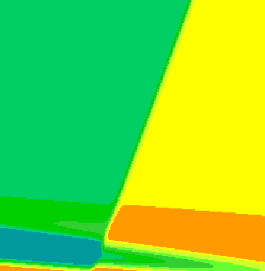
Neural Network Training Convergence
p
( )
x₂
log
=
w₀₀ + w₀₁H₁ + w₀₂H₂ + w₀₃H₃
1 - p
tanh⁻¹( H₁ ) = w₁₀ + w₁₁x₁ + w₁₂x₂
tanh⁻¹( H₂ ) = w₂₀ + w₂₁x₁ + w₂₂x₂
tanh⁻¹( H₃ ) = w₃₀ + w₃₁x₁ + w₃₂x₂
Objective function (w)
x₁
0
10
20
30
40
50
60
70
Training Data

Slide 18
Overfitting
A small value for the objective function, when calculated on training data, need not imply a small value for the function on validation data
Typically, improvement on the objective function is observed on both the training and the validation data over the first few iterations of the training process
At convergence, however, the model is likely to be highly overfit and the values of the objective function computed on training and validation data may be quite different

Slide 19
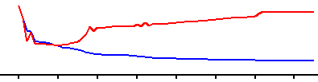
Overfitting
p
( )
x₂
log
=
w₀₀ + w₀₁H₁ + w₀₂H₂ + w₀₃H₃
1 - p
tanh⁻¹( H₁ ) = w₁₀ + w₁₁x₁ + w₁₂x₂
tanh⁻¹( H₂ ) = w₂₀ + w₂₁x₁ + w₂₂x₂
tanh⁻¹( H₃ ) = w₃₀ + w₃₁x₁ + w₃₂x₂
Objective function (w)
Validation
Training
x₁
0
10
20
30
40
50
60
70
Training Data

Slide 20
Final Model
To prevent overfitting, the overall average profit, computed on validation data, is examined
The final parameter estimates for the model are taken from the training iteration with the maximum validation profit

Slide 21
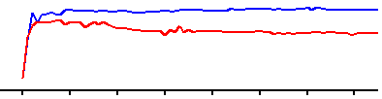
Neural Network Final Model
p
( )
x₂
log
=
w₀₀ + w₀₁H₁ + w₀₂H₂ + w₀₃H₃
1 - p
tanh⁻¹( H₁ ) = w₁₀ + w₁₁x₁ + w₁₂x₂
tanh⁻¹( H₂ ) = w₂₀ + w₂₁x₁ + w₂₂x₂
tanh⁻¹( H₃ ) = w₃₀ + w₃₁x₁ + w₃₂x₂
Profit
x₁
0
10
20
30
40
50
60
70
Training Data

Slide 22
Advantages and Disadvantages
Advantages
Disadvantages
Easy to implement
Can be trained to address very complex problems
Can handle non-linear and non-normal data
Neural networks are “black boxes”
Training can be slow
May require very large training data set

