Slide 1
Text Mining
DSCI 4520
Introduction to Data Mining
Russell R. Torres

Slide 2
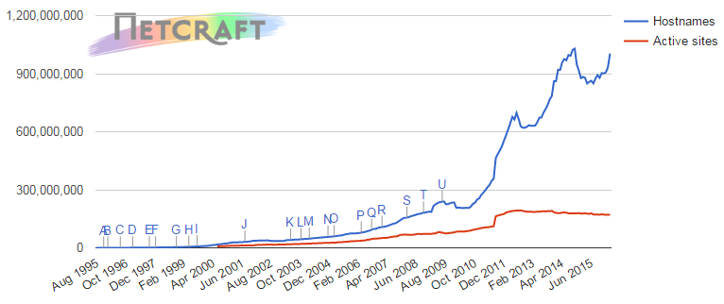
How Big is the Web?
Over 1 Billion reserved host names (Web Server Survey)
Over 1 Trillion individual web pages (CNN)
At least 4.62 Billion indexed pages (WorldWideWebSize.com)
There are another 995 Billion existing pages to index!!!

Slide 3
How Big is the Web?
BIG!

Slide 4
When information overload occurs, pattern recognition is how to determine truth.
Marshall McLuhan

Slide 5
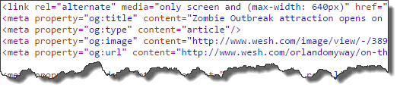
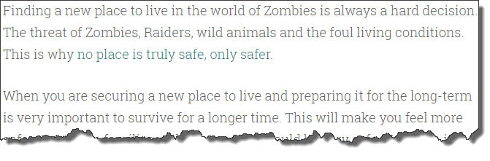
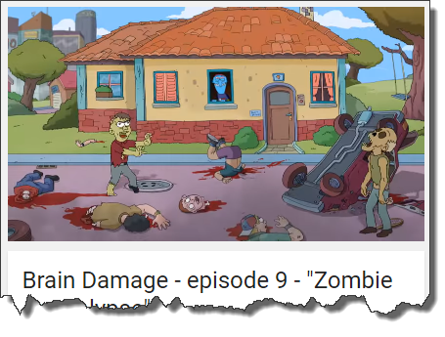
Web Content
Web content comes in a wide variety of forms
Structured HTML
Unstructured free text
Unstructured multimedia

Slide 6
Making Sense of Web Content
Web mining is the process of discovering, useful and previously unknown information from web content and usage
Web mining can be used to investigate various aspects of the web
Web usage
Web server data
Application server data
Application level data
Web structure
Link structure
Document structure
Web content
Text mining

Slide 7
Text Mining
Text mining is the process of applying data mining algorithms and approaches to textual, rather than numeric or categorical, data
Text mining is related to
Information extraction – extracting relevant facts from given documents
Natural language processing – using computers to interpret language delivered in natural form
Information retrieval – automatic retrieval of all relevant documents while retrieving as few of the non-relevant documents as possible
The goal of text mining is often to be able to identify similarities between documents within a corpus

Slide 8
Text Mining
A significant portion of the valuable information available to organizations is stored in documents (web or other)
News stories pertaining to competition, customers, and the business environment
Technical reports on new technologies or techniques
Email communication with customers, partners, and within the organization
Corporate documents containing corporate knowledge and expertise
Customer reviews of the company’s products or services
The problem is that text is unstructured
While organized, it is not organized in a manner that is easily interpretable by computers
It lacks a pre-defined data model

Slide 9
Text Characteristics
There are often multiple input modes, i.e., text is often intended for different consumers and is structured to support that target audience
Different languages for human consumers
Different formats for automated consumers
Words and phrases create context for each other and thus meaning is dependent on not only the word, but the words around it
Both words and sentences can be ambiguous (more about this in a minute)
Documents often contain noisy data
Erroneous
Misleading
As previously mentioned, text is unstructured

Slide 10
Difficulties in Text Quantification
Abstract concepts are difficult to quantify
Synonymy – multiple synonyms create multiple representations of the same concept e.g., zombie, walker, biter, and roamer may all represent the same thing
Polysemy – One term can be related to multiple concepts, depending on the context e.g., the word “book” can mean
A bound collection of pages
To record an action or event
The curse of dimensionality – Text representations result in high dimensionality (tens of thousands of dimensions)

Slide 11



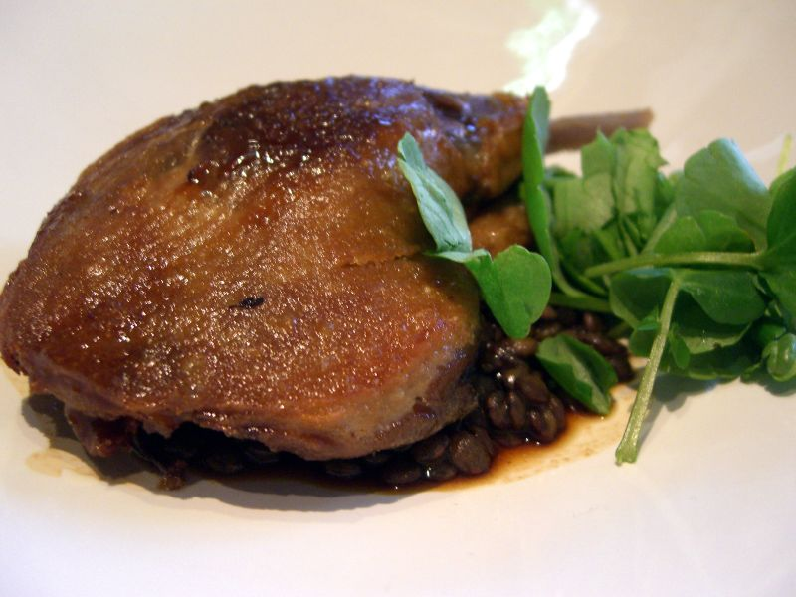
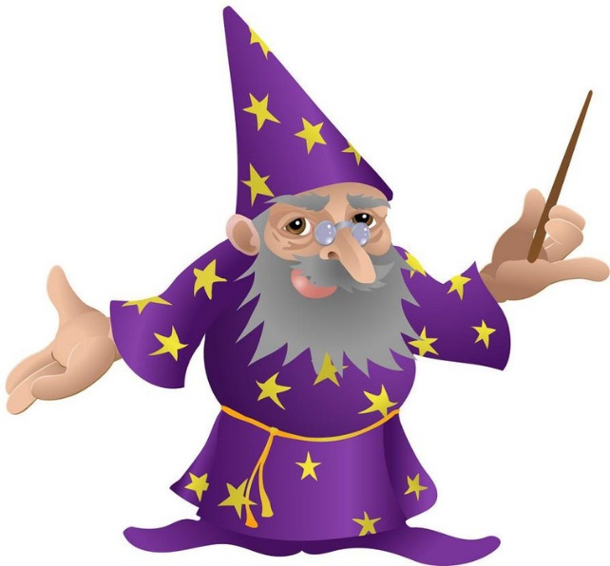
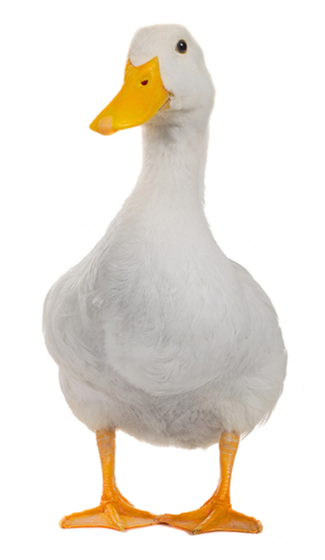
Syntax and Semantic Issues
To illustrate these issues, consider the sentence “I made her duck” (Jurafsky and Martin 2000, p. 4).
I cooked waterfowl for her
I cooked waterfowl belonging to her
I create the duck that she owns
I caused her to quickly lower her head or body
I waved my magic wand and turned her into undifferentiated waterfowl

Slide 12
Imposing Structure
There are many methods designed to analyze structured data (we have talked about a number of them this semester)
If we can find a way to represent documents via a set of attributes, existing data mining methods can be applied to analyze content
We need a useful representation of documents using attributes
Text
A
Miracle
Occurs
Numbers

Slide 13
Representing Documents
Documents are treated as a “bag” of words
Each document is represented as a vector
Elements of the vector represent words or groups of words
Documents can be compared via simple vector operations
Approaches
Boolean Encoding
Simple approach
Only presence or absence of terms are noted
Frequency-based approaches
Term Frequency (TF)
Term Frequency-Inverse Document Frequency (TF-IDF)

Slide 14
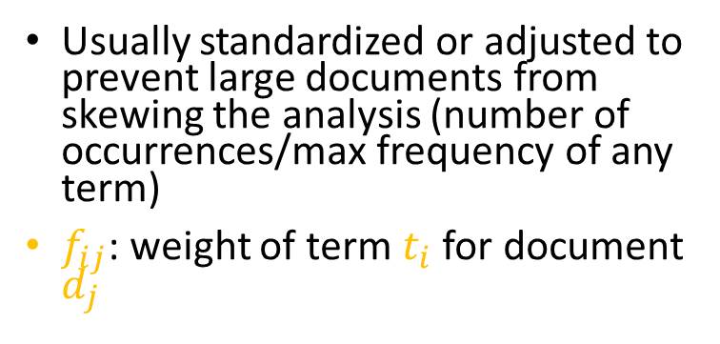
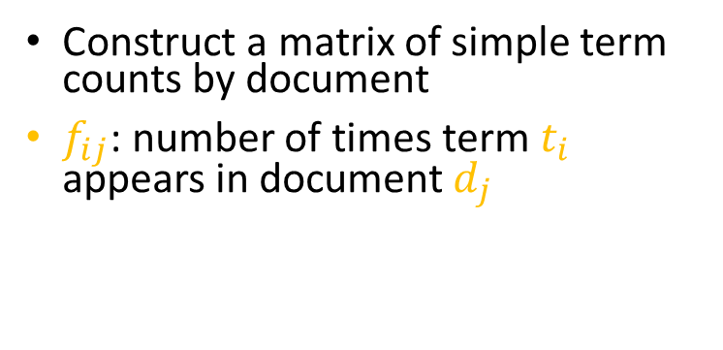
Term Frequency (TF)
 | Term 1 | Term 2 | Term 3 | Term 4 | … | Term m
Doc 1 | 3 | 2 | 0 | 1 | … | 1
Doc 2 | 0 | 4 | 0 | 3 | … | 6
 | … | … | … | … | … | …
Doc n | 1 | 2 | 4 | 0 | … | 0
 | Term 1 | Term 2 | Term 3 | Term 4 | … | Term m
Doc 1 | 0.06 | 0.04 | 0.00 | 0.02 | … | 0.02
Doc 2 | 0.00 | 0.04 | 0.00 | 0.03 | … | 0.06
 | … | … | … | … | … | …
Doc n | 0.05 | 0.10 | 0.20 | 0.00 | … | 0.00
Construct a matrix of simple term counts by document
$f_{ij}$: number of times term $t_{i}$ appears in document $d_{j}$
Usually standardized or adjusted to prevent large documents from skewing the analysis (number of occurrences/max frequency of any term)
$f_{ij}$: weight of term $t_{i}$ for document $d_{j}$

Slide 15
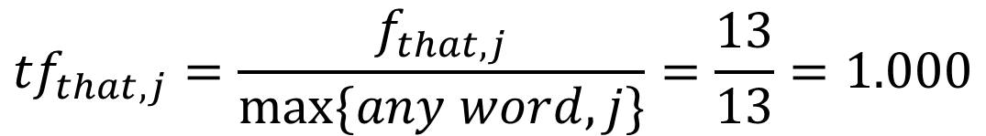
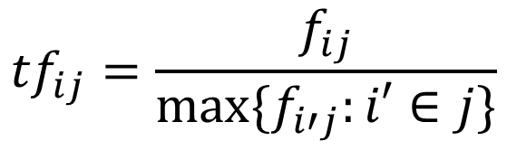
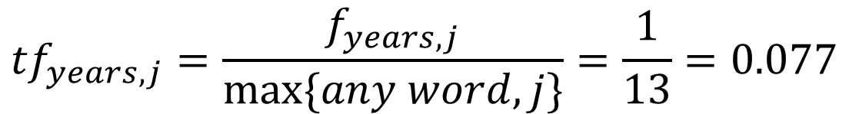
Calculating TF
Document j
that
13
$${tf}_{ij}=\frac{f_{ij}}{max⁡\{f_{i′j}:i′∈j\}}$$
years
1
$${tf}_{that, j}=\frac{f_{that,j}}{max⁡\{any word, j\}}=\frac{13}{13}=1.000$$
$${tf}_{years, j}=\frac{f_{years,j}}{max⁡\{any word, j\}}=\frac{1}{13}=0.077$$

Slide 16
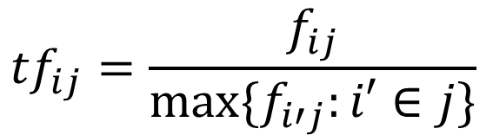
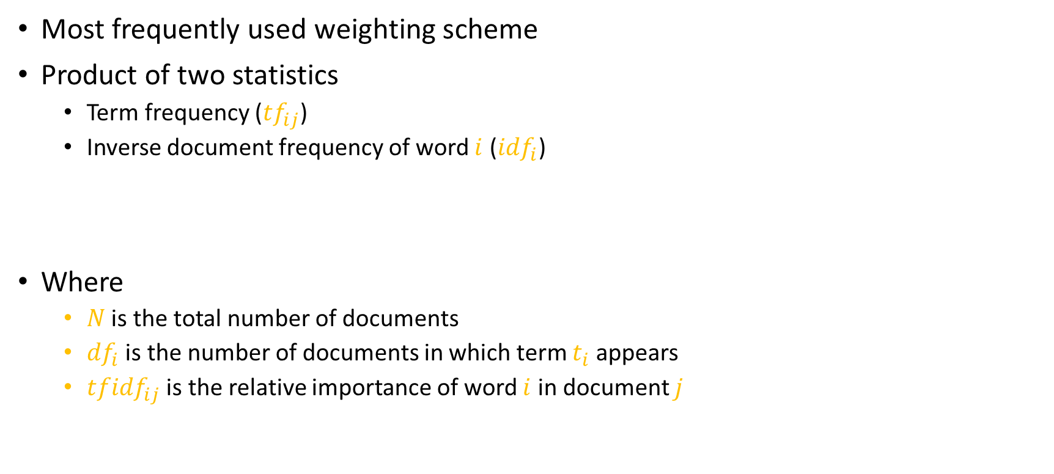


Term Frequency – Inverse Document Frequency (TF-IDF)
Most frequently used weighting scheme
Product of two statistics
Term frequency (${tf}_{ij}$)
Inverse document frequency of word $i$ (${idf}_{i}$)
Where
$N$ is the total number of documents
${df}_{i}$ is the number of documents in which term $t_{i}$ appears
${tfidf}_{ij}$ is the relative importance of word $i$ in document $j$
$${tf}_{ij}=\frac{f_{ij}}{max⁡\{f_{i′j}:i′∈j\}}$$
$${idf}_{i}=\log{\frac{N}{{df}_{i}}}$$
$$w_{ij}={tfidf}_{ij}={tf}_{ij}×{idf}_{i}$$

Slide 17

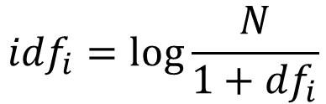

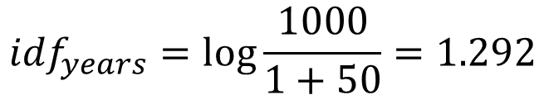
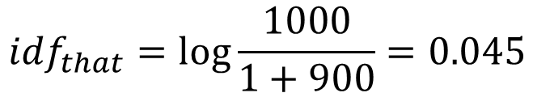
Calculating TF - IDF
Document j
that
13 (1.000)
years
1 (0.077)
$$w_{ij}={tfidf}_{ij}={tf}_{ij}×{idf}_{i}$$
Assumptions
We have 1000 documents in the corpus
The word “that” appears in 900 documents
The word “years” appears in 50 documents
$${idf}_{i}=\log{\frac{N}{{1+df}_{i}}}$$
$${idf}_{that}=\log{\frac{1000}{1+900}=0.045}$$
$${idf}_{years}=\log{\frac{1000}{1+50}=1.292}$$
$${tfidf}_{that,j}=1.000×0.045=0.045$$
$${tfidf}_{years,j}=0.077×1.292=0.099$$

Slide 18
Text Mining Process
Preprocessing
Pattern Discovery
Interpretation/Evaluation

Slide 19
Preprocessing
Preprocessing prepares the data for analysis
It is the most labor intensive part of text mining and involves multiple tasks
Text cleanup
Remove adds and other non-relevant text
Deal with tables, figures, formulas, etc.
Tokenization
Splitting up a string of characters into a set of tokens to build a dictionary
Some challenges
Apostrophes – is “Carl’s hat” one token or two?
Hyphens – database vs. data-base vs. data base
Other characters – C++, A/C, :-), …
Whitespace – is it significant or not?

Slide 20
Preprocessing
Managing dictionary size
Filtering
Removing unique terms (terms appearing only once in the entire corpus)
Removing common words or compiling a stopwords dictionary (the, a, an, etc.)
Lemmatization
Dealing with base words and their related terms (run vs. ran)
Stemming
Removal of term suffices (big, bigger, biggest → big-)
Linguistic preprocessing
Part-of-speech tagging
Text chunking
Word sense disambiguation

Slide 21
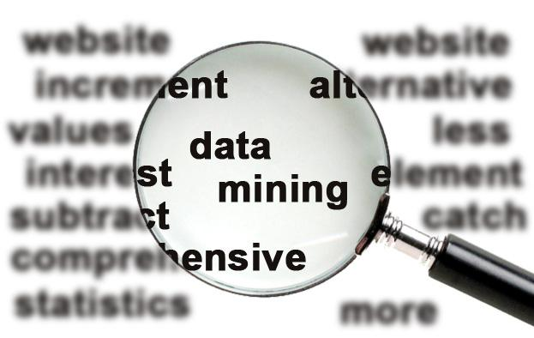
Pattern Discovery
As previously mentioned, much of text mining involves identifying similarities between documents within a corpus
There are numerous techniques
Vector space model
Document classification
k-means document clustering
Latent semantic analysis
We will take a deeper look at latent semantic analysis

Slide 22
Latent Semantic Analysis (LSA)
Latent semantic analysis is a method of automatic indexing and retrieval
Also referred to as latent semantic indexing (LSI)
It reveals the essence of a text by discarding surface elements and deducing a new vector space corresponding to “hidden” terms
LSA utilizes singular value decomposition (SVD) to reduce space dimensionality
It builds a semantic space in which similar words and documents are near one another

Slide 23

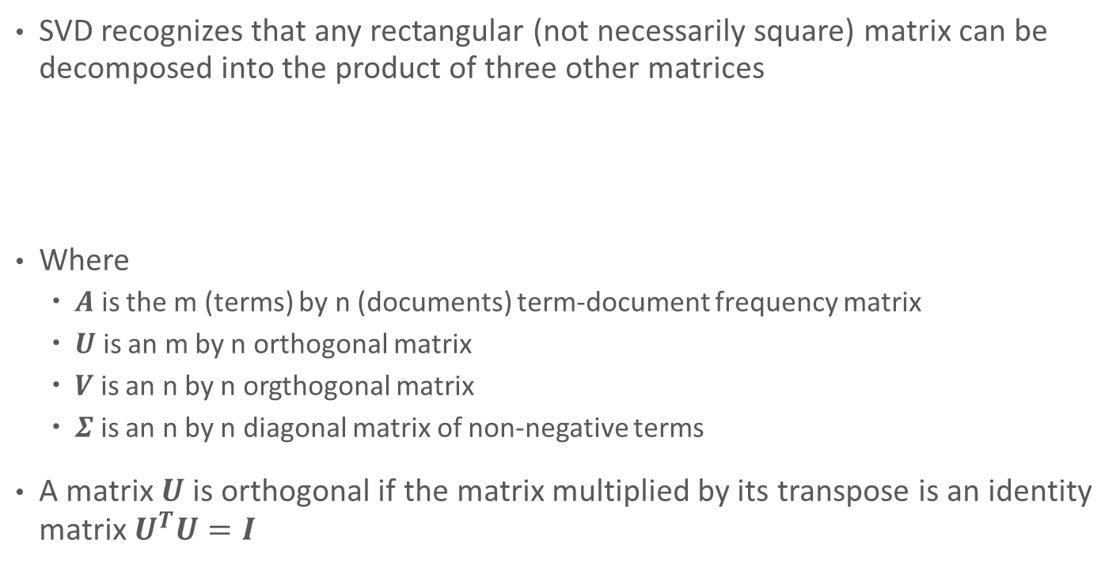
Singular Value Decomposition (SVD)
SVD recognizes that any rectangular (not necessarily square) matrix can be decomposed into the product of three other matrices
Where
$A$ is the m (terms) by n (documents) term-document frequency matrix
$U$ is an m by n orthogonal matrix
$V$ is an n by n orgthogonal matrix
$Σ$ is an n by n diagonal matrix of non-negative terms
A matrix $U$ is orthogonal if the matrix multiplied by its transpose is an identity matrix $U^{T}U=I$
$$A=UΣV$$

Slide 24
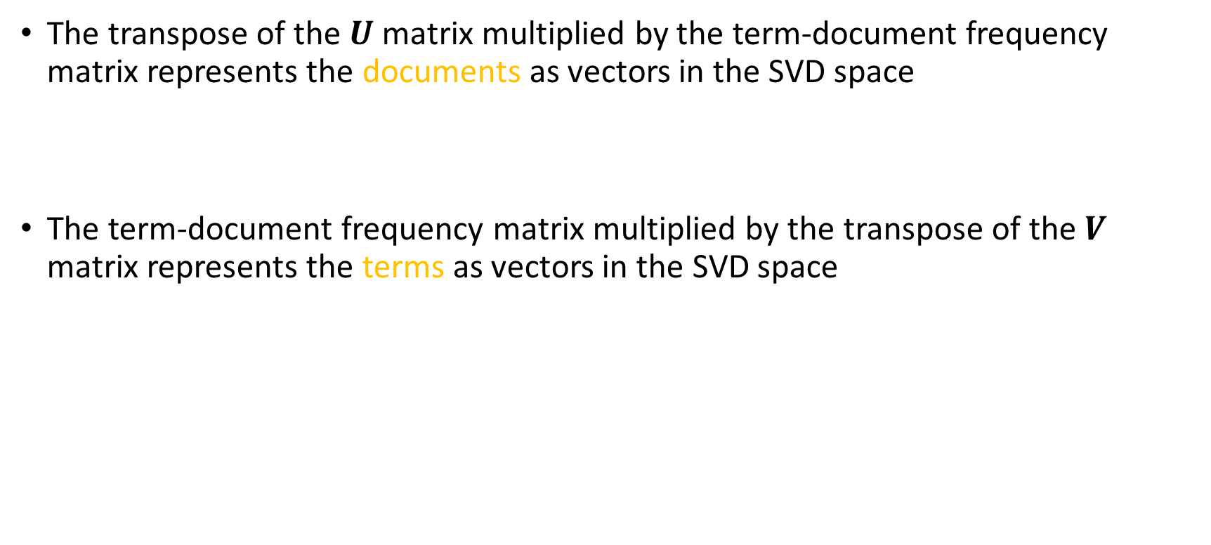

Singular Value Decomposition (SVD)
The transpose of the $U$ matrix multiplied by the term-document frequency matrix represents the documents as vectors in the SVD space
The term-document frequency matrix multiplied by the transpose of the $V$ matrix represents the terms as vectors in the SVD space
$$SVD Document Vectors=U^{T}A$$
$$SVD Term Vectors={AV}^{T}$$

Slide 25
What Does this have to do with Text Mining?
If you compute the full SVD, you preserve 100% of the information in the document collection
If you truncate the SVD dimensions, you preserve most of the information in the document collection and reduce dimensionality
In a least squares sense, you preserve the greatest amount of information for a given cutoff. Other approaches for averaging frequencies will not be as good.

Slide 26
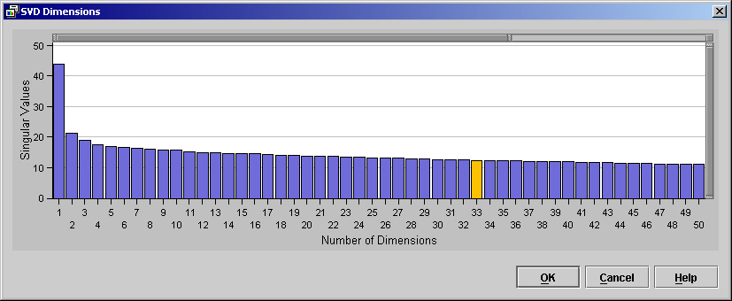
Reducing Dimensionality of the SVD

Slide 27
LSA Outputs
As previously mentioned, the LSA process produces two important matrices
Document/Factor matrix
Term/Factor matrix
Matrix values represent how strongly a given term or document relates to a given factor

Slide 28
Interpretation/Evaluation
But what exactly is a factor?
Each factor represents and important “theme” within the corpus
The text miner has the non-trivial task of naming those themes
LSA and similar algorithms are important components of search engines as they aggregate related (by theme) documents to key terms allowing quick, and hopefully accurate, retrieval
Relevant
documents
Retrieved
& Relevant
Retrieved
documents
All documents

Slide 29


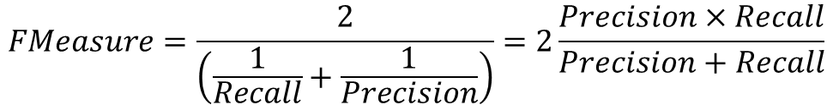
Interpretation/Evaluation
Relevant
documents
Retrieved
& Relevant
Retrieved
documents
All documents
Precision: Percent of retrieved documents that are relevant
Recall: Percent of relevant documents that are retrieved
F-Measure: Compromise between precision and recall (harmonic mean)
$$Precision=\frac{Retrieved∩Relevant}{Retrieved}$$
$$Recall=\frac{Retrieved∩Relevant}{Relevant}$$
$$FMeasure=\frac{2}{\left(\frac{1}{Recall}+\frac{1}{Precision}\right)}=2\frac{Precision×Recall}{Precision+Recall}$$

