Slide 1
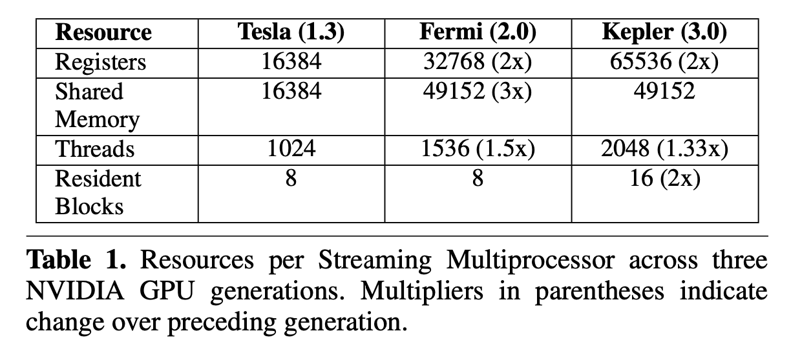
Each new GPU generation incorporates features that expand their ability to tackle larger and more complex computational prob- lems. The architectural resources available to GPU programs also increase with each new GPU generation.

Slide 2
GPU programming models like CUDA and OpenCL have been designed to allow older programs to take advantage of these increased resources without any programmer intervention.

Slide 3
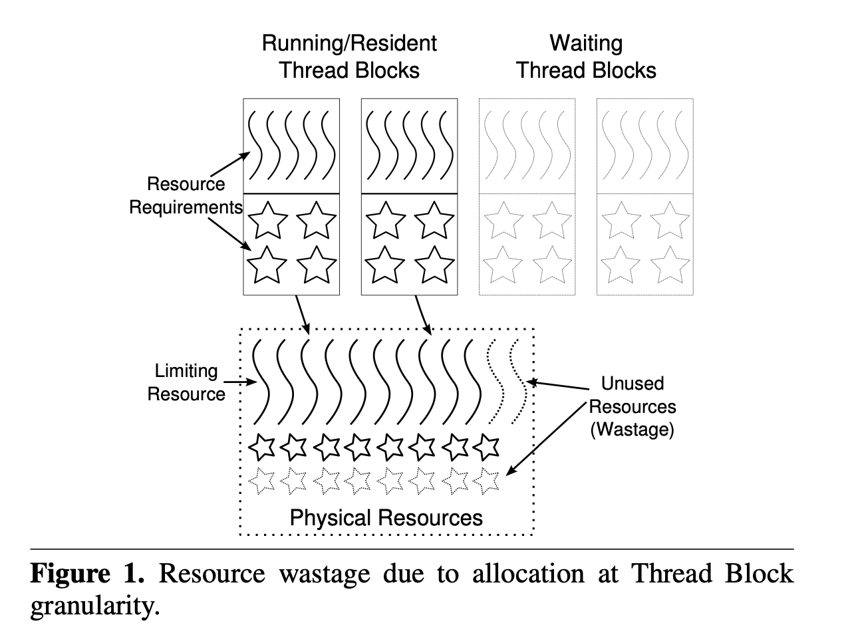
They find that the grid, a GPU programming construct that was designed to achieve scalability, also leads to under-utilization of those same resources. Figure 1 illustrates how resource allocation at the thread block level leads to wastage.

Slide 4
The unused resources obviously cannot accommodate another thread block from the same grid and are therefore wasted.

Slide 5
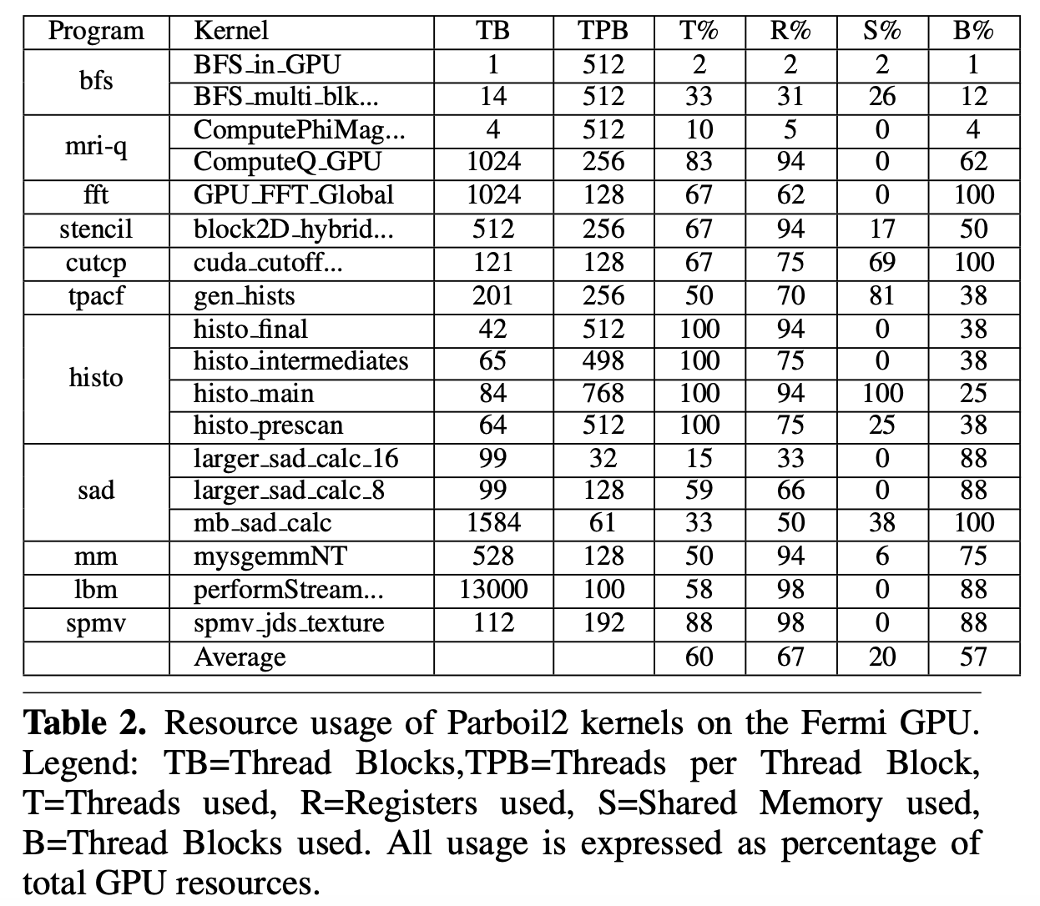

Slide 6
Since these wasted resources cannot be utilized by thread blocks from the same grid, the Fermi GPU supports concurrent execution of up to 16 grids.
None of the programs in the Parboil2 or Rodinia 2 benchmarks currently executes multiple grids in parallel; support for GPU concurrency is relatively new. So, in this work, we use multiprogrammed workloads which are a convenient source of independent grids.

Slide 7
Our experiments using microbenchmarks of concurrently executing synthetic kernels suggest that the Fermi uses the LEFTOVER policy. Under this policy, a grid begins concurrent execution only if there are enough resources to allow execution of at least one of its thread blocks.
for concurrent execution under this policy, the programmer must ensure that each inde- pendent grid will not consume too many resources.

Slide 8
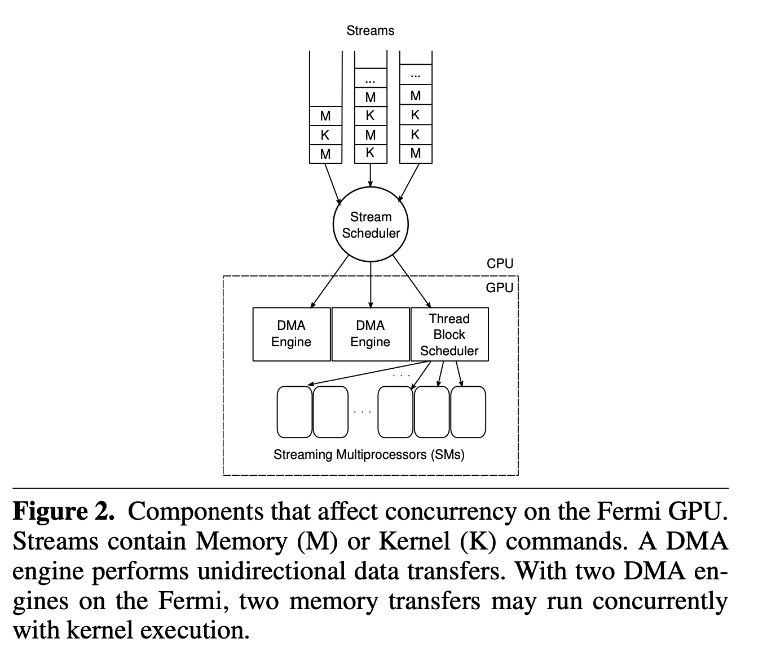

Slide 9
Serialization due to Lack of Resources
Under the current LEFTOVER policy, two grids cannot execute concurrently if the one scheduled first consumes too many resources to allow the other to begin execution. Since the resources consumed are specified by the programmer, the Thread Block Scheduler is forced to serialize the execution of such grids.

Slide 10
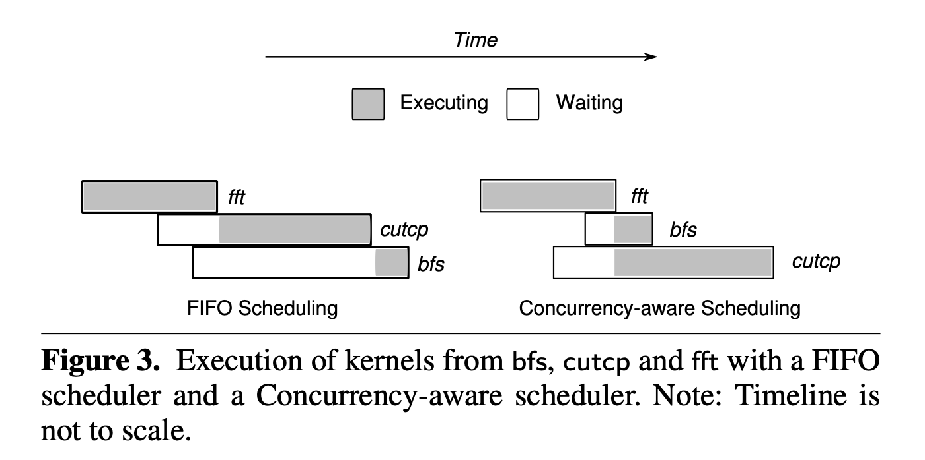
Serialization due to Inter-stream Scheduling

Slide 11
Serialization due to Kernel Execution
A long-running grid can serialize the execution of grids from other programs if it consumes too many resources, preventing other grids from executing concurrently with it. Even if it allows concurrent execution, the resources it occupies will be unavailable to other kernels for the duration of its execution, possibly slowing them down.

Slide 12
Serialization due to Memory Transfers
since only one transfer can be active in a given direction, memory transfers can cause serialization similar to that caused by long-running grids. A large memory trans- fer in one program can stall progress in other concurrently executing programs as they wait for the DMA engine to become free.

Slide 13
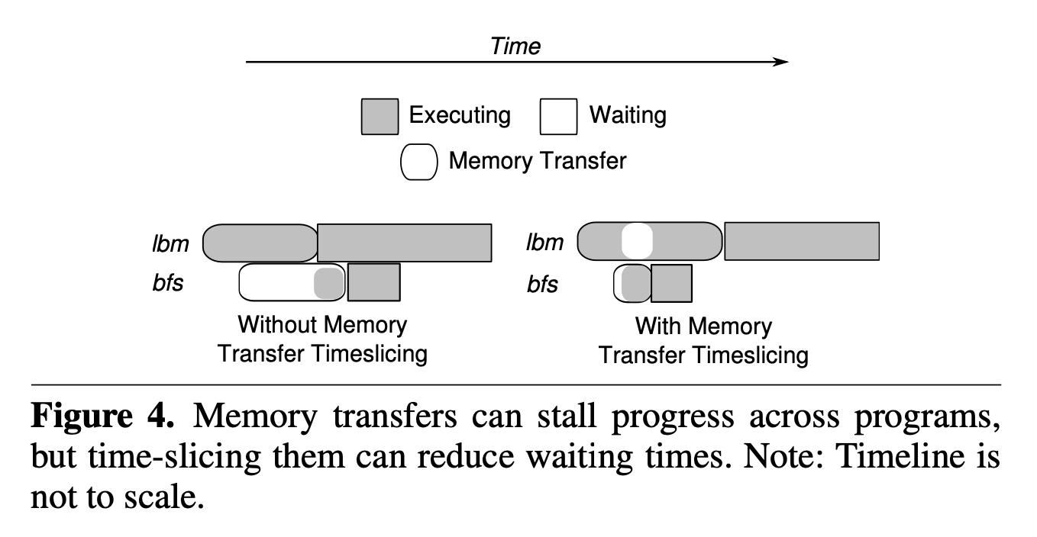
Serialization due to Memory Transfers

Slide 14
Serialization in the CUDA API
The CUDA API contains several functions that implicitly synchronize commands from different streams, they act as program-wide barriers for GPGPU functionality.

Slide 15
Serialization in the Implementation
To maintain ordering of commands in a single stream, the Fermi uses “signals” between the kernel and memory transfer hardware queues. These signals act as barriers and prevent Kernel–Memory Transfer, Memory Transfer– Kernel, Memory Transfer–Memory Transfer, and Kernel–Kernel dependencies (abbreviated as K–M, M–K, M–M and K–K respectively) from being violated in a stream.
This false serialization can severely restrict the ability of pro- grams to exploit concurrency.

Slide 16
Our N : 1 mapping scheme takes a 2D logical grid and a 3D logical thread block and executes them using a 1D grid and 1D thread blocks.
To preserve program semantics with respect to identities, we also replace any references to physical dimension variables (gridDim, blockDim) and physical identity variables (blockIdx, threadIdx) in the original kernel code with their logical equivalents (gd, bd, bi and ti respectively).

Slide 17
Change the kernels that use shared memory or synchronization instructions will violate CUDA semantics for shared memory accesses and behavior of synchronization instructions. So, they do not apply thread block resizing to kernels that use shared memory or synchronization instructions

Slide 18
forced to use ordinary variables to store logical identities and dimensions, increases register usage of the kernel and can cause a potential drop in throughput
use of the division and modulus operations in our transformed kernels which are not supported natively by the Fermi hardware

Slide 19
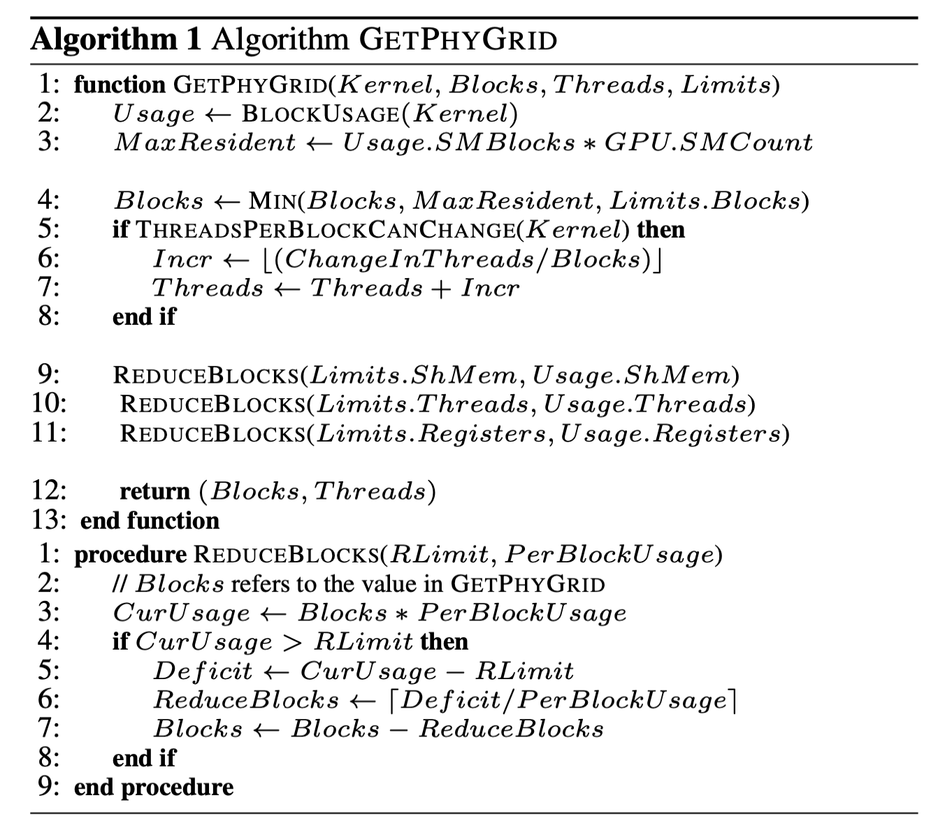

Slide 20
The MEDIAN policy uses profile-based information to reserve resources for a hypothetical median kernel.
MPMAX policy also uses profile information to reserve resources. This largest kernel need not correspond to an actual kernel of the program – it may have the register usage of one kernel and the shared memory usage of another.
The EQUAL policy partitions GPU resources equally among all concurrently running programs.
The QUEUEMOLD policy examines all kernels waiting to be launched and modifies the resources requested by them if they make excessive use of: (i) shared memory or (ii) threads.

Slide 21
NSS is only concerned with the serializing behavior of the M–K and K–M dependency checks, it only need two CUDA streams. One of these is used for all memory operations, and the other is used for kernel execution.
In order to enforce K–M and K–K dependencies, On every exit path of a kernel, they add the code shown in Listing 2. This code counts the thread blocks that have finished executing so far in the GPU-side blocks_done_d variable. Once all thread blocks have finished, the CPU/GPU shared (host-memory mapped) blocks_done_h is set, alerting a polling routine on the CPU of the completion of this kernel.

